Slide 1

Operators and Converting Between Data Types
Principles of Computer Programming I
Spring/Fall 20XX

Slide 2
Outline
Arithmetic and Assignment Operators
Data Types and Literal Assignment
Implicit Conversions
Explicit Conversions
Arithmetic on Mixed Data Types
Order of operations

Slide 3

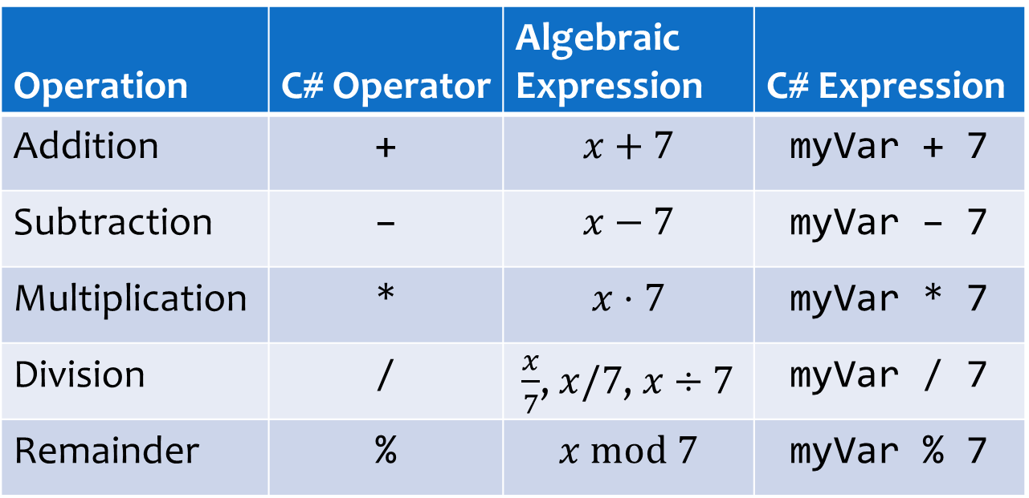
Doing Arithmetic
C# has math operators for numeric data
Operation | C# Operator | Algebraic Expression | C# Expression
Addition | + | $$x+7$$ | myVar + 7
Subtraction | – | $$x−7$$ | myVar – 7
Multiplication | * | $$x⋅7$$ | myVar * 7
Division | / | $\frac{x}{7}$, $x/7$, $x÷7$ | myVar / 7
Remainder | % | $$x \text{mod} 7$$ | myVar % 7
Remainder after integer division: $44 mod 7=2$ because $44÷7=6$ with remainder $2$

Slide 4
Arithmetic and Assignment
Result of an arithmetic expression is a numeric value
Numeric values can be assigned to variables
Variable in arithmetic expression = read its current value
int myVar = 3 * 4;
The value 12 is stored in myVar
This expression evaluates to 12
int a = 4;
int b = a + 5;
a = b * 2;
a has value 4, so b gets the resulting value 9
b has value 9, now a is assigned new value 18

Slide 5
Self-Assignment
A variable can appear on both sides of the = operator
Compound assignment operators: a shortcut
int myVar = 4;
myVar = myVar * 2;
What does this do?
Store result of 4 * 2 into myVar
Read myVar’s current value, 4
Statement | Equivalent
x += 2; | x = x + 2;
x -= 2; | x = x – 2;
x *= 2; | x = x * 2;
x /= 2; | x = x / 2;

Slide 6
Outline
Arithmetic and Assignment Operators
Data Types and Literal Assignment
Implicit Conversions
Explicit Conversions
Arithmetic on Mixed Data Types
Order of operations

Slide 7
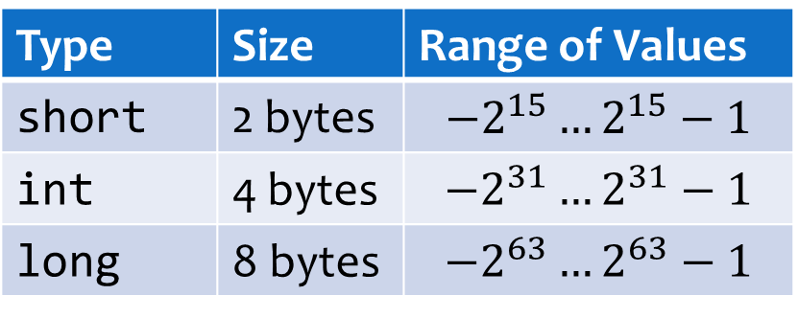
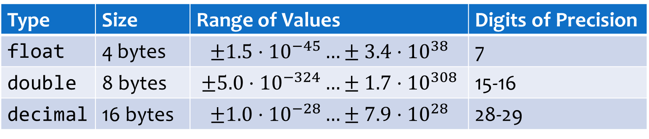
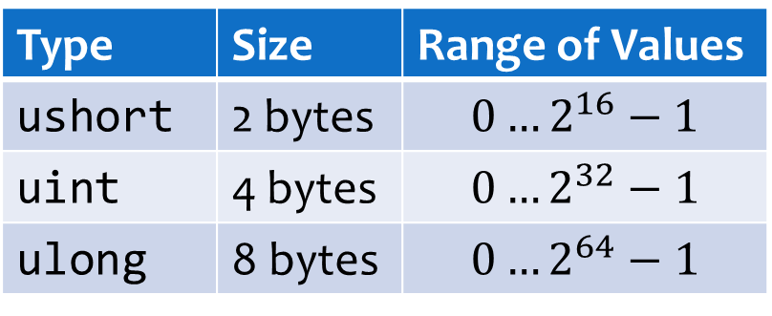
Review: Numeric Data Types
Integers
Floating-point
Size & range
Type | Size | Range of Values
short | 2 bytes | $$−2^{15}…2^{15}−1$$
int | 4 bytes | $$−2^{31}…2^{31}−1$$
long | 8 bytes | $${−2}^{63}…2^{63}−1$$
Type | Size | Range of Values
ushort | 2 bytes | $$0…2^{16}−1$$
uint | 4 bytes | $$0…2^{32}−1$$
ulong | 8 bytes | $$0…2^{64}−1$$
Type | Size | Range of Values | Digits of Precision
float | 4 bytes | $$±1.5⋅{10}^{−45}…±3.4⋅{10}^{38}$$ | 7
double | 8 bytes | $$±5.0⋅{10}^{−324}…±1.7⋅{10}^{308}$$ | 15-16
decimal | 16 bytes | $$±1.0⋅{10}^{−28}…±7.9⋅{10}^{28}$$ | 28-29

Slide 8
Assignment From Literals
If literal type matches variable type, assignment always works:
What if literal type is different?
int myAge = 29;
double myHeight = 1.77;
float radius = 2.3f;
float radius = 2.3;
Error! Can’t convert double to float
float radius = 2;
No error, even though 2 is an int literal
Why does this work?

Slide 9
Implicit Conversions
Value type must still match variable type
Some types can be implicitly converted to others:
Also applies to assignment from variables:
int value
float radius = 2;
implicit conversion
radius
2.0f
float value
int length = 2;
float radius = length;
value 2 implicitly converted to 2.0f
gets value 2.0f

Slide 10
Implicit Conversions
Type | Possible Implicit Conversions
short | int, long, float, double, decimal
int | long, float, double, decimal
long | float, double, decimal
ushort | uint, int, ulong, long, decimal, float, double
uint | ulong, long, float, double, decimal
ulong | float, double, decimal
float | double
What’s the pattern here? Given a type, what can you implicitly convert it to?

Slide 11

Implicit Conversions are “Safe”
int range: $−2^{31}…2^{31}−1$; float integer range: $±3.4⋅{10}^{38}$
Any int can be stored in a float without losing data
Reverse is not safe: Storing 4.7f in an int will lose the fraction
All integer types are safe to convert to float or double
Preserves data
330062719
330062719.0f
int
float
19
19.357f
Loses data

Slide 12
Other Safe Conversions
Smaller integer to larger integer; float to double
Unsigned to larger signed integer (why larger?)
short
int
long
float
double
ushort
int
uint
long
Unsafe, can lose data

Slide 13
Outline
Arithmetic and Assignment Operators
Data Types and Literal Assignment
Implicit Conversions
Explicit Conversions
Arithmetic on Mixed Data Types
Order of operations

Slide 14
Data-Losing Conversions
Unsafe conversions: Potential to lose data
Will not happen automatically; compile error
19.35499674
19.354998f
19
double
float
int
Loses significant figures
Loses fractional part
double length = 2.886;
float radius = length;
Error! Can’t convert double to float

Slide 15
Explicit Conversion with Casts
Cast operator: Force the compiler to allow an unsafe conversion
Explicit conversion from original to target type must exist
Most built-in C# types have explicit conversions defined
double length = 2.886;
float radius = (float) length;
double value
gets value 2.886f
Target type name in parentheses
string strAge = "29";
int myAge = (int) strAge;
Error! Can’t convert string to int

Slide 16
Casting Side-Effects
Casting from floating-point to integer: fraction is truncated
Casting to less precise floating-point: fraction is rounded
int intLength = (int) length;
value: 2.886
gets value 2
cast to int
decimal myDecimal = 123456789.999999918m;
double myDouble = (double) myDecimal;
float myFloat = (float) myDouble;
myDouble: 123456789.99999993
myFloat: 123456790.0f

Slide 17

Casting Side-Effects
Casting to smaller integer: Most significant bits are truncated
Casting to decimal: Stored precisely, unless it is out of range – crashes with a System.OverflowException
$2^{63}−1$, all 1’s with sign bit 0
int bigNumber = (int) 9223372036854775807;
gets value -1: all 1’s with sign bit 1
long value
decimal fromSmall = (decimal) 42.76875;
double bigDouble = 2.65e35;
decimal fromBig = (decimal) bigDouble;
fromSmall: 42.76875m
System.OverflowException!

Slide 18
Common Conversions Summary
Implicit (safe)
Explicit – may crash
int
float
double
decimal
Explicit – truncating
Explicit – rounding

Slide 19
Outline
Arithmetic and Assignment Operators
Data Types and Literal Assignment
Implicit Conversions
Explicit Conversions
Arithmetic on Mixed Data Types
Order of operations

Slide 20
Integer vs. Fractional Arithmetic
Math operators (+, -, *, /, %) are defined separately for each type
The int / operator does integer division – remainder is dropped
Value: 7
Result of expression: 7
Result of expression: 5.5
int sum1 = 2 + 5;
double sum2 = 2.25 + 3.25;
int version of + operator
double version of + operator
Result of expression: 4
Result of expression: 4.2
int intDiv = 21 / 5;
double fracDiv = 21.0 / 5.0;
int version of / operator
double version of / operator

Slide 21
Operators For Each Type
Binary operators, like +, -, *, /, are really 2-input functions
Result type of function depends on input types:
Action taken (function code) also depends on input types:
int + int
float + float
double + double
decimal + decimal
int
float
double
decimal
int / int
integer division
int
double / double
floating-point division
double

Slide 22
Implicit Conversions in Math
Arguments to a math operator must be the same type
If they are not, implicit conversion will happen
Less-precise argument gets converted to more-precise type
int value
double value
double fracDiv = 21 / 2.4;
implicit conversion
Result: 8.75
21.0 / 2.4
double version of / operator

Slide 23
Implicit Conversions in Math
Result type of expression determined by arguments
Can be implicitly converted to store in a variable
This happens after computing the result
int version of / operator
int value
double fraction = 21 / 5;
int value
Result of expression: 4
implicit conversion
fraction
4.0

Slide 24
Casting to Prompt Conversion
What if you don’t want integer division?
Make one argument a double using casting:
int version of / operator
int numCookies = 21;
int numPeople = 6;
double share = numCookies / numPeople;
share: 3.0
double value
implicitly converted to double
double share = (double) numCookies / numPeople;
share: 3.5
double version of / operator

Slide 25
Casting in Math Expressions
Casting may be necessary to make types match:
Casting may be desirable to change which operator runs:
double a = 35.0;
decimal b = 0.5m;
decimal result = (decimal) a * b;
decimal * decimal operator
double can’t implicitly convert to decimal
int numCookies = 21;
int numPeople = 6;
double share = (double) numCookies / numPeople;
implicitly converted to double
share: 3.5
explicitly convert from int to double
double / double operator

Slide 26
Order of Operations
C# math operators follow standard PEMDAS order, left-to-right
Cast operator is higher priority than binary (math) operators
int x = 4 + 10 * 3 – 21 / 2 – (3 + 3);
4
+
30
–
10
–
6
18
double share = (double) numCookies / numPeople;
2. Implicitly convert to double so operands match types
1. Cast int to double
3. Execute / operator

Slide 27
Order of Operations
What will each of these results be? What is the difference?
int a = 5, b = 4;
double result;
result = a / b;
result = (double) a / b;
result = a / (double) b;
result = (double) a / (double) b;
result = (double) (a / b);
Parentheses: Highest priority
int / int operator

Slide 28
Summary
Arithmetic and Assignment Operators
Data Types and Literal Assignment
Implicit Conversions
Explicit Conversions
Arithmetic on Mixed Data Types
Order of operations

Slide 29
Miscellaneous Syntax Note
Can declare multiple variables on one line:
Can combine declarations and initializations:
double length;
double depth;
double height;
equivalent
double length, depth, height;
comma
int age = 29;
int weight;
int votes;
equivalent
int age = 29, weight, votes;

