Slide 1

Reading Input and Displaying Output
Principles of Computer Programming I
Spring/Fall 20XX

Slide 2
Outline
Converting numbers to strings
The ToString method
String concatenation
Reading user input
Parsing user input

Slide 3
String Interpolation
Casting won’t convert numbers to strings, interpolation will
Interpolation can convert any expression, not just a variable
int x = 47, y = 6;
double fraction = (double) x / y;
string text = $"{x} divided by {y} is {fraction}";
“47”
“6”
“7.8333333”
“7.8333333”
Console.WriteLine($"{x} divided by {y} is {(double) x / y}");
Console.WriteLine($"{x} plus 7 is {x + 7}");
“54”
This does not change the value of x or y:
Console.WriteLine($"x={x}, y={y}");
Prints “x=47, y=6”

Slide 4
Behind the Scenes
Interpolation doesn’t know how to convert numbers to strings
All data types in C# are objects, even int
All objects in C# have a ToString() method – “convert this object to a string”
int num = 42;
double fraction = 33.5;
string intText = num.ToString();
string fracText = fraction.ToString();
Call method ToString on object num
Result: “42”
Result: “33.5”
Call method ToString on object fraction

Slide 5
Behind the Scenes
Interpolation calls ToString() on the result of each expression
int num = 42;
string intText = num.ToString();
This:
Console.WriteLine($"num is {num}");
Is the same as:
Console.WriteLine($"num is {intText}");
Is the same as:
Console.WriteLine($"num is {num.ToString()}");

Slide 6
Outline
Converting numbers to strings
The ToString method
String concatenation
Reading user input
Parsing user input

Slide 7
String Concatenation
The + operator is a different function for each operand type
If the operand types are string, it performs concatenation
Works as expected for string variables:
string greeting = "Hi there, " + "John";
Result: “Hi there, John”
string + string operator
string name = "Paul";
string greeting2 = "Hi there, " + name;
Result: “Hi there, Paul”

Slide 8
Mixed Types with +
What if we use + operator with a string and a number?
Answer: Converts the other argument to a string with ToString()
int bananas = 42;
string text = "Bananas: " + bananas;
string text = "Bananas: " + bananas;
bananas.ToString()
"Bananas: "
+
"42"
"Bananas: 42"
string + string, concatenation

Slide 9
Interpolation and Concatenation
Can “print out” variables two equivalent ways:
Interpolation is easier to write with many variables:
int num = 42;
Console.WriteLine($"num is {num}");
Console.WriteLine("num is " + num);
Console.WriteLine($"The variables are {a}, {b}, {c}, {d}, and {e}");
Console.WriteLine("The variables are " + a + ", " + b + ", "
+ c + ", " + d + ", and " + e);

Slide 10
Concatenation Puzzle
Code executes left-to-right, binary operators (like +) are grouped left-to-right
What does this produce?
int + int
int + string
int var1 = 6, var2 = 7;
Console.WriteLine(var1 + var2 + " is the result");
Console.WriteLine("The result is " + var1 + var2);
“13 is the result”
“The result is 67”
string + int
string + int

Slide 11
Parentheses Define Order
Parentheses make order, grouping explicit
Use to ensure compiler does what you mean
int var1 = 6, var2 = 7;
Console.WriteLine((var1 + var2) + " is the result");
Console.WriteLine("The result is " + (var1 + var2));
“13 is the result”
“The result is 13”
Evaluates second, concatenates string with result of parentheses
Evaluates first, so + operator sees int + int

Slide 12
Outline
Converting numbers to strings
The ToString method
String concatenation
Reading user input
Parsing user input

Slide 13
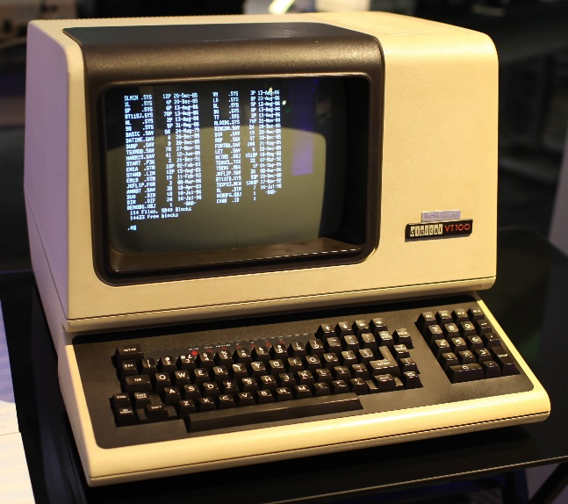
Input from the User
With a CLI, output = print text to screen, input = read text from keyboard
Console represents the “terminal” interface
Output:
Text to output
Input:
Waits until user presses “Enter”
Console.WriteLine("Hi!");
Console.ReadLine();
Result: Terminal displays “Hi!”
Result: A string value containing text typed in at terminal (one line)

Slide 14
Lab Recap
class PersonalizedWelcomeMessage
{
static void Main()
{
string firstName;
Console.WriteLine("Enter your first name:");.
firstName = Console.ReadLine();
Console.WriteLine($"Welcome, {firstName}!");
}
}
Declare a string variable named firstName
Print text to the console
Wait for a line of text to be typed in
Insert the text from firstName into this string and print it
Assign the text received from the console to firstName

Slide 15
Outline
Converting numbers to strings
The ToString method
String concatenation
Reading user input
Parsing user input

Slide 16
The Opposite of ToString()
Recall: Converting int to string requires a method
Similarly, converting string to int uses a method:
int myAge = 29;
string strAge = (string) myAge;
Error! Can’t convert int to string
string strAge = myAge.ToString();
string strAge = "29";
int myAge = (int) strAge;
Error! Can’t convert string to int
int myAge = int.Parse(strAge);

Slide 17
Parse Methods
Each built-in numeric type has a “Parse” method
Useful for turning user input into data:
int.Parse("42")
42
double.Parse("3.65")
3.65
long.Parse("42")
42L
float.Parse("3.65")
3.65f
Console.WriteLine("Please enter the year.");
string userInput = Console.ReadLine();
int curYear = int.Parse(userInput);
Console.WriteLine("Next year it will be {curYear + 1}");

Slide 18
What Could Go Wrong?
String is not a number: program crashes with FormatException
String is a number that can’t fit the desired type: program crashes with OverflowException
int badIdea = int.Parse("Hello!");
FormatException!
int fail1 = int.Parse("52.5");
int fail2 = int.Parse("3000000000");
OverflowException!
OverflowException!

Slide 19
Summary
Converting numbers to strings
The ToString method
String concatenation
Reading user input
Parsing user input

