Slide 1

Intro to Classes and Objects
Principles of Computer Programming I
Spring/Fall 20XX

Slide 2
Outline
Class and Object Basics
Writing Our First Class
Using a Class

Slide 3
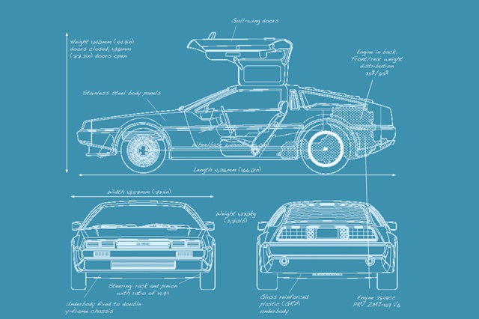

Reminder: Classes and Objects
Class = blueprint, template for object
Code that describes an object
Object = single instance of class
Running code, with specific values/state
Instantiate = create an object from a class
Attribute = data stored in object
Method = function that uses object’s data
Defined in class, but executed on specific object (usually)
Class
Object

Slide 4
Encapsulation
Attribute data is stored in instance variables
Instance variables are “hidden” inside the object
Other code cannot access instance variables directly; only the object’s methods can access them
Accessor: method that allows other code to access attributes
Object
Instance Variable
Instance Variable
Other Code
Method (accessor)

Slide 5
Outline
Class and Object Basics
Writing Our First Class
Using a Class
Object and Method Details
Instance variable modification
Return types and return values

Slide 6
The Rectangle Class
Attributes:
Length
Width
Methods:
Get and set length (accessors)
Get and set width (accessors)
Compute area
Width
Length

Slide 7
Code: Attributes and Setter
class Rectangle
{
private int length;
private int width;
public void SetLength(int lengthParameter)
{
length = lengthParameter;
}
//continued…
Declare an instance variable
Access modifier: ensures that length cannot be accessed outside of Rectangle
Declare a method named SetLength
Parameter type: int
Parameter name: lengthParameter
Access modifier: SetLength can be called by any code
Method body: Assign parameter’s value to instance variable

Slide 8
Code: More Accessors
Declare a method named GetLength
public int GetLength()
{
return length;
}
public void SetWidth(int widthParameter)
{
width = widthParameter;
}
public int GetWidth()
{
return width;
}
Return type: when called, this method will return an int value to the caller
return keyword: directs method to return a value
Return type void: This method does not return a value
Assign parameter’s value to instance variable
Just like GetLength(), but returns the value of width instead

Slide 9
Code: ComputeArea
Note: Not an accessor. Does not get or set an attribute
Return type: int
public int ComputeArea()
{
return length * width;
}
}
int * int = int
return uses result of expression as value to return
Expression computed first, using current values of length and width
End of class declaration

Slide 10
Outline
Class and Object Basics
Writing Our First Class
Using a Class

Slide 11
A Program That Uses Rectangle
class Program
{
static void Main(string[] args)
{
Rectangle myRectangle = new Rectangle();
myRectangle.SetLength(12);
myRectangle.SetWidth(3);
int area = myRectangle.ComputeArea();
Console.WriteLine("Your rectangle's length is" +
$"{myRectangle.GetLength()}, and its width is" +
$"{myRectangle.GetWidth()}, so its area is {area}.");
}
}
Declare a variable with type Rectangle
Instantiate a Rectangle object
Call the SetLength method with argument 12
Call the ComputeArea method, store its return value in a variable
Call the GetLength and GetWidth methods, put their return values in a string

Slide 12
Syntax Details
Instantiation: keyword new
Method call: “dot” operator
Name of class
Class name is also a type
Rectangle myRectangle = new Rectangle();
Assign variable a value of type Rectangle
Result: A Rectangle object
Name of method
Argument for method: becomes value of widthParameter
Variable containing a Rectangle object
myRectangle.SetWidth(3);
“Call a method on this object”

Slide 13
Flow of Control
In Program.cs:
static void Main(string[] args)
{
Rectangle myRectangle = new Rectangle();
myRectangle.SetLength(12);
…
Value: 12
In Rectangle.cs:
public void SetLength(int lengthParameter)
{
length = lengthParameter;
}
The length variable stored in myRectangle

Slide 14
Summary
Class and Object Basics
Writing Our First Class
Using a Class

