Slide 1
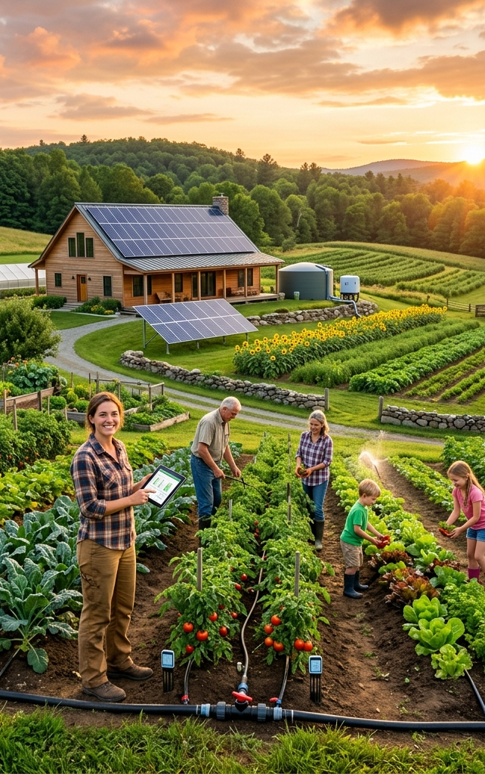

GROUP PROJECT PRESENTATION
AgroFast
AI-powered crop diagnostics and farm management, in one app.
TEAM
Arthur
Bono
Paballoo
Ipfilanga
Tshepang
Temwani
Notes:
Welcome the audience. Introduce the team briefly by name. State the one-line pitch: AgroFast combines an AI crop-disease scanner with full farm management in a single app. Keep this slide under 45 seconds.

Slide 2
THE PROBLEM
Farmers decide with too little information
Diseases are caught late
Expertise is out of reach
01
02
By the time symptoms are obvious to the eye, yield damage is already done.
Agronomists and soil labs aren't accessible to most smallholder farmers.
Records live on paper
Planting is a guessing game
03
04
Expenses, planting dates, and soil history are rarely tracked consistently.
Decisions are made without reliable local weather or market data.
02
Notes:
Ground the audience in why this project matters before showing the app. Optional stat if asked: the FAO estimates pests and diseases destroy roughly 20-40% of global crop yields each year -- use only if it comes up naturally.

Slide 3
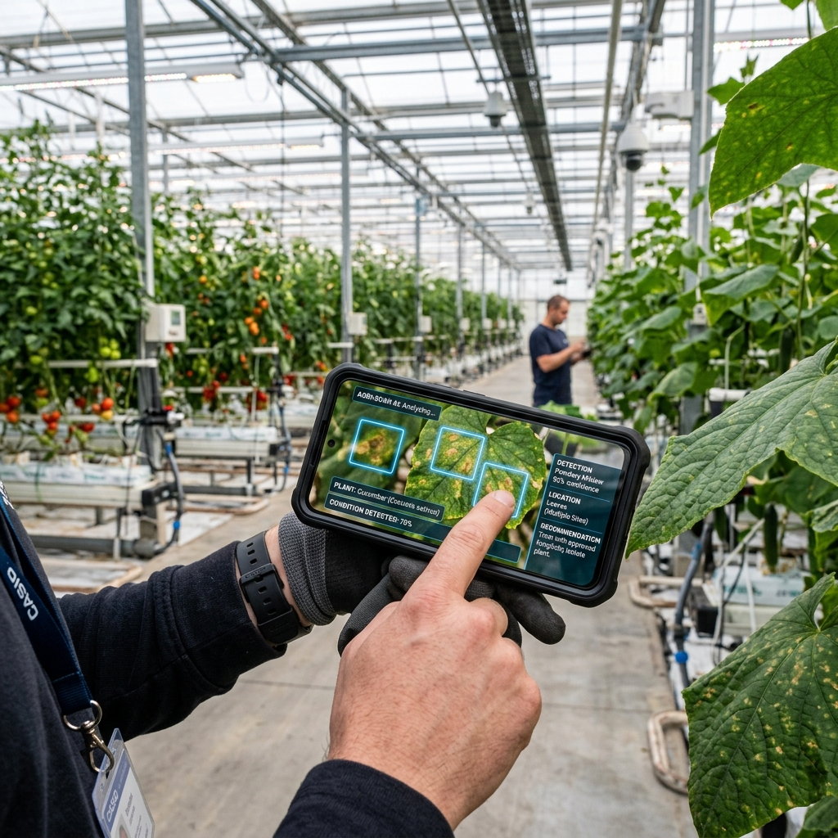
OUR SOLUTION
Diagnose, manage, grow.
AgroFast pairs an AI leaf scanner with practical farm-management tools and a conversational assistant — so every decision is backed by data.
1
2
3
4
5
6
Scan
Manage
Predict
Track
Advise
Go Offline
Next two slides: a closer look at each pillar.
03
Notes:
This is the roadmap slide -- six pillars, quick preview only. Don't explain each one yet, that's the next two slides. Keep this to 30 seconds.

Slide 4
KEY FEATURES — PART 1
Diagnose and manage
AI Crop Scanner
01
Upload a leaf photo to get crop type, disease diagnosis, a confidence score, bounding boxes on affected spots, and treatment advice. Also reads soil scans for NPK levels, pH, and suitable crops.
CNN
OpenCV
PlantCV
Manage Farms
02
Track multiple farm plots at once — soil type, irrigation method, water source, planting dates, and live NPK nutrient levels updated from each farm card.
Firebase
04
Notes:
Spend most time on the scanner -- it's the technical centerpiece. Mention the ~91-92% validation accuracy figure here if it flows naturally, full detail comes on the AI model slide.

Slide 5
KEY FEATURES — PART 2
Plan, spend, and get advice
Smart Crop Recommendations
03
Auto-detects location to pull live weather, then scores crop profitability month-by-month: 40% weather fit plus 60% projected revenue.
Open-Meteo
04
Expense Tracker & Budget Safety
Logs spend per plot and category with visual budget meters, and warns before an expense pushes a farm over budget.
05
AgroFast AI Assistant
06
Offline Desktop Build
Gemini-powered chat in 5 languages, aware of your own farms and scan history.
An Electron-packaged version with a bundled backend for use without internet.
05
Notes:
The AI assistant is a good demo moment -- it can answer in the user's own language and reference their real farm data. Mention offline build briefly; it's a bonus, not the core pitch.

Slide 6
UNDER THE HOOD
System architecture
Frontend
HTML / CSS / vanilla JS
No framework — served directly by FastAPI
▼
Backend
FastAPI (Python)
/predict and /chat endpoints, static file serving
▼
AI / ML
TensorFlow · Keras · OpenCV · PlantCV · Gemini API
Crop model inference, disease-spot detection, chat
▼
Data
Firebase Auth + Realtime Database
Accounts, farms, scans, expenses, chat history
06
Notes:
Walk top to bottom: browser talks to FastAPI, FastAPI calls the ML pipeline or Gemini, and Firebase holds all user data. Good slide to pause on for technical questions.

Slide 7
AI MODEL DEEP DIVE
Inside the crop scanner
Input image 224×224
~91–92%
▼
MobileNetV2 backbone (ImageNet-pretrained)
Validation accuracy
▼
Global Average Pooling
56
▼
Trained classes
Dense 512 → Dense 256
2
▼
Output: class probabilities
Training phases
Two-phase transfer learning: head trained first, then top backbone layers fine-tuned at a lower learning rate.
Data augmentation (rotation, shift, zoom, brightness) and inverse-frequency class weighting keep rare classes from being ignored.
07
Notes:
Keep this technical but not a code walkthrough. If asked 'why MobileNetV2', the answer is transfer learning: a small team can't train a CNN from scratch on a tiny CPU-trained dataset, so we start from ImageNet-pretrained weights.

Slide 8
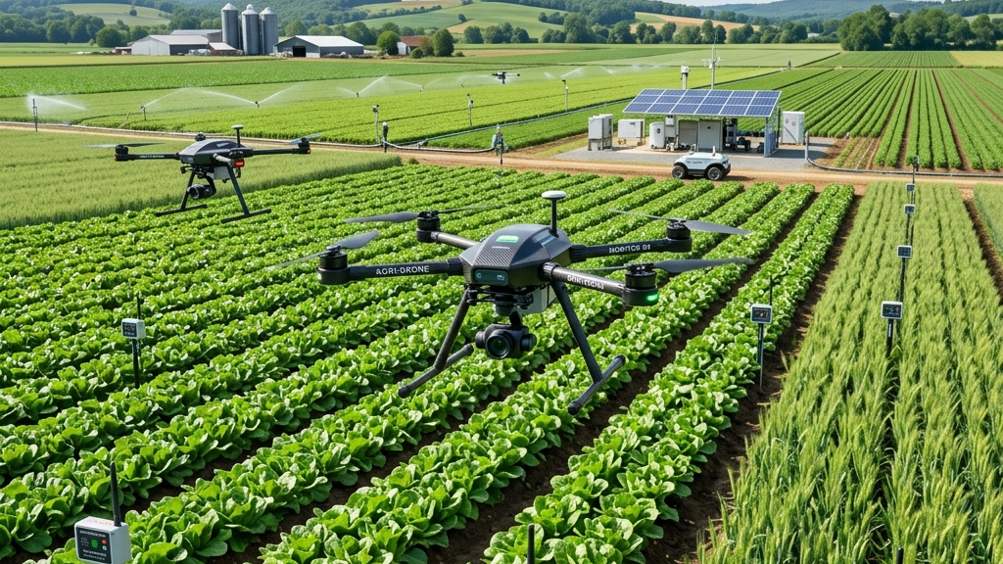
LIVE DEMO
Let's switch to the app
1
2
3
Sign up / log in
Scan a crop leaf
Review diagnosis & treatment
4
5
6
Check crop recommendations
Log a farm expense
Ask the AI assistant
08
Notes:
This slide is a cue card for the presenter driving the demo, not for the audience to read closely -- move to the actual running app right after it. Have a backup screen recording ready in case live internet/location APIs fail.

Slide 9
CHALLENGES & TRADEOFFS
Engineering decisions we made — and why
Small training set
150 images/class train, 30 val
CPU-only training budget; plan to expand with GPU access
Optimistic accuracy figure
Validation set used for both tuning and reporting
Next step: a true held-out test set
Open CORS during development
allow_origins="*" on the API
Will be restricted before any public deployment
Deprecated chat SDK
google-generativeai has reached end of support
Migration to google-genai is planned
09
Notes:
This slide is meant to show engineering maturity, not weakness -- every limitation here is documented in the repo with a plan attached. If a marker pushes on any of these, that's a good sign they're engaged.

Slide 10
WHO THIS HELPS
Built for the whole farming ecosystem
1
2
3
4
Smallholder farmers
Commercial farm managers
Extension officers
Students & researchers
Fast, low-cost disease diagnosis without waiting for an expert visit.
One dashboard to track multiple plots, budgets, and yields.
A tool to support and scale advice across many farms at once.
An open, documented reference for applied agri-AI.
10
Notes:
Pick ONE of these to make concrete with a short story or example if time allows -- 'imagine a smallholder maize farmer in...' lands better than reading all four abstractly.

Slide 11
OUR TEAM
Six people, one build
A
Arthur
B
Bono
P
Paballoo
Team Lead / Full-Stack
AI / ML
Frontend
Backend, integration, project direction
Model training and evaluation
UI implementation
I
Ipfilanga
T
Tshepang
T
Temwani
Frontend / UX
Backend / Data
QA / Presentation
Design and user flows
Firebase and API work
Testing and documentation
11
Notes:
Roles here are placeholders -- swap in what each person actually owned before presenting. Each person should be ready to speak to their own slide/section.

Slide 12
WHAT'S NEXT
Roadmap
Expand the dataset
Harden for production
Collect more images per class and retrain on GPU for higher accuracy.
Lock down CORS, add a held-out test set, tighten Firebase rules.
Migrate the chat SDK
Pilot with real farmers
Move from the deprecated google-generativeai to google-genai.
Field-test with a small group and fold feedback into the roadmap.
12
Notes:
Frame this as a realistic next-steps list, not vaporware -- each item ties directly back to a limitation named on the challenges slide.

Slide 13
Thank You
Questions?
Arthur • Bono • Paballoo • Ipfilanga • Tshepang • Temwani
AgroFast — Group Project
Notes:
Open the floor. Decide beforehand who fields which type of question (e.g. Bono for model questions, Arthur for architecture) so answers don't collide.

