Slide 1
ARM Architecture
Computer Organization and Assembly Languages
Yung-Yu Chuang
2008/11/17
with slides by Peng-Sheng Chen, Ville Pietikainen

Slide 2
ARM history
1983 developed by Acorn computers
  To replace 6502 in BBC computers
  4-man VLSI design team
  Its simplicity comes from the inexperience team
  Match the needs for generalized SoC for reasonable power, performance and die size
  The first commercial RISC implemenation
1990 ARM (Advanced RISC Machine), owned by Acorn, Apple and VLSI

Slide 3
Why ARM?
One of the most licensed and thus widespread processor cores in the world
  Used in PDA, cell phones, multimedia players, handheld game console, digital TV and cameras
  ARM7: GBA, iPod
  ARM9: NDS, PSP, Sony Ericsson, BenQ
  ARM11: Apple iPhone, Nokia N93, N800
  75% of 32-bit embedded processors
Used especially in portable devices due to its low power consumption and reasonable performance

Slide 4
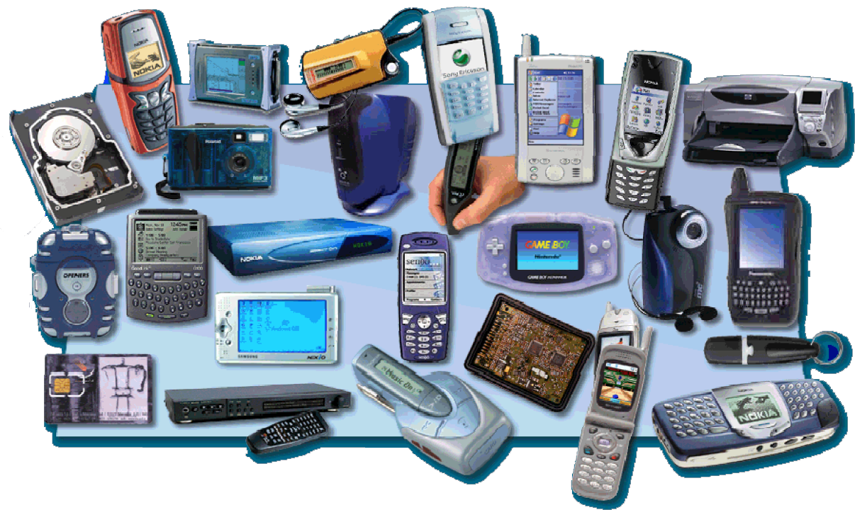
ARM powered products

Slide 5
ARM processors
A simple but powerful design
A whole family of designs sharing similar design principles and a common instruction set

Slide 6
Naming ARM
ARMxyzTDMIEJFS
  x: series
  y: MMU
  z: cache
  T: Thumb
  D: debugger
  M: Multiplier
  I: EmbeddedICE (built-in debugger hardware)
  E: Enhanced instruction
  J: Jazelle (JVM)
  F: Floating-point
  S: Synthesizible version (source code version for EDA tools)

Slide 7
Popular ARM architectures
ARM7TDMI
  3 pipeline stages (fetch/decode/execute)
  High code density/low power consumption
  One of the most used ARM-version (for low-end systems)
  All ARM cores after ARM7TDMI include TDMI even if they do not include TDMI in their labels
ARM9TDMI
  Compatible with ARM7
  5 stages (fetch/decode/execute/memory/write)
  Separate instruction and data cache
ARM11

Slide 8
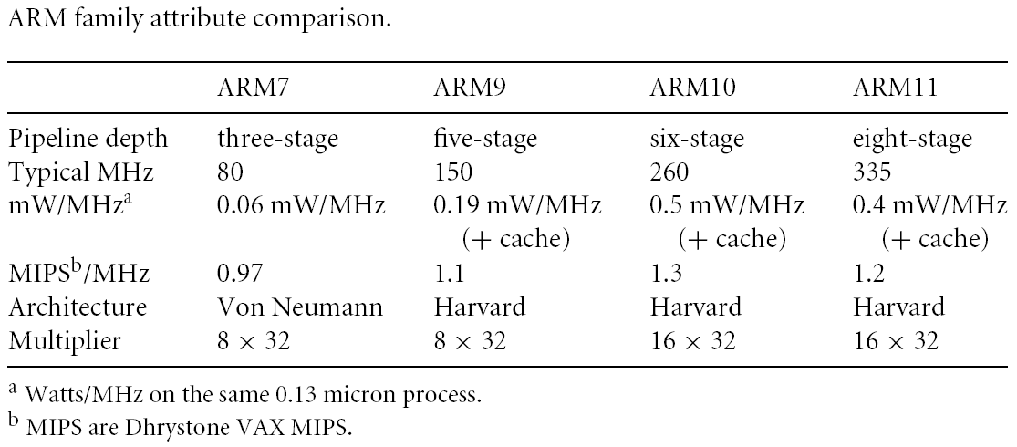
ARM family comparison
year 1995 1997 1999 2003

Slide 9
ARM is a RISC
RISC: simple but powerful instructions that execute within a single cycle at high clock speed.
Four major design rules:
  Instructions: reduced set/single cycle/fixed length
  Pipeline: decode in one stage/no need for microcode
  Registers: a large set of general-purpose registers
  Load/store architecture: data processing instructions apply to registers only; load/store to transfer data from memory
Results in simple design and fast clock rate
The distinction blurs because CISC implements RISC concepts

Slide 10
ARM design philosophy
Small processor for lower power consumption (for embedded system)
High code density for limited memory and physical size restrictions
The ability to use slow and low-cost memory
Reduced die size for reducing manufacture cost and accommodating more peripherals

Slide 11
ARM features
Different from pure RISC in several ways:
  Variable cycle execution for certain instructions: multiple-register load/store (faster/higher code density)
  Inline barrel shifter leading to more complex instructions: improves performance and code density
  Thumb 16-bit instruction set: 30% code density improvement
  Conditional execution: improve performance and code density by reducing branch
  Enhanced instructions: DSP instructions

Slide 12
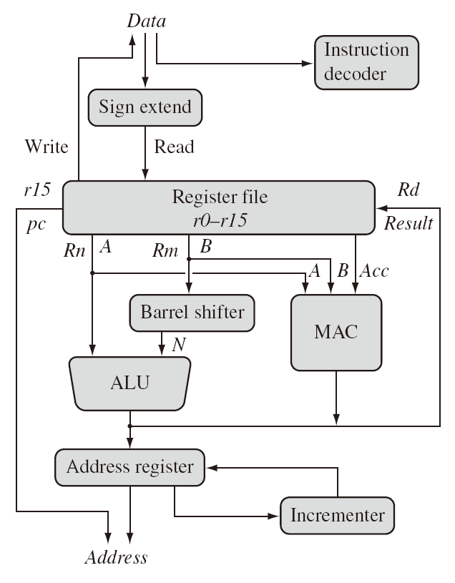
ARM architecture

Slide 13
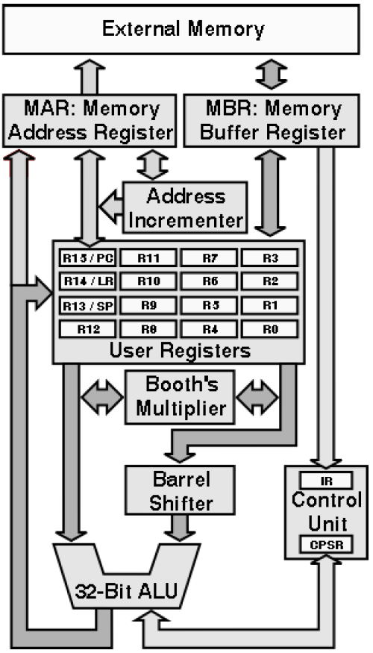
ARM architecture
Load/store architecture
A large array of uniform registers
Fixed-length 32-bit instructions
3-address instructions

Slide 14
Registers
Only 16 registers are visible to a specific mode. A mode could access
  A particular set of r0-r12
  r13 (sp, stack pointer)
  r14 (lr, link register)
  r15 (pc, program counter)
  Current program status register (cpsr)
  The uses of r0-r13 are orthogonal

Slide 15
General-purpose registers
31
24 23
16 15
8 7
0
8-bit Byte
16-bit Half word
32-bit word
6 data types (signed/unsigned)
All ARM operations are 32-bit. Shorter data types are only supported by data transfer operations.

Slide 16
Program counter
Store the address of the instruction to be executed
All instructions are 32-bit wide and word-aligned
Thus, the last two bits of pc are undefined.

Slide 17
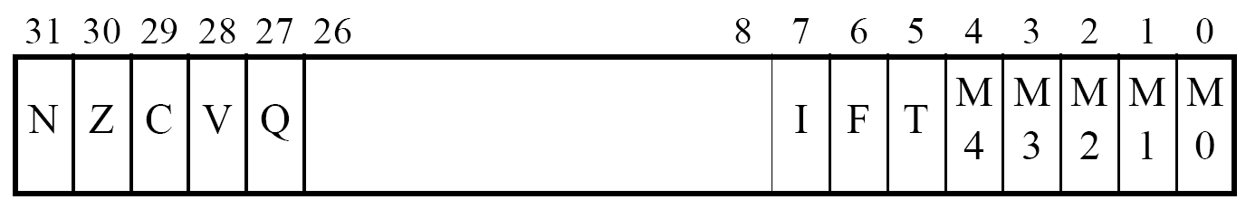
Program status register (CPSR)
mode bits
overflow
Thumb state
carry/borrow
FIQ disable
zero
IRQ disable
negative

Slide 18
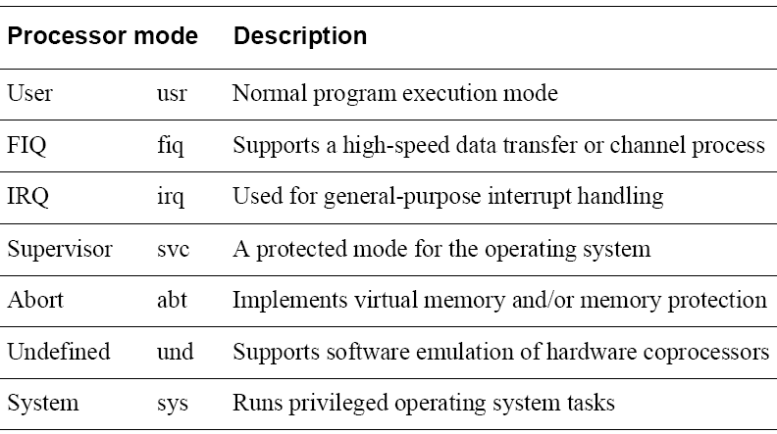
Processor modes

Slide 19
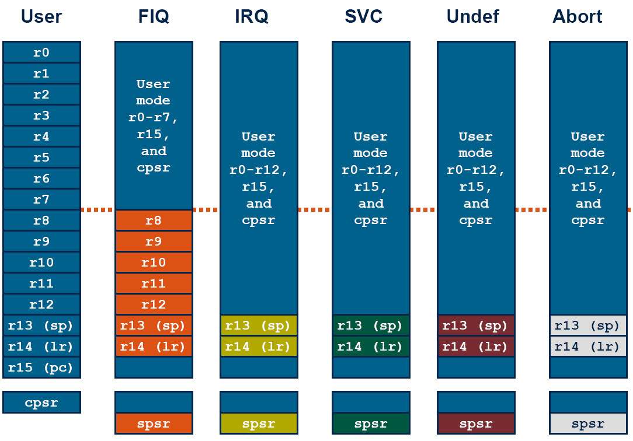
Register organization

Slide 20
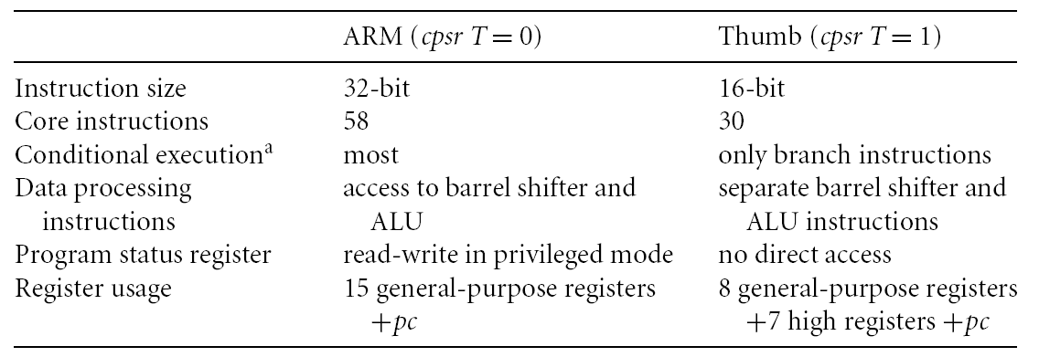
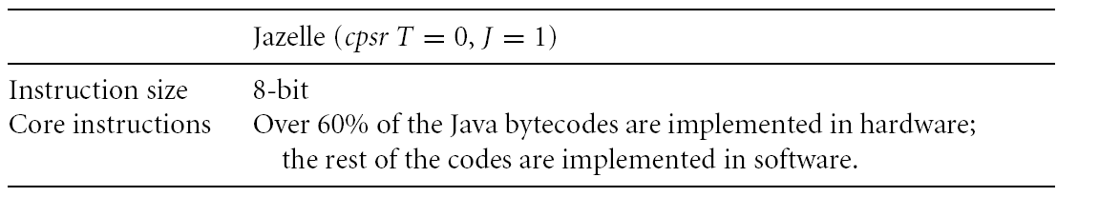
Instruction sets
ARM/Thumb/Jazelle

Slide 21

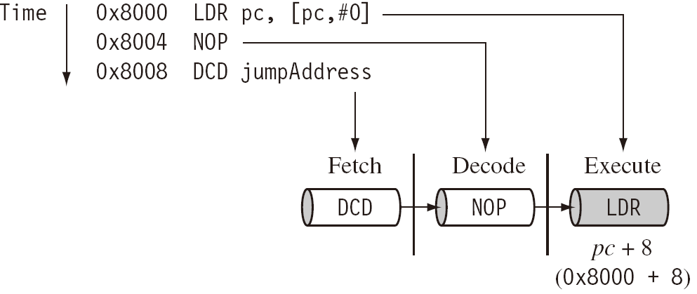
Pipeline
ARM7
ARM9
In execution, pc always 8 bytes ahead

Slide 22
Pipeline
Execution of a branch or direct modification of pc causes ARM core to flush its pipeline
ARM10 starts to use branch prediction
An instruction in the execution stage will complete even though an interrupt has been raised. Other instructions in the pipeline are abondond.

Slide 23
Interrupts
Vector table
:
Interrupt handlers
code

Slide 24
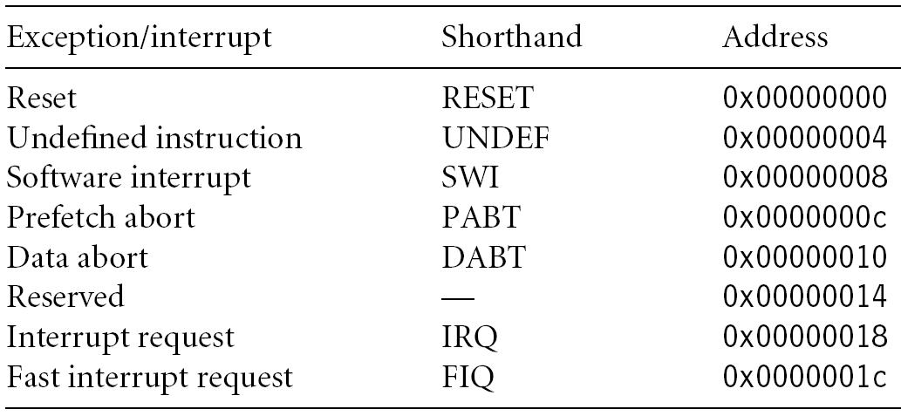
Interrupts

