Slide 1
ARM Instruction Set
Computer Organization and Assembly Languages
Yung-Yu Chuang
2008/11/17
with slides by Peng-Sheng Chen

Slide 2
Introduction
The ARM processor is easy to program at the assembly level. (It is a RISC)
We will learn ARM assembly programming at the user level and run it on a GBA emulator.

Slide 3
ARM programmer model
The state of an ARM system is determined by the content of visible registers and memory.
A user-mode program can see 15 32-bit general-purpose registers (R0-R14), program counter (PC) and CPSR.
Instruction set defines the operations that can change the state.

Slide 4
Memory system
Memory is a linear array of bytes addressed from 0 to 2³²-1
Word, half-word, byte
Little-endian
0x00000000
00
10
20
30
FF
FF
FF
00
00
00
0x00000001
0x00000002
0x00000003
0x00000004
0x00000005
0x00000006
0xFFFFFFFD
0xFFFFFFFE
0xFFFFFFFF

Slide 5
Byte ordering
Big Endian
  Least significant byte has highest address
  Word address 0x00000000
  Value: 00102030
Little Endian
  Least significant byte has lowest address
  Word address 0x00000000
  Value: 30201000
0x00000000
00
10
20
30
FF
FF
FF
00
00
00
0x00000001
0x00000002
0x00000003
0x00000004
0x00000005
0x00000006
0xFFFFFFFD
0xFFFFFFFE
0xFFFFFFFF

Slide 6
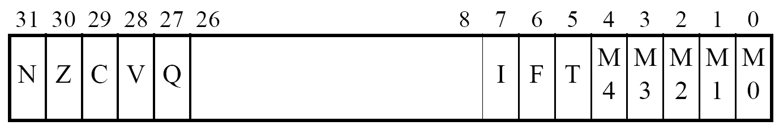
ARM programmer model
0x00000000
00
10
20
30
FF
FF
FF
00
00
00
0x00000001
R0 | R1 | R2 | R3
R4 | R5 | R6 | R7
R8 | R9 | R10 | R11
R12 | R13 | R14 | PC
0x00000002
0x00000003
0x00000004
0x00000005
0x00000006
0xFFFFFFFD
0xFFFFFFFE
0xFFFFFFFF

Slide 7
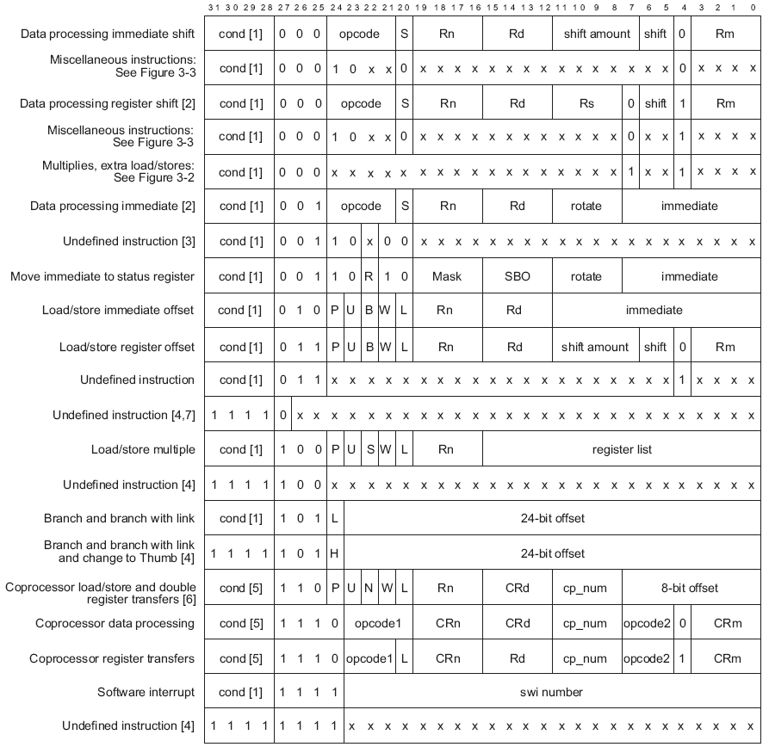
Instruction set
ARM instructions are all 32-bit long (except for Thumb mode). There are 2³² possible machine instructions. Fortunately, they are structured.

Slide 8
Features of ARM instruction set
Load-store architecture
3-address instructions
Conditional execution of every instruction
Possible to load/store multiple registers at once
Possible to combine shift and ALU operations in a single instruction

Slide 9
Instruction set
Data processing
Data movement
Flow control

Slide 10
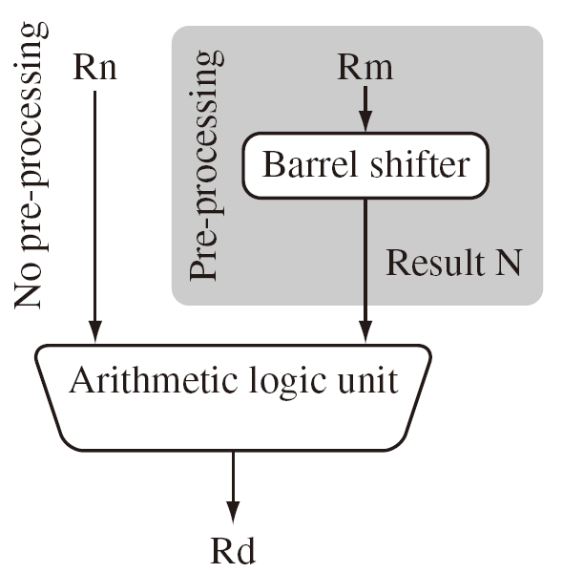
Data processing
They are move, arithmetic, logical, comparison and multiply instructions.
Most data processing instructions can process one of their operands using the barrel shifter.
General rules:
  All operands are 32-bit, coming from registers or literals.
  The result, if any, is 32-bit and placed in a register (with the exception for long multiply which produces a 64-bit result)
  3-address format

Slide 11
Instruction set
MOV<cc><S> Rd, <operands>
MOVCS R0, R1 @ if carry is set
@ then R0:=R1
MOVS R0, #0 @ R0:=0
@ Z=1, N=0
@ C, V unaffected

Slide 12
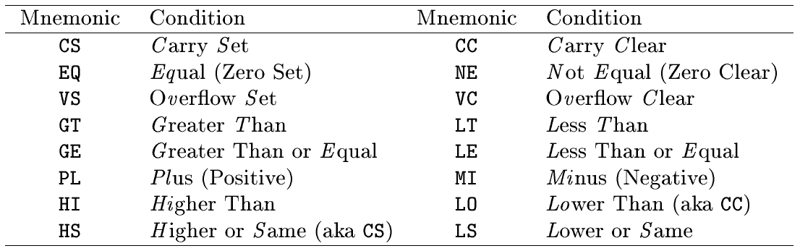
Conditional execution
Almost all ARM instructions have a condition field which allows it to be executed conditionally.
movcs R0, R1

Slide 13
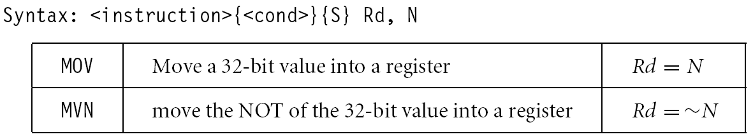
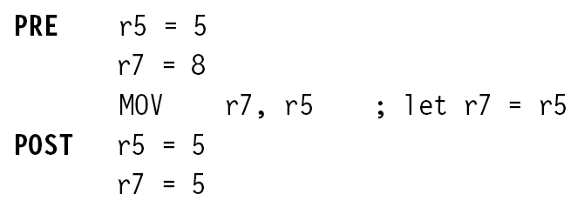
Register movement
immediate,register,shift
MOV R0, R2 @ R0 = R2
MVN R0, R2 @ R0 = ~R2
move negated

Slide 14
Addressing modes
Register operands
ADD R0, R1, R2
Immediate operands
ADD R3, R3, #1 @ R3:=R3+1
AND R8, R7, #0xff @ R8=R7[7:0]
a literal; most can be represented
by (0..255)x2^{2n} 0<n<12
a hexadecimal literal
This is assembler dependent syntax.

Slide 15
Shifted register operands
One operand to ALU is routed through the Barrel shifter. Thus, the operand can be modified before it is used. Useful for fast multipliation and dealing with lists, table and other complex data structure. (similar to the displacement addressing mode in CISC.)
Some instructions (e.g. MUL, CLZ, QADD) do not read barrel shifter.

Slide 16
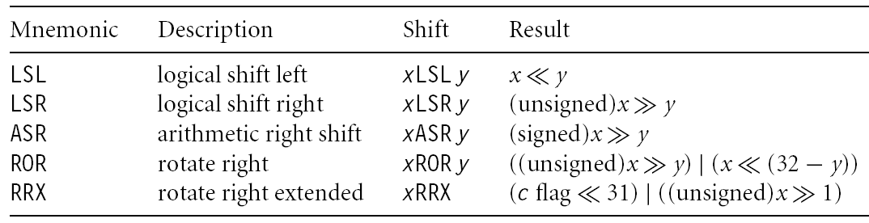
Shifted register operands

Slide 17
Logical shift left
C
register
0
MOV R0, R2, LSL #2 @ R0:=R2<<2
@ R2 unchanged
Example: 0…0 0011 0000
Before R2=0x00000030
After R0=0x000000C0
R2=0x00000030

Slide 18
Logical shift right
0
register
C
MOV R0, R2, LSR #2 @ R0:=R2>>2
@ R2 unchanged
Example: 0…0 0011 0000
Before R2=0x00000030
After R0=0x0000000C
R2=0x00000030

Slide 19
Arithmetic shift right
MSB
register
C
MOV R0, R2, ASR #2 @ R0:=R2>>2
@ R2 unchanged
Example: 1010 0…0 0011 0000
Before R2=0xA0000030
After R0=0xE800000C
R2=0xA0000030

Slide 20
Rotate right
register
MOV R0, R2, ROR #2 @ R0:=R2 rotate
@ R2 unchanged
Example: 0…0 0011 0001
Before R2=0x00000031
After R0=0x4000000C
R2=0x00000031

Slide 21
Rotate right extended
C
register
C
MOV R0, R2, RRX @ R0:=R2 rotate
@ R2 unchanged
Example: 0…0 0011 0001
Before R2=0x00000031, C=1
After R0=0x80000018, C=1
R2=0x00000031

Slide 22
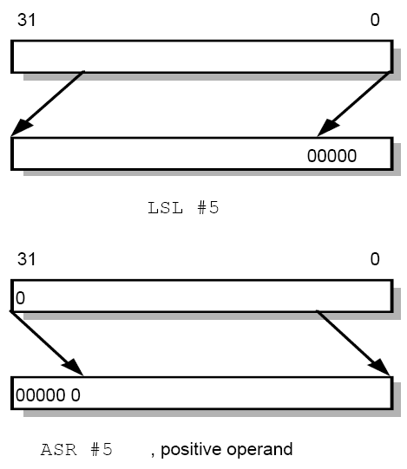
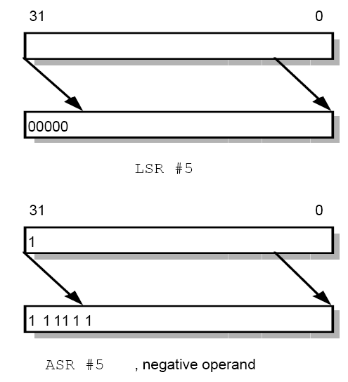
Shifted register operands

Slide 23
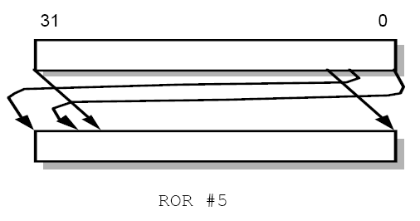
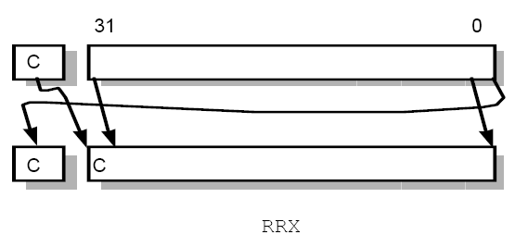
Shifted register operands

Slide 24
Shifted register operands
It is possible to use a register to specify the number of bits to be shifted; only the bottom 8 bits of the register are significant.
@ array index calculation
ADD R0, R1, R2, LSL R3 @ R0:=R1+R2*2^{R3}
@ fast multiply R2=35xR0
ADD R0, R0, R0, LSL #2 @ R0’=5xR0
RSB R2, R0, R0, LSL #3 @ R2 =7xR0’

Slide 25
Multiplication
MOV R1, #35
MUL R2, R0, R1
or
ADD R0, R0, R0, LSL #2 @ R0’=5xR0
RSB R2, R0, R0, LSL #3 @ R2 =7xR0’

Slide 26
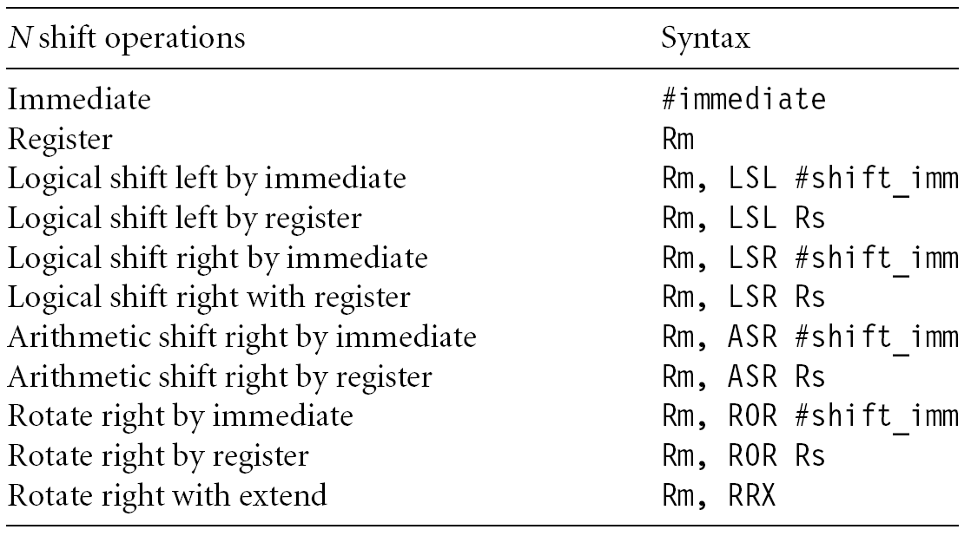
Shifted register operands

Slide 27
Encoding data processing instructions
31
28
27
26
25
24
21
20
19
16
15
12
1
1
0
cond
0 0
#
opcode
S
Rn
Rd
operand 2
destination register
first operand register
set condition codes
arithmetic/logic function
25
1
1
8
7
0
1
#rot
8-bit immediate
immediate alignment
1
1
7
6
5
4
3
0
#shift
Sh
0
Rm
25
immediate shift length
0
shift type
second operand register
1
1
8
7
6
5
4
3
0
Rs
0
Sh
1
Rm
register shift length

Slide 28
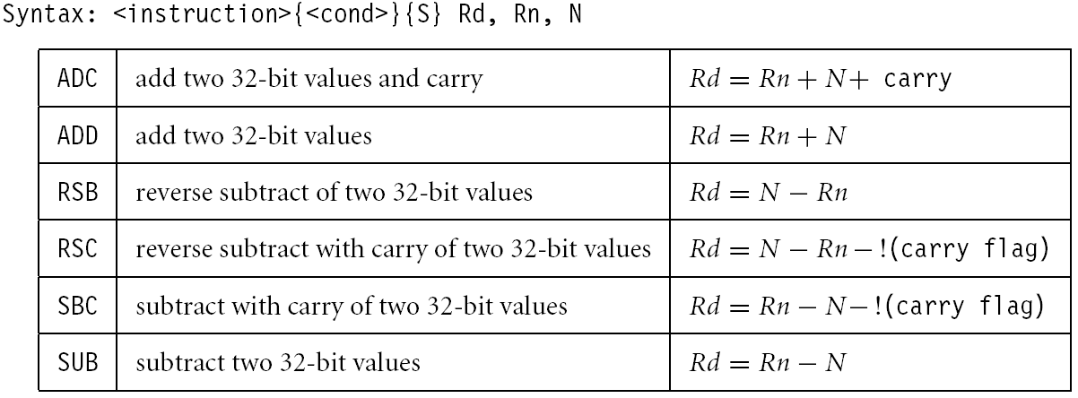
Arithmetic
Add and subtraction

Slide 29
Arithmetic
ADD R0, R1, R2 @ R0 = R1+R2
ADC R0, R1, R2 @ R0 = R1+R2+C
SUB R0, R1, R2 @ R0 = R1-R2
SBC R0, R1, R2 @ R0 = R1-R2-!C
RSB R0, R1, R2 @ R0 = R2-R1
RSC R0, R1, R2 @ R0 = R2-R1-!C
-1
-128
127
0
-5
3
255
128
127
0
3-5=3+(-5) → sum<=255 → C=0 → borrow
5-3=5+(-3) → sum > 255 → C=1 → no borrow

Slide 30
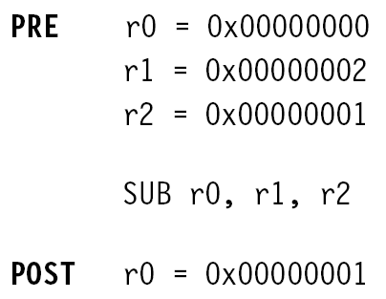
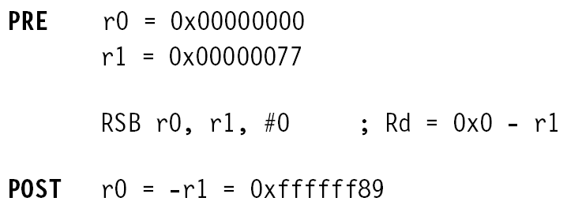
Arithmetic

Slide 31
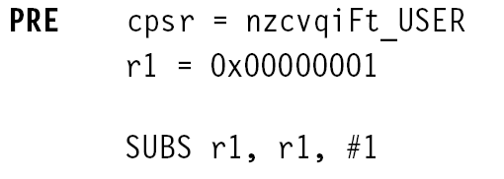
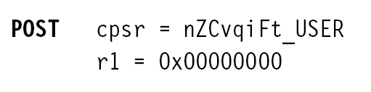
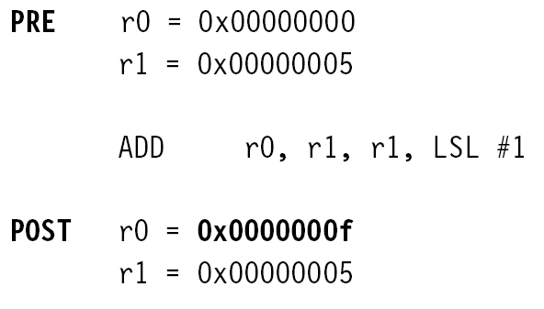
Arithmetic

Slide 32
Setting the condition codes
Any data processing instruction can set the condition codes if the programmers wish it to
64-bit addition
ADDS R2, R2, R0
ADC R3, R3, R1
R1
R0
+
R3
R2
R3
R2

Slide 33
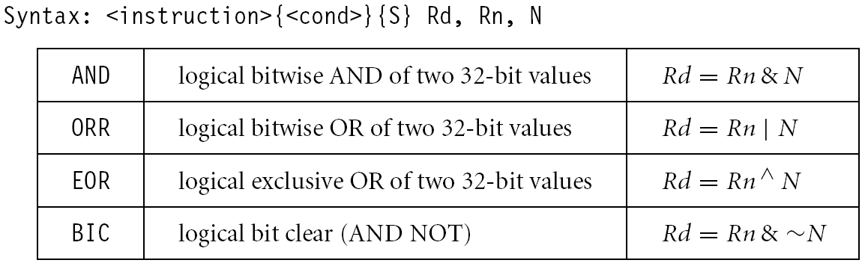
Logical

Slide 34
Logical
AND R0, R1, R2 @ R0 = R1 and R2
ORR R0, R1, R2 @ R0 = R1 or R2
EOR R0, R1, R2 @ R0 = R1 xor R2
BIC R0, R1, R2 @ R0 = R1 and (~R2)
bit clear: R2 is a mask identifying which
bits of R1 will be cleared to zero
R1=0x11111111 R2=0x01100101
BIC R0, R1, R2
R0=0x10011010

Slide 35

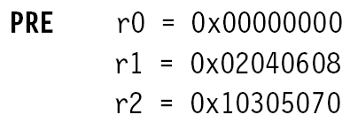
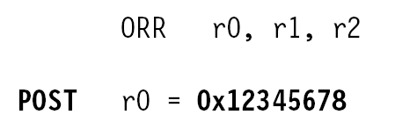
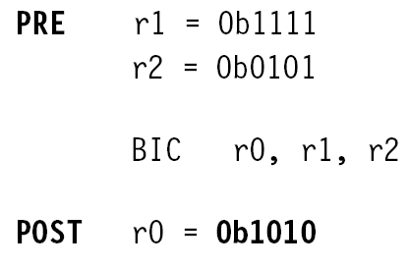
Logical

Slide 36
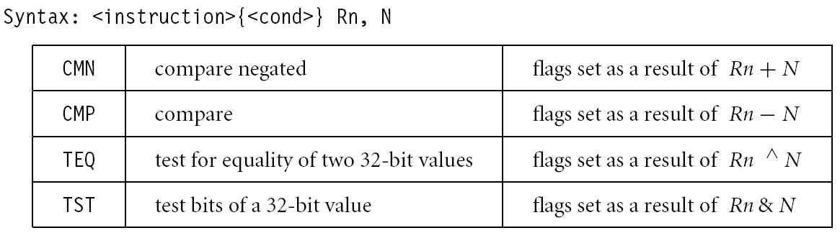
Comparison
These instructions do not generate a result, but set condition code bits (N, Z, C, V) in CPSR. Often, a branch operation follows to change the program flow.

Slide 37
Comparison
CMP R1, R2 @ set cc on R1-R2
CMN R1, R2 @ set cc on R1+R2
TST R1, R2 @ set cc on R1 and R2
TEQ R1, R2 @ set cc on R1 xor R2
compare
compare negated
bit test
test equal

Slide 38
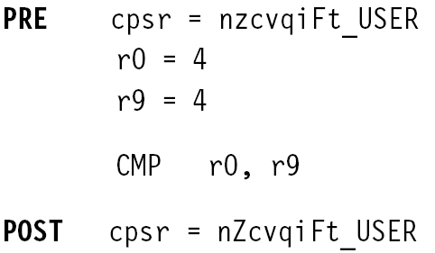
Comparison

Slide 39
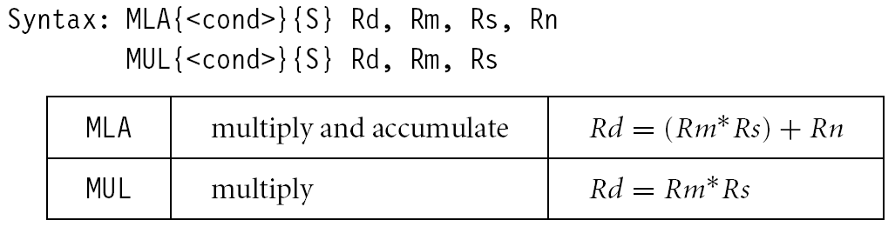
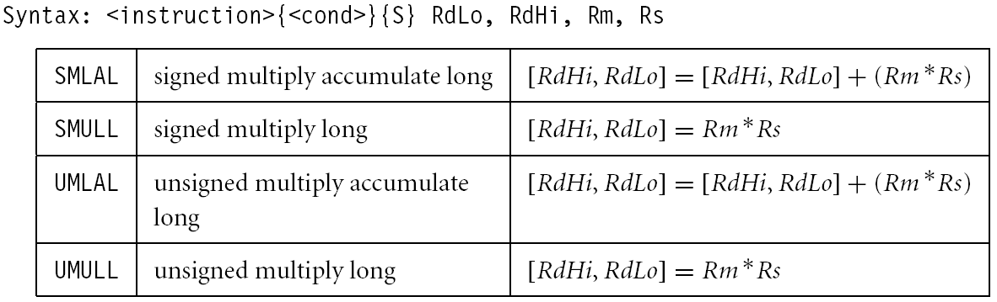
Multiplication

Slide 40
Multiplication
MUL R0, R1, R2 @ R0 = (R1xR2)_{[31:0]}
Features:
  Second operand can’t be immediate
  The result register must be different from the first operand
  Cycles depends on core type
  If S bit is set, C flag is meaningless
See the reference manual (4.1.33)

Slide 41
Multiplication
Multiply-accumulate (2D array indexing)
MLA R4, R3, R2, R1 @ R4 = R3xR2+R1
Multiply with a constant can often be more efficiently implemented using shifted register operand
MOV R1, #35
MUL R2, R0, R1
or
ADD R0, R0, R0, LSL #2 @ R0’=5xR0
RSB R2, R0, R0, LSL #3 @ R2 =7xR0’

Slide 42
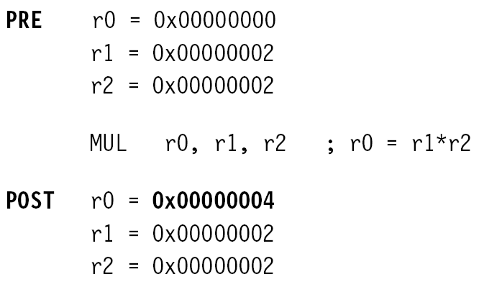
Multiplication

Slide 43
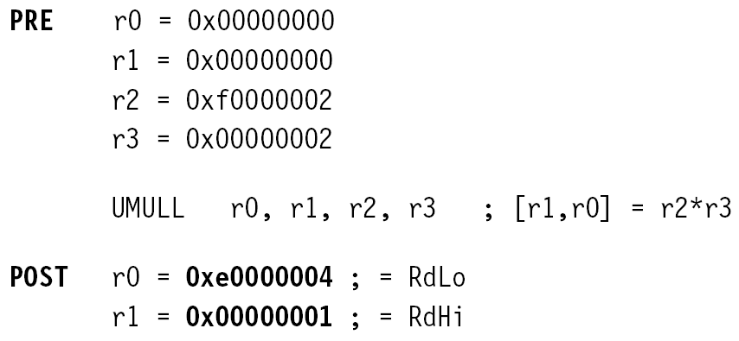
Multiplication

Slide 44
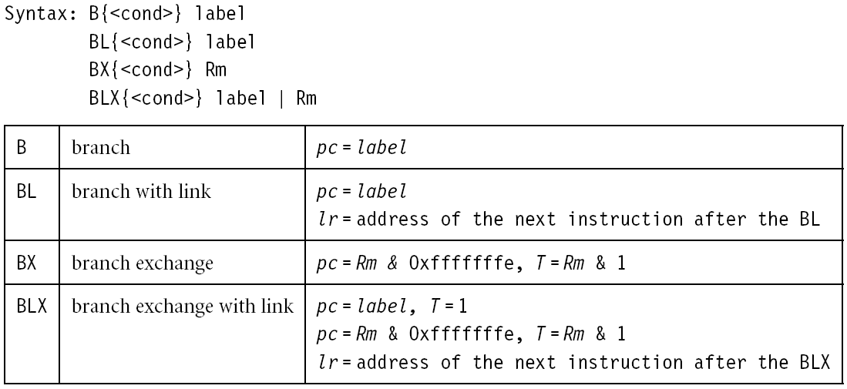
Flow control instructions
Determine the instruction to be executed next
pc-relative offset within 32MB

Slide 45
Flow control instructions
Branch instruction
B label
…
label: …
Conditional branches
MOV R0, #0
loop: …
ADD R0, R0, #1
CMP R0, #10
BNE loop

Slide 46
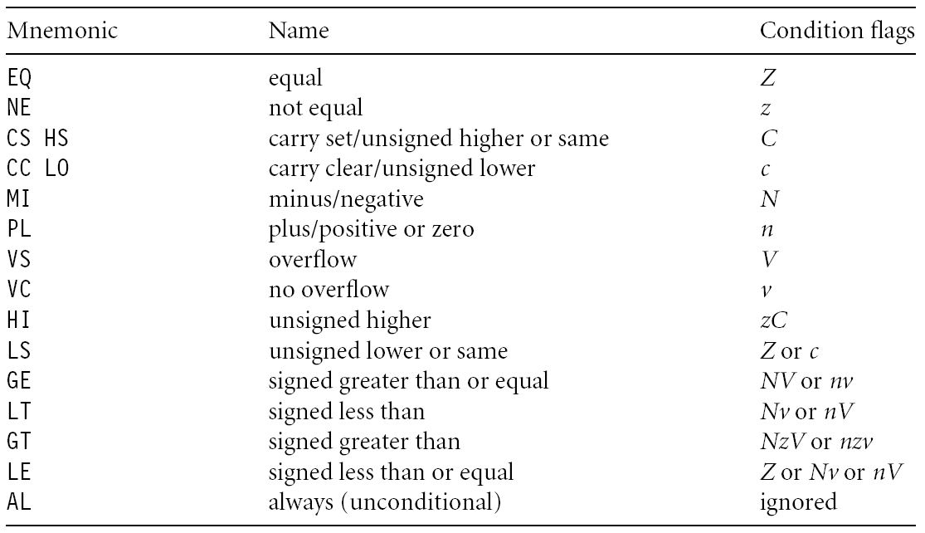
Branch conditions

Slide 47
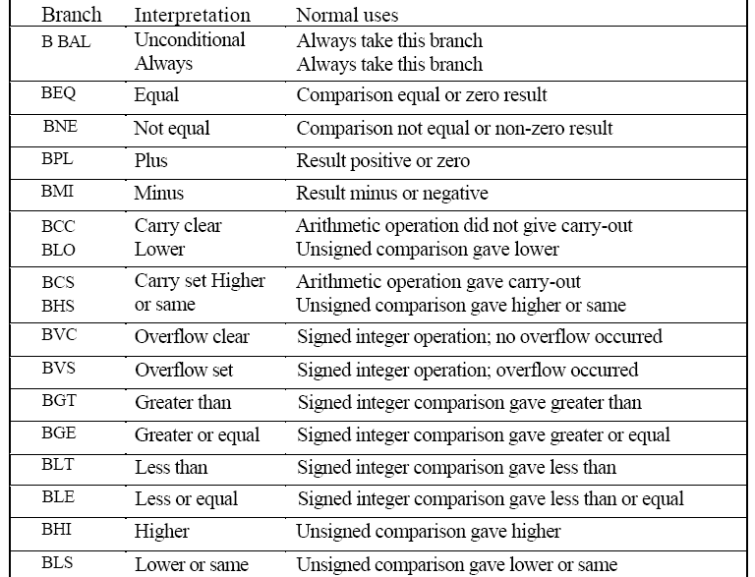
Branches

Slide 48
Branch and link
BL instruction save the return address to R14 (lr)
BL sub @ call sub
CMP R1, #5 @ return to here
MOVEQ R1, #0
…
sub: … @ sub entry point
…
MOV PC, LR @ return

Slide 49
Branch and link
BL sub1 @ call sub1
…
sub1: STMFD R13!, {R0-R2,R14}
BL sub2
…
LDMFD R13!, {R0-R2,PC}
sub2: …
…
MOV PC, LR
use stack to save/restore the return address and registers

Slide 50
Conditional execution
CMP R0, #5
BEQ bypass @ if (R0!=5) {
ADD R1, R1, R0 @ R1=R1+R0-R2
SUB R1, R1, R2 @ }
bypass: …
CMP R0, #5
ADDNE R1, R1, R0
SUBNE R1, R1, R2
smaller and faster
Rule of thumb: if the conditional sequence is three instructions
or less, it is better to use conditional execution than a branch.

Slide 51
Conditional execution
if ((R0==R1) && (R2==R3)) R4++
CMP R0, R1
BNE skip
CMP R2, R3
BNE skip
ADD R4, R4, #1
skip: …
CMP R0, R1
CMPEQ R2, R3
ADDEQ R4, R4, #1

Slide 52
Data transfer instructions
Move data between registers and memory
Three basic forms
  Single register load/store
  Multiple register load/store
  Single register swap: SWP(B), atomic instruction for semaphore

Slide 53
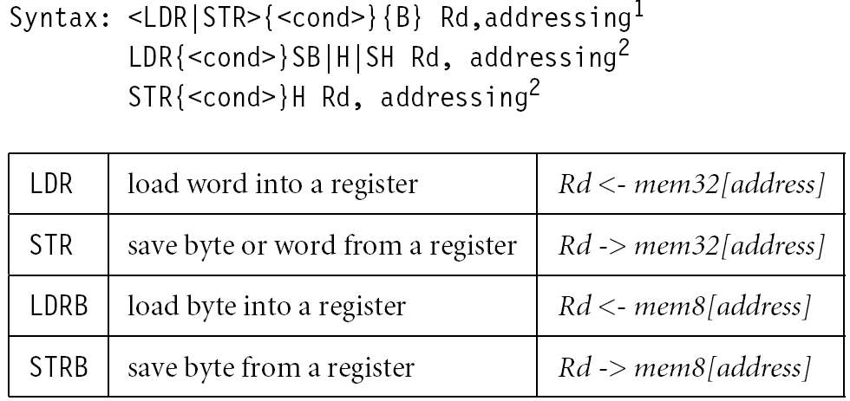
Single register load/store

Slide 54
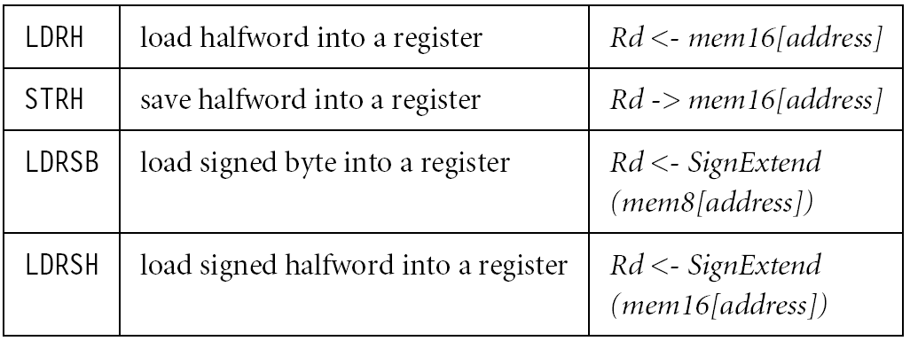
Single register load/store
No STRSB/STRSH since STRB/STRH stores both
signed/unsigned ones

Slide 55
Single register load/store
The data items can be a 8-bit byte, 16-bit half-word or 32-bit word. Addresses must be boundary aligned. (e.g. 4’s multiple for LDR/STR)
LDR R0, [R1] @ R0 := mem₃₂[R1]
STR R0, [R1] @ mem₃₂[R1] := R0
LDR, LDRH, LDRB for 32, 16, 8 bits
STR, STRH, STRB for 32, 16, 8 bits

Slide 56
Addressing modes
Memory is addressed by a register and an offset.
LDR R0, [R1] @ mem[R1]
Three ways to specify offsets:
  Immediate
LDR R0, [R1, #4] @ mem[R1+4]
  Register
  LDR R0, [R1, R2] @ mem[R1+R2]
  Scaled register @ mem[R1+4*R2]
  LDR R0, [R1, R2, LSL #2]

Slide 57
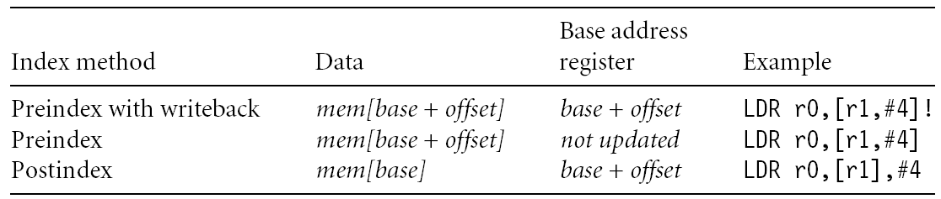
Addressing modes
Pre-index addressing (LDR R0, [R1, #4])
without a writeback
Auto-indexing addressing (LDR R0, [R1, #4]!)
Pre-index with writeback
calculation before accessing with a writeback
Post-index addressing (LDR R0, [R1], #4)
calculation after accessing with a writeback

Slide 58
Pre-index addressing
LDR R0, [R1, #4] @ R0=mem[R1+4]
@ R1 unchanged
LDR R0, [R1, ]
R1
+
R0

Slide 59
Auto-indexing addressing
LDR R0, [R1, #4]! @ R0=mem[R1+4]
@ R1=R1+4
No extra time; Fast;
LDR R0, [R1, ]!
R1
+
R0

Slide 60
Post-index addressing
LDR R0, R1, #4 @ R0=mem[R1]
@ R1=R1+4
LDR R0,[R1],
R1
R0
+

Slide 61
Comparisons
Pre-indexed addressing
LDR R0, [R1, R2] @ R0=mem[R1+R2]
@ R1 unchanged
Auto-indexing addressing
LDR R0, [R1, R2]! @ R0=mem[R1+R2]
@ R1=R1+R2
Post-indexed addressing
LDR R0, [R1], R2 @ R0=mem[R1]
@ R1=R1+R2

Slide 62
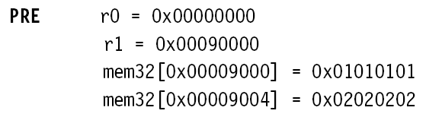

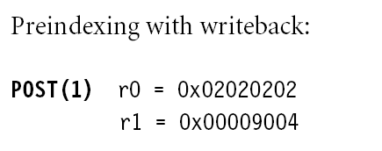
Example

Slide 63

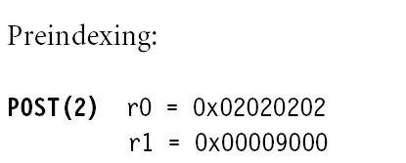
Example

Slide 64

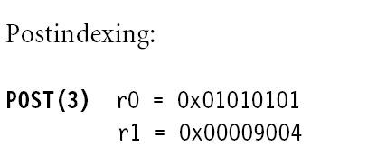
Example

Slide 65
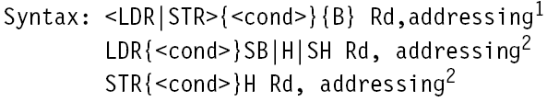
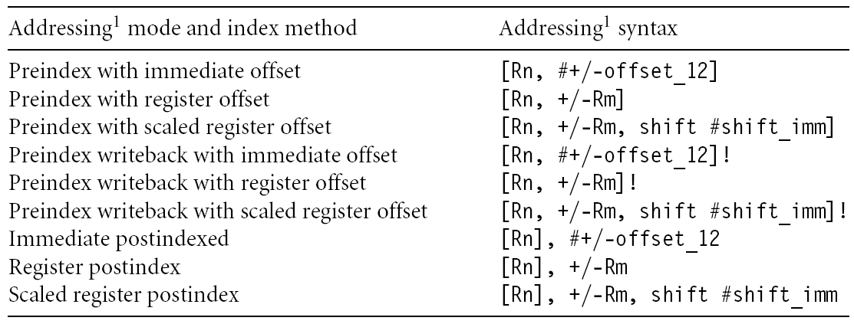
Summary of addressing modes

Slide 66
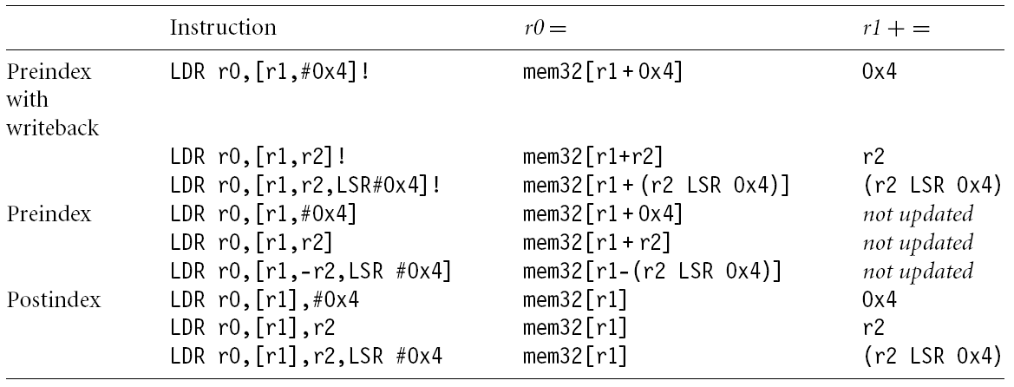
Summary of addressing modes

Slide 67
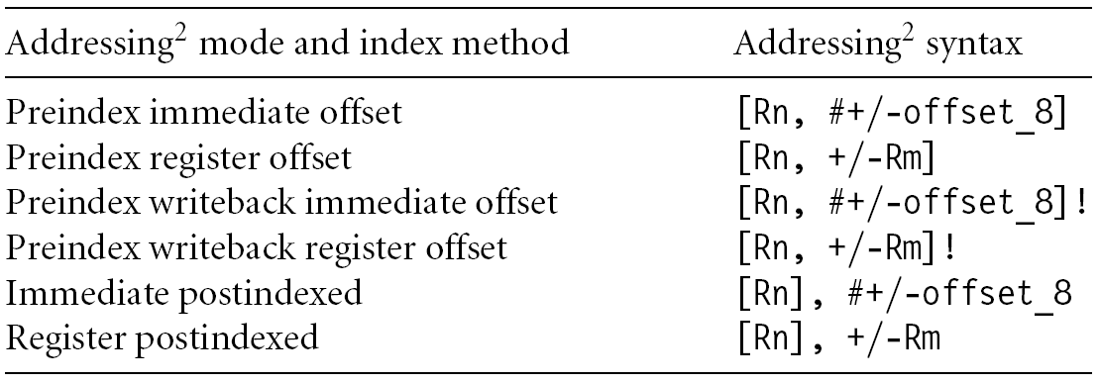
Summary of addressing modes

Slide 68
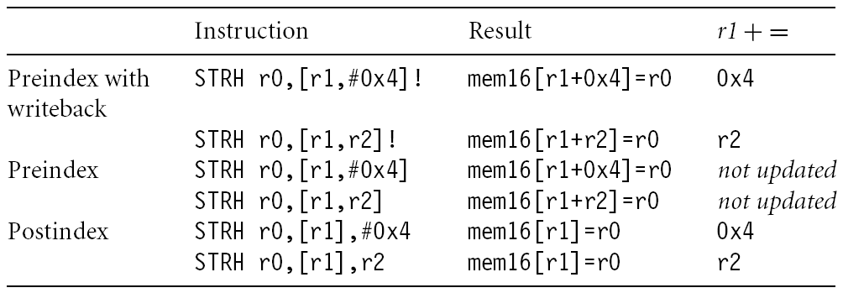
Summary of addressing modes

Slide 69
Load an address into a register
Note that all addressing modes are register-offseted. Can we issue LDR R0, Table? The pseudo instruction ADR loads a register with an address
table: .word 10
…
ADR R0, table
Assembler transfer pseudo instruction into a sequence of appropriate instructions
sub r0, pc, #12

Slide 70
Application
ADR R1, table
loop: LDR R0, [R1]
ADD R1, R1, #4
@ operations on R0
…
ADR R1, table
loop: LDR R0, [R1], #4
@ operations on R0
…
table
R1

Slide 71
Multiple register load/store
Transfer a block of data more efficiently.
Used for procedure entry and exit for saving and restoring workspace registers and the return address
For ARM7, 2+Nt cycles (N:#words, t:time for a word for sequential access). Increase interrupt latency since it can’t be interrupted.
registers are arranged an in increasing order; see manual
LDMIA R1, {R0, R2, R5} @ R0 = mem[R1]
@ R2 = mem[r1+4]
@ R5 = mem[r1+8]

Slide 72
Multiple load/store register
LDM load multiple registers
STM store multiple registers
suffix meaning
IA increase after
IB increase before
DA decrease after
DB decrease before

Slide 73
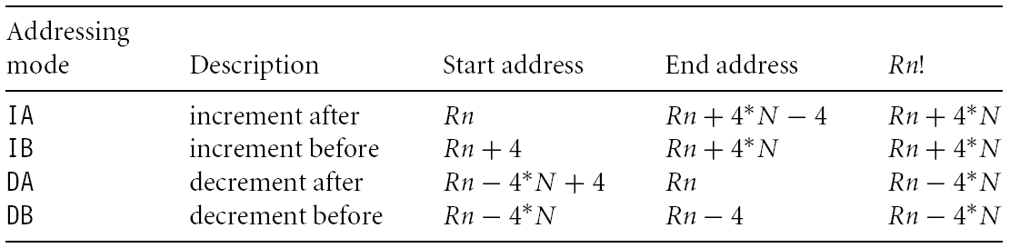
Addressing modes

Slide 74
Multiple load/store register
LDM<mode> Rn, {<registers>}
IA: addr:=Rn
IB: addr:=Rn+4
DA: addr:=Rn-#<registers>*4+4
DB: addr:=Rn-#<registers>*4
For each Ri in <registers>
IB: addr:=addr+4
DB: addr:=addr-4
Ri:=M[addr]
IA: addr:=addr+4
DA: addr:=addr-4
<!>: Rn:=addr
Rn
R1
R2
R3

Slide 75
Multiple load/store register
LDM<mode> Rn, {<registers>}
IA: addr:=Rn
IB: addr:=Rn+4
DA: addr:=Rn-#<registers>*4+4
DB: addr:=Rn-#<registers>*4
For each Ri in <registers>
IB: addr:=addr+4
DB: addr:=addr-4
Ri:=M[addr]
IA: addr:=addr+4
DA: addr:=addr-4
<!>: Rn:=addr
Rn
R1
R2
R3

Slide 76
Multiple load/store register
LDM<mode> Rn, {<registers>}
IA: addr:=Rn
IB: addr:=Rn+4
DA: addr:=Rn-#<registers>*4+4
DB: addr:=Rn-#<registers>*4
For each Ri in <registers>
IB: addr:=addr+4
DB: addr:=addr-4
Ri:=M[addr]
IA: addr:=addr+4
DA: addr:=addr-4
<!>: Rn:=addr
R1
R2
R3
Rn

Slide 77
Multiple load/store register
LDM<mode> Rn, {<registers>}
IA: addr:=Rn
IB: addr:=Rn+4
DA: addr:=Rn-#<registers>*4+4
DB: addr:=Rn-#<registers>*4
For each Ri in <registers>
IB: addr:=addr+4
DB: addr:=addr-4
Ri:=M[addr]
IA: addr:=addr+4
DA: addr:=addr-4
<!>: Rn:=addr
R1
R2
R3
Rn

Slide 78
Multiple load/store register
LDMIA R0, {R1,R2,R3}
or
LDMIA R0, {R1-R3}
R1: 10
R2: 20
R3: 30
R0: 0x10
addr | data
0x010 | 10
0x014 | 20
0x018 | 30
0x01C | 40
0x020 | 50
0x024 | 60
R0

Slide 79
Multiple load/store register
LDMIA R0!, {R1,R2,R3}
R1: 10
R2: 20
R3: 30
R0: 0x01C
addr | data
0x010 | 10
0x014 | 20
0x018 | 30
0x01C | 40
0x020 | 50
0x024 | 60
R0

Slide 80
Multiple load/store register
LDMIB R0!, {R1,R2,R3}
R1: 20
R2: 30
R3: 40
R0: 0x01C
addr | data
0x010 | 10
0x014 | 20
0x018 | 30
0x01C | 40
0x020 | 50
0x024 | 60
R0

Slide 81
Multiple load/store register
LDMDA R0!, {R1,R2,R3}
R1: 40
R2: 50
R3: 60
R0: 0x018
addr | data
0x010 | 10
0x014 | 20
0x018 | 30
0x01C | 40
0x020 | 50
0x024 | 60
R0

Slide 82
Multiple load/store register
LDMDB R0!, {R1,R2,R3}
R1: 30
R2: 40
R3: 50
R0: 0x018
addr | data
0x010 | 10
0x014 | 20
0x018 | 30
0x01C | 40
0x020 | 50
0x024 | 60
R0

Slide 83

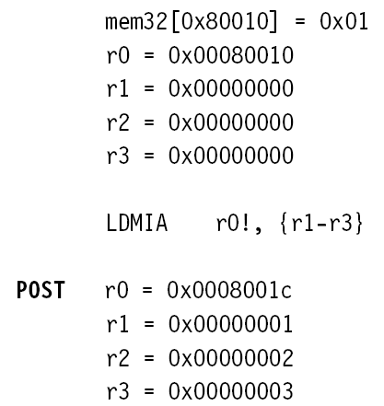
Example

Slide 84
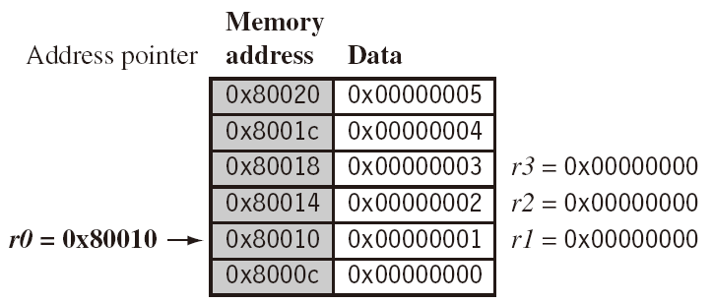
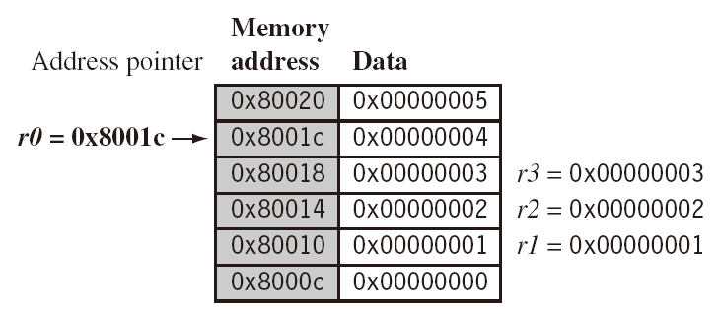
Example
LDMIA r0!, {r1-r3}

Slide 85
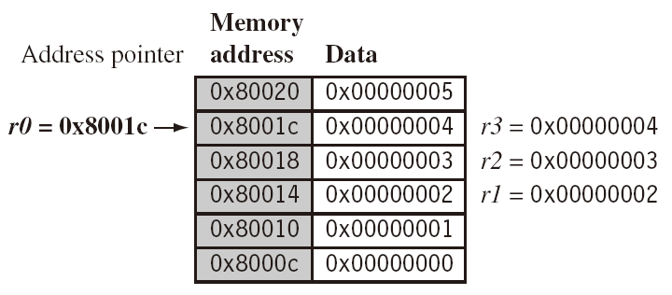
Example
LDMIB r0!, {r1-r3}

Slide 86
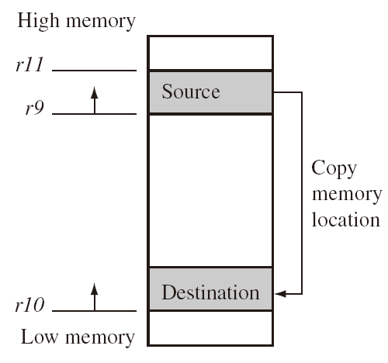
Application
Copy a block of memory
  R9: address of the source
  R10: address of the destination
  R11: end address of the source
loop: LDMIA R9!, {R0-R7}
STMIA R10!, {R0-R7}
CMP R9, R11
BNE loop

Slide 87
Application
Stack (full: pointing to the last used; ascending: grow towards increasing memory addresses)
LDMFD R13!, {R2-R9} @ used for ATPCS
… @ modify R2-R9
STMFD R13!, {R2-R9}
mode | POP | =LDM | PUSH | =STM
Full ascending (FA) | LDMFA | LDMDA | STMFA | STMIB
Full descending (FD) | LDMFD | LDMIA | STMFD | STMDB
Empty ascending (EA) | LDMEA | LDMDB | STMEA | STMIA
Empty descending (ED) | LDMED | LDMIB | STMED | STMDA

Slide 88
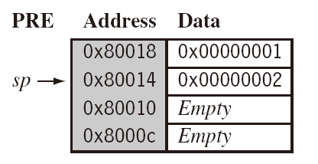


Example

Slide 89


Swap instruction
Swap between memory and register. Atomic operation preventing any other instruction from reading/writing to that location until it completes

Slide 90


Example

Slide 91

Application

Slide 92

Software interrupt
A software interrupt instruction causes a software interrupt exception, which provides a mechanism for applications to call OS routines.

Slide 93

Example

Slide 94

Load constants
No ARM instruction loads a 32-bit constant into a register because ARM instructions are 32-bit long. There is a pseudo code for this.

Slide 95


Load constants
Assemblers implement this usually with two options depending on the number you try to load.

Slide 96

Instruction set

