Slide 1
SOFTWARE ENGINEERING PROJECT – CS258
Group 8

Slide 2
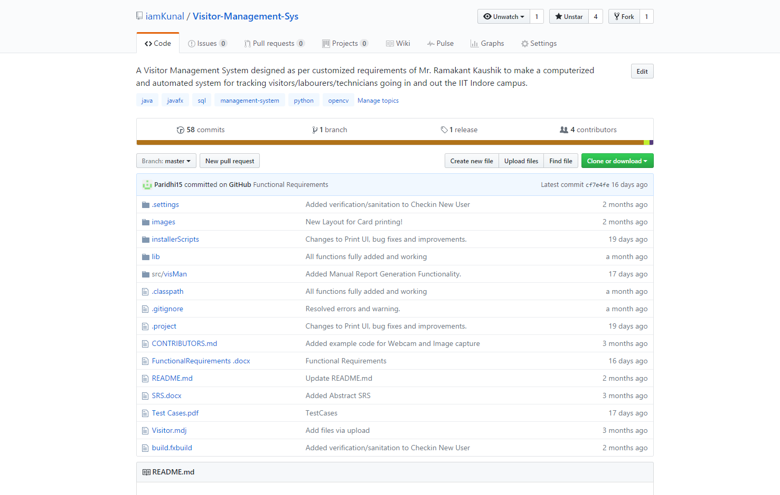
DESKTOP PROJECT
Visitor Management System.

Slide 3
About our Project
Visitor Management System is a software to deal with visitors in an institute like ours on a daily basis.
It has been designed for ease of use by security personnel.
Simple click-and-use GUI which can also be easily navigated by Tab.
Consists of automated installation and report generation to prevent hassles.

Slide 4
Processes involved
Requirements Elicitation
Design and Implementation
Testing and Maintanence

Slide 5
1.
REQUIREMENTS
The foundation on which the project is built

Slide 6
Client Requirements
System of checking and registering visitors.
Interactive Desktop GUI.
Photo based issuing of cards.
Cloud based system.
Provision of report and log viewing.
Efficient searching using different attributes.
Efficient managing of backend database tables, including maintenance.
Report generation system.

Slide 7
Technical Requirements
Software
Windows 7 OS or greater updated to KB2999226 update.
No Java or any host language required.
Hardware
Hardware pertaining to the software for smooth functioning with atleast 2GB of RAM.
1.5 GB of free HDD space.
Printer and Webcam (external preferred)
Others
Good LAN connectivity with low ping times.
Security personnel with enough computer literacy.

Slide 8
2. DESIGN & IMPLEMENTATION
Where caffeine turns into code.

Slide 9
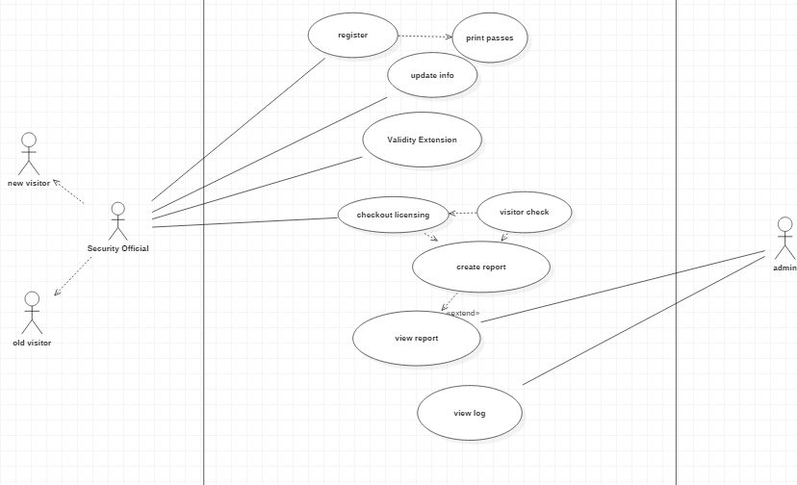
Use-Case Diagram

Slide 10

Implementation

Slide 11
Technology Used
JavaFX (included with Java 8) – UI and most code
OpenCV – Handling Webcam and Images
Python 3 with PIL and numpy - cropping and compressing images
XAMPP – MariaDB with Apache for Database Management
WinRAR – For creating SFX used in installer
Windows Batch Scripts – For installer and carrying out updates.
Software like Git and Eclipse for collaboration

Slide 12
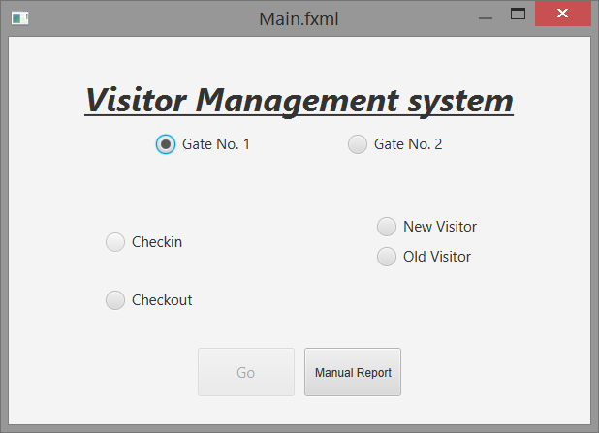
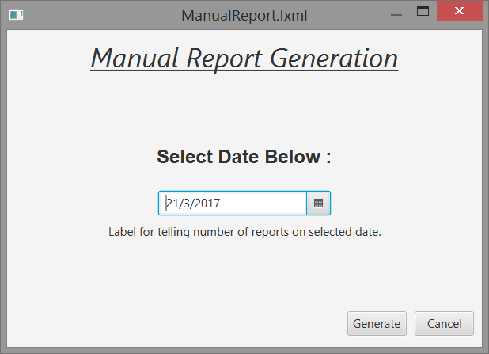
UI Design
Main Screen
Report Generation

Slide 13
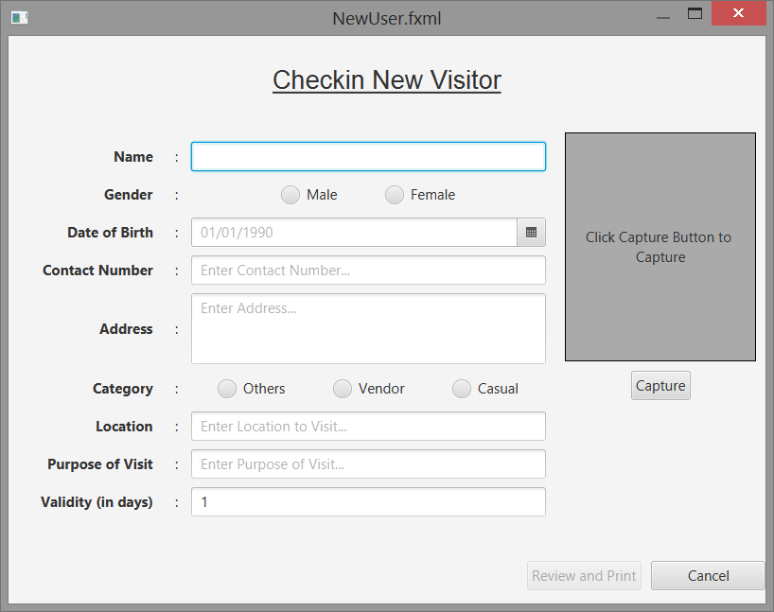
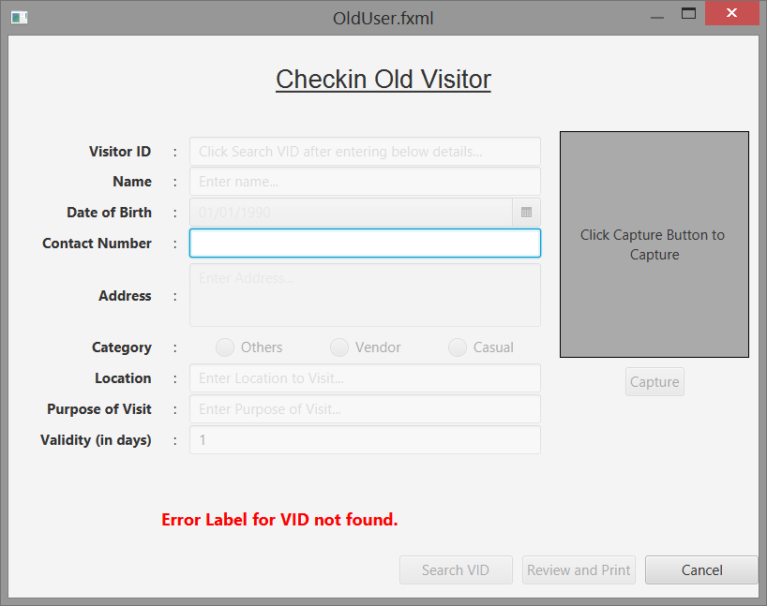
UI Design
New Visitor Entry
Old Visitor Entry

Slide 14
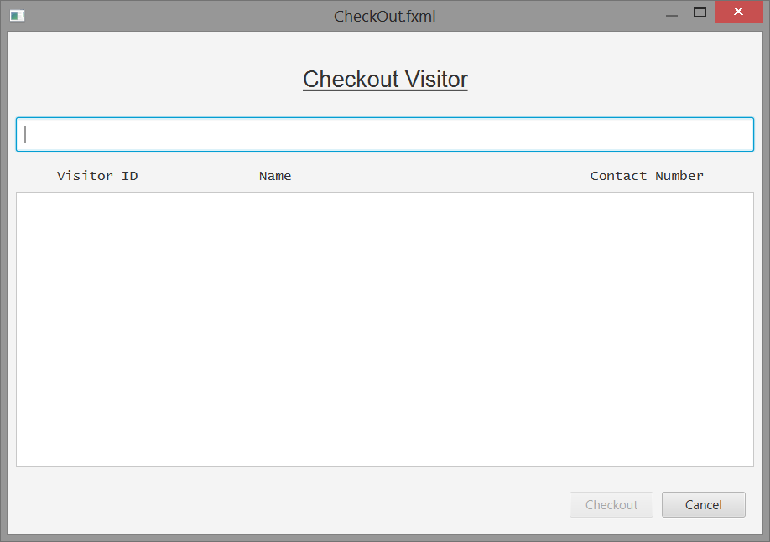
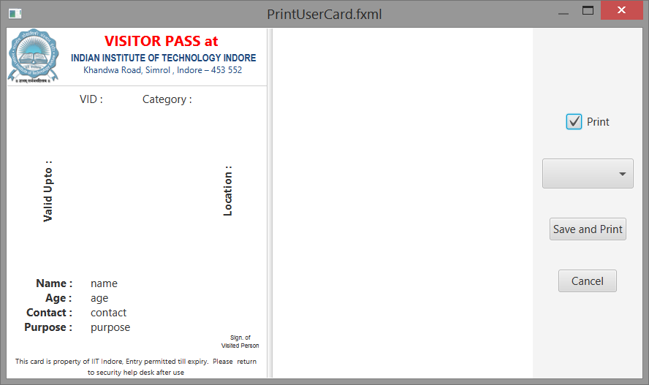
UI Design
Checkout Screen
Card Printing Screen

Slide 15
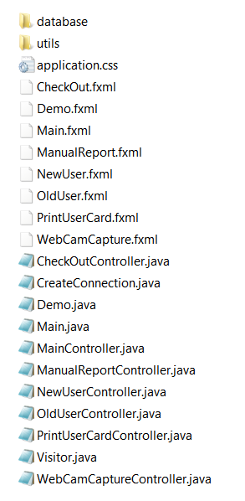
Project File Structure
- Database connections and Functions
- Utilities (like printing) and common functions
JavaFX FXML – UI Design
Java Files with the core code.

Slide 16
Commit History (as found on GitHub)

Slide 17
3.
TESTING
The developer’s nightmare

Slide 18
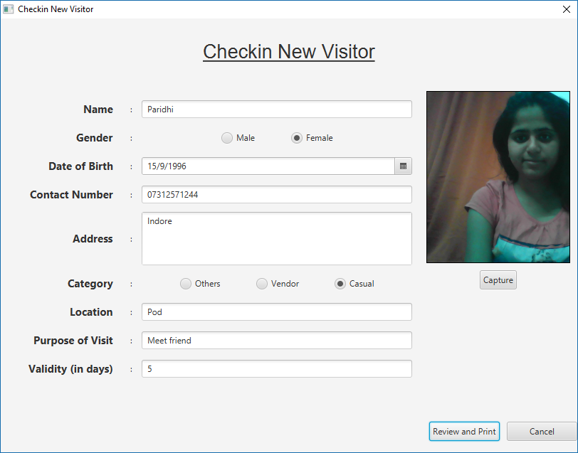
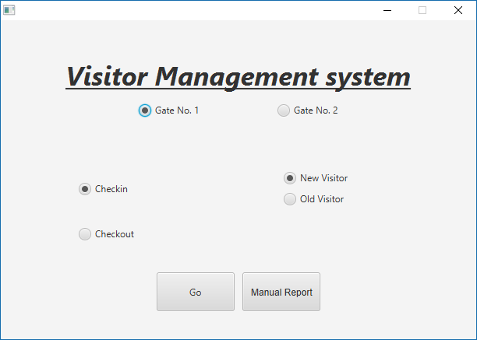
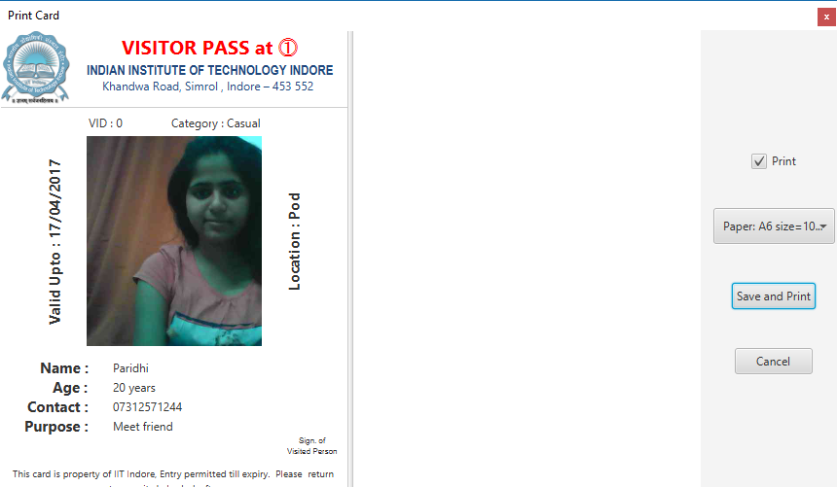
Test Cases

Slide 19
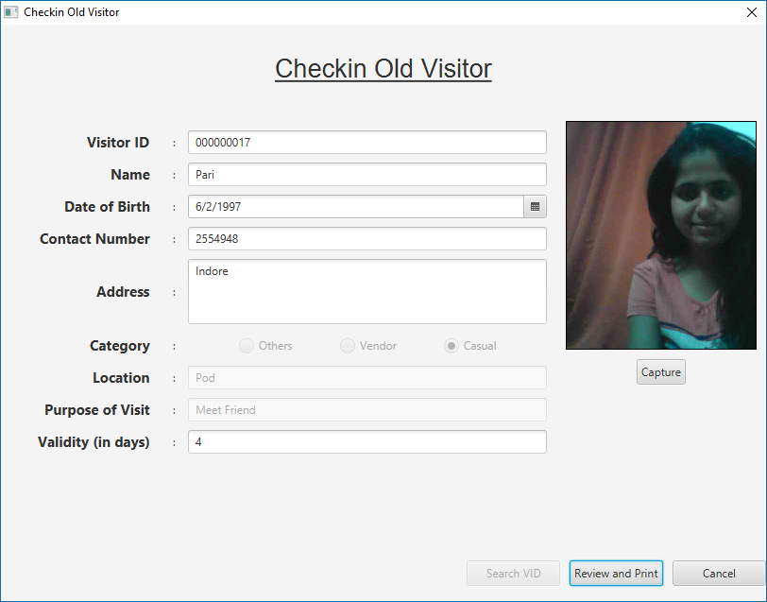
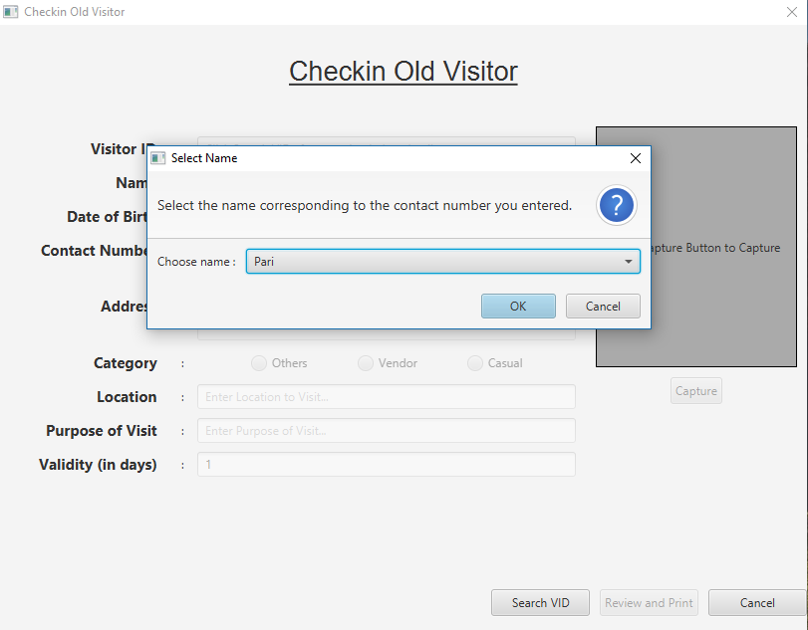
Test Cases

Slide 20
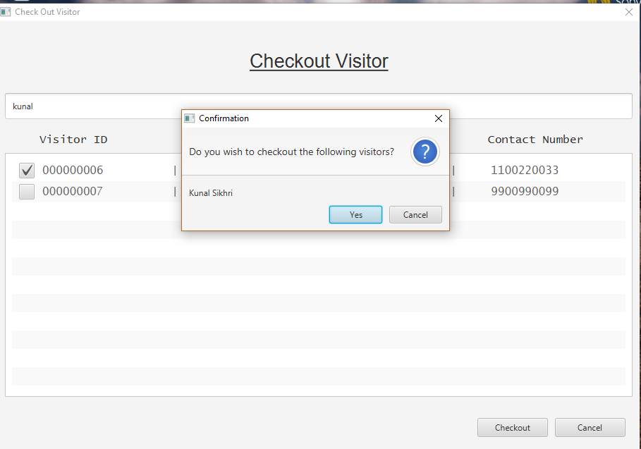
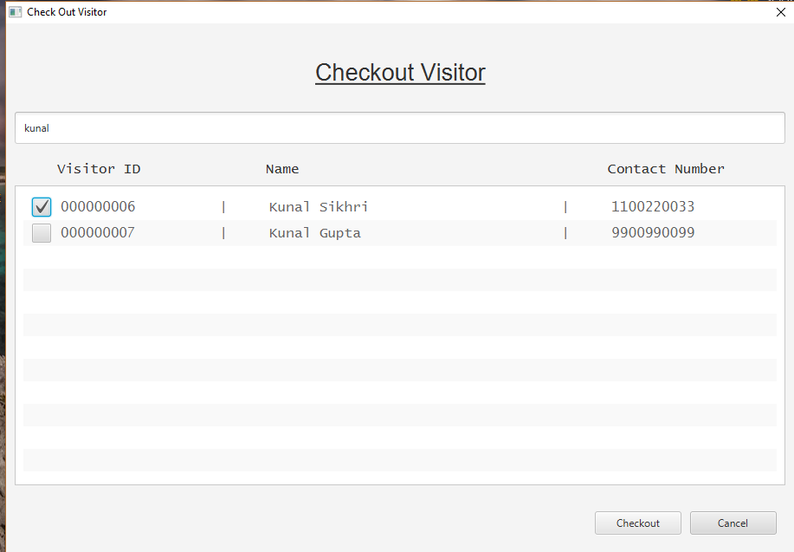
Test Cases

Slide 21
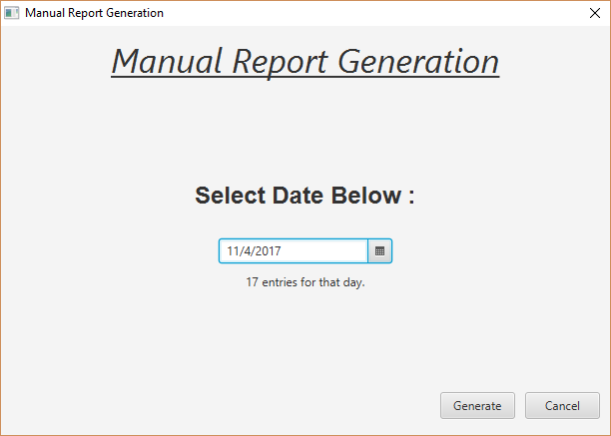
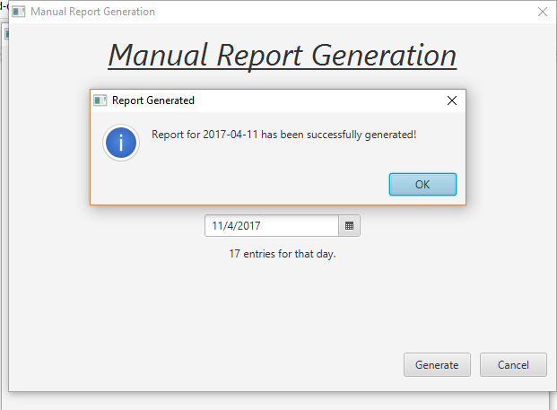
Test Cases

Slide 22
Testing
Our project is currently in α – Testing, set up in the 2nd week of April at the IIT Indore entry gate.
Maintenance is done and feedback taken regularly.

Slide 23
Challenges Faced

Slide 24
FUTURE WORK PLANNED
New printer, webcam and laptop to be bought.
Server space planned.
Interconnectivity between both gates.
Barcode based reading.
Smart Card based passes.
Biometric-enrolment (if possible)

Slide 25
LEARNING
Great experience for:
Making desktop apps with a clickable UI.
Making real-word based projects.
Implementation and Deployment of Software.
Learning new programming languages and standards.

Slide 26
THANKS!

