Slide 1
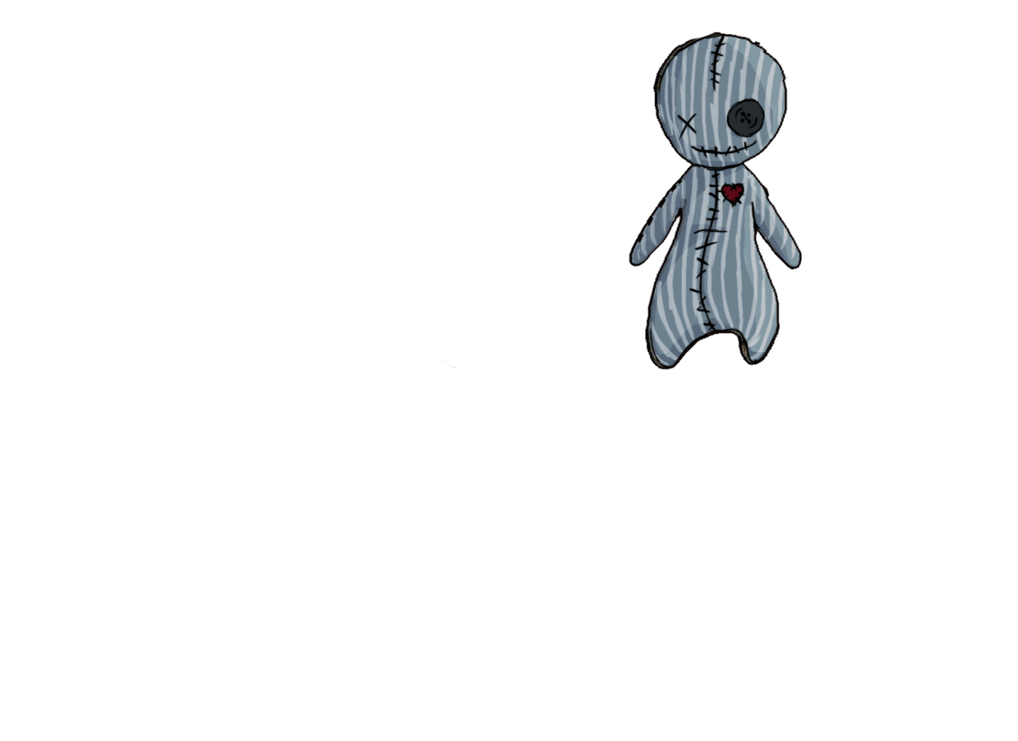
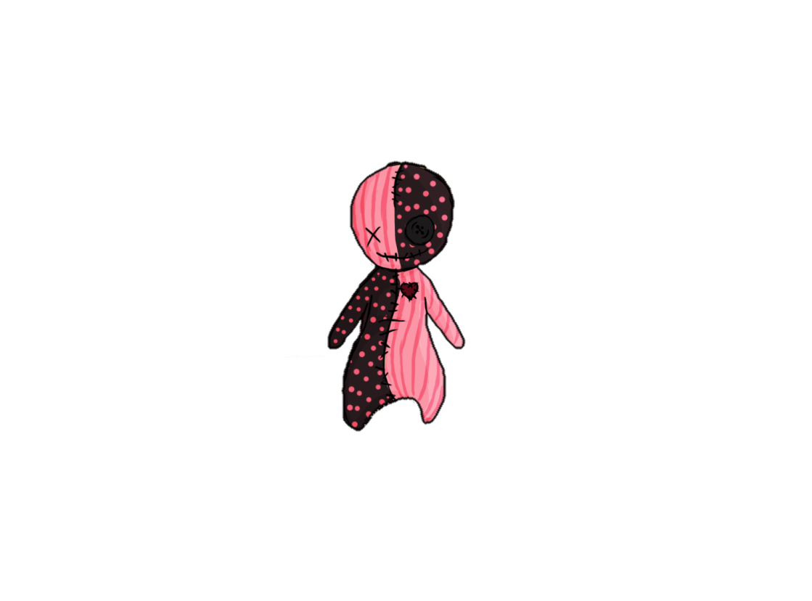


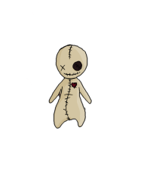
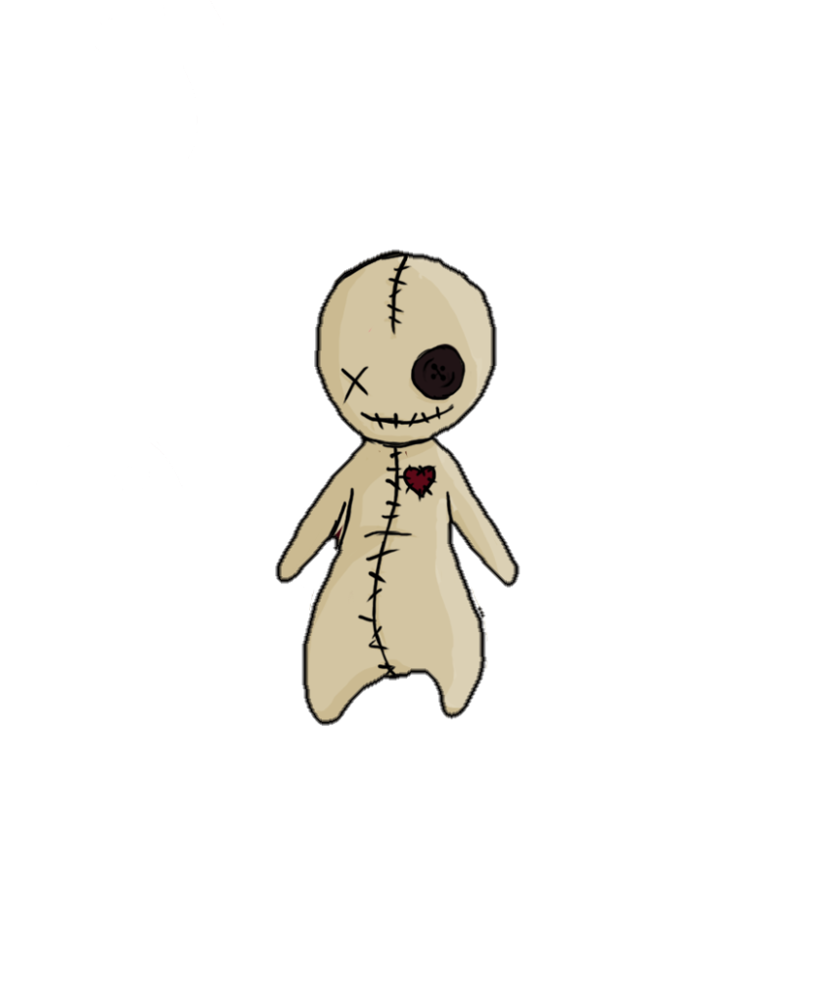




Voodoo
(Working title)
Notes:
Hallo, mein Name ist Sonja Köck und ich bin der Producer von Team 13. Hallo mein Name ist Tobias Schuster und ich bin der Game Designer.
Wir werden euch heute das Konzep unseres neuen Spiels Voodoo vorstellen.

Slide 2

Review
Game Type: 3D Platformer
Game Mode: Singleplayer
Genre: Supernatural Adventure
Platform: PC
Engine: Unity

Slide 3
Gameplay
Mechanics:
Clairvoyance – Watch the room from a static perspective
Posession – Posess a guard
Camera:
Third person slightly from below
Core Game Loop
Enter Room
Clairvoyance
Offering
Posession

Slide 4

Team 13
Producer: Sonja Köck
Programmer: Artjom Schmitke
Game Designer: Tobias Schuster
Art: Marlou Nolting
Jesse Haines
Michelle Mohn
Levin Lang
Michelle Gaußmann

Slide 5
Gate 1
Promise:
Present:
Core Experience – 1 playable stage
Basic, non-animated low-poly main character
First core mechanic: Clairvoyance
Core Experience – 1 playable stage
Basic, non-animated low-poly main character with textures
First core mechanic: Clairvoyance

Slide 6

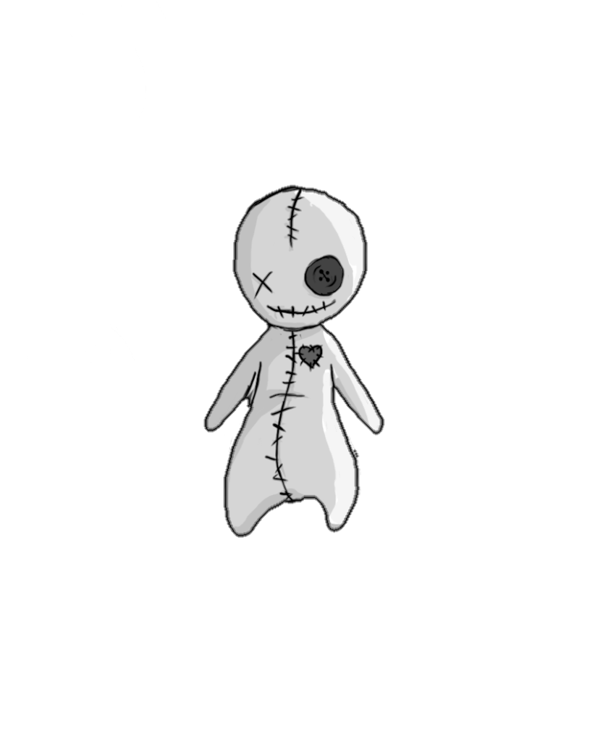
Let’s play!

Slide 7
Gate 2
Storeroom (Tutorial) oder Operationsraum?
Textured Environment, Basic Animated Main-Character
Second core mechanic: Posession

Slide 8

Any Questions?
Team 13
Games Academy Frankfurt
Hanauer Landstraße 146
60314 Frankfurt am Main
Sonja.Koeck@games-academy.de

