Slide 1
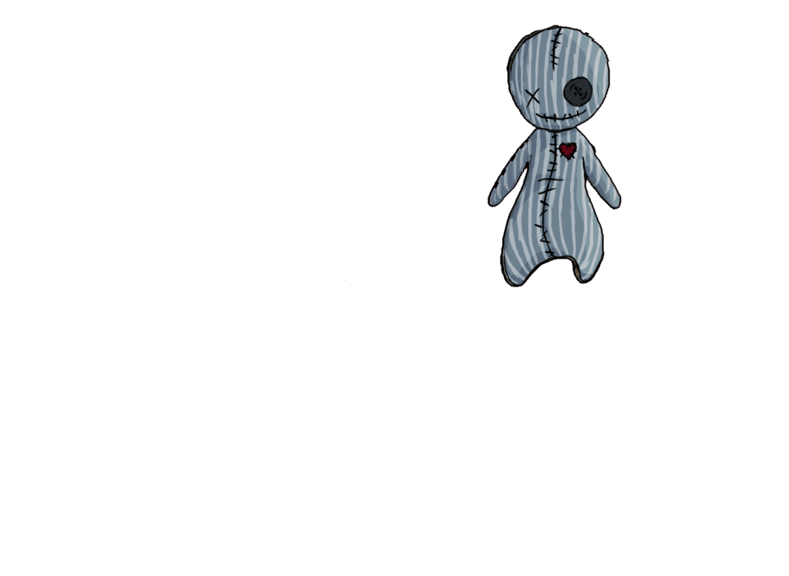
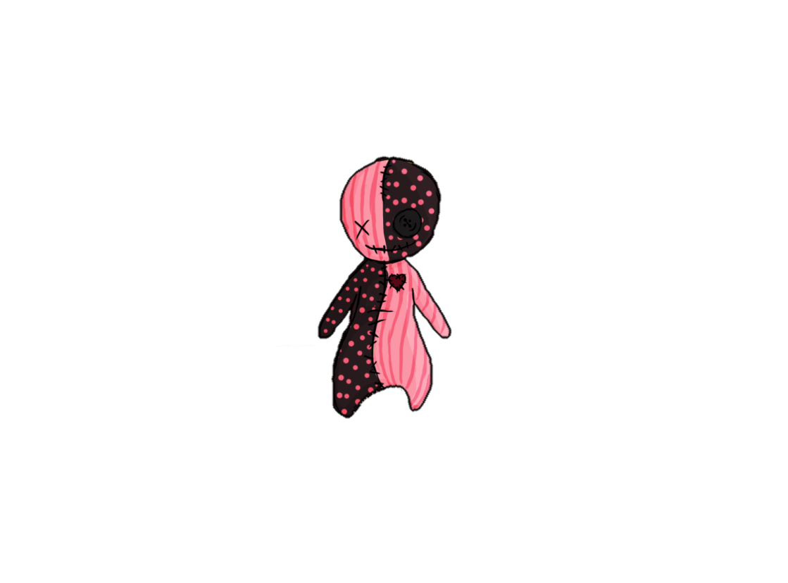


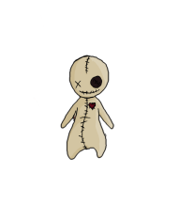
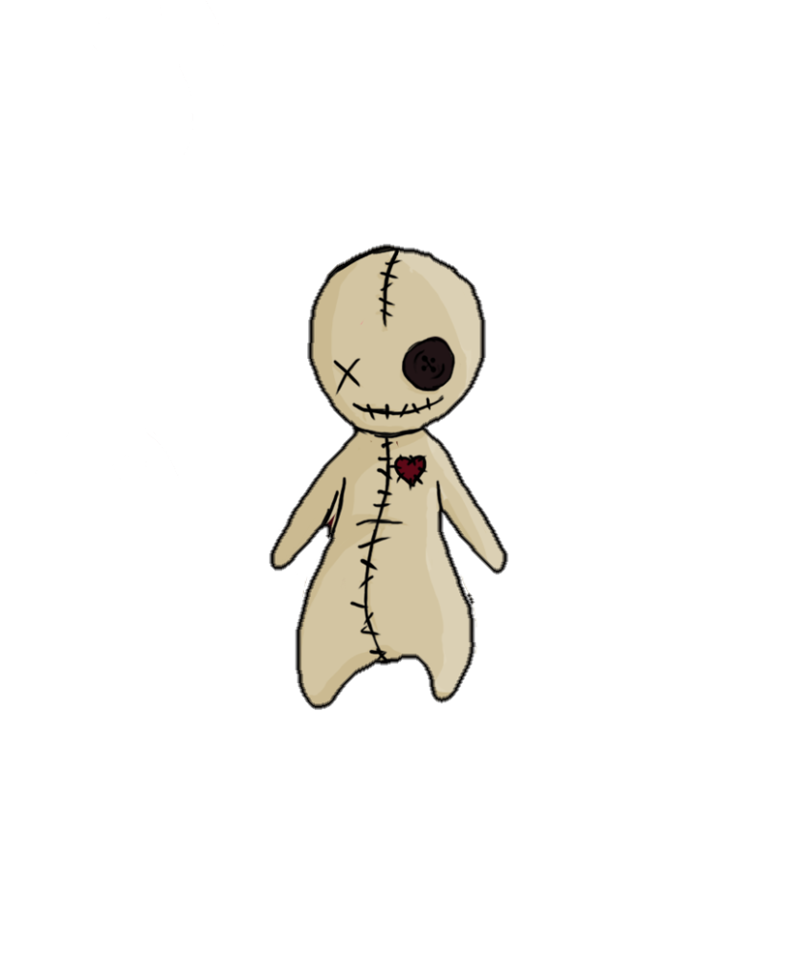




Voodoo
(Working title)
Notes:
Hallo, mein Name ist Sonja Köck und ich bin der Producer von Team 13. Hallo mein Name ist Tobias Schuster und ich bin der Game Designer.
Wir werden euch heute das Konzep unseres neuen Spiels Voodoo vorstellen.

Slide 2


Story
The small Voodoo puppet Nox came alife in a dark undergrund bunker and the first thing that catches her eye is a picture of a beautiful flower.
So he decides to find that flower and thus starts his journey through the bunker.
He discovers new powers along the way and uses them to find his way out.

Slide 3
Vision Statement
Voodoo is a 3D platformer for lovers of the occult with minimized stealth-elements.
The player discovers his surroundings from the perspective of a small puppet, finds different items to strenghten his voodoo-powers and posesses guards to ultimately flee from the underground bunker.
The low camera perspective and dark atmosphere in the beginning make the player feel vulnerable but the interesting mechanics and fun elements within the game lighten up the mood.

Slide 4
Game Facts
Game Type: 3D Platformer
Game Mode: Singleplayer
Genre: Supernatural Adventure
Platform: PC
Engine: Unity

Slide 5
Gameplay
Mechanics:
Clairvoyance – Watch the room from a static perspective
Posession – Posess a guard
Camera:
Third person slightly from below
Core Game Loop
Enter Room
Clairvoyance
Offering
Posession

Slide 6
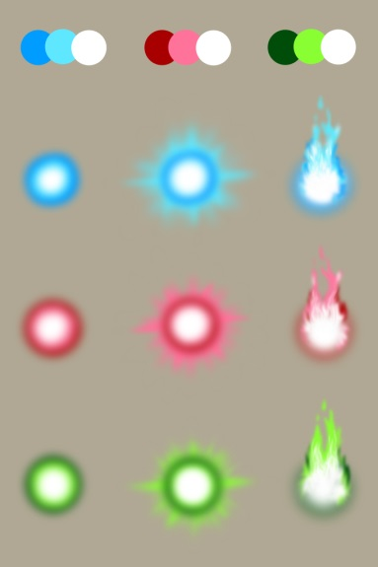
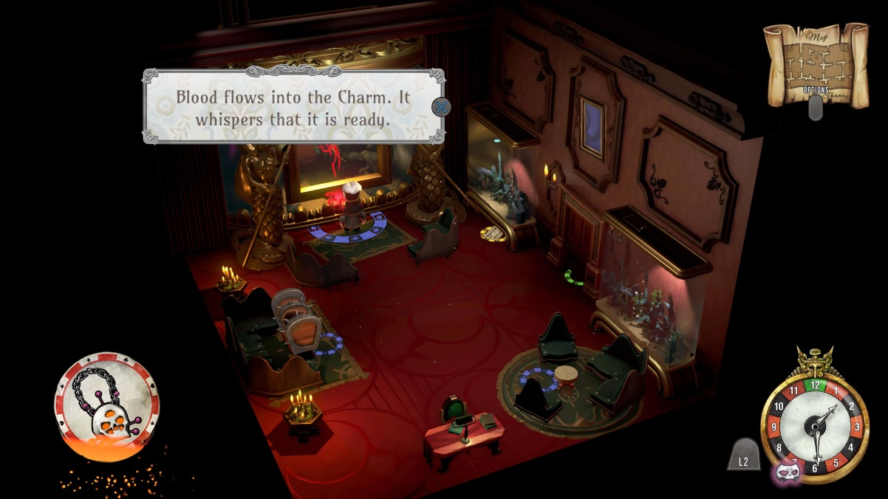
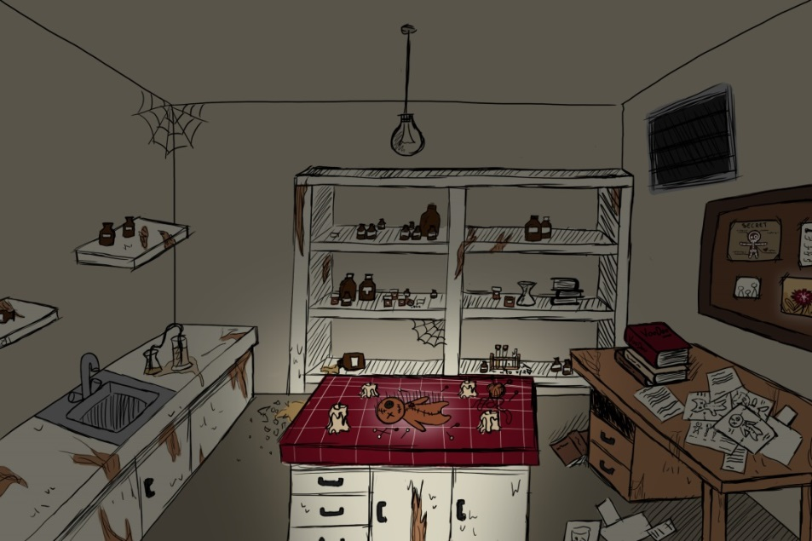
Mood & Concepts

Slide 7
Scope/Skeleton Version
Running and Jumping Main Character
Voodoo-Power Mechanics:
Clairvoyance
Possession (Quick-time event + using guard)
Hiding from Guard

Slide 8

Team 13
Producer: Sonja Köck
Programmer: Artjom Schmitke
Game Designer: Tobias Schuster
Art: Marlou Nolting
Jesse Haines
Michelle Mohn
Levin Lang
Michelle Gaußmann

Slide 9
Goals Gate 1
Core Experience – 1 playable stage
Basic, non-animated low-poly main character
First core mechanic: Clairvoyance

Slide 10

Any Questions?
Team 13
Games Academy Frankfurt
Hanauer Landstraße 146
60314 Frankfurt am Main
Sonja.Koeck@games-academy.de

