Slide 1
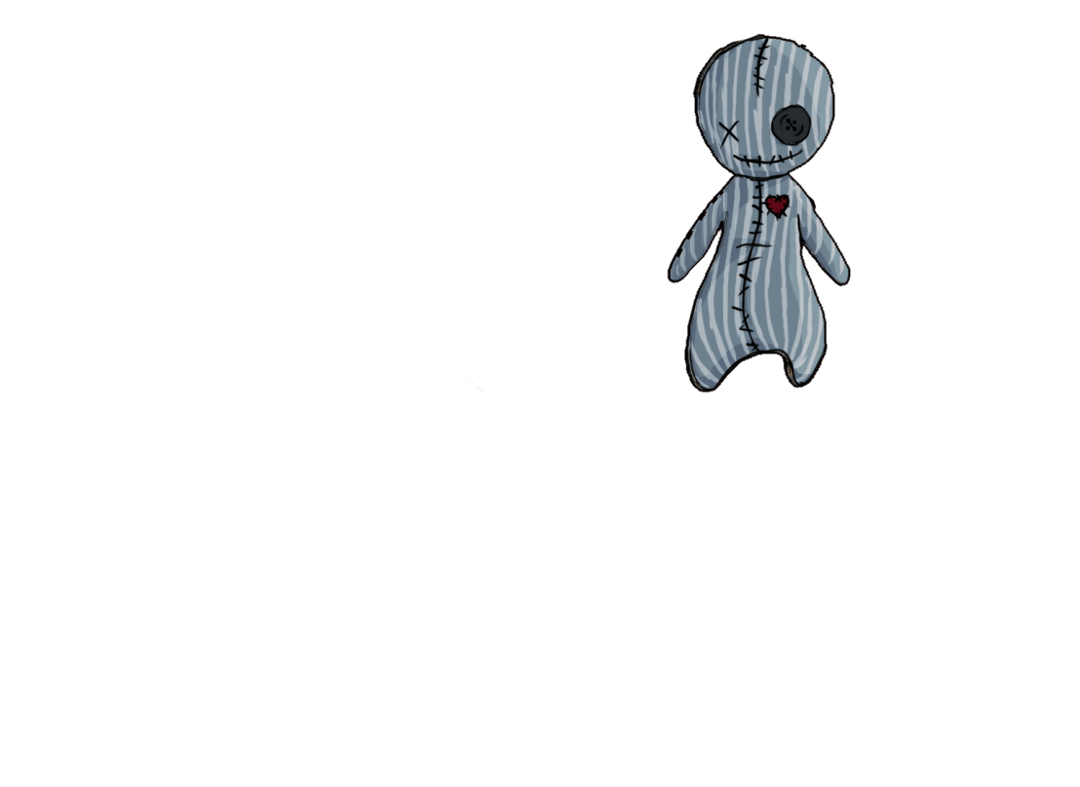









Voodoo
(Working title)

Slide 2
Vision Statement
Voodoo is a 3D platformer for lovers of the occult with minimized stealth-elements.
The player discovers his surroundings from the perspective of a small puppet, finds different items to strenghten his voodoo-powers and posesses guards to ultimately flee from the underground bunker.
The low camera perspective and dark atmosphere in the beginning make the player feel vulnerable but the interessting mechanics and fun elements within the game lighten up the mood.

Slide 3

Game Facts
Game Type: 3D Platformer
Game Mode: Singleplayer
Genre: Supernatural Adventure
Platform: PC
Engine: Unity

Slide 4
Gameplay
Core Game Loop
Mechanics:
Clairvoyance – Watch the room from a static, higher perspective
Posession – Posess a guard after finding a personal item from him
Camera:
Third person slightly from below
Enter Room
Offering
Posession
Open Door

Slide 5
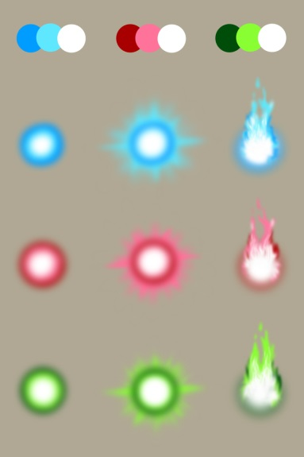
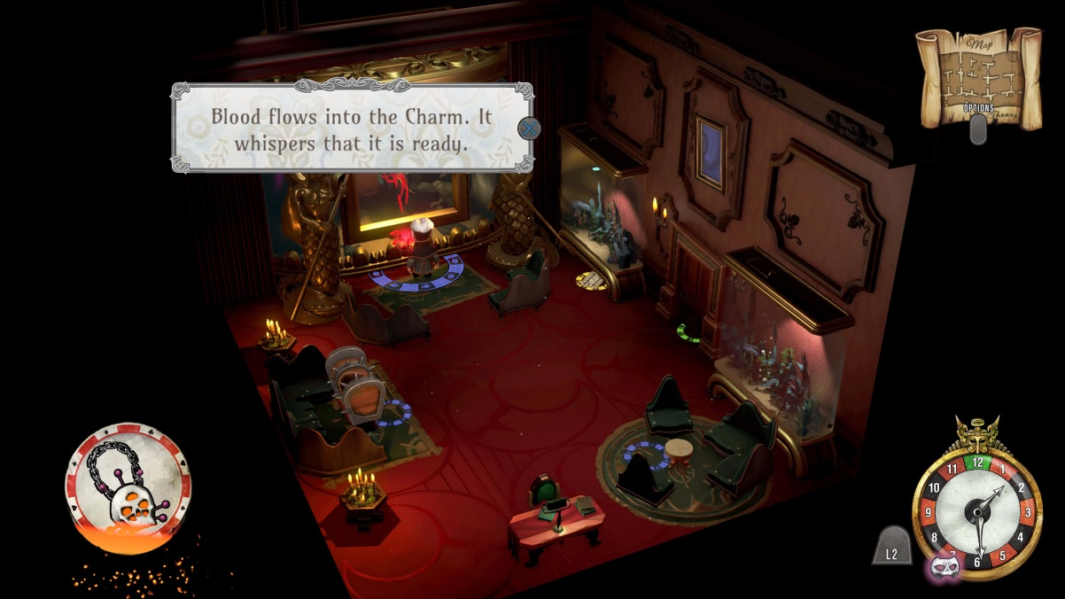
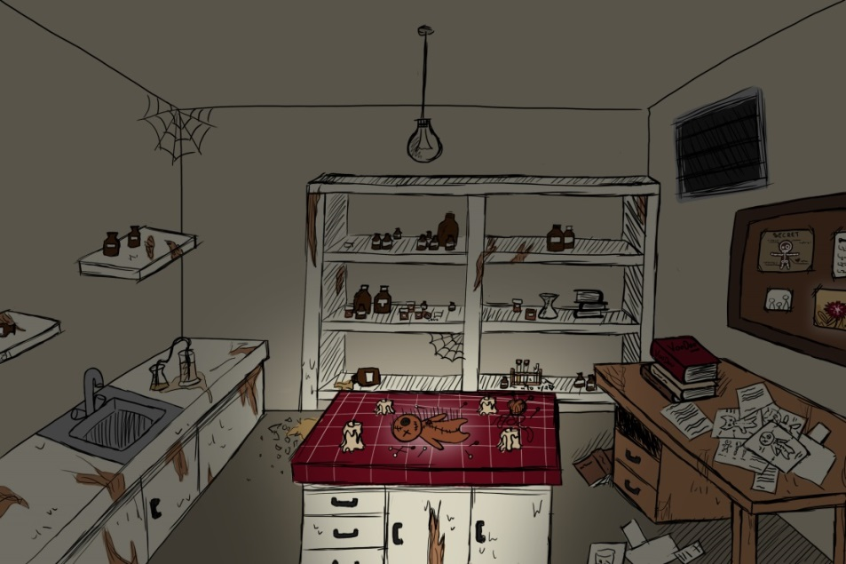
Mood & Concepts

Slide 6
Scope/Skeleton Version
Running and Jumping Main Character
Voodoo-Power Mechanics:
Clairvoyance
Possession “Mini-Game” (Open doors with possessed guard)
Hiding from Guard

Slide 7

Team 13
Producer: Sonja Köck
Programmer: Artjom Schmitke
Design: Tobias Schuster
Art: Marlou Nolting
Jesse Haines
Michelle Mohn
Levin Lang
Michelle Gaußmann

Slide 8
Goals Gate 1
Core Experience – 1 playable stage
Basic, non-animated low-poly main character
First core mechanic: Clairvoyance

Slide 9

Any Questions?
Team 13
Games Academy Frankfurt
Hanauer Landstraße 146
60314 Frankfurt am Main
Sonja.Koeck@games-academy.de

