Slide 1


OFFICE RAGE
Alexandre SACHS
Raphaël Guy
Kellian CIPIERRE
Charles Descoust

Slide 2

3D Game Action Adventure Beat Them All

Slide 3



Slide 4



Slide 5
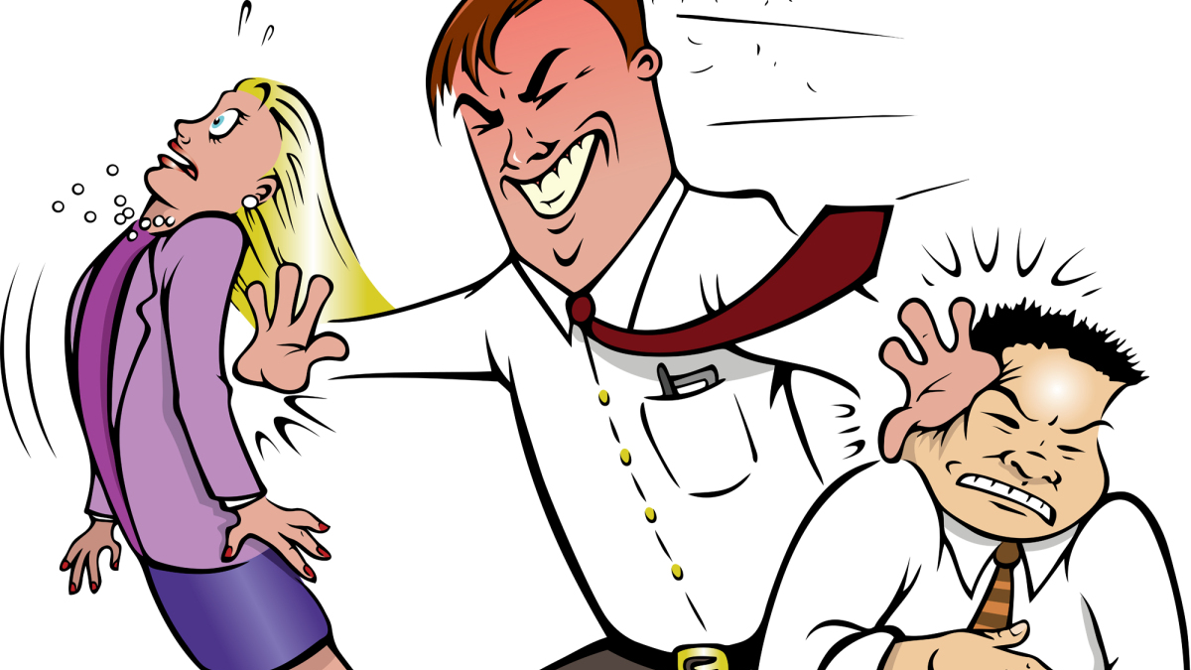

Slide 6



Slide 7
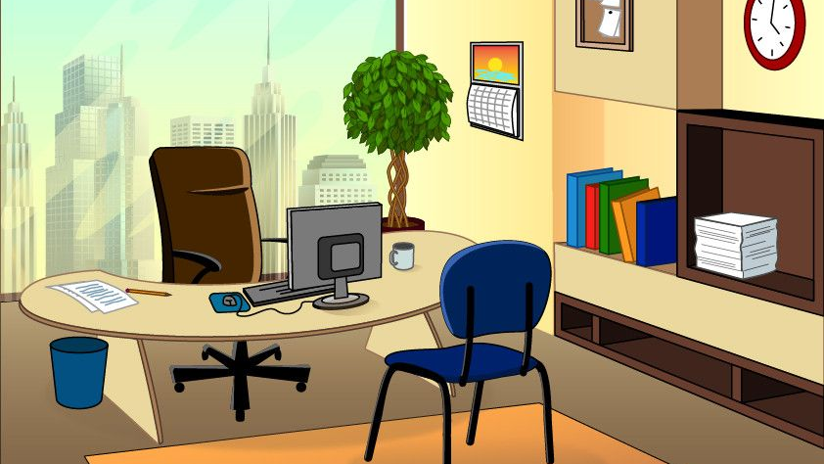


Slide 8



Slide 9
Rewards

Slide 10


Objectif

Slide 11
Charles Descoust
Level Design

Slide 12
Kellian Cipierre
Enemies

Slide 13
Raphaël Guy
Player

Slide 14
Alexandre Sachs
Menus

Slide 15
Demonstration

Slide 17
OFFICE RAGE
Alexandre SACHS
Raphaël Guy
Kellian CIPIERRE
Charles Descoust

