Slide 1


OFFICE RAGE
Alexandre SACHS
Raphaël Guy
Kellian CIPIERRE
Charles Descoust

Slide 2

3D Game Action Adventure Beat Them All

Slide 3



Slide 4



Slide 5
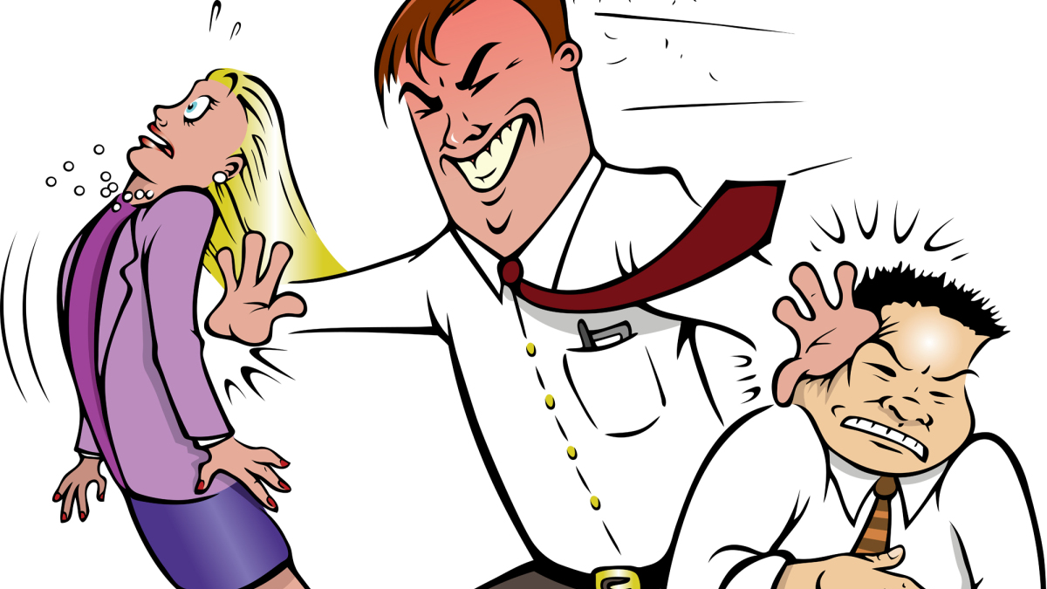

Slide 6



Slide 7
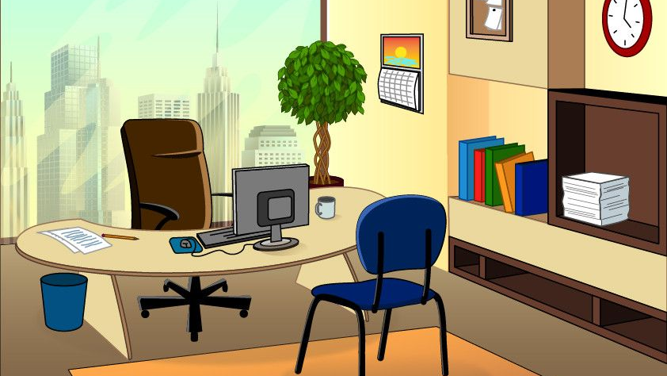


Slide 8



Slide 9
Rewards

Slide 10


Objectif

Slide 11
OFFICE RAGE
Alexandre SACHS
Raphaël Guy
Kellian CIPIERRE
Charles Descoust

