Slide 1


OFFICE RAGE
Alexandre SACHS
Raphaël Guy
Kellian CIPIERRE
Charles Descoust

Slide 2

3D Game Beat Them All

Slide 3



Slide 4

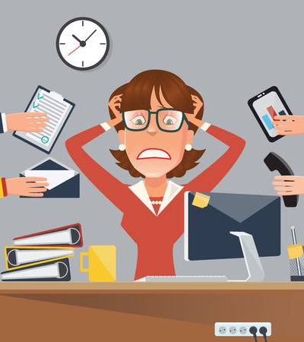

Slide 5
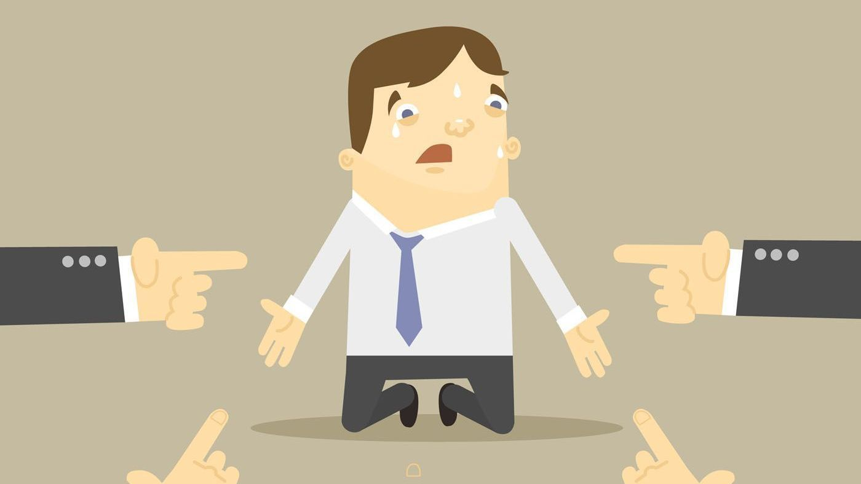

Slide 6
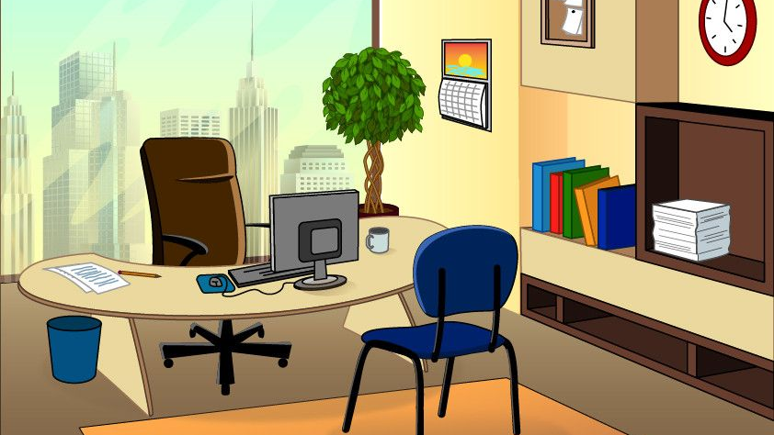


Slide 7



Slide 8
Rewards

Slide 9

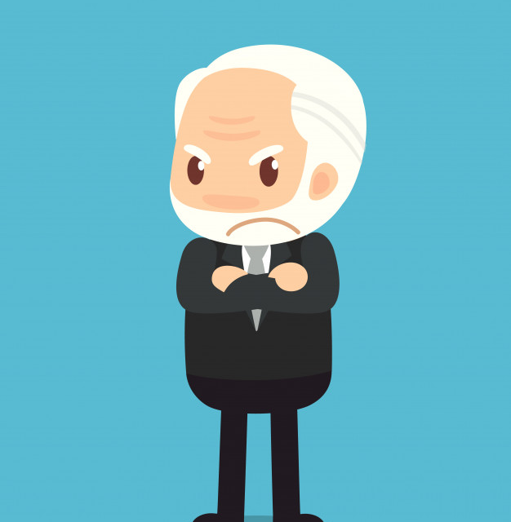
Objectif

Slide 10
OFFICE RAGE
Alexandre SACHS
Raphaël Guy
Kellian CIPIERRE
Charles Descoust

