Slide 1

Alexandre Sachs
Charles Descoust Kellian Cipierre
Raphaël Guy

Slide 2
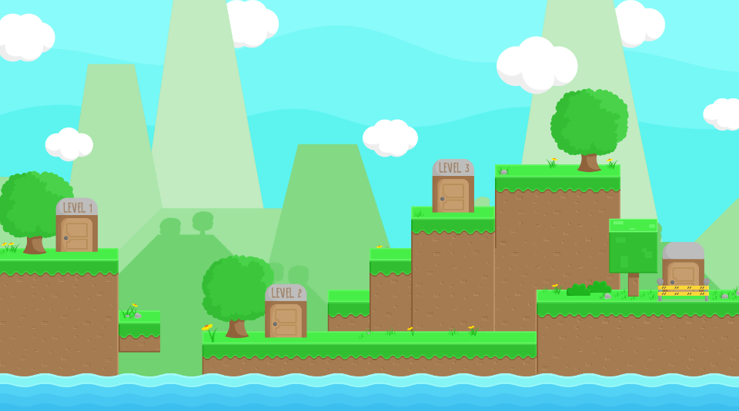

2D
Platformer
Die and Retry

Slide 3

Rewards

Slide 4

Lifes

Slide 5


Objectives

Slide 6



Enemies

Slide 7
Charles Descoust
Inventory
Introduction
Level Selection

Slide 8
Alexandre Sachs
Game UI
Player
Level1

Slide 9
Kellian Cipierre
Sound
Enemies
Level2

Slide 10
Raphaël Guy
Game Over
Level3
Level4

Slide 11

Achievments
Introduction
Level Selection
Inventory
Player
Levels
Game UI
Enemies
Sound
Game Over

Slide 12
Alexandre Sachs
Charles Descoust Kellian Cipierre
Raphaël Guy

