Slide 1
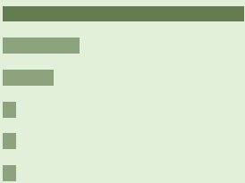

Capstone Project
 |  |  |  | Group B
 | MyIT Consult Internship Program 2025

Slide 2
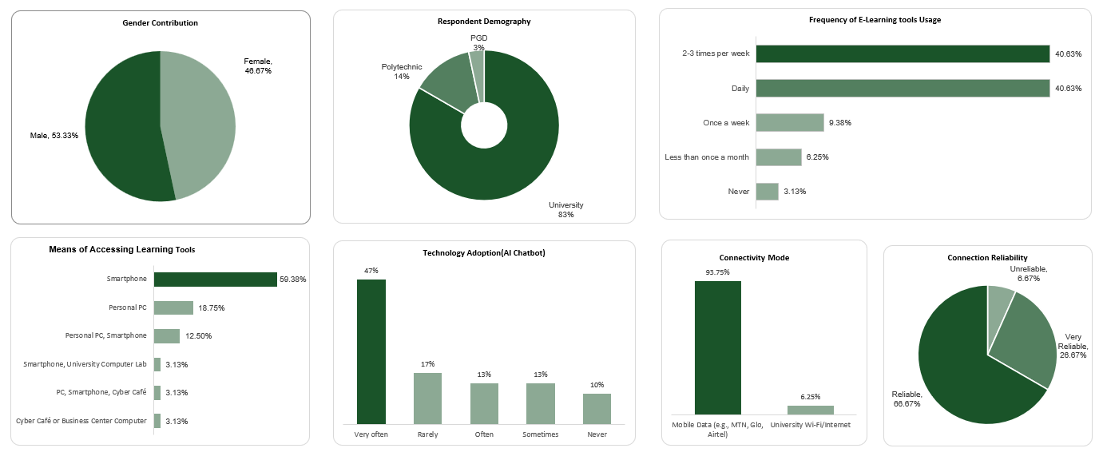
Bridging the Digital Divide: Access to Learning Tools
Research Focus: Access to Digital Learning Tools Among Nigerian Students
(Higher Institution)
Group: 3
Date: October 2025

Slide 3

THE PROBLEM: ACCESS vs. AFFORDABILITY
The Gap in Digital Learning
The NUC mandates e-learning, but students face a critical gap between policy and reality.
1. The Assumption (What we thought):
The main barrier is lack of digital literacy or device ownership.
2. The Reality (Research shows that):
Students own devices (Smartphones 60%) and knows how to use them (New Tech. e.g. AI chatbots 47% Usage).
The true barriers are COST and INFRASTRUCTURE RELIABILITY.
Research Question:
What are the primary financial and infrastructural barriers preventing consistent, quality engagement with formal digital learning platforms?

Slide 4
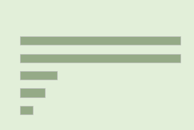
OUR RESEARCH APPROACH
Quick Mini-Study (N = 30)
We used a mixed-method approach to gather targeted data on student habits and challenges.
Secondary Data Context:
NCC Reports: Show high national mobile data consumption, confirming market reliance.
Academic Studies: Highlight high data cost and unreliable power as systemic barriers to e-learning adoption in Nigeria
Component | Detail
Research Type | Mixed Method (Quantitative Survey + Desk Review)
Target Group | Higher Education Students (ND, HND, UG, PGD)
Data Tool | Online Survey (Google Forms)
Sample Size (N) | 30 Respondents (Convenience sampling)

Slide 5
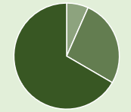
KEY FINDING 1: INFRASTRUCTURE & RELIANCE
Students Pay for Institution's Gaps
The data confirms a total reliance on personal, expensive resources for academic work.
Conclusion:
The cost of learning is being downloaded from institutions to students.
Access Point | Percentage of N = 30 | Implication
Mobile Data (MTN, Glo, etc.) | 93.33% | Extreme vulnerability to mobile tariff hikes.
University Wi-Fi/Internet | 6.67% | Institutional support for daily connectivity is negligible.
Connection reliability | 26.67% rate their connection as "Unreliable" or worse. | 1 in 4 students cannot consistently attend live sessions or download large files.

Slide 6

KEY FINDING 2: DIGITAL COMPETENCY
High Skills, High Barriers
Students are ready for the digital age, but the cost limits engagement.
Summary:
The student is capable, but the infrastructure makes online learning unaffordable and unreliable.
Digital Skill Indicator | Sample N = 30 | Implication
AI chatbot usage | 46.67% use them "Very Often" | Students are proactive and highly adaptable to new technologies.
Digital Skills Challenge | 73.33% say skills challenge is "Minor" or "Not a Challenge." | Focus should be on access (bandwidth/cost), not basic literacy training.
Primary Missing Tool (Qualitative) | Affordable Data / Stable Power | The real "missing tool" is sustainable access.

Slide 7
Limitations and Ethics
Acknowledge the Boundaries of Our Study
1. Core Limitation:
Small Sample Size: Our N = 30 sample is non-random (convenience sampling).
Impact: The findings are suggestive of trends and cannot be reliably generalized to all Nigerian higher education students. This must be noted in all official reports.
2. Ethical Compliance:
All participation was voluntary.
All data collected was anonymous to protect student privacy.

Slide 8
OUR SOLUTION: DEVELOPMENT INTERVENTION
The Higher Education Data Subsidy (HEDS) Pilot Program
Goal: To mitigate the cost barrier and drive students toward using official institutional platforms (LMS).
Project Objective 1: Access (The Subsidized Data)
What: Provide subsidized data (e.g., 5GB/month) to 500 students in a pilot university.
Project Objective 2: Usage (The Behavior Change)
What: Increase the average student log-in rate to the institution's official LMS by 30% within 6 months.
Project Objective 3: Impact (The Outcome)
What: Reduce the failure rate in blended-learning courses by 10% within 12 months.

Slide 9
MEASURING SUCCESS: M&E Plan
Holding the Project Accountable
We use a Logical Framework to ensure our outcomes are tracked using clear Key Performance Indicators (KPIs).
How Impact is Measured:
Success is proven if data subsidy directly correlates with increased use of formal LMS and leads to improved academic results.
Level | Key Performance Indicator (KPI) | Data Source | Frequency
Output (Access) | Number of students receiving the data subsidy (Target: 500). | Project Disbursement Register. | Monthly
Outcome (Usage) | Percentage increase in student log-ins to the official LMS (Target: ↑ 30%). | LMS Backend Analytics Report. | Quarterly
Impact (Attainment) | Change in failure rate for blended-learning courses (Target: ↓ 10%). | Institutional Academic Records. | Endline (12 months)

Slide 10

Thank You
Aisha Dauda
Inuwa Hauwa Walida
Chidubem Paschal Obiamalu
Maikano Yusuf Lawal
Joy Momoh
Esuwa Stephen
Umar Rabiu
Igoche Esther Agbenu
Nuhu Abubakar Sediq
Ujunwa Scholastica
Joshua dagba Benjamin

