Slide 1
Transcriptome quantification
Elisa Donnard, PhD
UMassMed Biocore Bootcamp 2020
Notes:
With RNA-Seq data, there may be multiple goals in mind, the most common and our focus here will be differential expression. However, it is good to keep in mind there are many other ways to explore these data and they will require different library preparation strategies, as well as different pipelines to process them.
Examples: finding variants (sequence or structural), assembly of new transcriptomes, RNA editing...

Slide 2
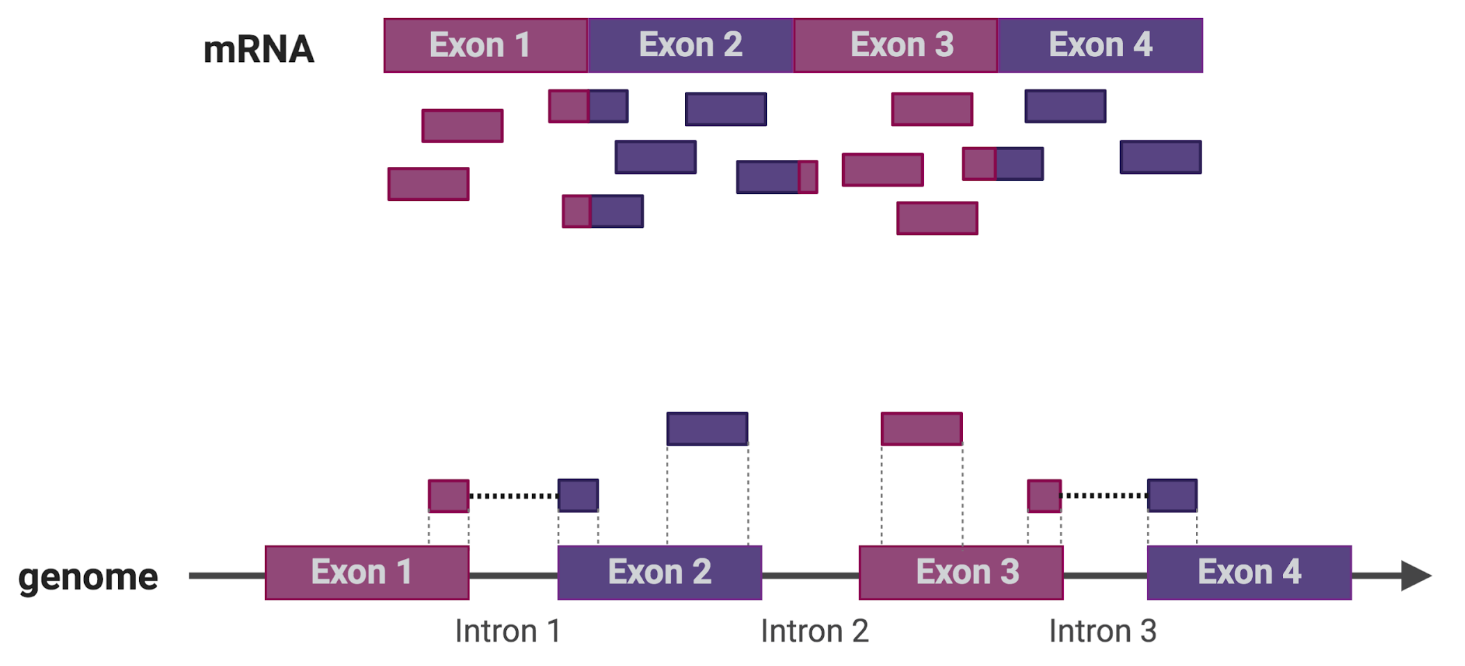
RNA-Seq mapping
Notes:
So, for differential gene expression we need to use the mapped reads and figure out what was the level of expression of each gene in the original cell or tissue

Slide 3
RNA-Seq quantification
E(# f_{g}) = #reads *θg * l_{g}
f_{g} = Fragment from gene (transcript) g
θ_{g} = Fraction of gene g in sample
l_{g} = (effective) length of gene g
Notes:
A few things to consider about the experiment…
You will recover more reads from longer transcripts (generated more fragments) and from transcripts that are more highly expressed (also generate more fragments)
In addition, the variable number of reads sequenced and fragments captured will also introduce variability between samples

Slide 4
Some assumptions
High library complexity
#molecules in library >> #sequenced molecules
Short reads
Read length << sequenced molecule length
Not all applications satisfy this:
miRNA sequencing
Small input sequencing (e.g. single cell sequencing)

Slide 5
Challenges
Libraries satisfying assumptions 1 & 2 only measure relative abundance
Key quantity: # fragments sequenced for each transcript.
Data: Aligned reads
Wanted: transcript generated the observed read?
Isn’t this easy?
Reads do not uniquely map
Genes have different isoforms with overlapping exons
Sequencing has a ~ 1% error rate
Transcripts are not uniformly sequenced
Notes:
Like we saw on the previous lecture on genomic alignment, there is uncertainty in the read mapping, genes have paralogs that share sequence similarity, it is hard to define a single true location for each short read to have originated from.

Slide 6

The RNA-Seq quantification problem
Let’s begin by simplifying the problem a bit:
Start with a set of previous gene/transcript annotations
Assume only one isoform per gene
Assume 1-1 read to transcript correspondence
(Sequencing depth or total number of aligned reads)

Slide 7
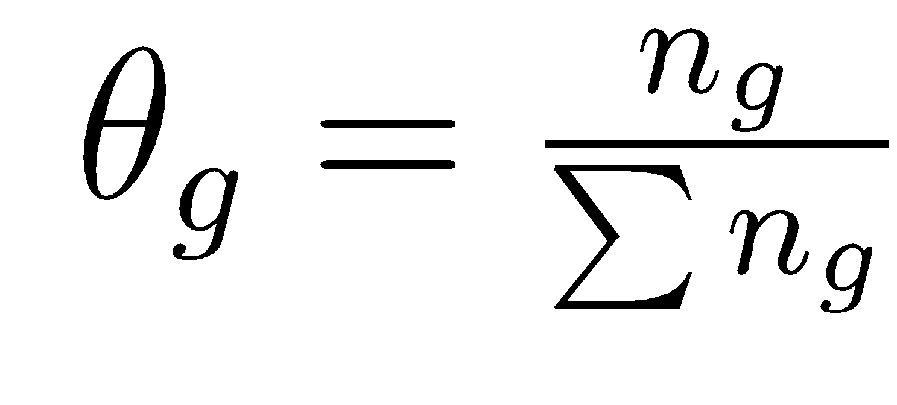
The RNA-Seq quantification problem
When a success has probability 𝛉, the probability of n successes in N tries can be calculated by:
Which, has maximum probability at
Notes:
In this simple example, a success (getting a read) has a probability of theta (relative abundance of the gene) and the probability of obtaining n reads from gene g in N trials (total reads) follows the binomial distribution.
So it can be written as the probability of obtaining n successes given the relative abundance (theta g), which is equal to
The binomial coefficient, in this case N choose n
Times the probability of n successes (theta to the power of n)
Times the probability of N-n failures ([1-theta] to the power of N-n)
Which means our best estimate of the true relative abundance is n over N
*** we wish it were this simple, remember the three assumptions we made on the previous slide and see how we cannot get to the true relative abundance of a gene based on the reads sequenced

Slide 8
The process of RNA-Seq quantification
Sequenced reads are aligned to a reference sequence:
the species genome or
its transcriptome
Transcript abundance is measured:
By counting reads mapped to each transcript (not accurate when multiple isoforms or paralogs share sequence)
By solving a maximum likelihood of the observed mapping given transcript abundance
To compare samples, the counts need to be normalized:
Libraries have different sequencing depth
Sample composition may be different
Most standard normalization: counts → Transcripts per Million (TPM) units

Slide 9
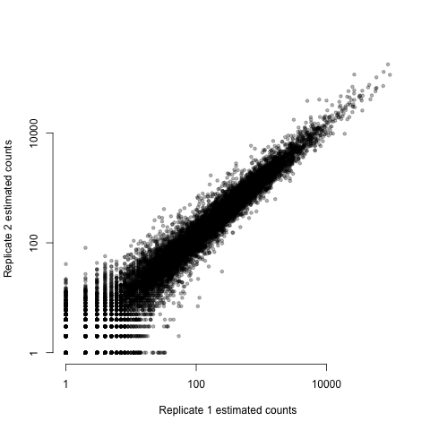
What are we normalizing?
A typical replicate scatter plot
Notes:
The most important reason is sequencing depth

Slide 10
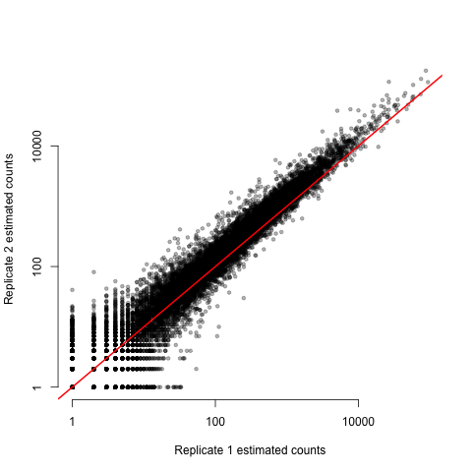
What are we normalizing?
A typical replicate scatter plot
Notes:
Without normalization, our quantification would imply that all genes are higher expressed in Replicate 2 (y axis)

Slide 11
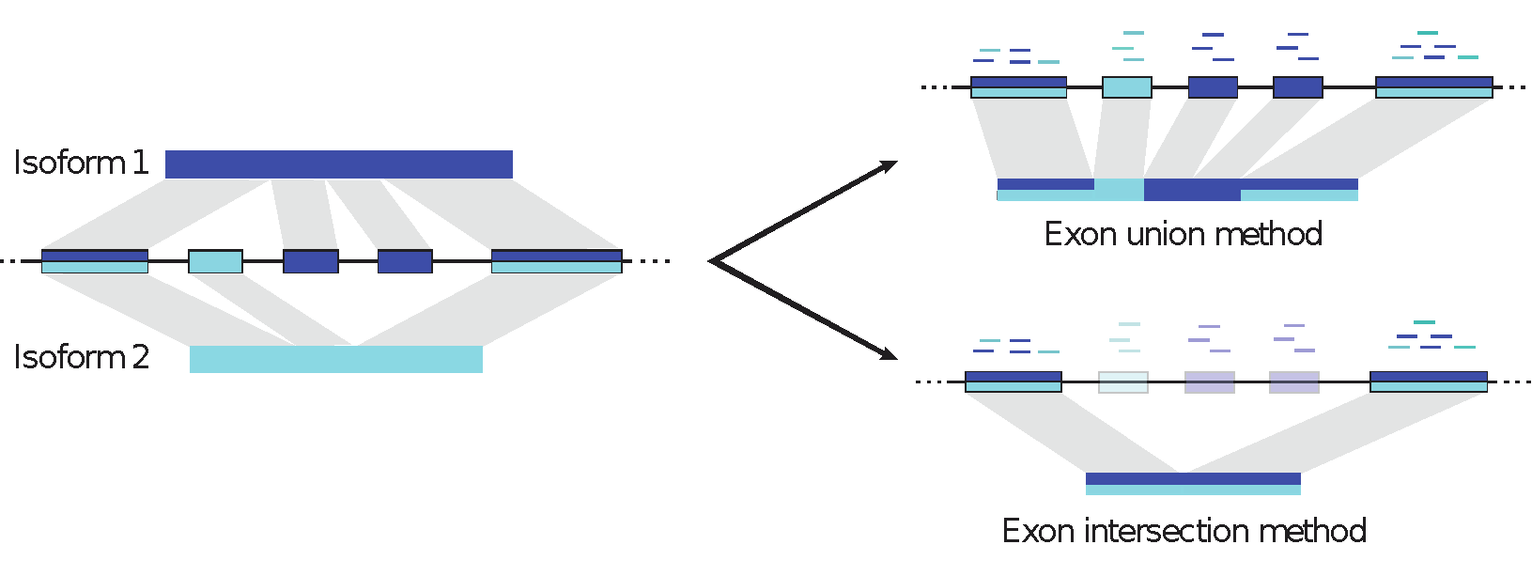
But, what happens when there are different isoforms?
Start with a set of previous gene/transcript annotations
Assume Define only one isoform per gene
Assume 1-1 read to transcript correspondence.
Reads (fragments) are short, one transcript generates many fragments.
Notes:
Now we have to revisit our previous assumptions.
Here is an example of a gene where you know two isoforms exist, 1 & 2, where isoform 1 transcript is formed by 4 exons and the isoform 2 transcript by 3 exons, some of the exons are also common between the two isoforms.
One way to deal with this is to define one isoform per gene, and restrict the experiment to a gene level analysis
They are convenient, but both of these methods present problems and the estimated transcript abundance will differ from the truth
Union will result in underestimated expression for genes where there is alternative splicing, and intersection will reduce the power for DE analysis

Slide 12
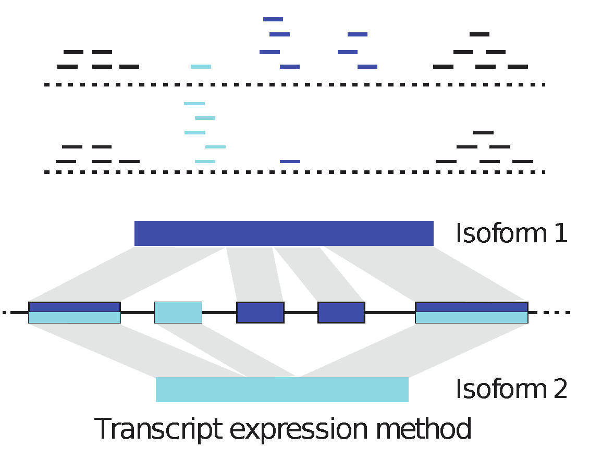
A probabilistic approach: Isoform deconvolution
Main difference:
Quantification involves read assignment.
Our model must capture read assignment uncertainty.
Objective: Transcript relative abundance
Unknown!: Fragment alignment source
Observed variables: N fragment alignments, transcripts, fragment length distribution
Notes:
Many current models handle the read mapping uncertainty by constructing a 'likelihood function' that models the sequencing process and identifies isoform abundance estimates that best explain the reads obtained in the experiment.
Reads that map to unique regions of each isoform are fine as they are, the problem lies with the reads from common exons
The fragment length distribution is know from the library construction (bioanalyzer trace for example) and remember that in a paired-end sequencing experiment we generate reads from the 3’ and 5’ ends of each fragment

Slide 13
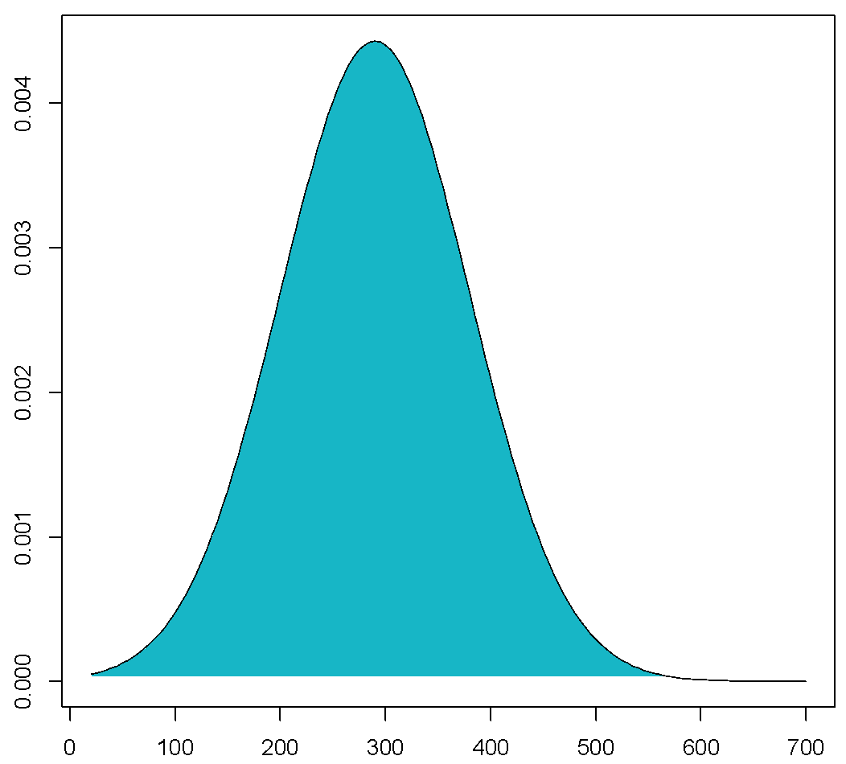
We can estimate the insert size distribution
P₁
P₂
Splice and compute insert distance
d₁
d₂
Get all single isoform reconstructions
Estimate insert size empirical distribution
Notes:
Insert size is calculated from the alignment distance of two reads in a pair, considering the mature transcript (spliced)
The distance between these paired reads is calculated for each isoform reconstruction
And we end up with a distribution

Slide 14
… and use it for probabilistic read assignment
Isoform 1
Isoform 2
Isoform 3
d₂
d₁
d₁
d₂
P(d₂ > d₁)
For methods such as MISO, Cufflinks and RSEM, it is critical to have paired-end data
Notes:
We can then use this empirical distribution for read assignment,
For example here we have a pair of reads which map to common exons between 3 isoforms,
For each isoform, the distance is calculated, green and brown would have distance d1 and purple would have distance d2
According to the insert size distribution we observed, which of these is more likely to have given origin to these reads? Purple transcript!

Slide 15
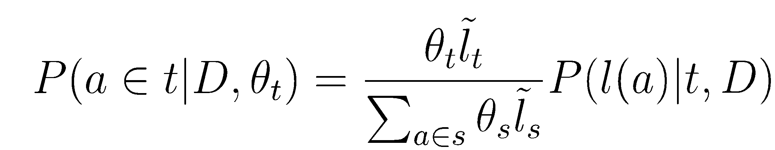
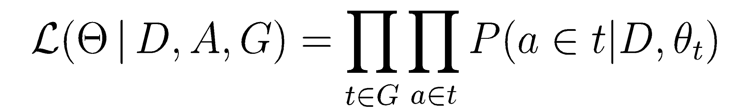
Isoform deconvolution
Parameters: Transcript relative abundance
Latent variables: Fragment alignment source
Observed variables:
N fragment alignments, transcripts,
fragment length distribution
d₂
d₁
Probability of the fragment alignment originating from t
solvable by expectation maximization
Notes:
We want to estimate the relative abundance for each transcript
But we do not know the fragment alignment source
What we do know are the fragment alignments, what are the possible transcripts present, and the fragment length distribution
So the probability of a given alignment a having originated from a transcript t, given that we have the distribution of sizes D, and the transcript relative abundance theta t
Is equal to theta t times the length of the transcript t
Over the sum of theta s times length of transcript s (for all other transcripts that a maps to)
Times the probability of obtaining a fragment of length l for a in transcript t, given the fragment length distribution D
This is solvable by and algorithm called EM = expectation maximization, to solve for the values of theta that maximize the observed data likelihood

Slide 16
Summary: Current quantification models are complex
In its simplest form we assume that reads can be unequivocally mapped
Read counts distribute multinomial with abundance estimated from the observed counts
When this assumption breaks, multinomial is no longer appropriate
More general models use:
Base quality scores
Sequence mappability
Protocol biases (e.g. 3’ bias)
Sequence biases (e.g. GC)
Handling each of these involves a more complex model where reads are assigned probabilistically, not only to an isoform but to a different locus
Notes:
Read counts n for a given sample s and a gene g, follow a multinomial distribution considering the set of all genes.
More general models will use additional information to accommodate the uncertainty of the data

Slide 17
The gene expression table
Genes are quantified, each gene or isoform has:
A fragment count value (expected or raw)
A TPM or RPKM value (normalized)
All samples are quantified in the same fashion and arranged into a table of genes (ex: 22,000) x samples (ex: 6)
Row i gives the expression of a single gene i across all samples
Column j gives the expression of all genes in one sample j
GENE | Ctrl rep1 | Ctrl rep2 | Ctrl rep3 | KO rep1 | KO rep2 | KO rep3
Mir301 | 0 | 0 | 0 | 0 | 0 | 0
Cpne2 | 157 | 158.98 | 88.04 | 69 | 111.99 | 114.33
Capn5 | 36 | 65 | 46 | 46 | 69 | 42
Lage3 | 313.06 | 241.23 | 276.23 | 218.9 | 285.19 | 359.65
Brd7 | 379 | 358.58 | 390 | 336 | 357.26 | 368.08
Dimt1 | 77 | 68 | 58 | 54 | 62 | 60
AK017068 | 0 | 0 | 0 | 0 | 0 | 0

Slide 18
RNA-Seq libraries revisited: End-sequence libraries
Target the start or end of transcripts
Fragmented then selected
Fragmented then enzymatically purified
Uses
Annotation of transcriptional start sites
Annotation of 3’ UTRs
Quantification and gene expression
Depth required 3-8 million reads
Low quality RNA samples
Single cell RNA sequencing

Slide 19
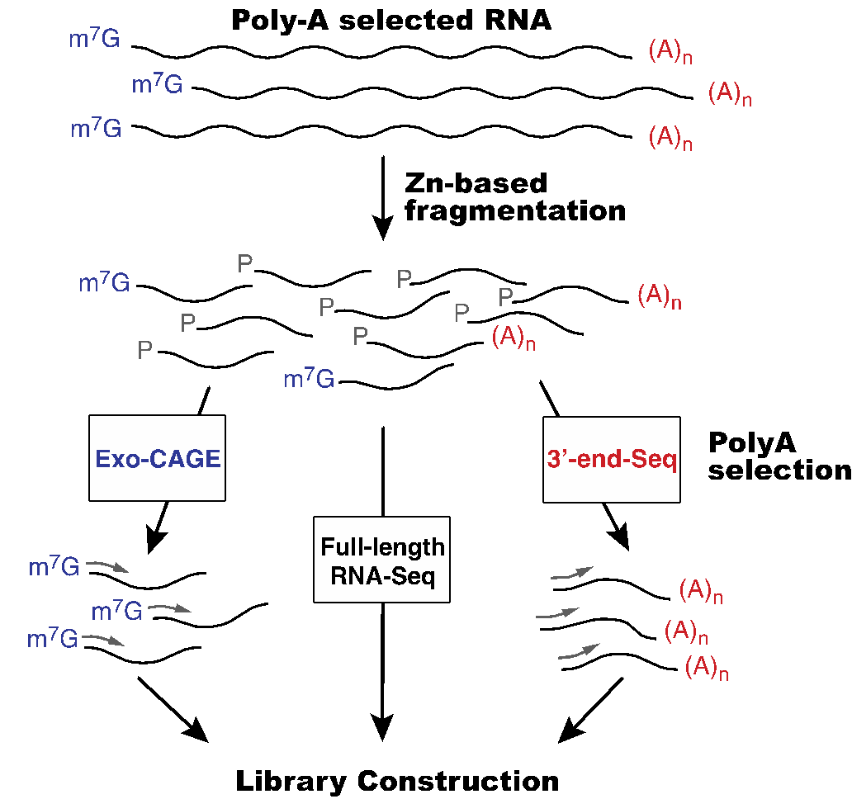
RNA-Seq libraries

Slide 20
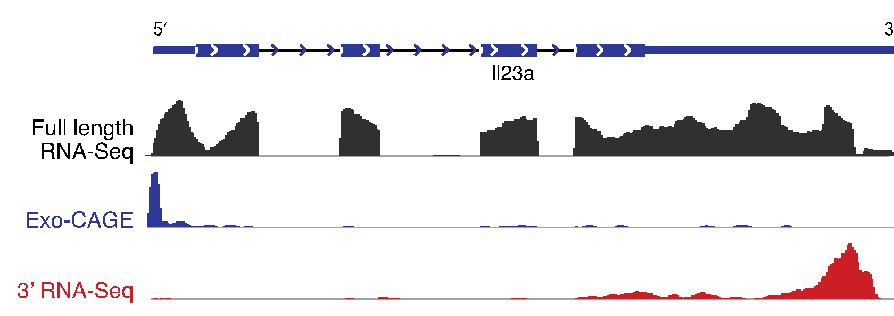
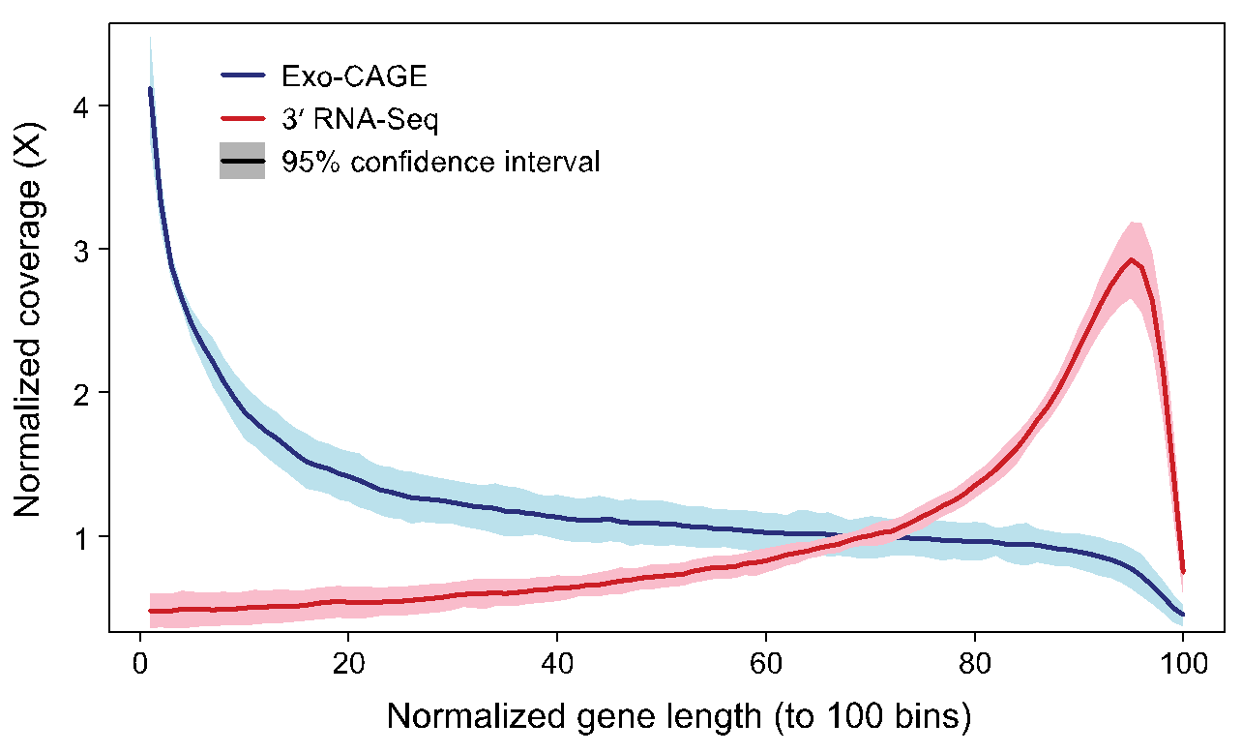
End-sequencing solution

Slide 21
References
Garber M, Grabherr M, Guttman M & Trapnell C. Computational methods for transcriptome annotation and quantification using RNA-seq. Nat Methods 8, 469–477 (2011). https://doi.org/10.1038/nmeth.1613
Bo Li, Victor Ruotti, Ron M. Stewart, James A. Thomson, Colin N. Dewey, RNA-Seq gene expression estimation with read mapping uncertainty, Bioinformatics, Volume 26, Issue 4, 15 February 2010, Pages 493–500, https://doi.org/10.1093/bioinformatics/btp692
Griffith M, Walker JR, Spies NC, Ainscough BJ, Griffith OL (2015) Informatics for RNA Sequencing: A Web Resource for Analysis on the Cloud. PLoS Comput Biol 11(8): e1004393. https://doi.org/10.1371/journal.pcbi.1004393

