Slide 1
Visualization:
Genome Browsers
Elisa Donnard, PhD
UMassMed Biocore Bootcamp 2020

Slide 2
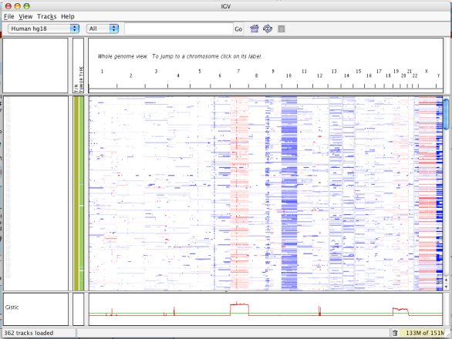
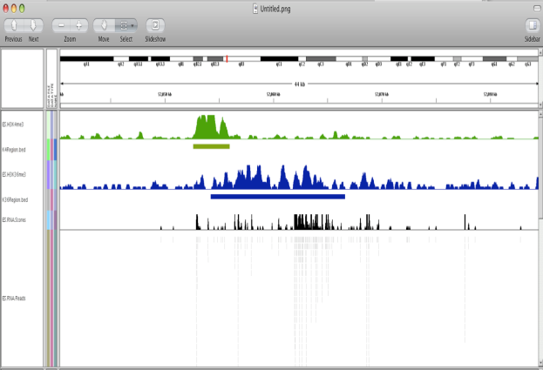
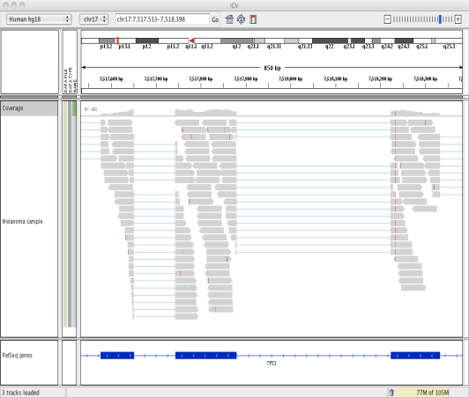
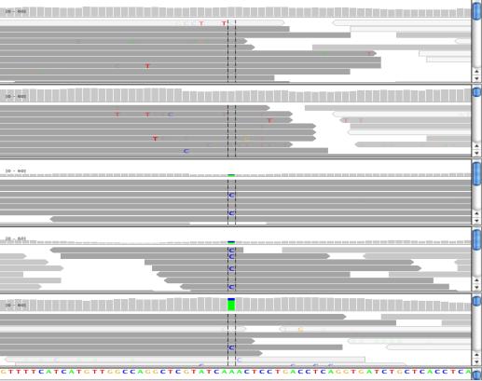
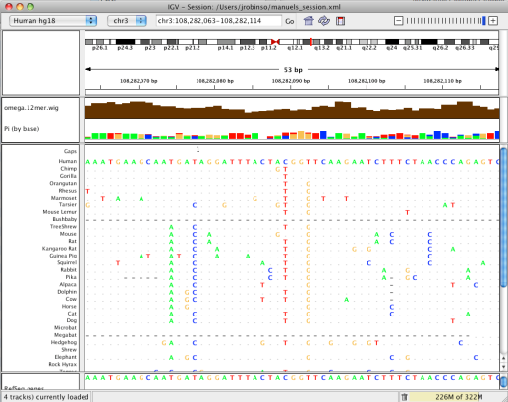
IGV: Integrative Genomics Viewer
A desktop application for the visualization and interactive exploration of genomic data
Microarrays
Epigenomics
RNA-Seq
NGS alignments
Comparative genomics
Notes:
Visualization of data is a key need in this field, IGV currently has all the necessary features to allow
* Desktop app – you run on your computer – not through a Web browser (like UCSC genome browser)
Viewer – not computational tool
Supports any type of data that can be mapped to the genome
Data can be local or stored in a server

Slide 3
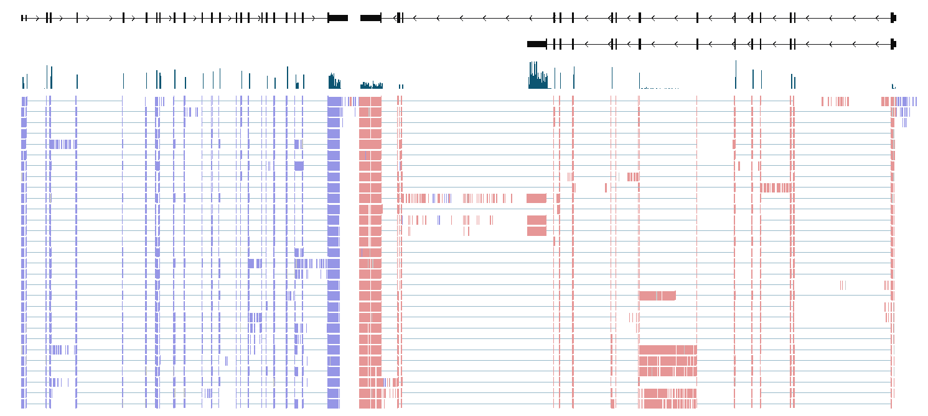
Visualizing read alignments with IGV — RNASeq
Strand specific library!
Gap between reads spanning exons

Slide 4
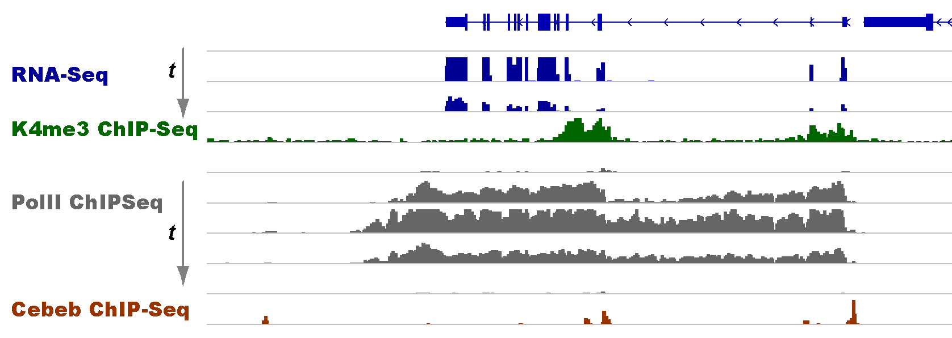
Visualizing read coverage with IGV

Slide 5
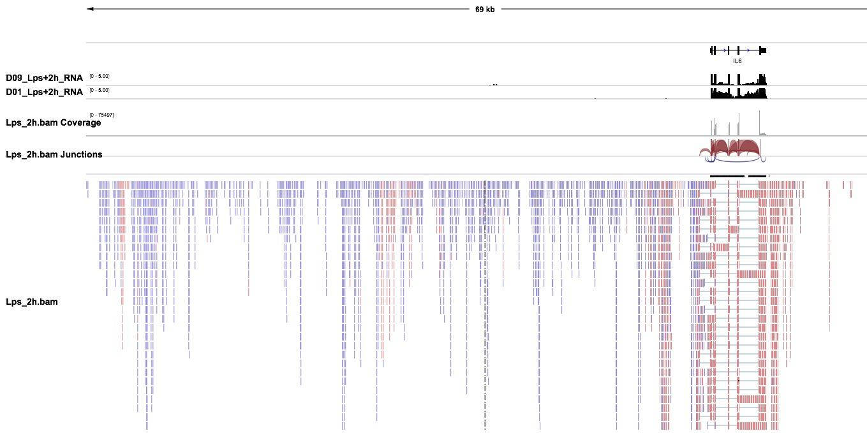
Or to troubleshoot

Slide 6
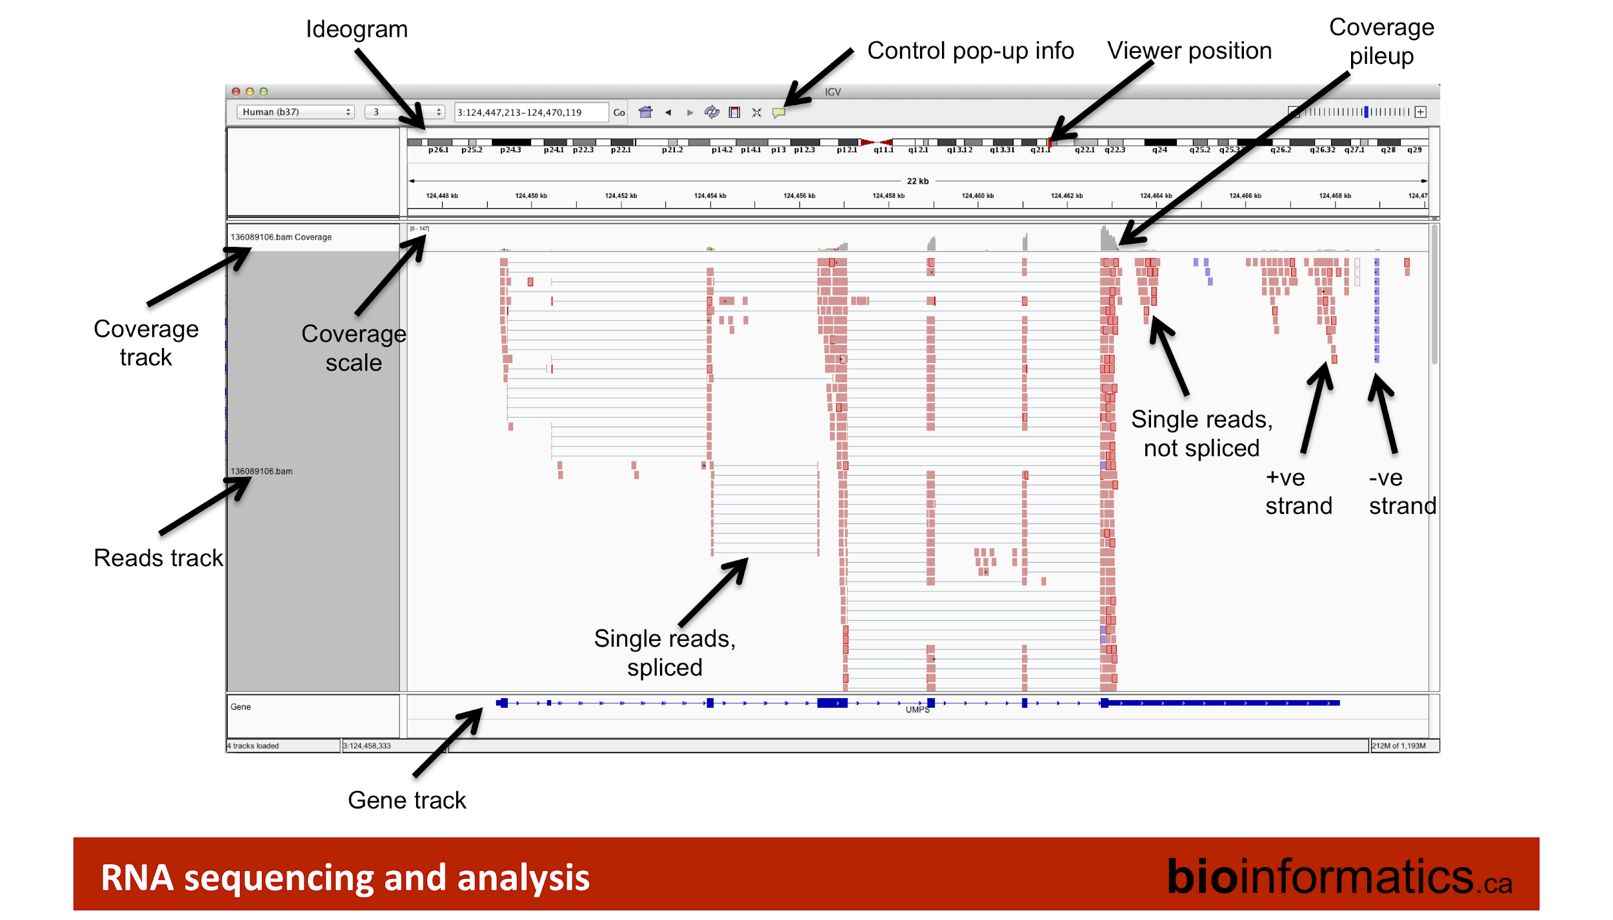

Slide 7
References
IGV YouTube channel https://www.youtube.com/channel/UCb5W5WqauDOwubZHb-IA_rA
Bioinformatics.ca
A lot of course material for genomic analysis
IGV tutorial slides: https://drive.google.com/file/d/1snsoqquDgJ8o7fg8TsIGNHvE2cRqskyP/view
Other browser choice? With more public data available and pre-loaded?
UCSC Genome Browser: https://genome.ucsc.edu/cgi-bin/hgGateway

