Slide 1
Synergy
Servlet, session, AJAX

Slide 2
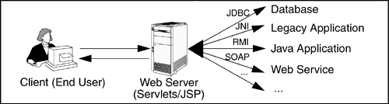
What is a Servlet?
Servlet is a program that run on Web or application server, acting as a middle layer between HTTP clients and databases or applications on the HTTP server.

Slide 3
A Servlet's Job
Read the explicit data sent by the client.
Read the implicit HTTP request data sent by the browser.
Generate the results.
Send the explicit data (i.e., the document) to the client.
Send the implicit HTTP response data.

Slide 4
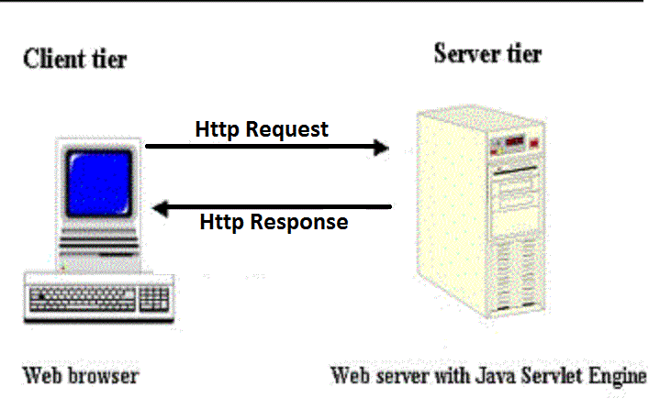
Servlet Basics
Single instance of Servlet handles requests from multiple browser instances by assigning a thread from the thread-pool for each request.

Slide 5
Servlet Containers
A servlet container is a compiled, executable program. The main function of the container is to load, initialize and execute servlets.
Servlet containers are:
Apache Tomcat
Jetty
JRun
Chaucho Resin
JBoss
WebLogic
WebSphere

Slide 6
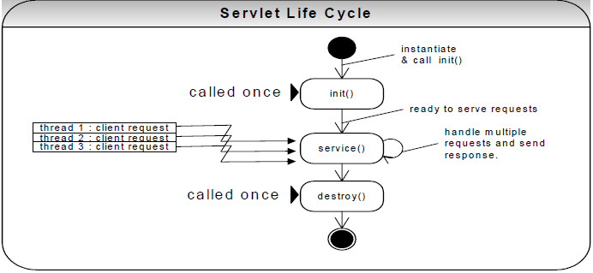
Servlet life cycle
The Web container calls the no-arg constructor.
The Web container calls the init() method.
After initialization, the servlet can service client requests by calling service() method.
Finally, the Web container calls the destroy() method.
Notes:
Check HelloServlet example.

Slide 7
HTTP GET and POST Requests
GET
The request parameters are transmitted as a query string appended to the request:
security risk – to use for static resource retrieval
sends only textual data - limited to 1024 characters
http://MyServer/MyServlet?name=paul
HTML: <form name=”SSS” method=”GET” >
POST
The request parameters are passed with the body of the request:
secured – to use for dynamic resource retrieval
Sends textual data and binary data such as serialized Java objects
HTML: <form name=”SSS” method=”POST” >

Slide 8
Java Servlet API
Servlet interface
Defines methods that all servlets must implement.
HttpServlet abstract class
Servlets typically extend HttpServlet.
Notes:
Create custom servlet and check network

Slide 9
HttpServletRequest
Cookie[] getCookies()
Enumeration getHeaderNames()
Enumeration getParameterNames()
HttpSession getSession()
String getContentType()
String getHeader(String name)
String getMethod()
String getParameter(String name)
String getQueryString()
String[] getParameterValues(String name)
int getIntHeader(String name)

Slide 10
HttpServletRequest (continued)
BufferedReader getReader()
RequestDispatcher getRequestDispatcher(String path)

Slide 11
HttpServletResponse
String encodeURL(String url)
boolean containsHeader(String name)
void addCookie(Cookie cookie)
void addDateHeader(String name, long date)
void addHeader(String name, String value)
void addIntHeader(String name, int value)
void sendError(int sc)
void sendError(int sc, String msg)
void sendRedirect(String location)
void setContentType(String type)
void setDateHeader(String name, long date)
void setHeader(String name, String value)
void setIntHeader(String name, int value)
void setStatus(int sc)

Slide 12
Http Session
Http protocol is stateless.
To retain the state information between different page requests 2 mechanisms can be obtained:
to implement session-tracking yourself
to use servlet session-tracking HTTP Session API solution.

Slide 13
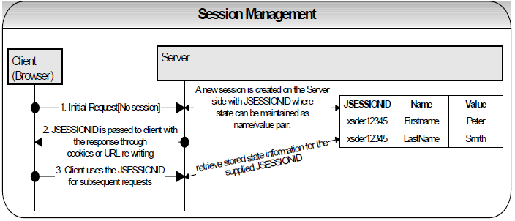
To Implement Session Tracking Yourself
3 mechanisms can be used:
Cookies Cookie: JSESSIONID=SomeUniqueString;
URL rewriting http://host/path/file.html;jsessionid=a1234
Hidden form fields <input type="hidden" name="session" value="a1234">

Slide 14
Servlet Session-tracking HTTP Session API Solution
In a Java servlet the session can be obtained as follows:
//returns a current session or a new session
HttpSession session = request.getSession();
//to put/get a value in/from the session
session.setAttribute(“Firstname”, “Peter”);
session.getAttribute(“Firstname”);
//if a session is no longer required e.g. user has logged out, etc then it can be invalidated
session.invalidate();
//you can also set the session inactivity lease period on a per session basis
session.setMaxInactiveInterval(300);
//resets inactivity period for this session as 5 minutes

Slide 15
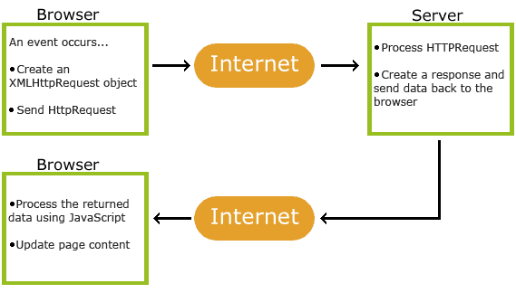
Ajax - Asynchronous JavaScript and XML
AJAX is the group of technologies that allow to exchange data with a server, and update parts of a web page - without reloading the whole page.
Notes:
Check AjaxExample

Slide 16
Ajax example
const xhttp = new XMLHttpRequest(); xhttp.onreadystatechange = function() { if (this.readyState == 4 && this.status == 200) { console.log(this.response) } }; xhttp.open("GET", "ajax_info.txt", true); xhttp.send();
Notes:
Check AjaxExample

Slide 17
states
0: request not initialized 1: server connection established 2: request received 3: processing request 4: request finished and response is ready
Notes:
Check AjaxExample

Slide 18
Exception Handling
Request Attributes | Type
javax.servlet.error.status_code | java.lang.Integer
javax.servlet.error.exception_type | java.lang.Class
javax.servlet.error.message | java.lang.String
javax.servlet.error.exception | java.lang.Throwable
javax.servlet.error.request_uri | java.lang.String
javax.servlet.error.servlet_name | java.lang.String
Notes:
Check AjaxExample

Slide 19
Filter
public void doFilter (ServletRequest, ServletResponse, FilterChain)
public void init(FilterConfig filterConfig)
public void destroy()
Notes:
Check AjaxExample

Slide 20
Cookies
A cookie is a piece of text that a Web server can store on a user’s hard disk. Cookies allow a website to store information on a user’s machine and later retrieve it.
If you type the URL of a website into your browser, your browser sends the request to the Web server. The browser looks on your machine for a cookie file that URL has set. If it finds it, your browser will send all of the name-value pairs along with the URL. If it does not find a cookie file, it sends no cookie data.
The Web server receives the cookie data and requests for a page. If name-value pairs are received, the server can use them. If no name-value pairs are received, the server can create a new cookie and then sends name-value pairs to your machine in the header for the Web page it sends. Your machine stores the name value pairs on your hard disk.

Slide 21
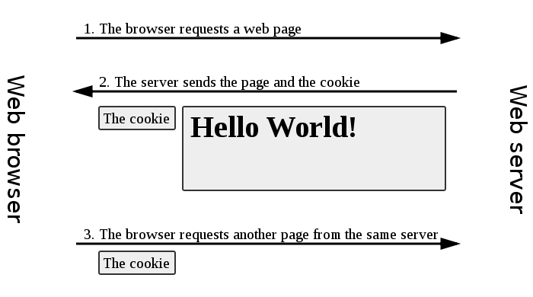

Slide 22
browser server
browser server
browser server
GET /index.html HTTP/1.1 Host: www.example.org
HTTP/1.1 200 OK Content-type: text/html Set-Cookie: name=value Set-Cookie: name2=value2; Expires=Wed, 09 Jun 2021 10:18:14 GMT (content of page)
GET /spec.html HTTP/1.1 Host: www.example.org Cookie: name=value; name2=value2 Accept: */*

Slide 23
Restrictions
300 cookies in total
4096 bytes per cookie
20 cookies per domain

Slide 24
Cookies in Servlet
Sending Cookies to the Client
//1. create cookie object
Cookie userCookie = new Cookie("user", "uid1234");
//2. specify how long (in seconds) the cookie should be valid (one year)
userCookie.setMaxAge(60*60*24*365);
//3. place the Cookie into the HTTP response headers
response.addCookie(userCookie);
Reading Cookies from the Client
// 1. yield an array of Cookie objects from the request
Cookie[] cookies = request.getCookies();
// 2. loop down the array, calling getName() on each one until you find the cookie of // interest
…
cookie.getName();
cookie.getValue();

Slide 25
THANK YOU!

