Slide 1

am prezentaciaSi aris asaxuli “Address Book”-is Seqmna. es programa Sedgeba 5 failisgan(index.php, database.php, insert.php, delete.php, main.js) da monacemTa bazisagan. am programis daxmarebiT SegviZlia SevinaxoT konkretul adamianze: saxeli, gvari, qveyana, qalaqi, misamarTi da telefoni.

Slide 2
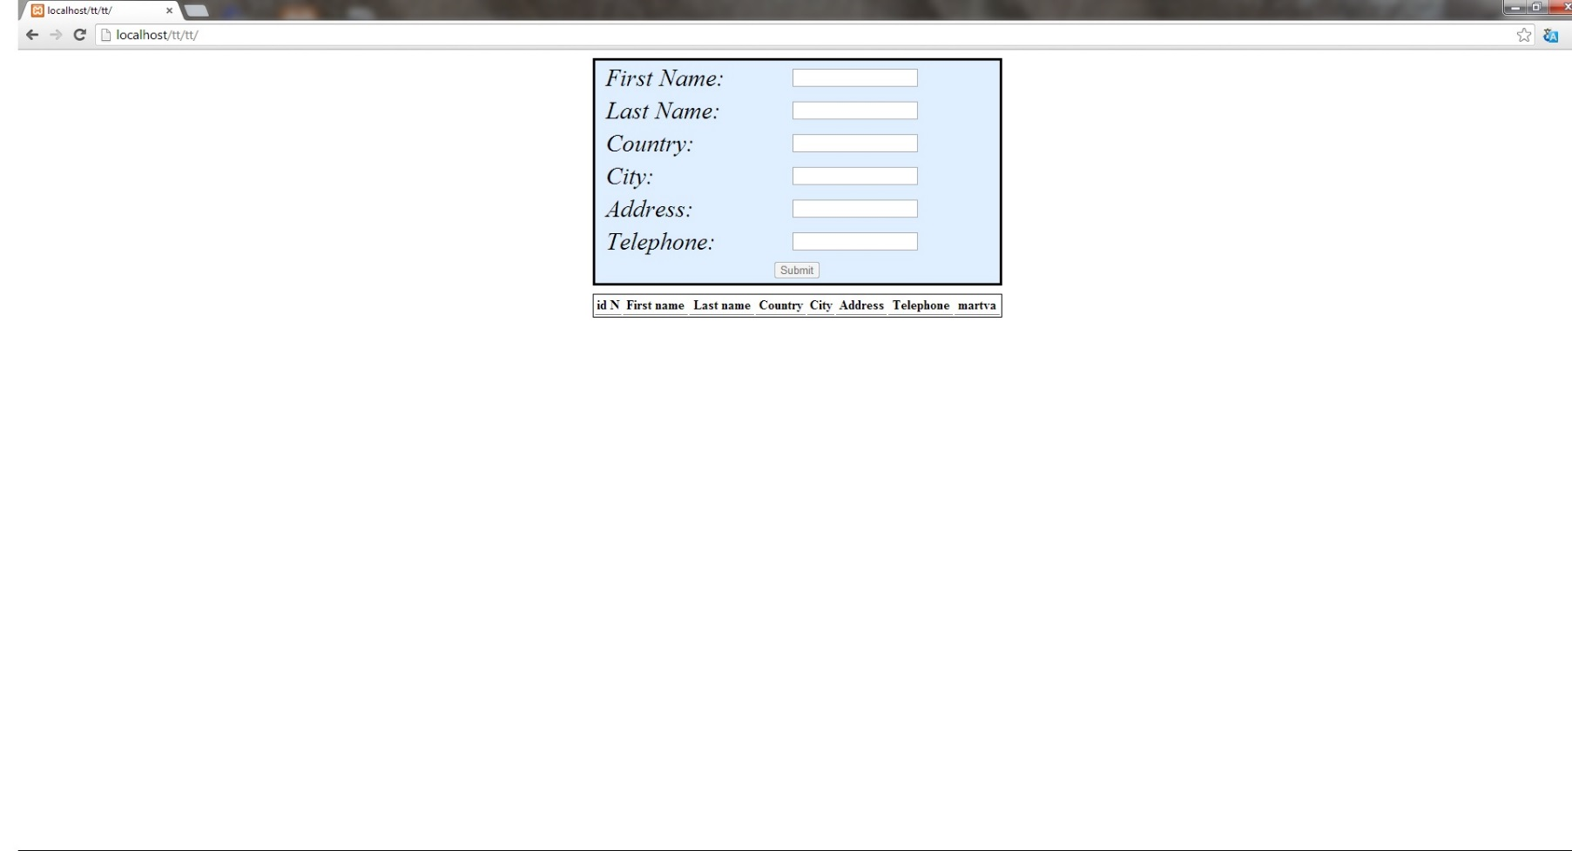
Index.php
am failSi aris HTML, CSS da PHP skripti. es aris mTavari gverdi, romelic gamoiyureba ase:

Slide 3
Database.php
am failSi aris PHP skripti, romlis daxmarebiTac vukavSirdebiT monacemTa bazas:
<?php
$host = "localhost";
$user = "root";
$dbpasswd = "vertrigo";
$database = "addressbook";
$connect = mysql_connect($host, $user,$dbpasswd);
$select = mysql_select_db($database);
?>

Slide 4
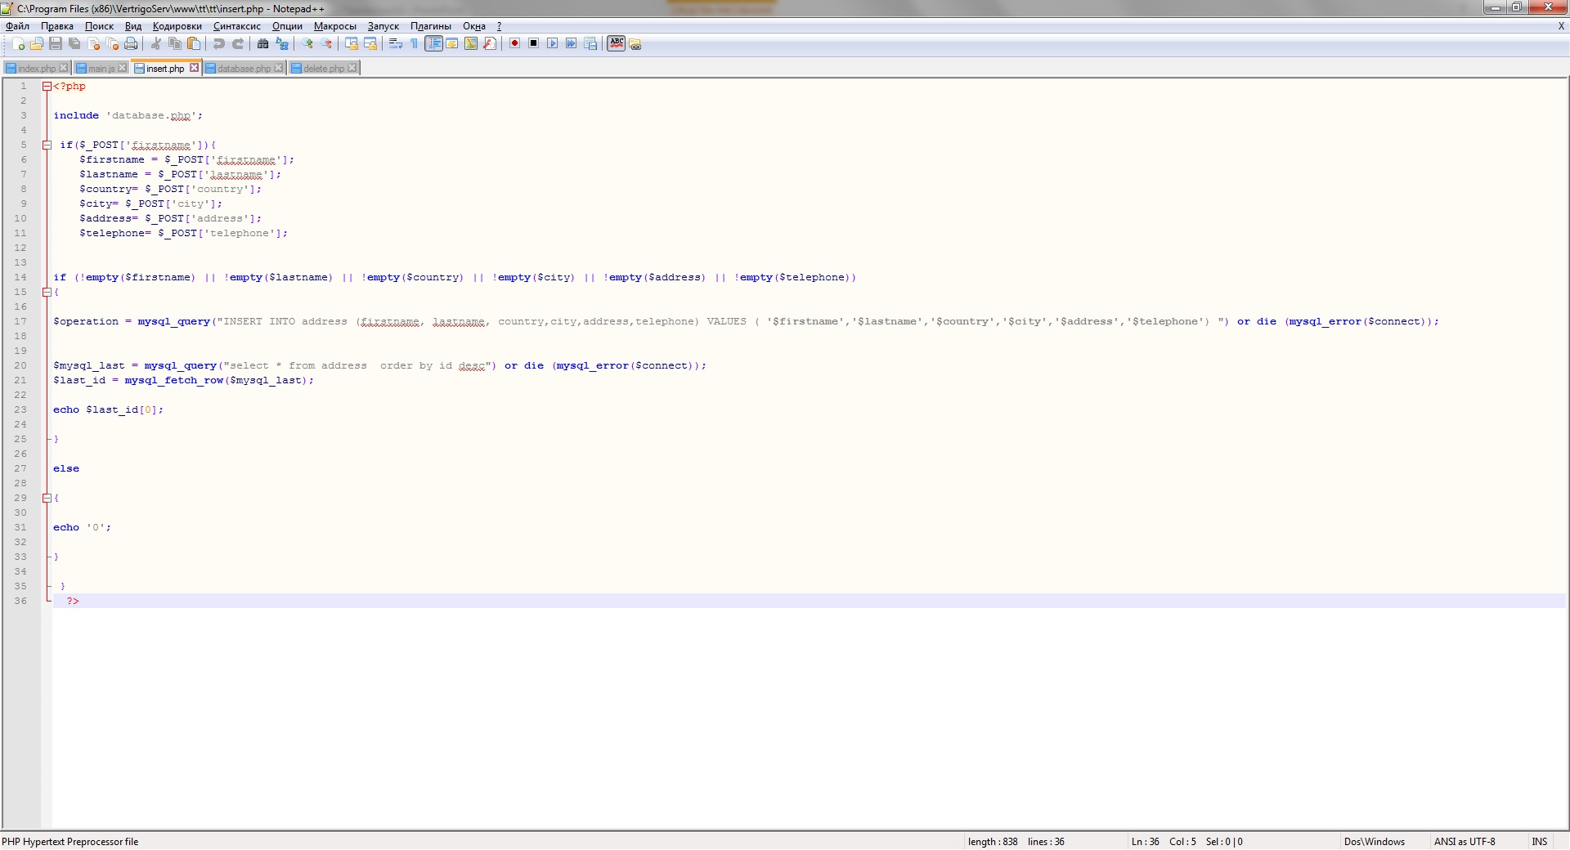
Insert.php
am failSi aris PHP da MYSQL skripti, romelic amatebs monacemebs monacemTa bazaSi:

Slide 5
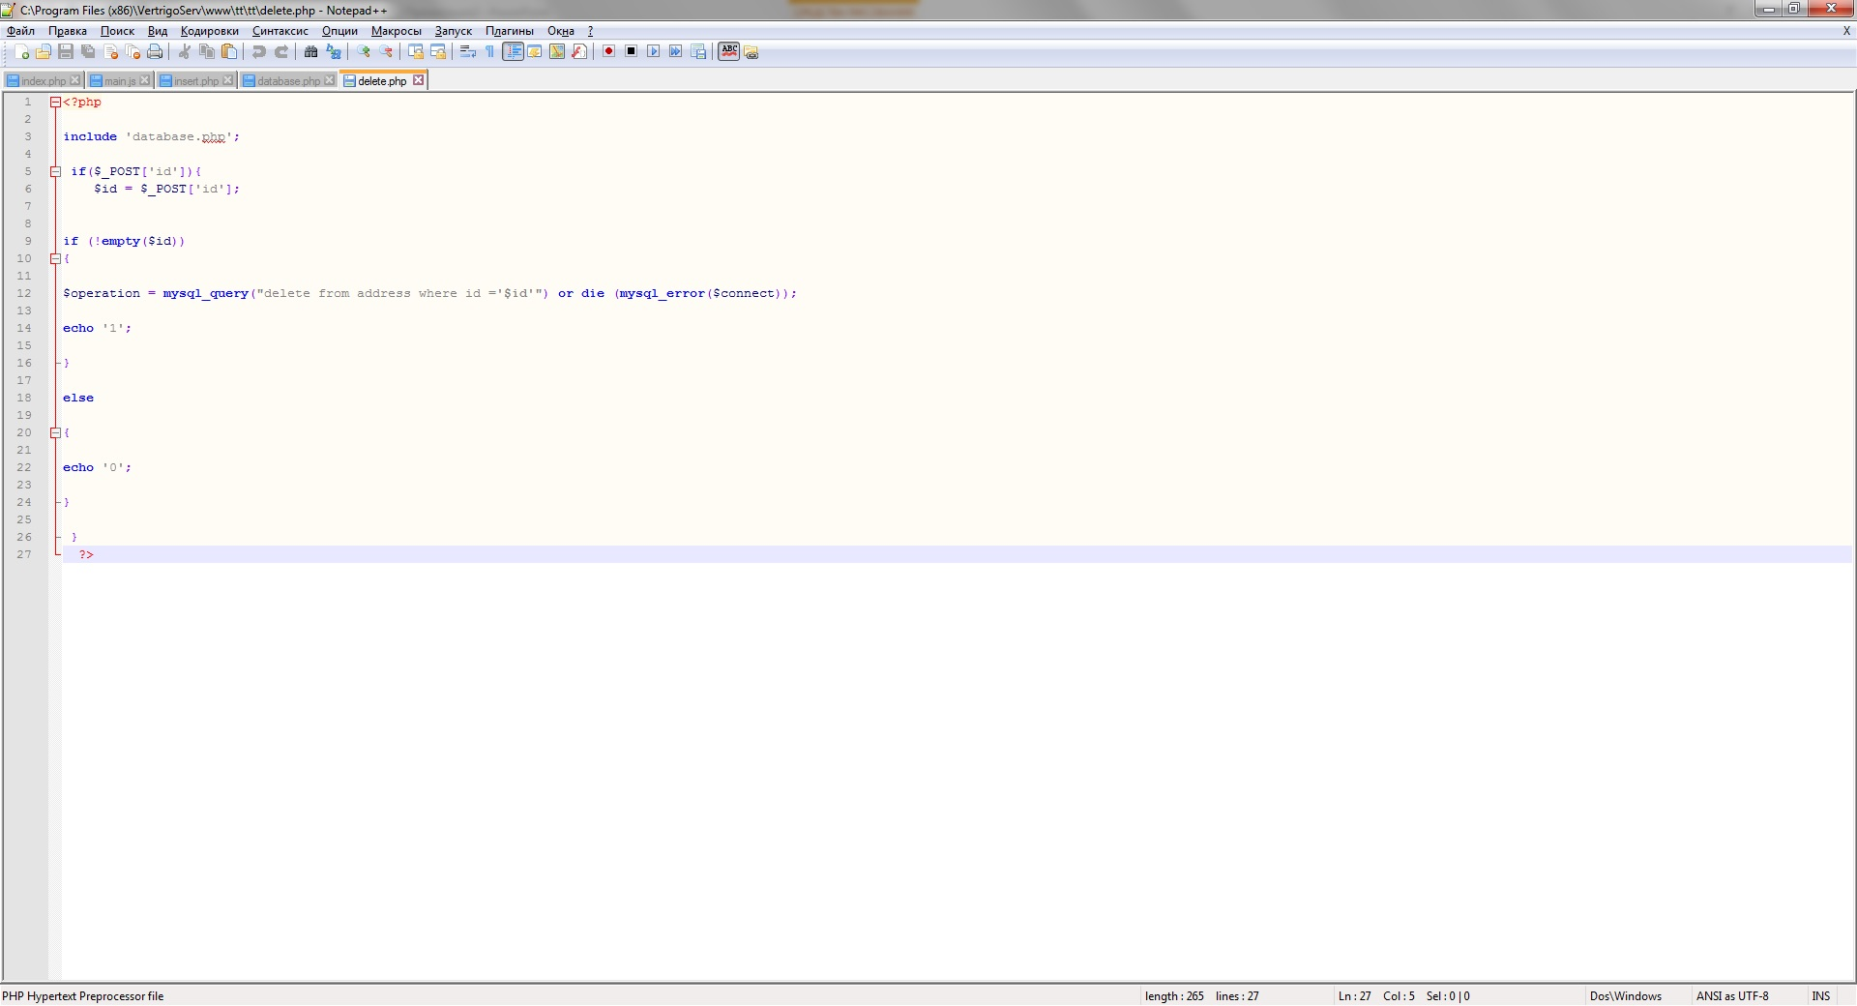
Delete.php
am failSi aris PHP da MYSQL skripti, romelic Slis monacemebs monacemTa bazidan:

Slide 6
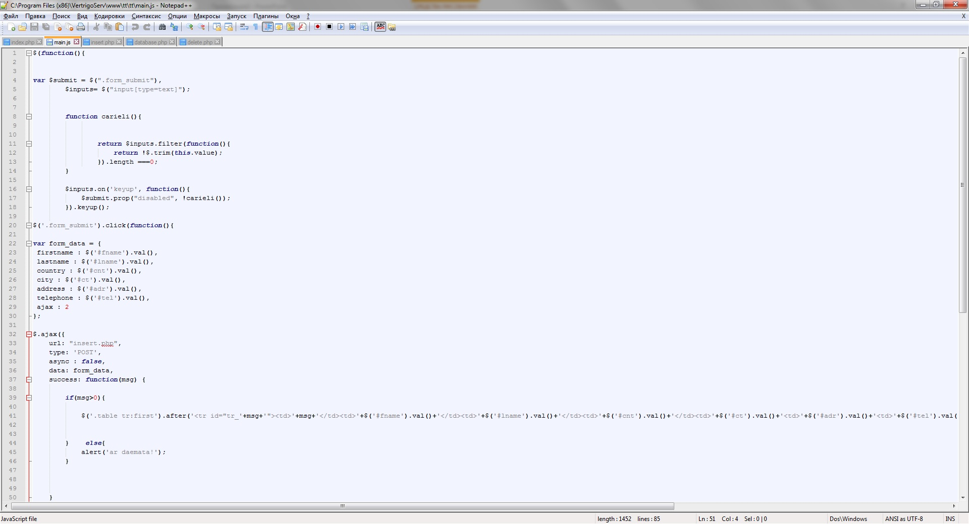
Main.js
am failSi aris Javascript kodi, romlis daxmarebiTac SegviZlia dinamiurad davamatod da wavSaloT monacemebi. es aris kodis fragmenti:

Slide 7


