Slide 1
26. Security of wireless networks
Artur Bucki

Slide 2

What Is Wi-Fi Security?
Wi-Fi security is the protection of devices and networks connected in a wireless environment. Without Wi-Fi security, a networking device such as a wireless access point or a router can be accessed by anyone using a computer or mobile device within range of the router's wireless signal.

Slide 3
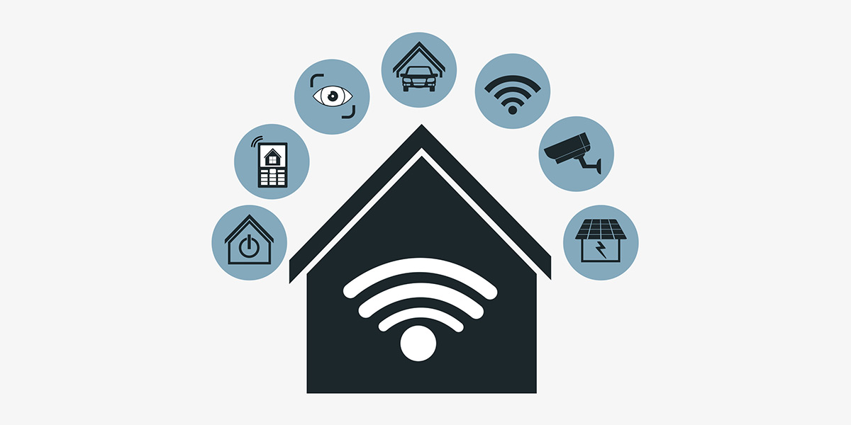
How do unsecured Wi-Fi networks create risk?
Unsecured Wi-Fi poses serious risks, including personal data exposure, identity theft, and compromised financial/business information. Open networks allow any nearby Wi-Fi device access, making users and organizations vulnerable to adversarial threats like data collection and eavesdropping.

Slide 4
What are some ways to protect a Wi-Fi network?
Notes
Media Access Control (MAC) addresses
Encryption
Virtual private networks (VPNs)
Security software

Slide 5
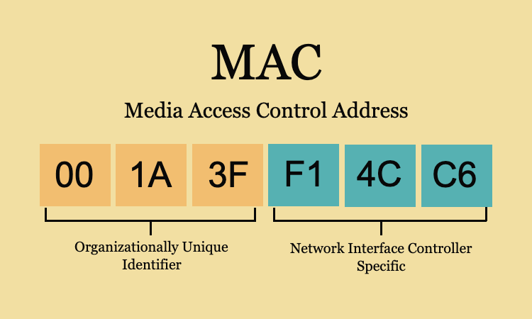
Media Access Control (MAC) addresses
Using MAC addresses is a basic Wi-Fi security method, restricting network access based on unique device codes. Though more secure than open networks, it remains vulnerable to attacks through "spoofed" or modified addresses.
Notes:
Each device has its unique MAC address, identifying it on the network. This method adds an additional layer of security

Slide 6

Encryption
A common Wi-Fi security method involves encryption through protocols like WPA (Wi-Fi Protected Access) and WPA2. Encryption encodes and decodes data for authorized recipients, adding a layer of security. Modern network devices, including access points and routers, typically have built-in encryption protocols for Wi-Fi protection.
Notes:
These protocols encrypt information during transmission and decode it only for authorized recipients. It functions like a closed key, safeguarding data from unauthorized access.

Slide 7
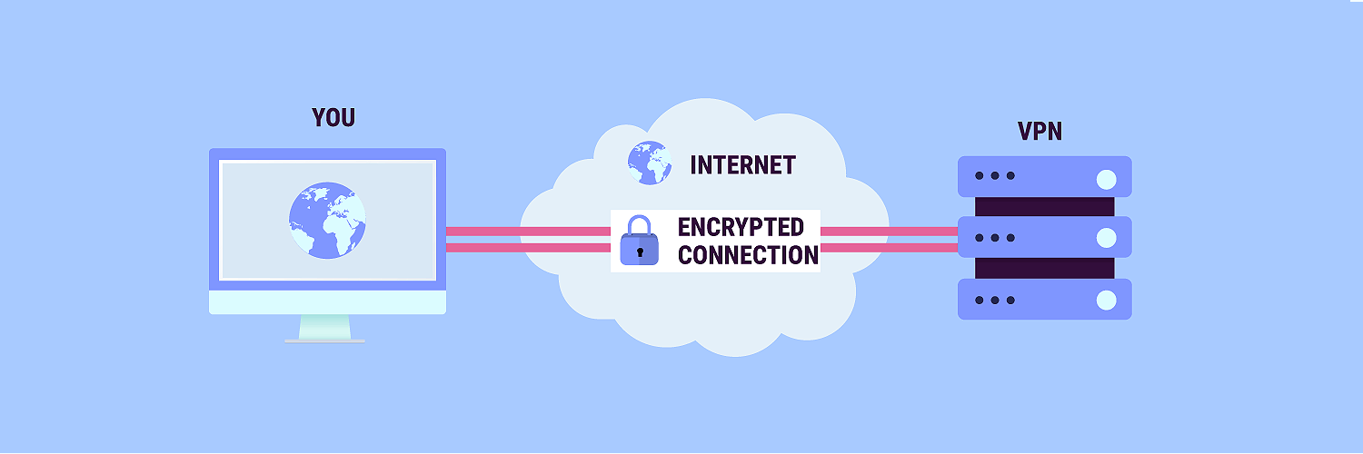
Virtual private networks (VPNs)
VPNs enhance Wi-Fi network security by creating secure tunnels between unprotected networks and the internet. They encrypt internet connections and conceal users' IP addresses through virtual addresses assigned as traffic passes through the VPN server.

Slide 8

Security software
Various types of consumer and enterprise software can enhance Wi-Fi security. Some software, including antivirus programs, comes bundled with Wi-Fi protection features. For more details on Wi-Fi

Slide 9
Types of Wireless Security Protocols
Notes
WEP
WPA
WPA2
WPA3

Slide 10

WEP
The first wireless security protocol was WEP (Wired Equivalent Privacy). It was the standard method of providing wireless network security from the late 1990s until 2004. WEP was hard to configure, and it used only basic (64-/128-bit) encryption. WEP is no longer considered secure and should be replaced by a newer protocol such as WPA2, described below.

Slide 11

WPA
WPA (Wi-Fi Protected Access) was developed in 2003. It delivers stronger (128-/256-bit) encryption than WEP by using a security protocol known as Temporal Key Integrity Protocol (TKIP). Along with WPA2, WPA is the most common protocol in use today. But unlike WPA2, it is compatible with older software.

Slide 12

WPA2
WPA2, a later version of WPA, was developed in 2004. It's easier to configure and provides even greater network security than WPA by using a security protocol known as the Advanced Encryption Standard (AES). Versions of the WPA2 protocol are available for individual users and enterprises.

Slide 13

WPA3
A new generation of WPA, known as WPA3, is designed to deliver simpler configuration and even stronger (192-/256-/384-bit) encryption and security than any of its predecessors. It is also meant to work across the latest Wi-Fi 6 networks.

Slide 14

Summary
Wi-Fi security evolves from WEP to WPA3, acknowledging legacy limitations like WEP. Additional layers include VPNs, MAC address encryption, and specialized security software. Best practices: upgrade to WPA2 or WPA3, implement VPNs, and use MAC encryption and security software for a robust Wi-Fi security approach.

Slide 15
Bibliography
https://www.cisco.com/c/en/us/products/wireless/what-is-wi-fi-security.html#~q-a

