Slide 1
4. Basic Web Usability Guidelines
Artur Bucki

Slide 2

What is web usability?
Web usability is a feature of websites and the way they are designed that focuses on the user's needs. It uses user-centered design processes to ensure that websites are efficient and easy to use for the people who actually use them, not the people who designed them

Slide 3
5 Factors that Influence Web Usability
Notes
Learnability
Efficiency
Memorability
Errors
Satisfaction

Slide 4
Learnanility, Efficeincy, Memorability, Errors, Satisfaction
Learnability – Is the website design intuitive?
Efficiency – How quickly can users complete tasks, find products?
Memorability – Does a returning user remember how to use your website or app effectively, or are they forced to learn everything all over again?
Errors – How often does a visitor make mistakes while using your website?
Satisfaction – After completing the task, does the user have a good opinion of your company?

Slide 5
Tools and Methods for Studying Website Usability
Notes
Heuristic Analysis
Benchmarking
User Behavioral Testing
Server Log Analysis
Page Loading Speed Measurement

Slide 6
10 Nielsen Heuristics
Visibility of System Status
Match Between System and the Real World
User Control and Freedom
Consistency and Standards
Error Prevention
Recognition Rather than Recall
Flexibility and Efficiency of Use
Aesthetic and Minimalist Design
Help Users Recognize, Diagnose, and Recover from Errors
Help and Documentation

Slide 7

Benchmarking
Benchmarking is a method that allows comparing a standard set of indicators between two ultimate states of a product to measure its relative performance. The two compared states are typically an earlier version of the product and the current version of the product.

Slide 8

User Behavioral Testing
Monitoring user behavior helps identify potential challenges users may encounter when using your product. It also aids in understanding each customer journey, eliminating assumptions, and focusing on detailed user segmentation to optimize product development.

Slide 9

Server Log Analysis
Server logs for a website are inexpensive, automatically captured records of the user experience (UX) on a website. They contain data that designers can use to assess the usability and effectiveness of design choices.

Slide 10
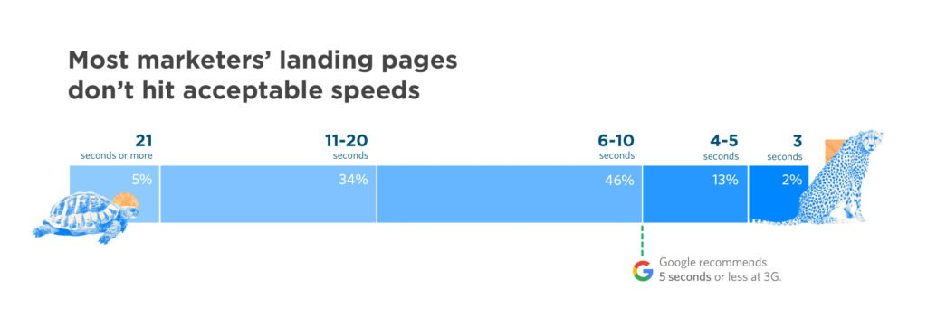
Page Loading Speed Measurement
Page speed, the measure of how quickly content loads on your website, has a significant impact on visitor satisfaction and your conversion rates. By defining Google's Core Web Vitals, Google highlights page loading speed as a crucial ranking factor.

Slide 11

Summary
Usability is a key element of a great website design. It is a metric that can be applied to any website, describing how effective your website is and whether it is a worthwhile investment.

Slide 12
Bibliography
https://artnova.com.pl/blog/web-usability-co-to-jest/

