Slide 1
47. Discussion of a Selected Tool Used in Web Data Analysis, e.g., Google Analytics.
Artur Bucki

Slide 2
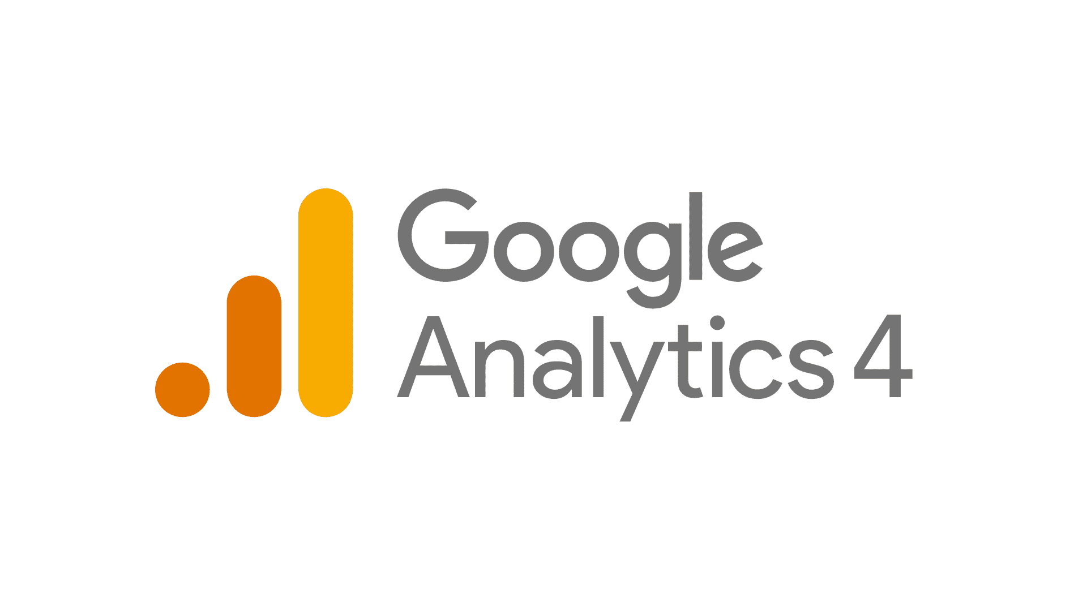
What is Google Analytics?
Google Analytics is a free analytical tool that allows you to gather information about website traffic and its effectiveness. Implementing Google Analytics is very simple, but to leverage this tool for business development, it is worth getting acquainted with some basics.

Slide 3
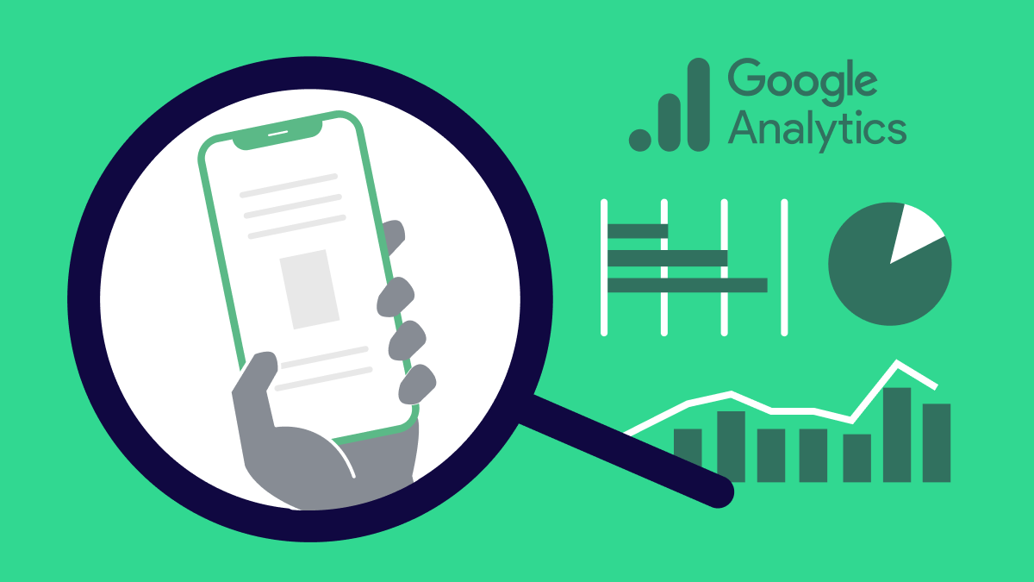
What does Google Analytics allow you to see?
Google Analytics gives you access to a great deal of information. For example, using the tool, you’ll discover how many visitors are coming to your website, and where they’re coming from.

Slide 4
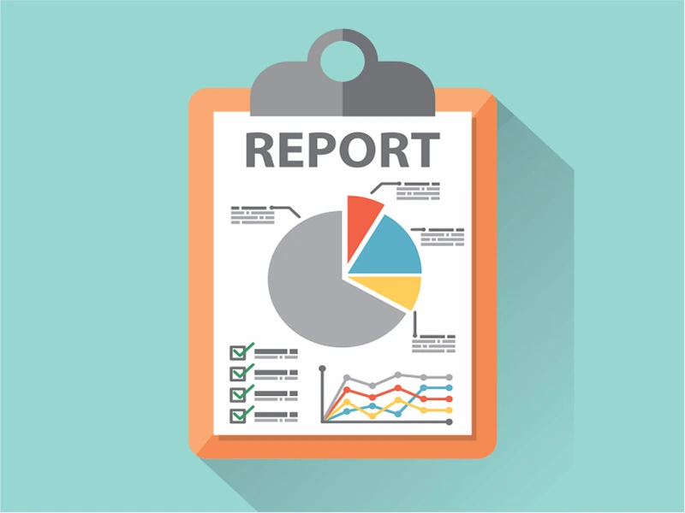
Default Reports in Google Analytics
Audience: Page views, average session duration, new vs. returning visitors.
Acquisition: Identify traffic sources - organic search, social media, paid ads.
Behavior: Understand user actions on your site.
Conversion: Track goal conversion rates and e-commerce revenue.
Notes:
Advanced users can customize reports to align with business goals.

Slide 5

Unlocking Deeper Insights
Massive Data Collection: Ideal for novices seeking simplified data and advanced users.
Advanced Feature: Event Tracking reveals user actions—video engagement, scrolling depth, PDF downloads.
Enhanced E-commerce: Focus on products—track views, cart activity, product revenue.

Slide 6
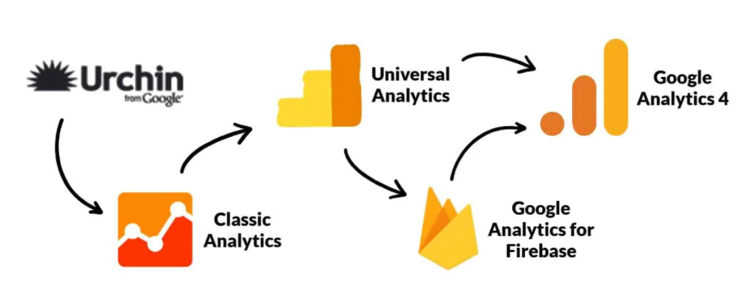
Continuous Updates and New Features
Dynamic Evolution: Google Analytics regularly introduces new features.
Transition to GA4: As of July 1, 2023, GA4 replaces Universal Analytics.

Slide 7

Real-Time Traffic Data
Real-time Reports: Monitor current site visitors and their activities.
Campaign Tracking: Evaluate one-day campaigns by tracking user engagement and conversions in real-time.
Content Popularity: Identify popular blog posts instantly with real-time data.

Slide 8

SUMMARY
Considering it's completely free, it's a great tool to add to your arsenal. However, the real deciding factor will be how much time and energy you want to invest in learning how the platform works.

Slide 9
Bibliography
https://www.abralytics.com/blog/google-analytics-the-main-pros-and-cons

