Slide 1
B1nary Cats
We have paws…

Slide 2
about()
>> repo = “https://github.com/ArturLukianov”
>> people_count = 2 + manager
>> project_count > 20
True
>> scopes = [
“Informational Security”,
“Artificial Intellegence”,
“Games”
]

Slide 3
games.list()
[
<object game ‘DiRo’>,
<object game ‘PACKER’>,
<object game ‘FallingDagger’>,
<object game ‘Qrena’>,
…
]

Slide 4
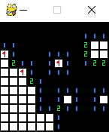
games.minesweeper.info()
author = ‘Alexnader’
algos = [‘BFS’]
games.minesweeper.screenshot()

Slide 5
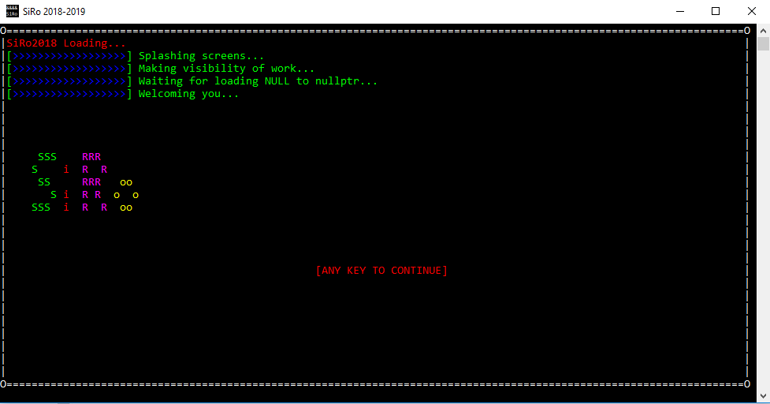
games.DiRo.history()
author = ‘Artur’
language = Cpp()
games.__cpp.SiRo.screenshot()

Slide 6
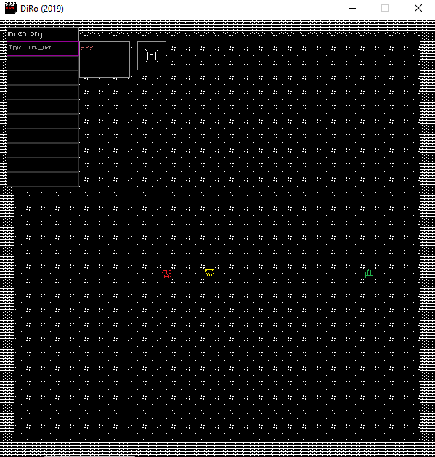
games.DiRo.info()
author = ‘Artur’
games.DiRo.screenshot()

Slide 7
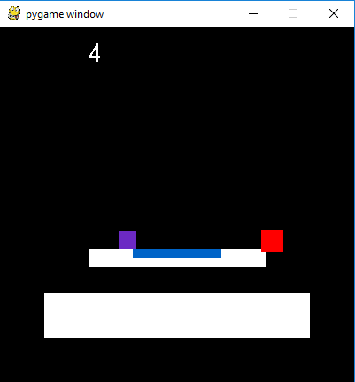
games.platformer.info()
author = ‘Alexnader’
feature = ‘physics’
games.platformer.screenshot()

Slide 8
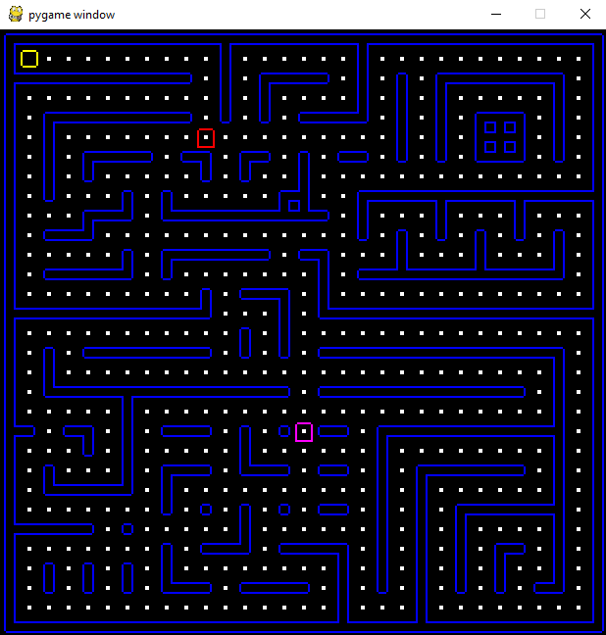
games.PACKER.info()
author = ‘Artur’
neural_networks = True
machine_learning = True
games.PACKER.screenshot()

Slide 9
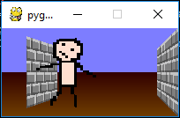
games.FallingDagger.info()
author = ‘Alexnader’
feature = ‘3D’
games.FallingDagger.screenshot()

Slide 10
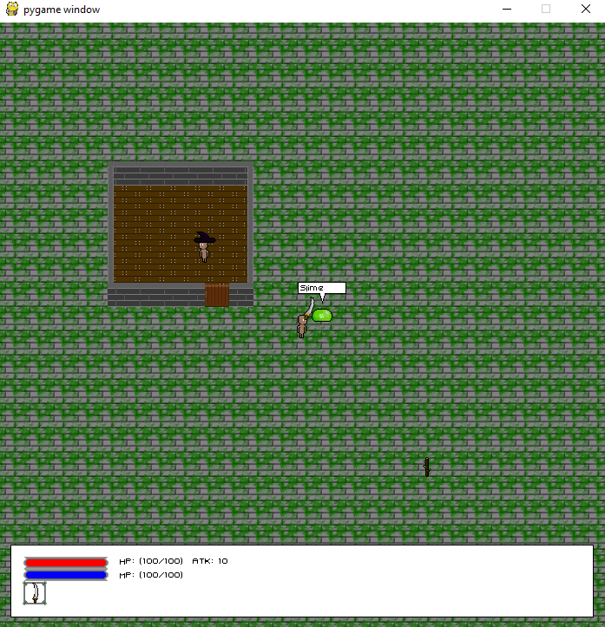
games.Qrena.info()
author = [‘Artur’, ‘Alexnader’]
games.Qrena.screenshot()

Slide 11
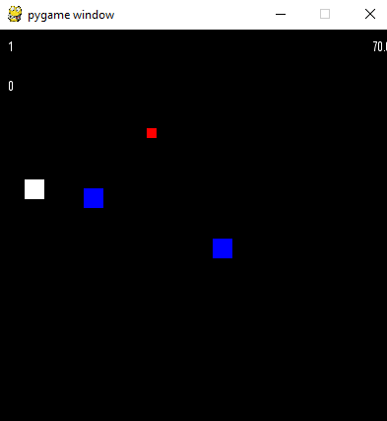
games.PySiRo.info()
author = ‘Alexnader’
games.PySiRo.screenshot()

Slide 12
games.play()
Traceback (most recent call last):
File "<stdin>", line 1, in <module>
GameError: Game not chosen

Slide 13
exit(0)

