Slide 1
Online Retail EDA – Customer & Returns Analytics
Data-Driven Insights from 500,000 Transactions (2009–2011)
Artur Melnyk – Data Analyst Python · Excel · Tableau

Slide 2



Project Overview
•
Objective: Uncover revenue, customer, and return trends from Online Retail II dataset.
Scope: Period 2009–2011 · ~500K transactions · 8 columns
Business Questions:
What drives revenue growth?
Who are top customers and high returners?
Which products/countries contribute most?
Timeline: Data Prep → EDA → Visualization → Documentation → Delivery
Data Prep
EDA
Visualizatio n
Documenta tion
Delivery

Slide 3
Tools & Methodology
•
Data Preparation – Python (Pandas, NumPy) – Handle nulls, clean types
•
Exploration – Matplotlib, Seaborn – Identify sales & return trends
•
Export for Viz – Excel – Prepare summary tables
•
Visualization – Tableau – Build interactive dashboards
•
Documentation – PDF & README – Ensure reproducibility

Slide 4
Data Cleaning Challenges & Solutions
•
Mixed Date Formats – pd.to_datetime(errors='coerce')
•
Missing Customer IDs – Dropped / flagged
•
Currency Strings – Converted to float
•
Invalid Descriptions – Flagged as Return Reasons
•
Lesson: Data cleaning = foundation of credible analysis

Slide 5
KPI Summary Bar
•
💶 Total Revenue: €14.7M (83% from UK)
•
👥 Top Customer (ID 18102): €608K spent
•
🔁 Average Return Rate: 7.3%
•
📦 Most Returned Product: Paper Craft Little Birdie
•
🌍 Countries Covered: 38 (UK & EIRE dominate)

Slide 6
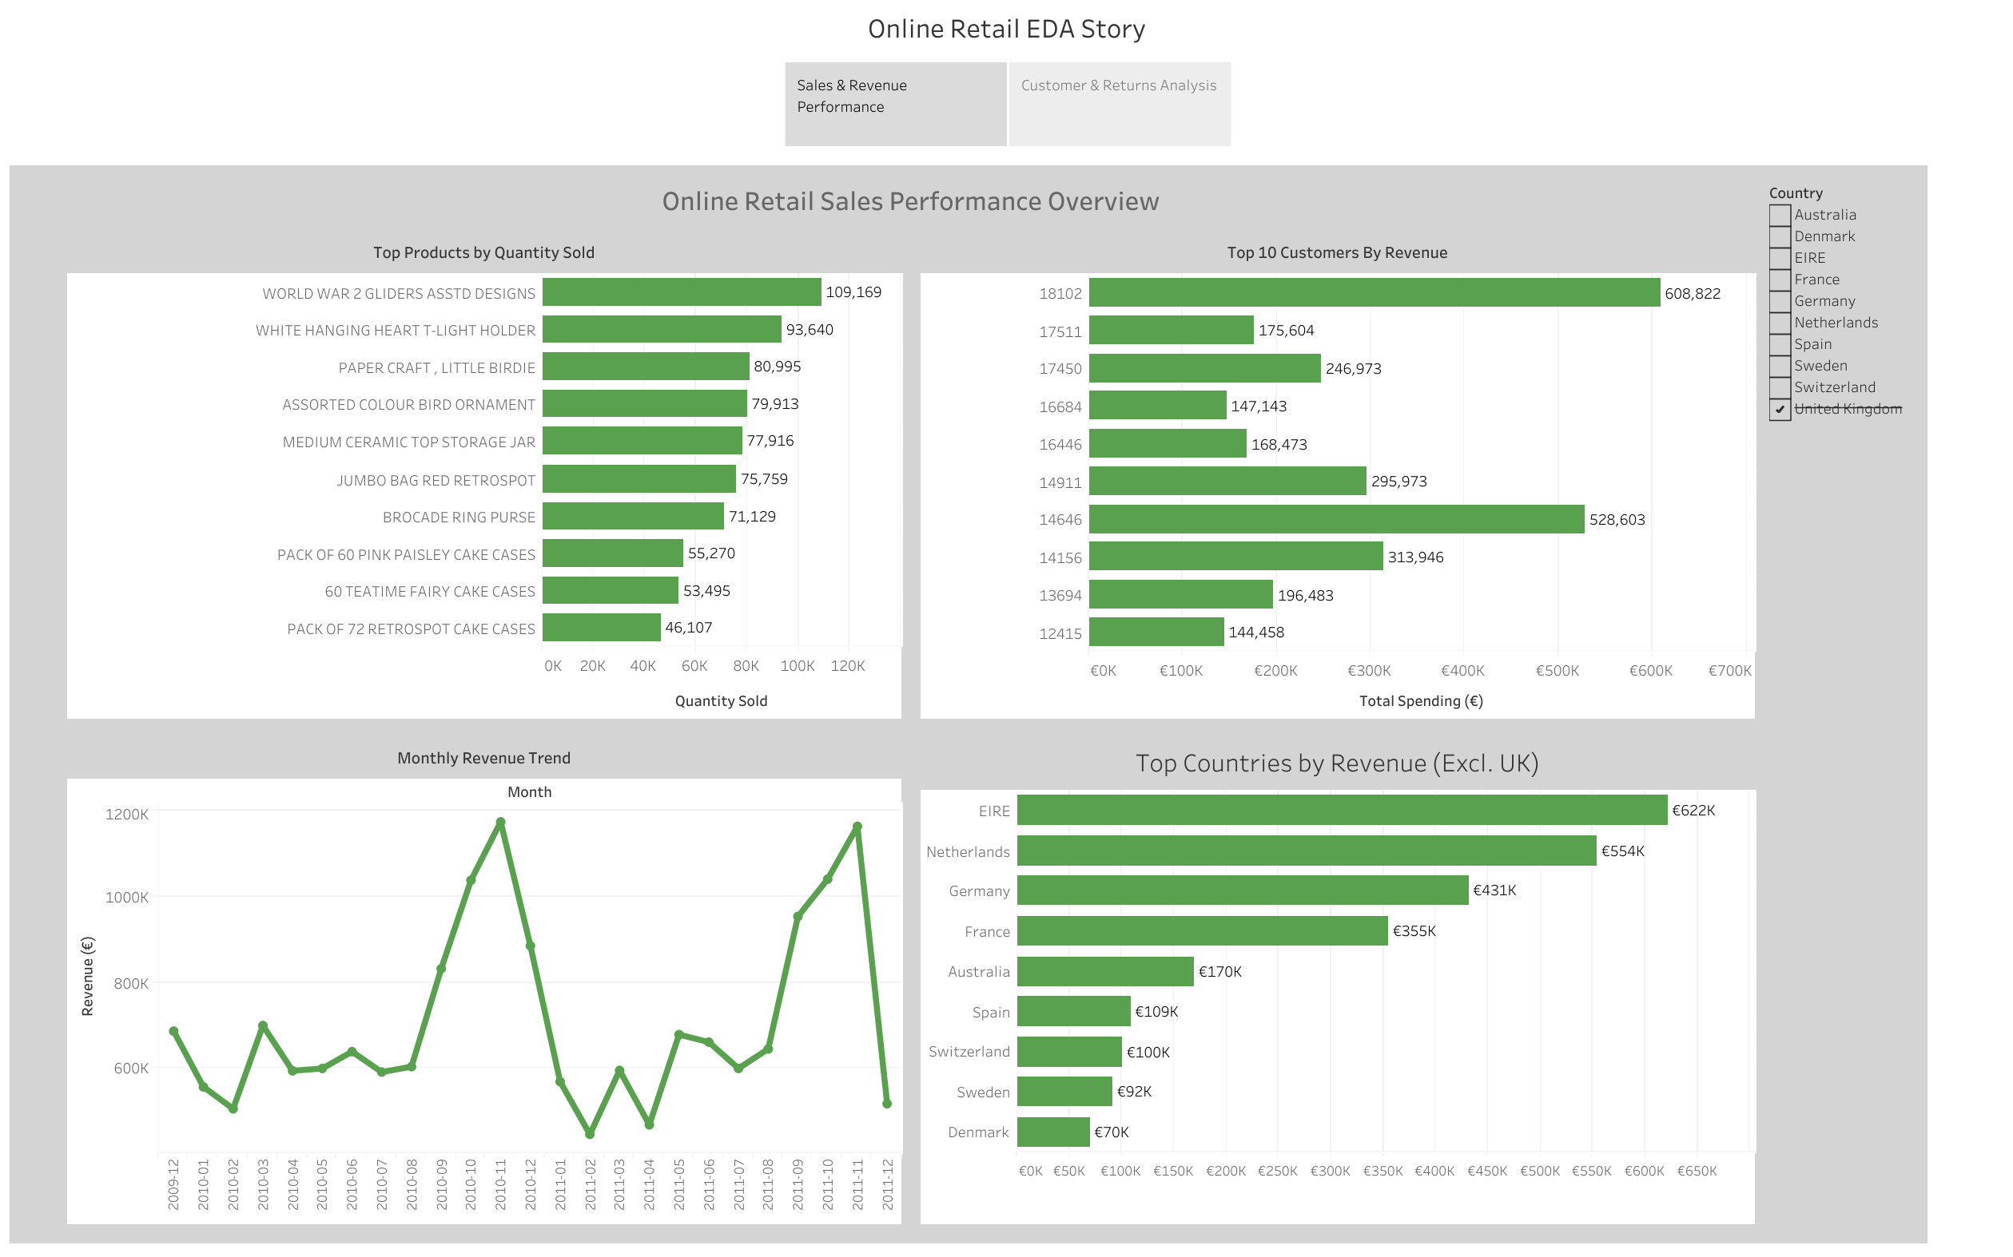
Sales & Revenue Performance

Slide 7
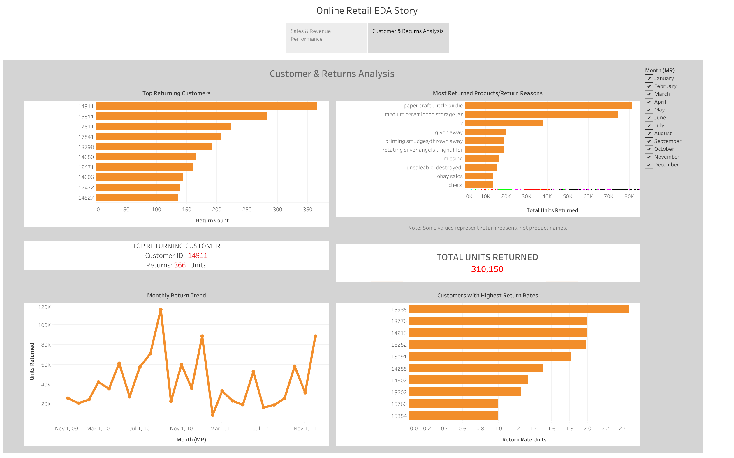
Customers & Returns Analysis

Slide 8
Top 3 Insights
🇬🇧" UK accounts for >80% sales → Focus marketing/logistics on UK
5% customers → 60% revenue → Loyalty & retention programs
Volume returners ≠ Rate returners → Differentiate return policies

Slide 9
Lessons Learned
Validate categorical semantics → detect hidden return reasons
Verify data types before Tableau import
Curate Top N → avoid clutter
Document continuously → reproducibility
Separate return metrics → volume vs rate clarity

Slide 10
Deliverables & Next Steps
•
Deliverables: Notebook, Clean Excel, Tableau Dashboard, PDF Documentation, README
•
Dashboard Link: Tableau Public (EDA Visualization)
•
Next Steps: Extend to RFM segmentation, automate monthly return alerts

Slide 11
Summary & Closure
•
•
Complete EDA case: raw data → insights → dashboards → documentation. Business-ready: actions tied to insights (UK focus, loyalty, differentiated returns).
Reproducible workflow: notebook + cleaned dataset + Tableau + PDF + README.
Executive communication: KPI slide, curated Top-N visuals, branded footer. Next: RFM segmentation, CLV model, automation of monthly return alerts. From Data to Decisions — Artur Melnyk, 2026
•
•
•
•
GitHUB: https://github.com/ArturMelnyk-analyst/EDA-onlineretail
Tableau: https://public.tableau.com/app/profile/artur.melnyk/viz/EDAvisualization/OnlineRetailEDAStory

