Slide 1
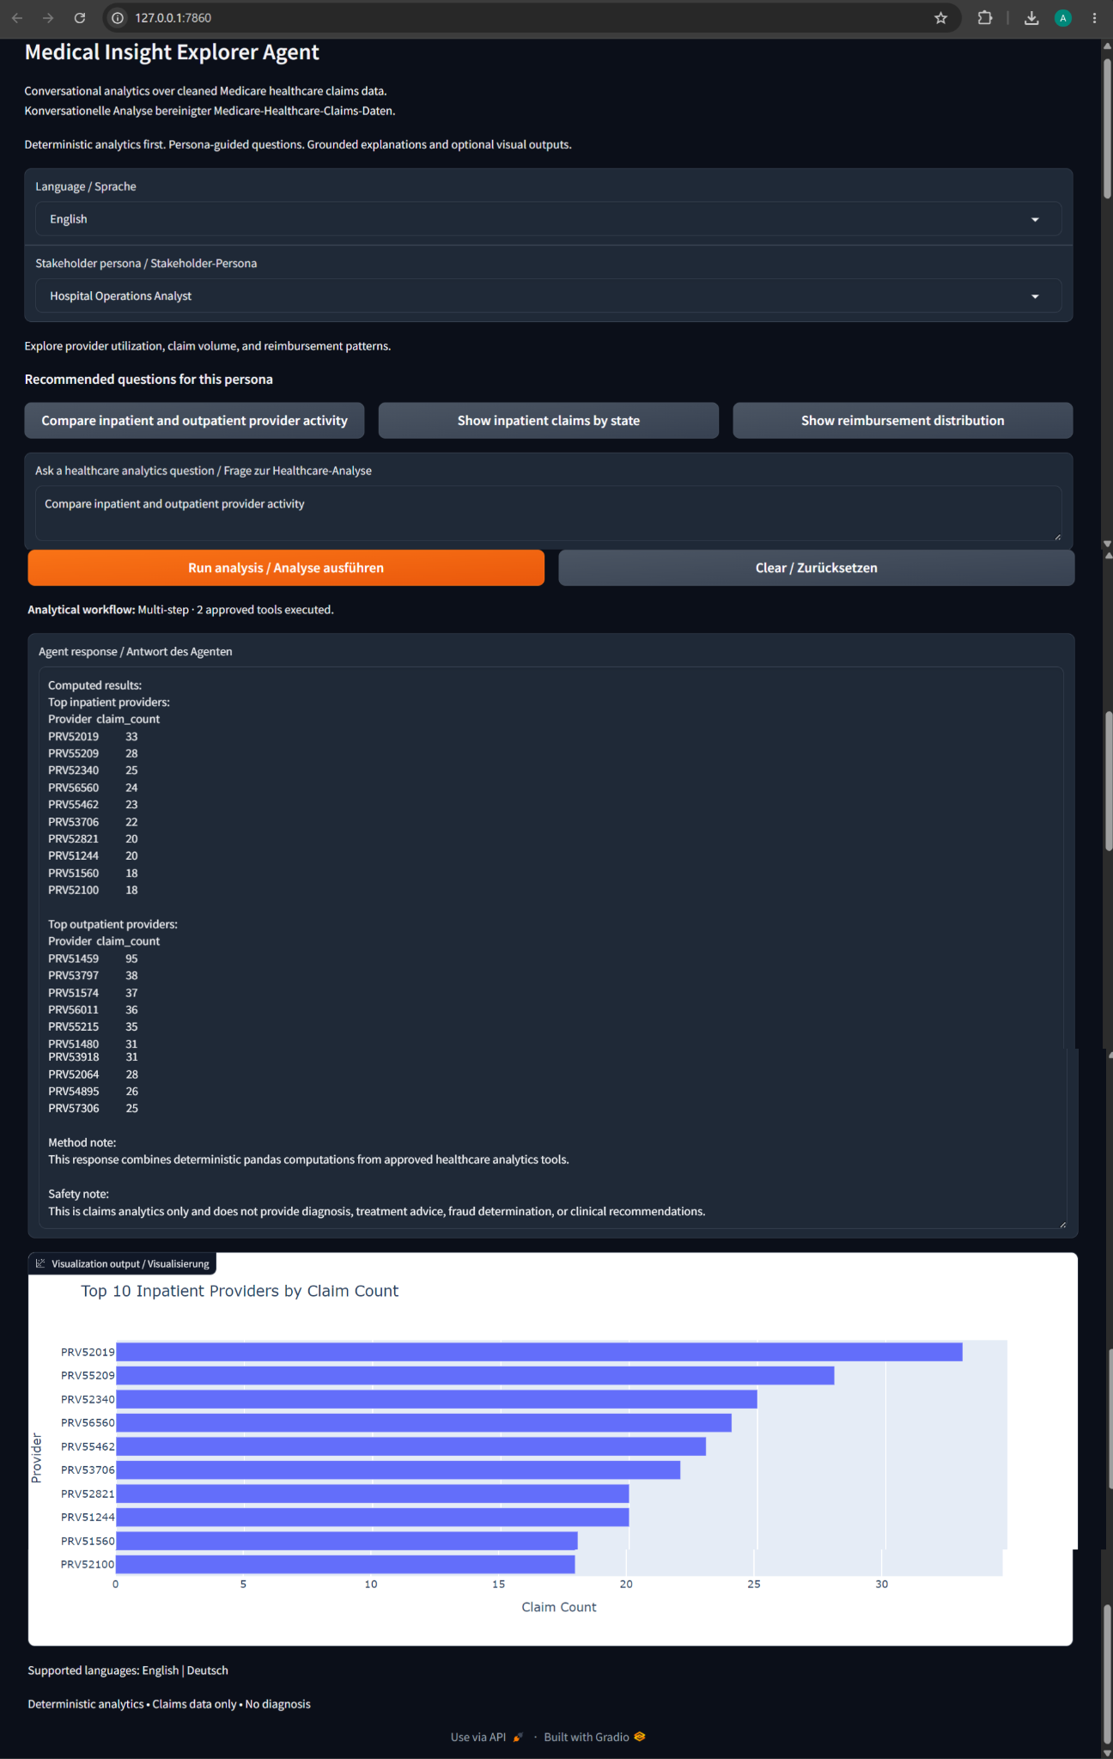
Medical Insight Explorer Agent
v1.2.0 • LangGraph • Gradio
Controlled, deterministic, bilingual healthcare claims analytics
Artur Melnyk | Applied Data Scientist

Slide 2
Business Problem → Design Response
Why the system is deliberately bounded
The problem
Healthcare claims data is large, relational, and difficult to explore. Natural-language analytics can improve accessibility, but unrestricted AI-generated analysis risks invented calculations and unsupported healthcare conclusions.
The design response
Separate natural-language interaction from numerical authority. Questions may select approved analytical capabilities, while predefined pandas functions calculate the actual healthcare metrics.
The outcome
A portfolio-grade analytics agent that is reproducible, bilingual, explainable, and intentionally limited to descriptive healthcare claims analysis.
“Natural language may choose approved analytics. It should not invent the analytics themselves.”
Medical Insight Explorer Agent • v1.2.0

Slide 3
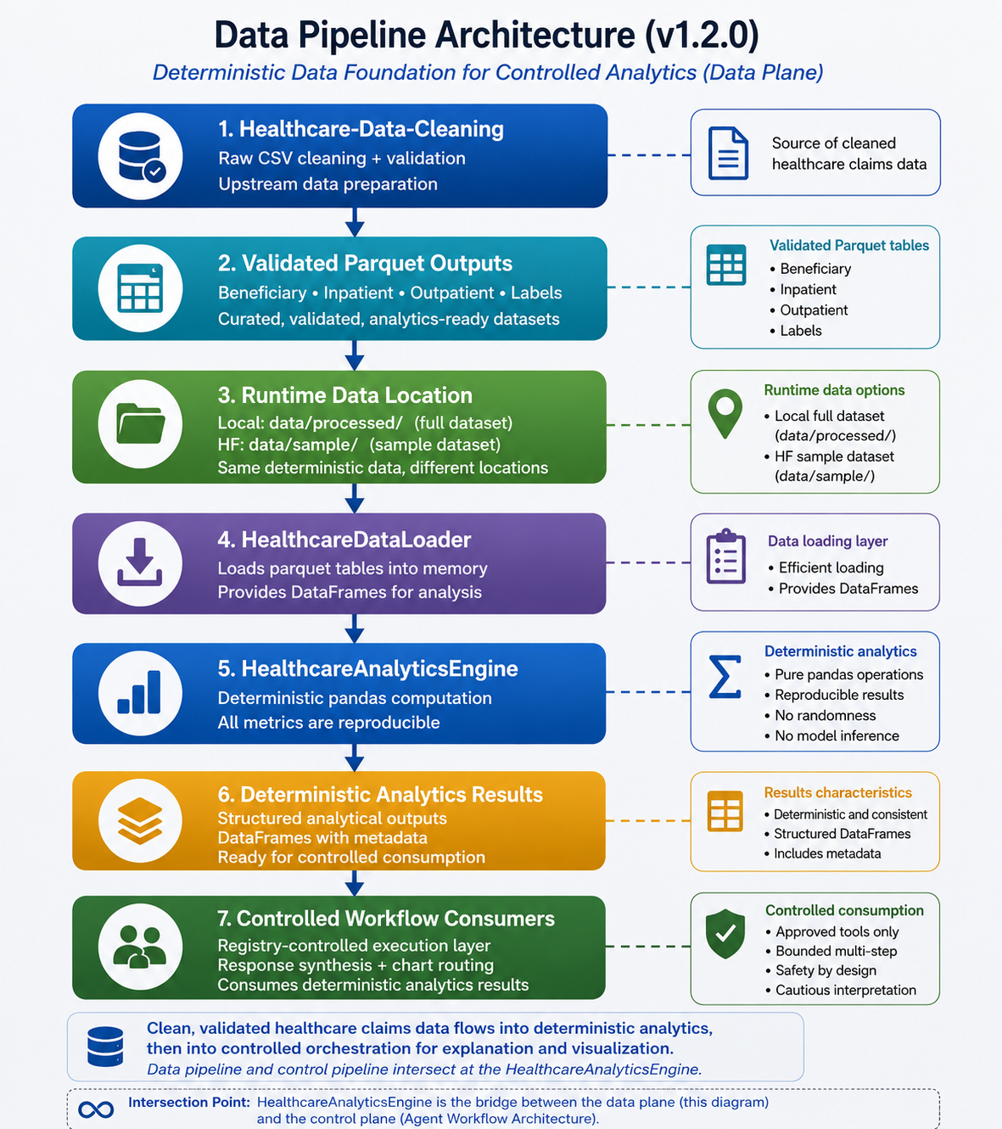
Data Foundation
Upstream cleaning and deterministic analytics remain separate from conversational control
Medical Insight Explorer Agent • v1.2.0

Slide 4
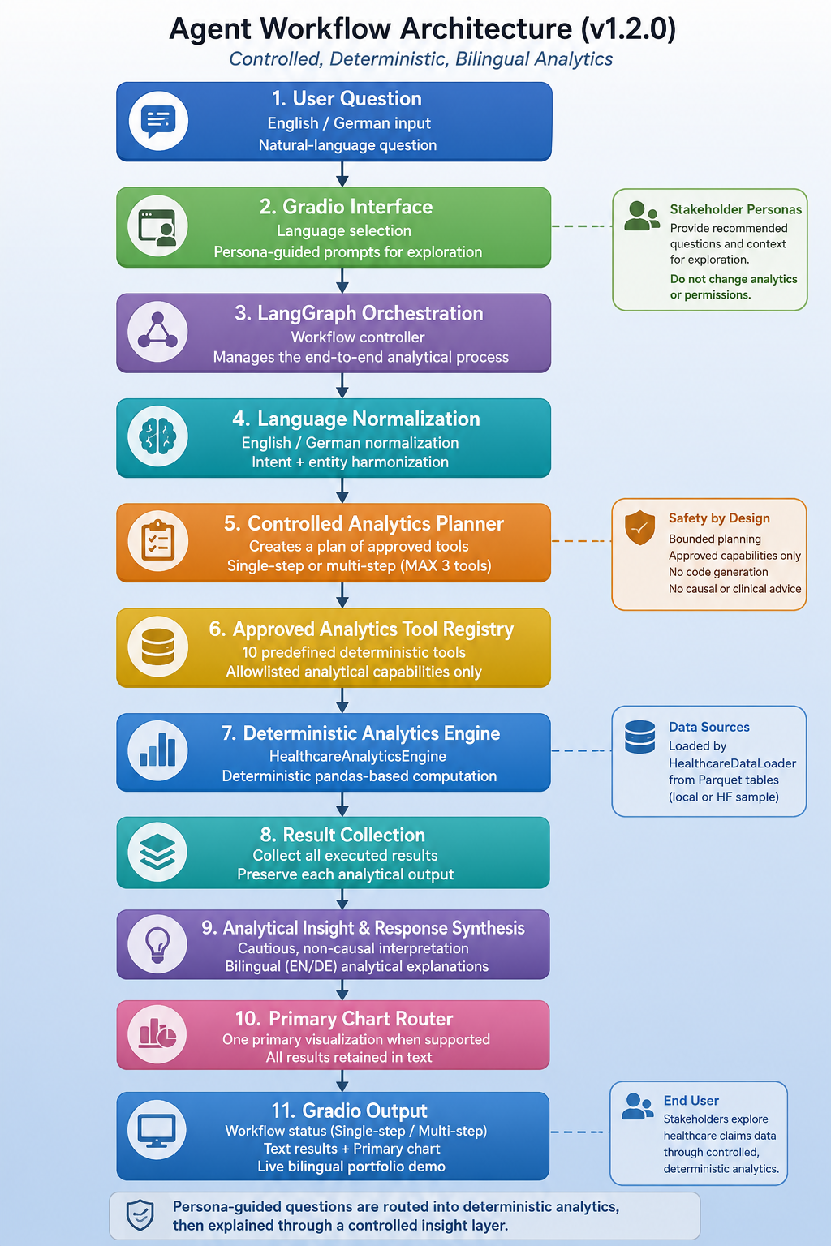
Agent Workflow Architecture
The control plane selects, constrains, executes, synthesizes, and presents
Medical Insight Explorer Agent • v1.2.0

Slide 5
What Changed in v1.2.0
From controlled single-step routing to bounded multi-step orchestration
1. Planner
Creates one-tool plans for simple questions and multi-tool plans only for explicitly supported compound questions. Maximum: 3 analytics steps.
2. Tool Registry
Ten allowlisted symbolic capabilities form the controller-facing execution boundary. Unknown or unregistered tools are rejected.
3. LangGraph
Coordinates sequential execution, stores all deterministic results, synthesizes the response, and preserves one primary chart.
Planner selects → Registry constrains → Analytics engine computes → LangGraph coordinates
Medical Insight Explorer Agent • v1.2.0

Slide 6
Approved Analytics Boundary
10 deterministic capabilities; no arbitrary Python, SQL, pandas, or dataframe execution
Dataset
table_shapes age_summary
Claims
inpatient_summary outpatient_summary
Providers
top_inpatient_providers top_outpatient_providers
Geography
inpatient_claims_by_state outpatient_claims_by_state
Reimbursement
diabetes_cost_summary reimbursement_distribution
Supported compound workflow
Compare inpatient and outpatient provider activity
Supported compound workflow
Compare inpatient and outpatient claims by state
Supported compound workflow
Compare inpatient and outpatient claim summaries
0 tools = unsupported/rejected • 1 tool = single-step • 2–3 tools = bounded multi-step
Medical Insight Explorer Agent • v1.2.0

Slide 7
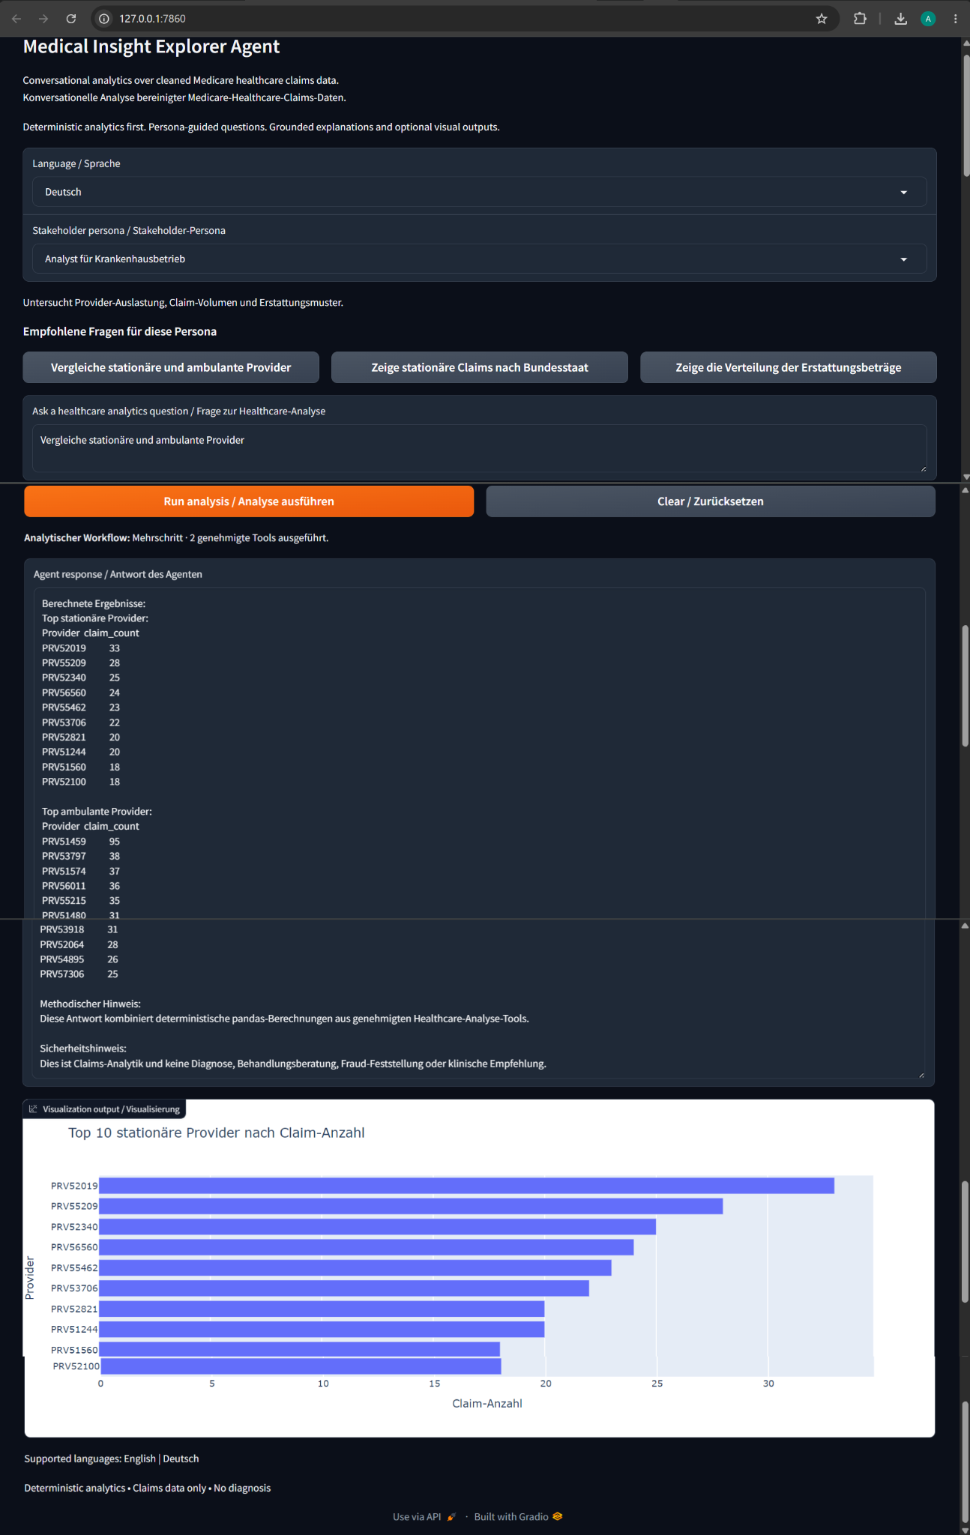
Bilingual, Persona-Guided UX
Language and stakeholder context improve exploration without changing analytics permissions
English + German
Same deterministic analytical capabilities.
3 stakeholder personas
Operations • Fraud investigation • Policy
Persona boundary
Guidance only — no formula or permission changes.
Medical Insight Explorer Agent • v1.2.0

Slide 8
Multi-Step Analytics in the Interface
One question → two approved tools → combined text results → one primary visualization
Visible workflow status
Multi-step · 2 approved tools executed
Multi-result response
Both inpatient and outpatient provider results are retained in the textual output.
Primary-chart compatibility
The current release intentionally renders one primary chart rather than a multi-chart dashboard.
Medical Insight Explorer Agent • v1.2.0

Slide 9
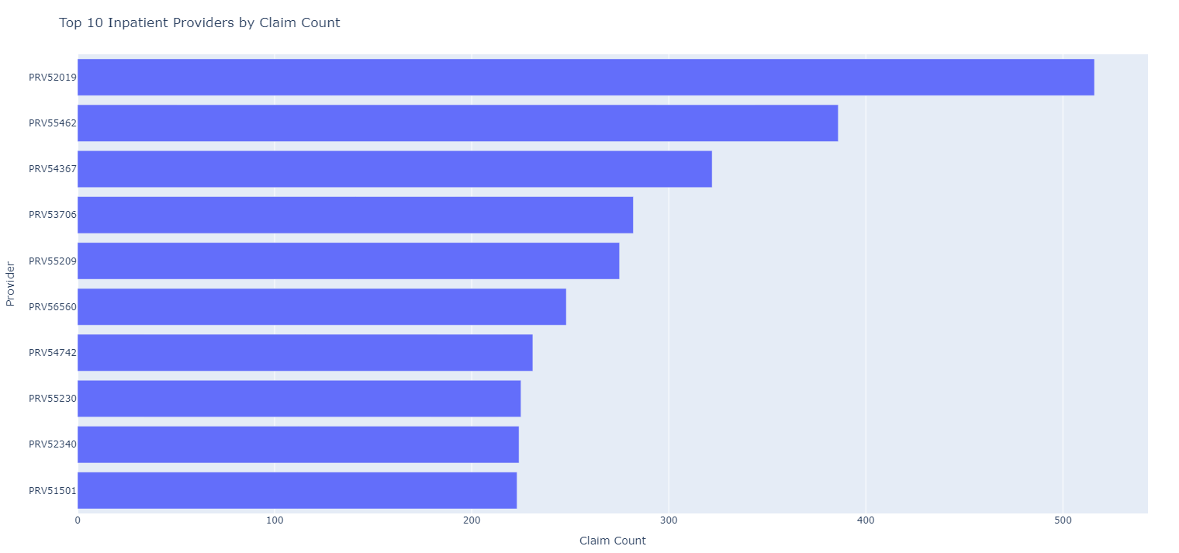
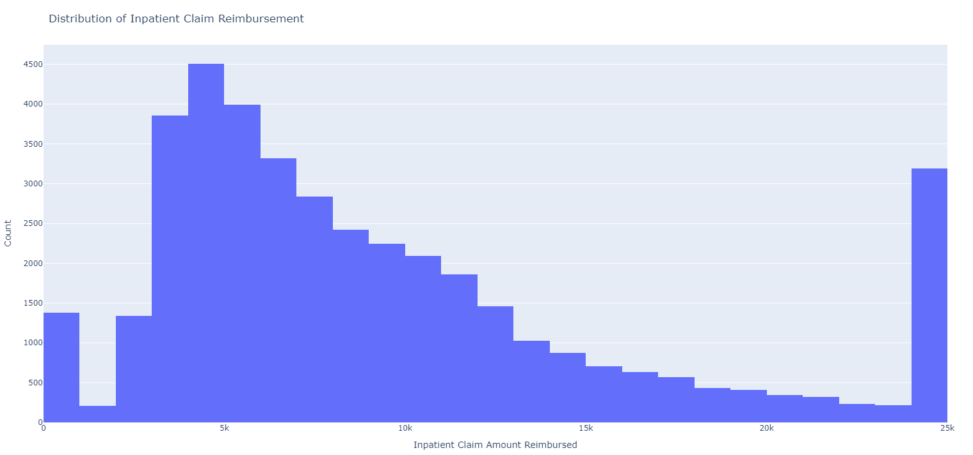
Representative Analytics Outputs
Deterministic results are calculated first; interpretation is added afterward
Provider activity
Provider claim volume is concentrated among a smaller subset of providers, supporting descriptive utilization monitoring and operational review.
Reimbursement distribution
The distribution is strongly right-skewed: most claims fall in lower-to-mid reimbursement ranges, with a smaller high-cost tail.
Medical Insight Explorer Agent • v1.2.0

Slide 10
Safety & Responsible Analytics
The constraints are architectural, not just wording in the interface
What the system enforces
✓ Predefined deterministic pandas calculations ✓ Allowlisted controller-facing tool registry ✓ Bounded planning: MAX_ANALYTICS_STEPS = 3 ✓ Unsupported and causal requests can execute zero tools ✓ Personas guide exploration only
What the system does not do
× No diagnosis or treatment recommendations × No patient-specific clinical advice × No fraud determination × No causal medical conclusions × No arbitrary Python / SQL / pandas execution
Descriptive healthcare claims analytics ≠ clinical or causal inference
Medical Insight Explorer Agent • v1.2.0

Slide 11
Engineering & Deployment
Same core architecture; different runtime data footprints
Local runtime
Full cleaned Parquet data when available `data/processed/`
Hugging Face Space
Lightweight public sample data `data/sample/`
Shared application core
Same planner, registry, analytics engine, LangGraph workflow, response and chart layers.
Clear module boundaries
Data loading • deterministic analytics • bounded planning • approved execution • orchestration • presentation
Validation focus
English/German • single/multi-step • fallback • causal rejection • chart behavior
Portfolio positioning
A controlled applied-DS system demonstrating analytics engineering, orchestration, UX, safety, and deployment.
Python • pandas • Plotly • Gradio • LangGraph • Hugging Face
Medical Insight Explorer Agent • v1.2.0

Slide 12
Medical Insight Explorer Agent — v1.2.0
Controlled multi-step analytics without unrestricted numerical authority
Deterministic
Predefined pandas analytics remain the source of numerical truth.
Controlled
Planner + allowlisted registry constrain what natural language can execute.
Usable
Bilingual personas, guided prompts, transparent workflow status, and live deployment.
Hugging Face: huggingface.co/spaces/Artur-Melnyk/Medical-Insight-Explorer-Agent
GitHub: github.com/ArturMelnyk-analyst/Medical-Insight-Explorer-Agent
Artur Melnyk • Applied Data Scientist

