Slide 1

eCAL5
enhanced Communication Abstraction Layer
http://github.conti.de/CTZS/ecal
Chassis & Safety Division

Slide 2
Overview
eCAL == enhanced Communication Abstraction Layer
middleware for high performance and scalable inter-process communication on single computational nodes or in heterogeneous networks
designed for minimal latency and high data throughput
lightweight API for message transport only
operates on a wide range of hardware platforms from high end server machines to ARM based embedded hardware
easy integration in different computing languages and frameworks

Slide 3











Overview
implementation language: C++11
Dependencies
Plattforms
Languages

Slide 4
Features
loose connection of all components via publish / subscribe pattern
all participants synchronize all information automatically, no central demon instance
different transport layers (inner-process, shared memory, udp unicast/multicast, lcm, rtps)
support a subset of quality of services (depends from transport layer mode)
native support of different serialization formats:
google::protobuf (reflection supported)
capnproto (reflection supported)
google::flatbuffers, messagepack, json ..
application eco system:
eCALMon: monitoring interface for real-time diagnostic and message debugging
eCALRec: recording distributed in an eCAL network or on a central host
eCALPLay: message replay with modern user interface or via command line
eCALSys: system start / stop

Slide 5
Transport Layers
inner process
ultra fast, reliable, single threaded, single process
shared memory
ultra fast, none reliable, highest throughput for 1 to n scenarios, multi threaded, multi process
udp multicast (can use multiple multicast groups for data transport)
performance depends on ethernet stack, none reliable, single threaded, multi process / hosts
udp metal
lightweight implementation (using one single multicast group for all data transport)
none reliable, single threaded, multi process / host
google:lcm (http://lcm-proj.github.io/)
udp multicast based (single multicast group), none reliable, single threaded, multi process / host
fastRTPS (http://www.eprosima.com)
dds standard - supports QOS, multi process / host (currently multicast transport only)

Slide 6
Serialization support
Binary
eCAL::CPublisher
String
eCAL::CStringPublisher<std::string>
Google:Protobuf https://developers.google.com/protocol-buffers/
eCAL::CProtoPublisher<GoogleProtobufType>
Google:Flatbuffers https://google.github.io/flatbuffers/
eCAL::CFlatPublisher<flatbuffers::FlatBufferBuilder>
CapnProto https://capnproto.org/index.html
eCAL::CCapnpPublisher<capnp::MallocMessageBuilder>
Message Pack http://msgpack.org/
eCAL::CMsgPackPublisher<CAddress>
JSON
eCAL::CProtoDynJSONSubscriber

Slide 7


Applications
eCALMon
monitors all eCAL entities
monitors the internal state of the whole eCAL cloud
central logging target for all eCAL participants
live data preview for raw payload string payload protobuf messages CapnProto messages
plugin interface for customer data visualization

Slide 8
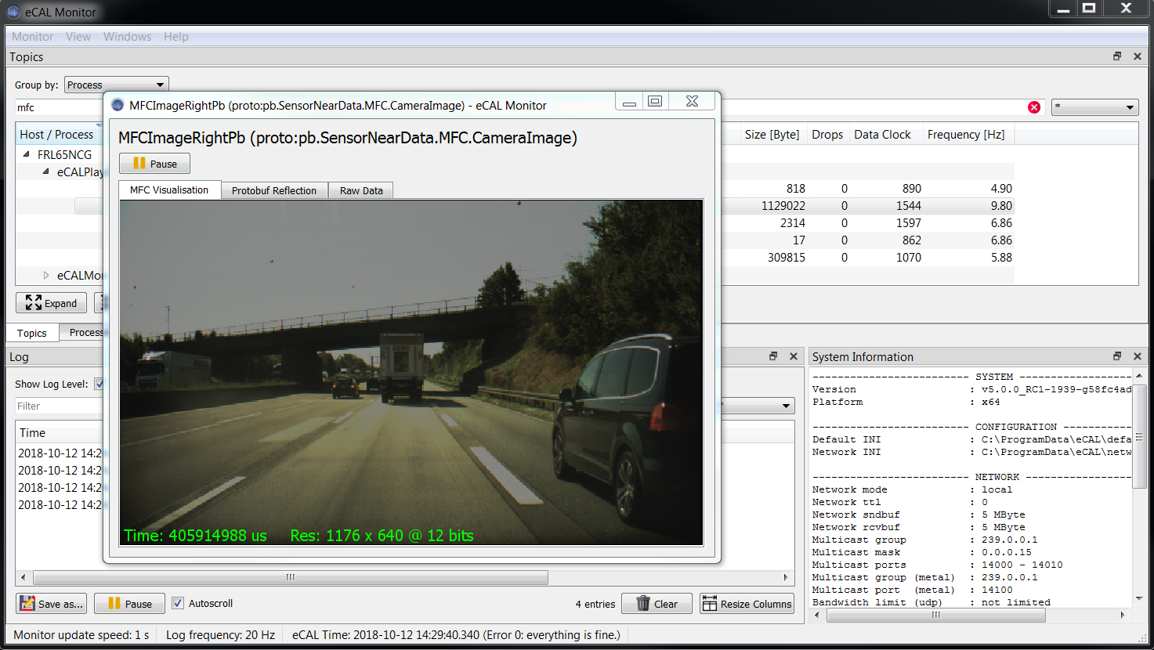
eCAL Monitor – live data view plugins

Slide 9
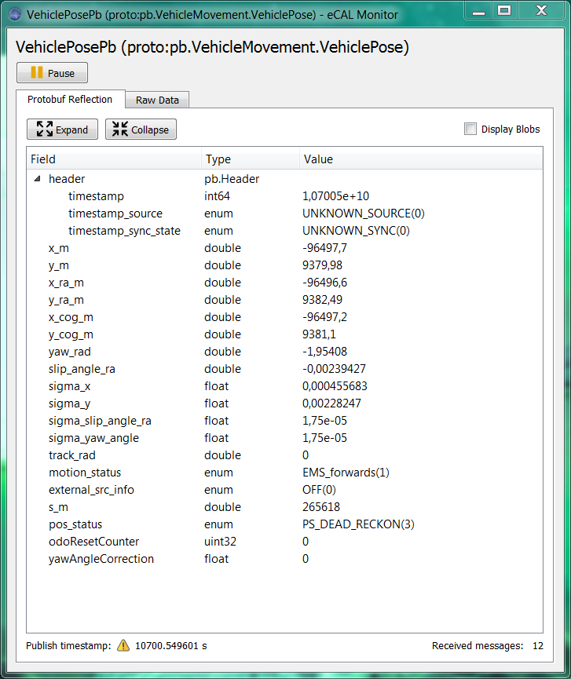
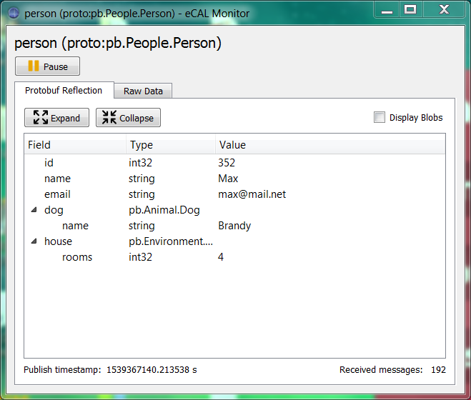
eCAL Monitor – reflection support for protobuf and capnproto

Slide 10
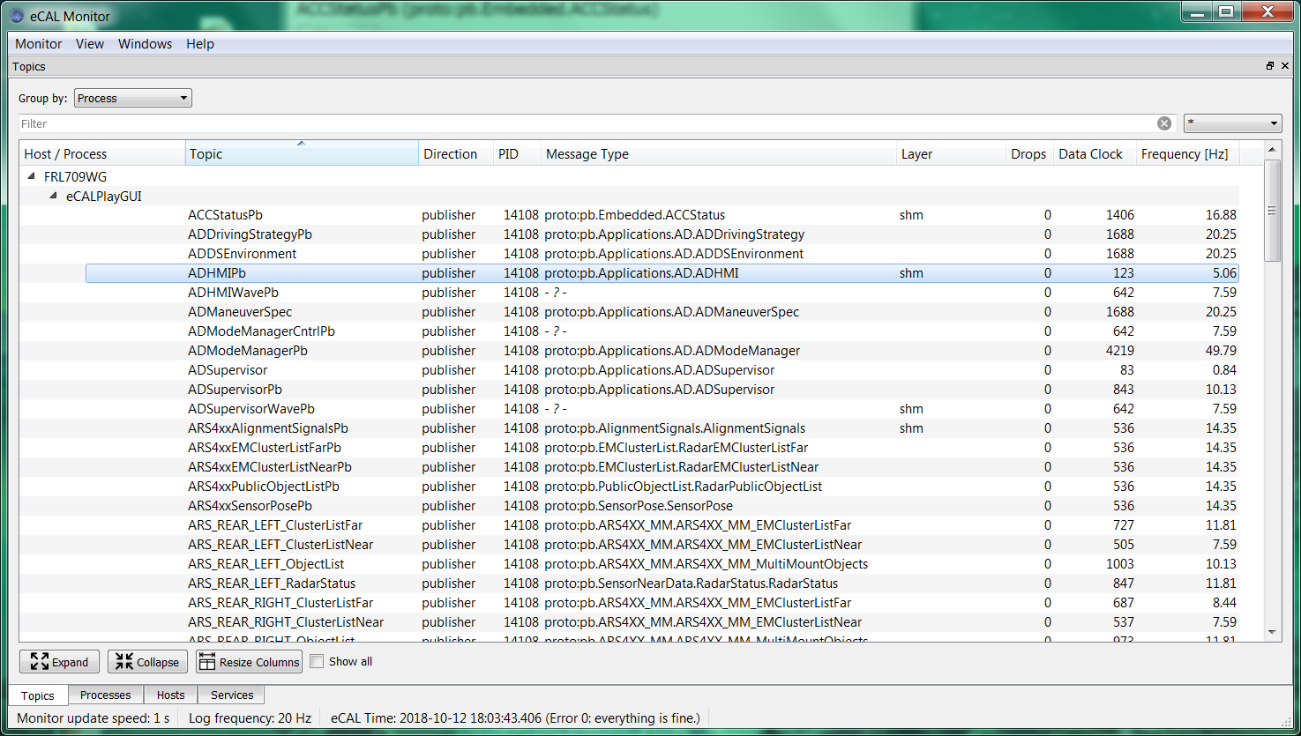
eCAL Monitor – layer diagnostic

Slide 11

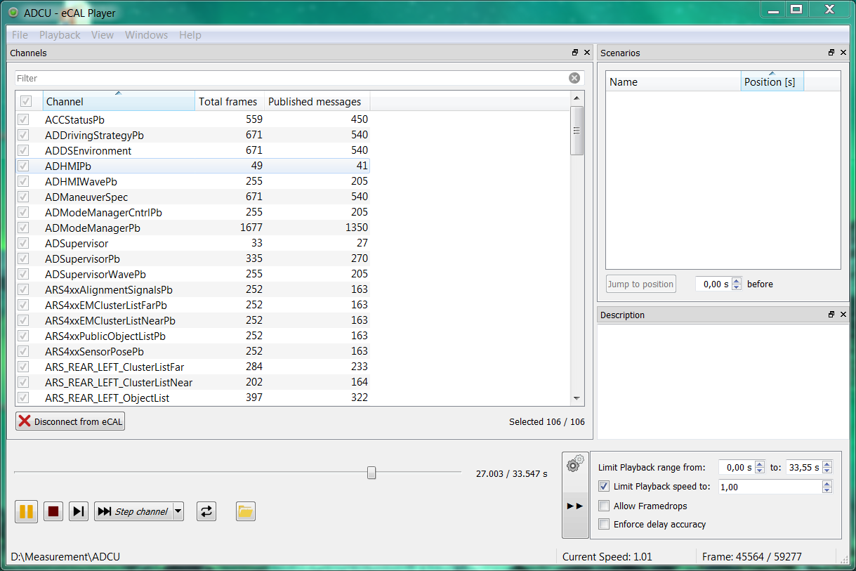
eCAL Player

Slide 12

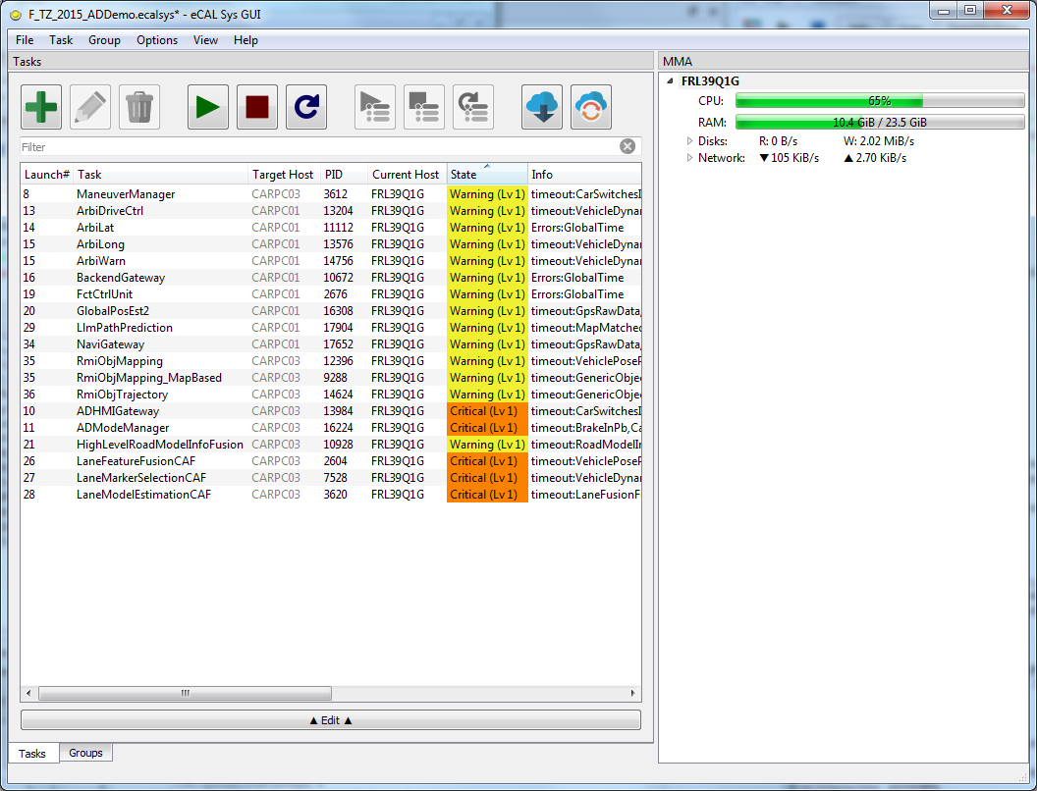
eCAL Sys

Slide 13
Thank you
for your attention!

