Slide 1
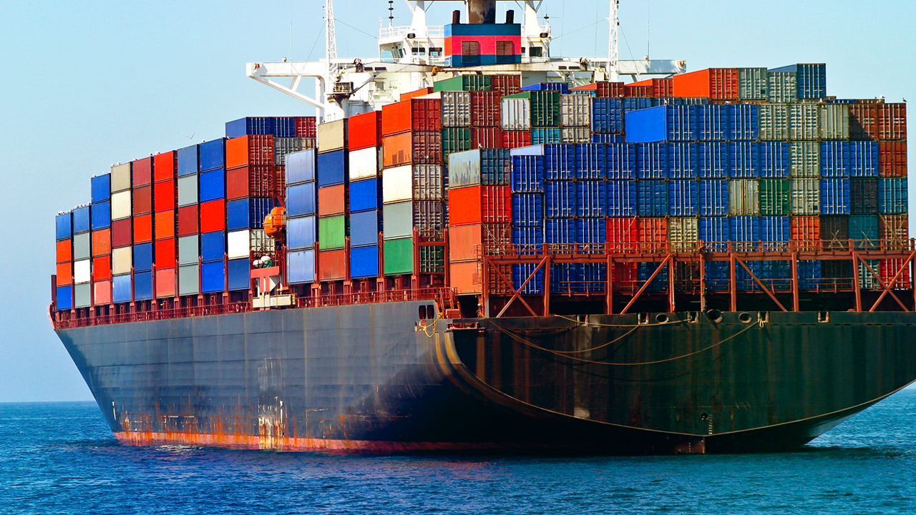
Containers 101
Notes:
Presentation created by editing a powerpoint made by Tomer Rosenthal (Tomer.Rosenthal@microsoft.com)

Slide 2
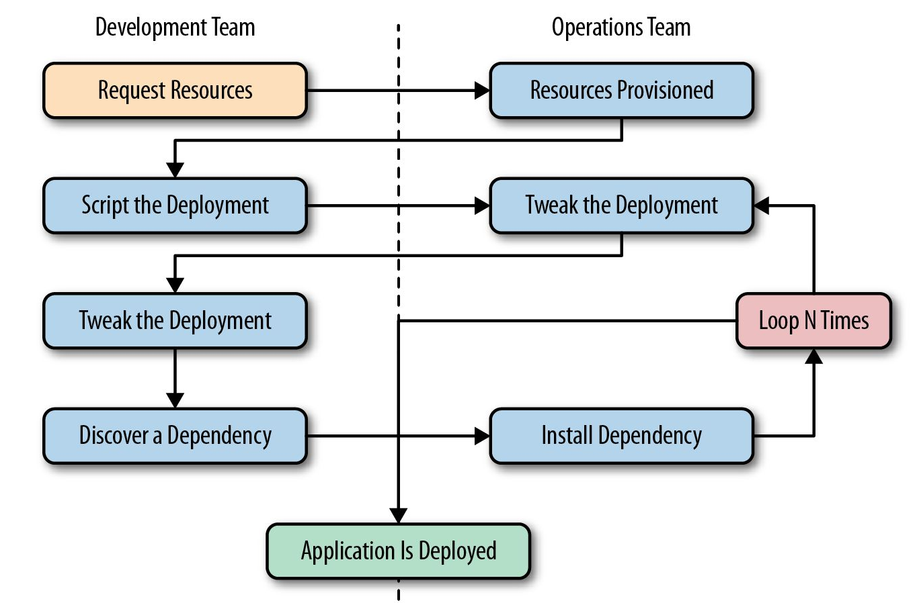
Typical Application Deployment Workflow
Application takes days or months to deploy – It may work in the old world….

Slide 3
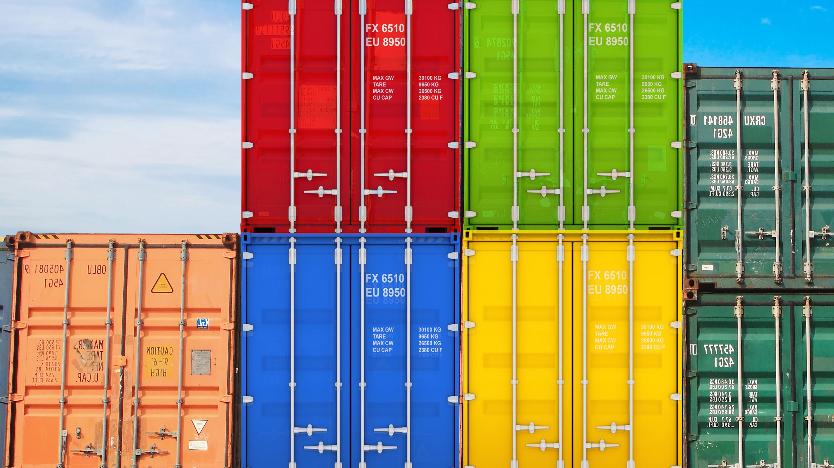
What is a container?
Containers are a method of operating system virtualization that allow you to run an application and its dependencies in resource-isolated processes
Slice up the OS to run multiple apps on a single OS
Typically you run one application/service per container
Container and apps share lifecycle
Every container has an isolated view and gets
Own root directory
eth0 network interface
its own PID0
Kernel features to accomplish this:
cgroups: limiting what you can use
namespaces: limiting what you can view
Cannot mix operating systems
Notes:
Containers are a method of operating system virtualization that allow you to run an application and its dependencies in resource-isolated processes

Slide 4

Why containers?
Repeatable execution
immutable environment
reusable and portable code (“Build, Ship, and Run”)
Consistency across development, test, & production
Fast & agile app deployment; instant startup
Cloud portability
Density, partitioning, scale
Diverse developer framework support
Microservices

Slide 5
Containers vs. VM’s
Virtual Machines
Each VM has independent, full OS
Full isolation
Separate app frameworks
Support features such as live migration
Containers
Shared Host OS
Near instant start-up
Processes in containers are isolated
Dependent app services and libraries are tied to container (layers)
All containers on a host will share the same guest OS version
App
A
App
A
App
B
App
C
App
Framework
App
Framework
App
Framework
App
Framework
VM
Guest OS
Guest OS
Guest OS
Guest OS
Hypervisor
Physical Server
App
A
App
A
App
B
App
B
App
C
App
C
Container
App
Framework
App
Framework
App
Framework
Guest OS w/ Docker
Hypervisor
Physical Server

Slide 6
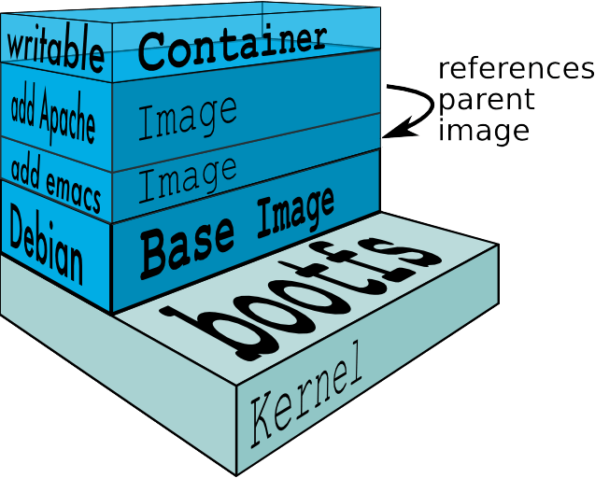
Constructing a Container
Images versus containers
Container tied to dependencies
Base image
Added files, binaries, libraries
App platforms. Eg – MongoDB, apache, node.js etc.
Configuration changes
Networking
Custom code
Can think of these as “layers”
One can build new layers on top of an existing container
Docker will pull these required dependencies to install/run
Notes:
Explain about IT creating the base container with requirements and then distributing the container to the developers
Show demo dockerfile

Slide 7
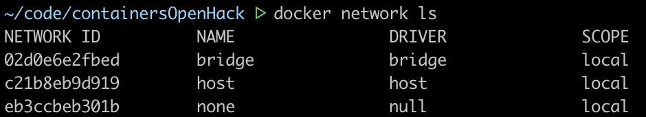
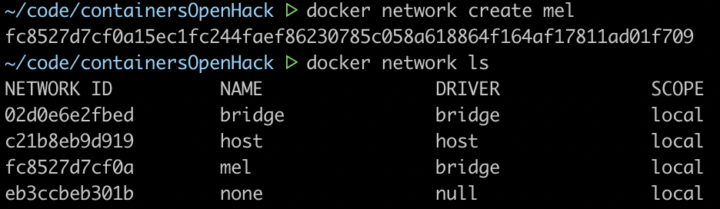
Docker Container Networking
Docker creates three networks
By default, Docker runs containers in the “bridge” network
Containers can only access each other by IP address
Need port mapping to communicate
User-defined bridge network
Containers expose all ports to each other and none to the outside world
Resolve IP addresses by container name
If you use the default bridge network, you must publish any ports that need to be accessed
Extra step: block access to ports

Slide 8
Dockerfile
# Use an official Python runtime as a parent image
FROM python:3.7
# Set the working directory to /app
WORKDIR /app
# Copy the current directory contents into the container at /app
ADD . /app
# Install any needed packages specified in requirements.txt
RUN pip install -r requirements.txt
# Make port 80 available to the world outside this container
EXPOSE 80
# Define environment variable
ENV <name>=<value>
# Run app.py when the container launches, CMD v. ENTRYPOINT
ENTRYPOINT ["python","app.py"]

Slide 9
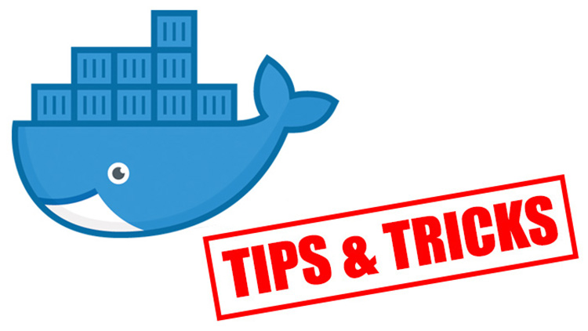

Slide 10
Common commands
List all images – docker images
List all containers – docker ps -a
Running
Every docker run creates a new container with the specified image and starts a command inside of it (CMD or ENTRYPOINT specified in the Dockerfile)
When using this command many times, use the --rm flag, so that the container data is removed after it finishes
docker run --rm -it debian /bin/bash
-it means --interactive --tty
Used to attach the command line to the container after it starts
Logs
If a container was started in detached mode (-d), the logs of it can be retrieved using the following:
docker logs –f <container_name>
-f tag to follow the upcoming log messages.
When you are done, hit Ctrl-c.
Use docker exec to "enter into a container"
Use docker exec to enter into a container:
docker exec -it ubuntu_bash bash
Use it to inspect and debug running containers

Slide 11
Remove all containers
Windows
FOR /f "tokens=*" %i IN ('docker ps -a -q') DO docker rm -f %i
Linux / OSX
docker ps -q -a | xargs docker rm -f
Remove all untagged images
Windows
FOR /f "tokens=*" %i IN ('docker images -q -f "dangling=true"') DO docker rmi -f %i
Linux / OSX
docker rmi –f $(docker images | grep "^<none>" | awk '{print $3}')

