Slide 1
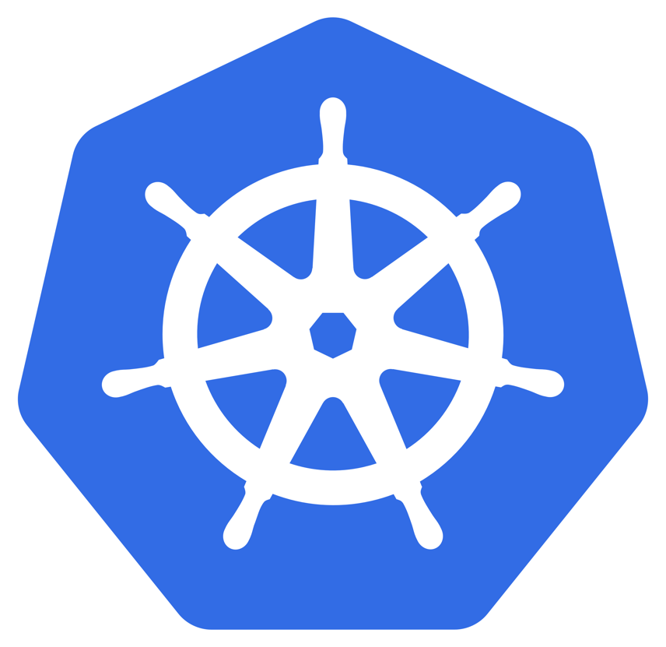
Kubernetes - K8S

Slide 2
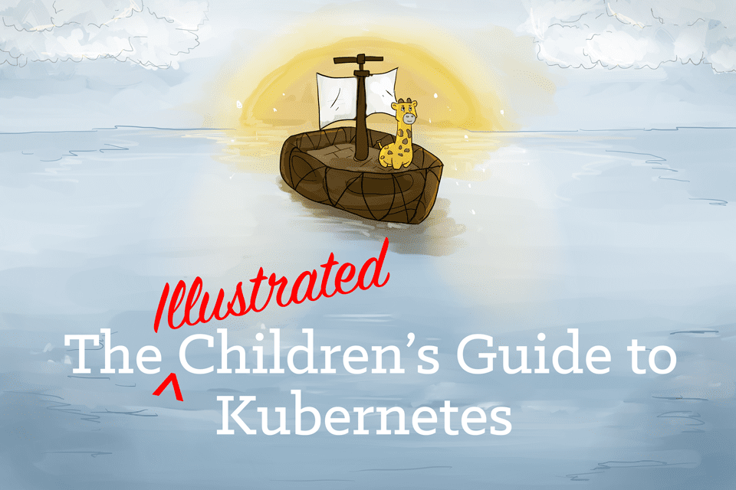
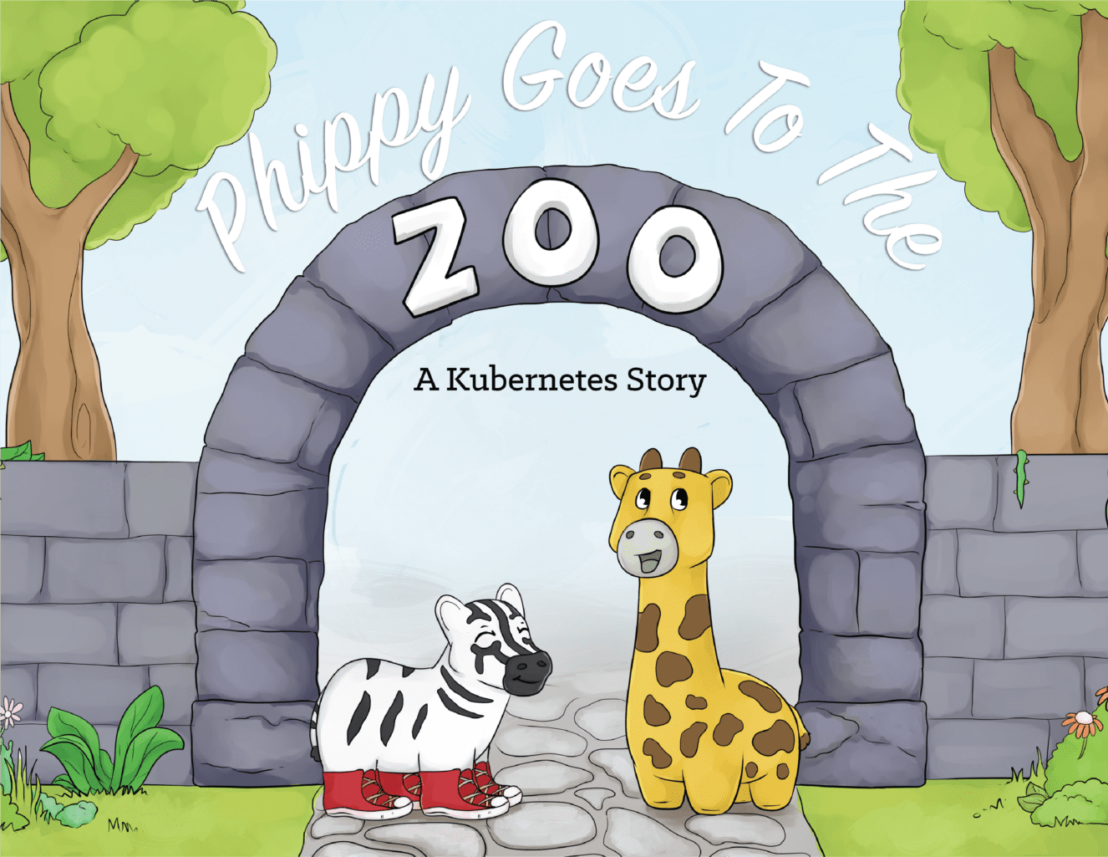
Why Kubernetes?
kubectl – central control plane
Horizontal scaling and node autoscaling
Self-healing
Service discovery and load balancing
Automated rollouts and rollbacks
Secret and configuration management
Storage orchestration
Open sourced – very large community
Native support for Azure networking, load balancer, and Azure disk integration

Slide 3
Kubernetes Basics
Control 0
Node 0
Node 1
…
Node N
Availability set
Availability set
Open Source Project: aks-engine
Managed Kubernetes: Azure Kubernetes Service (aks)
One control plane across many servers
Single management endpoint for X workloads across Y servers (VM’s).
Resiliency based on application health
Service discovery

Slide 4
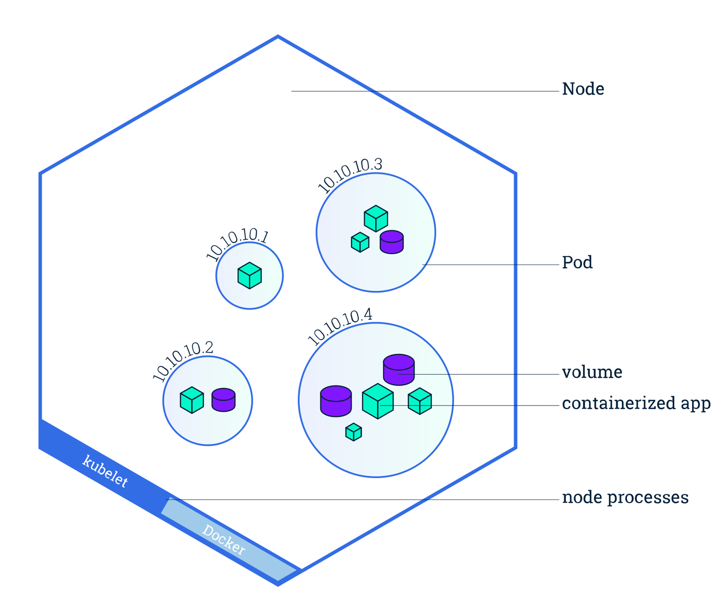
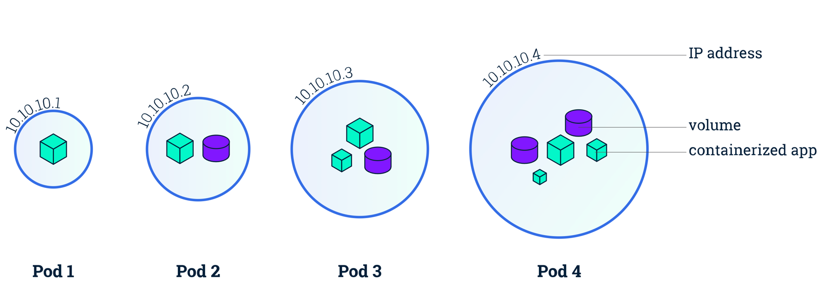
Kubernetes Basics
Pod – a group of containers that always run together on a host.
Usually exposes one or more ports to outside callers
Pods have a unique IP (distinct from node) and may be short-lived
Pods are the atomic unit on the Kubernetes platform.
Notes:
A Pod models an application-specific "logical host" and can contain different application containers which are relatively tightly coupled. For example, a Pod might include both the container with your Node.js app as well as a different container that feeds the data to be published by the Node.js webserver. The containers in a Pod share an IP Address and port space, are always co-located and co-scheduled, and run in a shared context on the same Node.
Pods are the atomic unit on the Kubernetes platform. When we create a Deployment on Kubernetes, that Deployment creates Pods with containers inside them (as opposed to creating containers directly). Each Pod is tied to the Node where it is scheduled, and remains there until termination (according to restart policy) or deletion. In case of a Node failure, identical Pods are scheduled on other available Nodes in the cluster.
A Pod is a group of one or more application containers (such as Docker or rkt) and includes shared storage (volumes), IP address and information about how to run them.
Pods can be used to host vertically integrated application stacks (e.g. LAMP), but their primary motivation is to support co-located, co-managed helper programs, such as:
content management systems, file and data loaders, local cache managers, etc.
log and checkpoint backup, compression, rotation, snapshotting, etc.
data change watchers, log tailers, logging and monitoring adapters, event publishers, etc.
proxies, bridges, and adapters
controllers, managers, configurators, and updaters
Individual pods are not intended to run multiple instances of the same application

Slide 5
Basic Terms
Pods – A description of a set of containers that need to run together.
ReplicaSet – Defines how many copies of a pod to keep running.
Controllers – These implement different policies for automatic pod management. There are three types, but I will only mention two:
Deployment – Responsible for maintaining a set of running pods of the same type.
DaemonSet – Runs a specific type of pod on each node based on a condition.
Namespaces – This is a tool used to group, separate, and isolate groups of objects. Namespaces are used for access control, network access control, resource management, and quoting.
Services – An object that describes a set of pods that provide a useful service. Services are typically used to define clusters of uniform pods.
Notes:
Show dashboard with “kubectl proxy” command. Make sure everybody opens their dashboards
Show Pods and Services Demos. Explain only deployment controller and deployment with kubectl and YAML files.
Hello-World challenge

Slide 6
Kubernetes Services
Service – A Kubernetes Service is an abstraction layer which defines a logical set of Pods and enables external traffic exposure, load balancing and service discovery for those Pods. It has a unique IP and outlives its pods
Service
Control 0
Node 0
Node 1
…
Node N
Pod
Pod
ServiceTypes - 4 Total Types
ClusterIP - internal
LoadBalancer - external
Key Point: Because Pods can come and go, Kubernetes provides service location via DNS and updates DNS based on service location

Slide 7
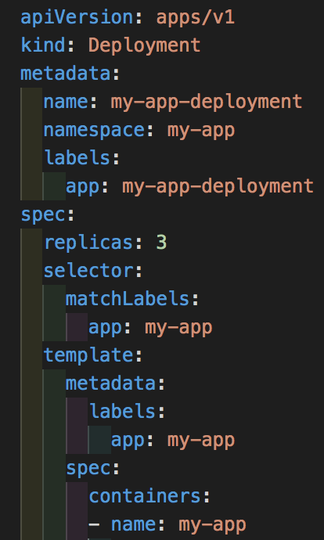

Kubernetes Yaml Files
Tabs vs. spaces matter
Very sensitive to formatting: indentation, string vs not
Download the VS Code extension!
And now a walkthrough of a yaml file
Notes:
Show dashboard with “kubectl proxy” command. Make sure everybody opens their dashboards
Show Pods and Services Demos. Explain only deployment controller and deployment with kubectl and YAML files.
Hello-World challenge

