Slide 1
DIAGRAM GENERATION PIPELINE
How a Diagram Is Born
From a natural-language prompt to a costed Azure architecture — every stage, end to end.
LLM decides structure
Deterministic code decides visuals
Technical walkthrough for AI PSAs • Worked example: HIPAA-compliant Healthcare FHIR API

Slide 2
The one idea that explains everything
The model never picks a pixel, an icon, or a price. It emits a strict JSON contract; deterministic engines do the rest.
LLM · the semantic step
CODE · the visual step
Interprets intent from natural language
Chooses which Azure services fit
Assigns services to logical groups
Declares connections + a workflow narrative
Outputs JSON only — no coordinates, no styling
Normalizes names against a curated icon map
Resolves each service to a real Azure SVG
Renders groups as containers, typed edges
Computes every position (Dagre / ELK)
Prices services from Azure Retail Prices data
Why it matters: reproducible, model-swappable, and correct-by-construction — not "AI magic."
Azure Architecture Diagram Builder
2 / 16

Slide 3
The pipeline: 10 stages, one JSON contract in the middle
Purple stages run in the model. Teal stages run as deterministic code in the browser + token server.
01
02
03
04
05
Input
Prompt assembly
Model call
JSON contract
Parse + normalize
entry
LLM
LLM
LLM
code
06
07
08
09
10
Icon resolution
Groups / zones
Edges
Layout engine
Costing
code
code
code
code
code
Azure Architecture Diagram Builder
3 / 16

Slide 4
STAGE 01 ENTRY
Input — one prompt, four entry points
Natural language is the primary path — free-form intent, no schema required.
Voice input is transcribed (Azure Speech) into the same prompt box.
Two deterministic entry points skip the model entirely:
Import Template — ARM JSON parsed directly (<1s)
Import from Azure — live Resource Graph of a resource group
Everything converges on the same architecture object downstream.
EXAMPLE PROMPT (ACTUAL)
"A HIPAA-compliant healthcare data
platform integrating EHR systems
via HL7 FHIR R4 APIs, PACS/DICOM
imaging (500TB), clinical decision
support, patient portal + secure
messaging, PHI audit logging,
15-min RPO DR…"
→ sent verbatim as the user message
Azure Architecture Diagram Builder
4 / 16

Slide 5
STAGE 02 LLM
Prompt assembly — the system prompt does the heavy lifting
Role: "expert Azure cloud architect… return a JSON specification."
Known-services catalog injected from SERVICE_ICON_MAP so the model uses exact display names.
Icon-category vocabulary (17 categories) constrains the "category" field.
13 rules encode Microsoft-reference-architecture conventions: grouping, edge budget, hub-and-spoke monitoring, service caps.
The exact output JSON schema is spelled out inline.
SYSTEM PROMPT (EXCERPT)
DO NOT include position, x, y,
width or height — the layout
engine calculates positions.
Rules (excerpt):
1 Create 2-5 logical groups
3 Use "Microsoft Entra ID"
9 Hub-and-spoke for monitoring
10 Limit connections to 12-18
12 Total services: 8-12 max
Azure Architecture Diagram Builder
5 / 16

Slide 6
STAGE 03 LLM
Model call — proxied, model-agnostic, JSON-only
The browser never holds the API key. All traffic goes through the token server at /api/openai (the security boundary).
12 selectable models (GPT-5.x, DeepSeek, Grok, Mistral, Kimi) — the pipeline is identical regardless of model.
The system + user messages are sent; JSON output is requested.
Latency + token metrics are captured and attached to the result for the leaderboard.
REQUEST SHAPE
POST /api/openai
messages: [
{ role: "system", content: … },
{ role: "user", content: prompt }
]
key stays server-side ✔
model swappable ✔
Azure Architecture Diagram Builder
6 / 16

Slide 7
STAGE 04 LLM
The JSON contract — four sections, zero coordinates
groups — logical containers (id + label only).
services — id, name, type, category, description, groupId.
connections — from, to, label, type (sync/async/optional).
workflow — ordered steps, each listing the service IDs involved.
This contract is the single hand-off from "AI" to "code." Everything after here is deterministic.
RESPONSE SCHEMA
{
"groups": [{ id, label }],
"services": [{ id, name, type,
category, groupId }],
"connections": [{ from, to, label,
type }],
"workflow": [{ step, description,
services:[…] }]
}
// no x, y, width, height
Azure Architecture Diagram Builder
7 / 16

Slide 8
STAGE 05 DETERMINISTIC
Parse + normalize — trust, but verify the model
JSON.parse with strict error handling; malformed output is rejected, not rendered.
Every service is matched against SERVICE_ICON_MAP by name, then by type.
On a match, the code overwrites name, type and category with the curated canonical values — so a diagram is consistent even if the model is loose.
Fuzzy matching catches near-misses (e.g. "FHIR service" → Azure Health Data Services).
NORMALIZATION
mapping = getServiceIconMapping(
service.name) ||
getServiceIconMapping(service.type)
if (mapping) {
name = mapping.displayName
category = mapping.category
}
🔧 "FHIR API" → Azure Health
Data Services (databases)
Azure Architecture Diagram Builder
8 / 16

Slide 9
STAGE 06 DETERMINISTIC
Icon resolution — the official Azure icon set, not clip-art
The icon map holds { displayName, category, iconFile } per service.
The SVG path is built deterministically from category + iconFile.
714 official Azure SVG icons across 29 category folders are glob-loaded at build time.
Because the category is validated upstream, every node gets a real, correct product icon — no guessing at render time.
PATH RESOLUTION
/Azure_Public_Service_Icons
/Icons
/{category}
/{iconFile}.svg
e.g. databases/
10142-icon-service-Azure-
API-for-FHIR.svg
714 icons · 29 categories
Azure Architecture Diagram Builder
9 / 16

Slide 10
STAGE 07 DETERMINISTIC
Groups & zones — structure the model already chose
Each service carries a groupId; groups become compound container nodes.
Prompt rules shape the topology: 2-5 groups, max 6 services each.
Directional flow is enforced: Ingress/Edge → Application → Data, left-to-right.
Cross-cutting zones are pinned: Identity/Security bottom-left, Monitoring bottom-right.
Tightly-coupled services are kept in the same group to minimize cross-group clutter.
ACTUAL GROUPS (FHIR EXAMPLE)
▸ Ingress and Patient Access
App Service
▸ Application and Clinical Workflows
Azure Functions, Logic Apps
▸ Healthcare Data and Storage
FHIR API, DICOM, Cosmos DB, Storage
▸ Identity and Security
Entra ID, Key Vault, Defender
▸ Monitoring and Observability
Azure Monitor, Log Analytics
Azure Architecture Diagram Builder
10 / 16

Slide 11
STAGE 08 DETERMINISTIC
Edges — typed, budgeted, and styled by meaning
Each connection becomes a React Flow edge from source to target node.
Edge type drives the visual style — no manual styling needed:
sync → solid (HTTP/SQL) · async → dashed (queues/events) · optional → dotted (fallback)
Labels must be action-oriented ("Submit FHIR bundle"), never generic ("data").
A 12-18 edge budget + hub-and-spoke monitoring keeps the graph legible.
EDGE TYPES
sync ─────── solid
async — — — — dashed
optional · · · · dotted
Monitoring pattern:
compute → Azure Monitor
→ Log Analytics
(one hub edge, not N edges)
Azure Architecture Diagram Builder
11 / 16

Slide 12
STAGE 09 DETERMINISTIC
Layout — where every pixel actually comes from
The model supplies zero coordinates; the layout engine computes them all.
Dagre (default): hierarchical, compound-node graph. Services nest inside their group; rankdir + nodesep/ranksep set the flow.
ELK (alternative): layered algorithm for denser graphs — same interface, swappable.
Layout presets + a re-layout action let users re-flow without regenerating.
DAGRE CONFIG
g = new dagre.graphlib.Graph(
{ compound: true })
g.setGraph({
rankdir: "LR",
nodesep: …, ranksep: …,
})
g.setParent(svc.id, group.id)
g.setEdge(conn.from, conn.to)
Dagre | ELK — swappable
Azure Architecture Diagram Builder
12 / 16

Slide 13
STAGE 10 DETERMINISTIC
Costing — grounded in Azure Retail Prices, per region
Each normalized service maps to a pricing meter from Azure Retail Prices snapshots.
Pricing data ships per region (8 regions) as local JSON — fast, offline, deterministic.
calculateMonthlyCost sums PAYG estimates; 1-year Reserved is shown side-by-side.
Microsoft Fabric bills at the shared F-SKU capacity; OneLake storage is separate.
Cost updates live as you change region or edit the diagram.
PRICING LOOKUP
src/data/pricing/regions/
eastus2/azure_api_for_fhir.json
{ "retailPrice": 0.25,
"unitOfMeasure": "1 Hour",
"armRegionName": "eastus2" }
8 regions · PAYG + 1-yr reserved
Azure Architecture Diagram Builder
13 / 16

Slide 14
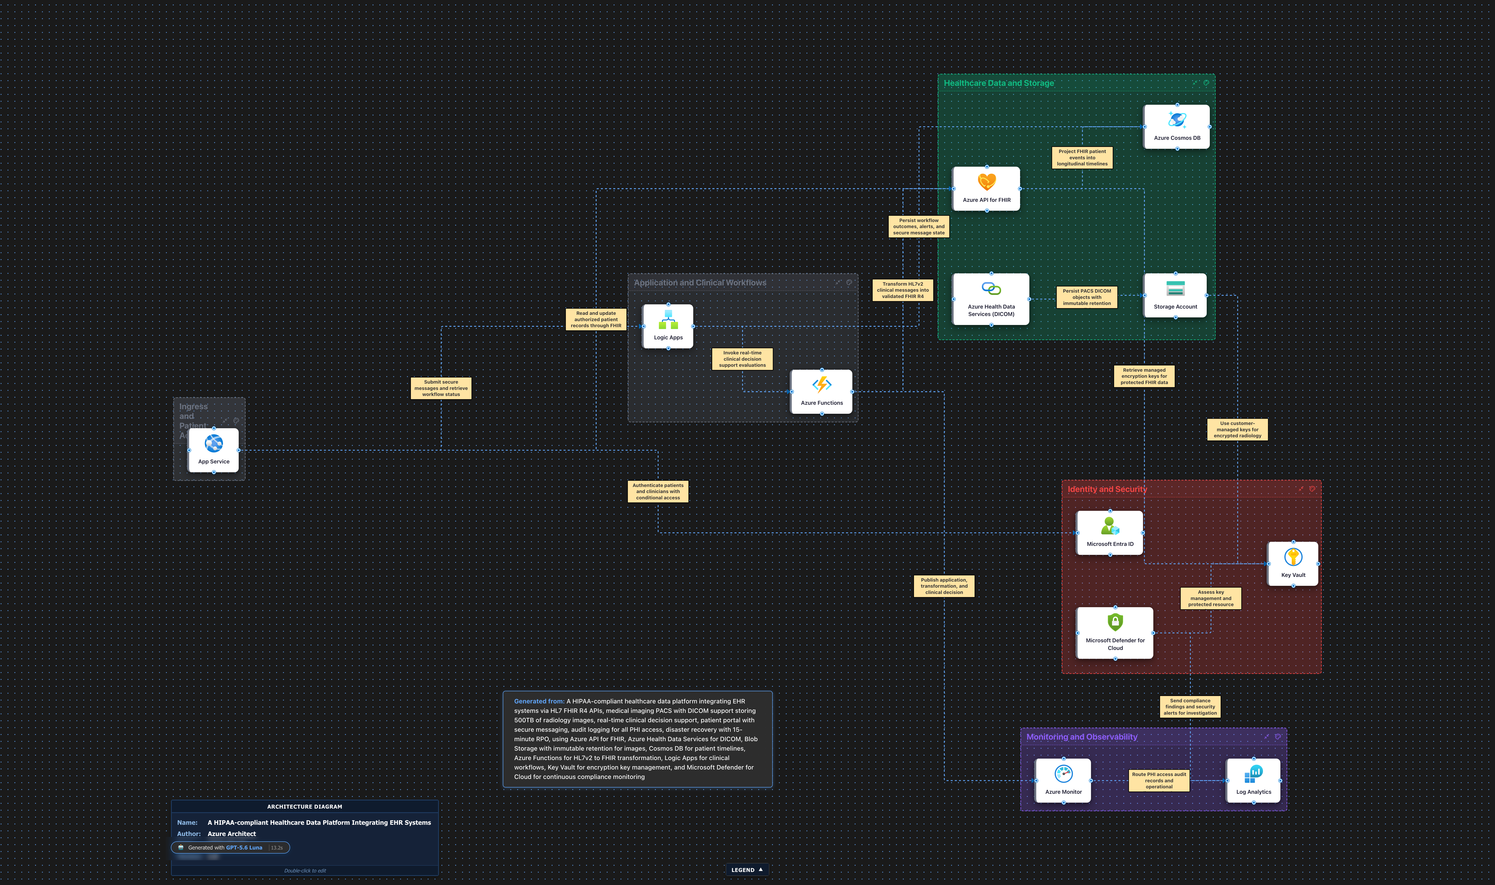
WORKED EXAMPLE Healthcare FHIR — real exported diagram
DICOM tier unpriced in this snapshot
$287 /mo PAYG
East US 2 12 services · 5 groups · 14 edges (9 sync / 5 async) Azure Retail Prices snapshot
14 / 16

Slide 15
Who does what — the boundary, stage by stage
Stage
LLM (purple)
Deterministic code (teal)
Input
—
Capture prompt / template / ARG
Prompt assembly
Receives rules + schema
Build system prompt from icon map
Model call
Infers architecture
Proxy key, capture metrics
JSON contract
Emits groups/services/edges
Validate JSON shape
Normalize
—
Canonicalize names + categories
Icons
—
Resolve category → real SVG
Groups & edges
Chose grouping + flows
Build containers + typed edges
Layout
—
Compute all positions (Dagre/ELK)
Costing
—
Map to Retail Prices, sum monthly
Azure Architecture Diagram Builder
15 / 16

Slide 16
WHY THIS DESIGN WINS
The contract is the product
Reproducible
Model-swappable
Same JSON → same diagram, every time. No render-time guessing.
All 12 models flow through one pipeline; swap models freely.
Correct by construction
Fast where it counts
Curated icon map + validation beat model hallucination.
ARM & Resource Graph imports skip the model — sub-second.
Deep dives: DOCS/LLM_PROMPT_DOCUMENTATION.md · DOCS/ARCHITECTURE.md · DOCS/LAYOUT_ENGINES_COMPARISON.md · DOCS/REGIONAL_PRICING_IMPLEMENTATION.md

