Slide 1
UNDER THE HOOD
How AADB Runs
Platform, identity, releases, Voice Live, MCP and pricing behind AADB.
Keyless by design
Reversible releases
Voice Live relay
13 MCP tools
14-region pricing
Technical deep dive · L300 · AADB v2.1.10 · October 2026
Azure Architecture Diagram Builder · Platform deep dive
1 / 11

Slide 2
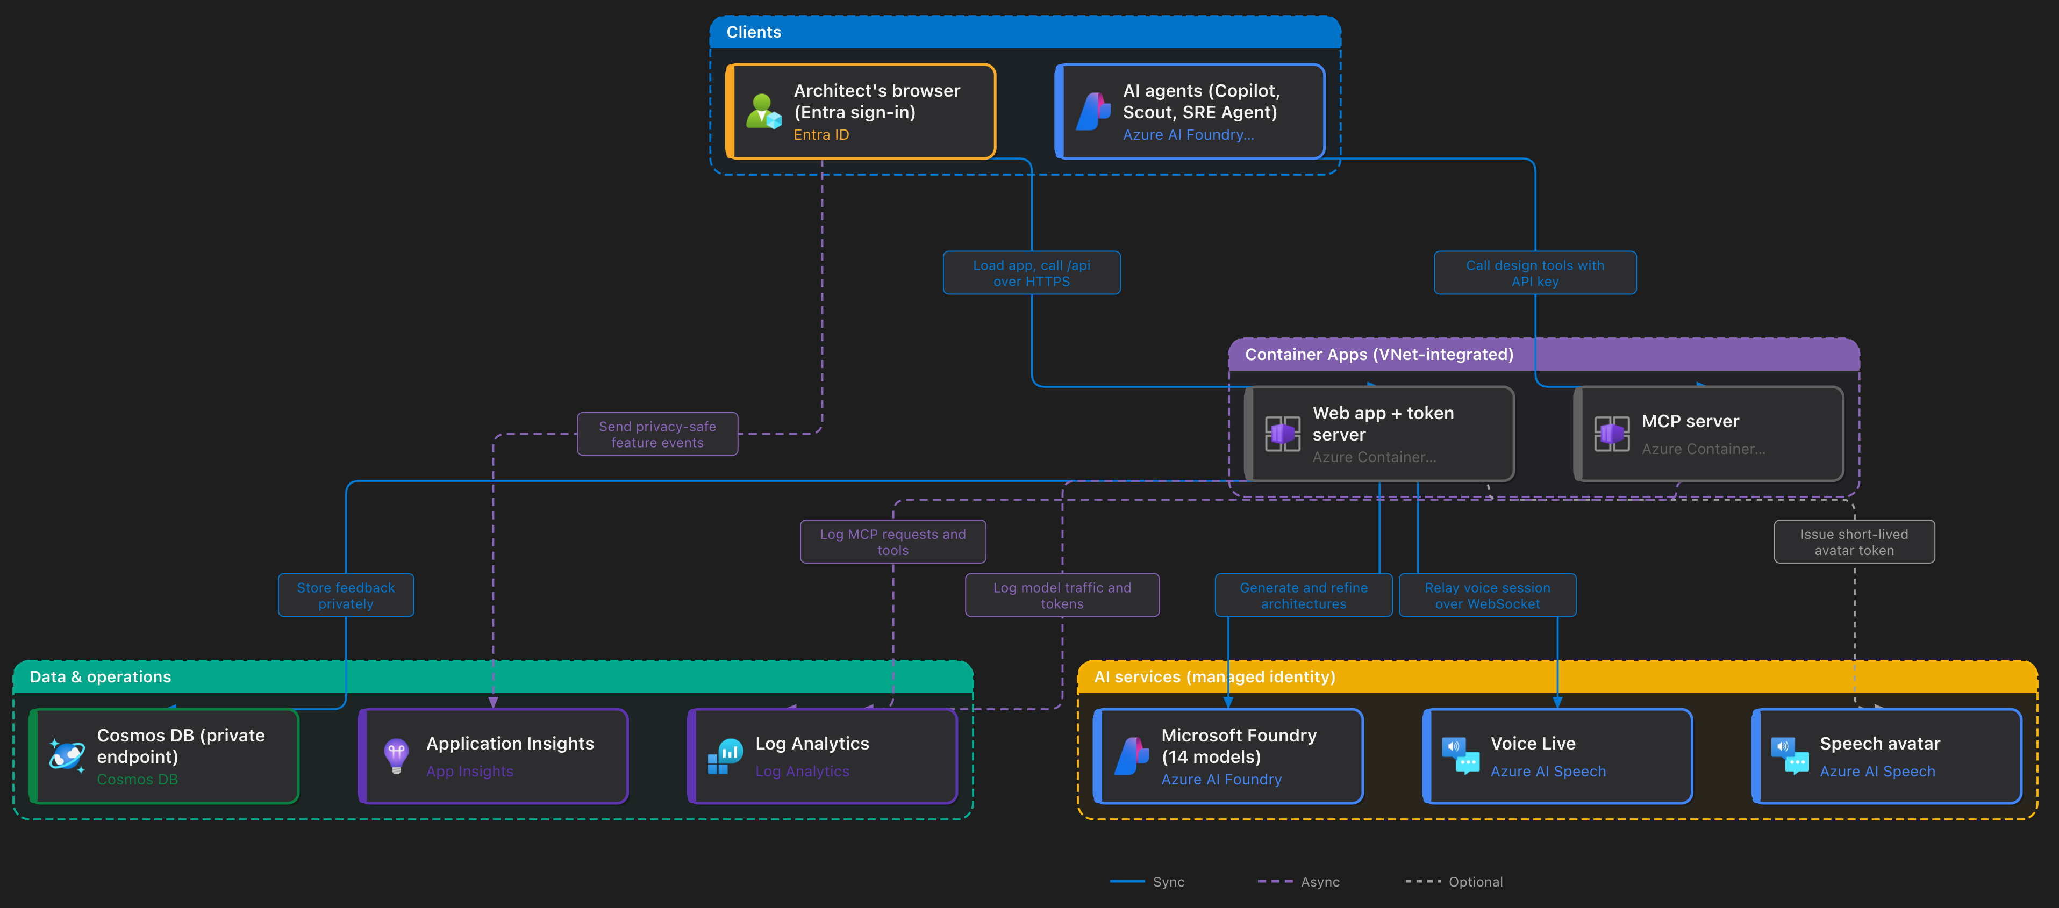
RUNTIME AT A GLANCE drawn by AADB itself through its render_diagram MCP tool
Every arrow into Azure services uses the app's managed identity; the only keys in the system are the hashed MCP client keys.
Azure Architecture Diagram Builder · Platform deep dive
2 / 11

Slide 3
IDENTITY
Keyless by design: every hop, how it authenticates
Hop
Credential
How
Browser → token server
None needed
Same origin; no keys or model endpoints in the bundle
Token server → Foundry (14 models)
Managed identity
Cognitive Services User + Foundry User roles
Token server → Voice Live
Managed identity
Server opens the realtime session; browser only streams audio
Browser → Speech avatar
Short-lived Entra token
Minted per session by /api/speech-token
Token server → Cosmos DB
Managed identity
Data Contributor; local auth off; private endpoint only
Container Apps → registry
Managed identity
AcrPull; no registry admin credentials
Browser → Azure (Import)
The user's own token
MSAL delegated sign-in; Resource Graph runs with the user's RBAC
Agents → MCP server
Named API key
Only SHA-256 hashes stored; revocable per client
Result: no API key or secret ever reaches the browser, and none is stored for any Azure service.
Azure Architecture Diagram Builder · Platform deep dive
3 / 11

Slide 4
HOSTING
One container per app, inside a private network
VNet 10.60.0.0/22
Images
Container Apps environment · subnet /23
Private endpoints · /27
Cosmos DB, resolved through the private DNS zone
privatelink.documents.azure.com
Immutable tags v<version>-<git sha>, built in Azure Container Registry and pulled with managed identity.
azure-diagram-builder
nginx serves the React SPA and proxies /api to the Node token server in the same container: model proxy, Voice Live relay, speech tokens, feedback, health and readiness.
Probes
/api/ready gates each revision; /api/health reports the running version.
azure-diagram-mcp
MCP server over Streamable HTTP (/mcp) with /healthz; the same tools run locally over stdio.
Scale
Each active revision keeps a replica warm; after a release only the newest three stay active.
Azure Architecture Diagram Builder · Platform deep dive
4 / 11

Slide 5
RELEASES
Every release is a reversible experiment
1
›
2
›
3
›
4
›
5
›
6
Version gate
Immutable image
Candidate revision
Direct smoke test
Traffic switch
One-command rollback
package.json is the single version source; an equal or older version is rejected.
Tag v<ver>-<sha>; a dirty worktree is refused, so the image is exactly a commit.
Created with readiness probes while production traffic stays pinned to the current revision.
Health and version checked on the candidate's own URL before it sees users.
100% moves to the candidate; the previous revision stays active at 0%.
The script prints the exact command to move traffic back.
Today: v2.1.10 serves production with v2.1.9 one command away · six releases shipped this way in ten days.
Azure Architecture Diagram Builder · Platform deep dive
5 / 11

Slide 6
QUALITY
One release gate for laptops, pull requests and Azure
npm run verify:release
21
✓
check:lockfiles
every dependency resolves through the package proxy
✓
typecheck + lint
TypeScript strict checks and ESLint
deterministic regression suites, no model calls, so they are fast and repeatable
✓
build + bundle budget
production build stays inside measured size limits
Same gate everywhere
Pull requests, pushes to main and the manual Azure workflow all run it. CI also runs the MCP server's catalog, contract and rendering tests.
✓
test:deterministic
21 regression suites: layout, imports, pricing, guards, telemetry
✓
test:version
UI, /version.json and package.json agree
✓
test:smoke
Playwright drives a mocked generation workflow
Azure Architecture Diagram Builder · Platform deep dive
6 / 11

Slide 7
VOICE LIVE
Ava draws the diagram, but never sees a key
Browser
Relay · /api/voice-live
Voice Live
Mic audio · canvas · generation pipeline
Owns model, voice, instructions and tools
gpt-realtime-2.1 · Ava HD voice
WebSocket: microphone audio only
Session opened with managed identity
Tool call: draw_architecture(brief)
Forward call; browser runs the pipeline
tool.result for that call_id only
Result returned; Ava speaks the outcome
Guards: client-event allow-list · 256 KB frames · tool output capped at 8,000 chars · results only for calls the model made · 5 sessions × 10 min
Azure Architecture Diagram Builder · Platform deep dive
7 / 11

Slide 8
AGENTS
The same design logic as 13 deterministic MCP tools
Design
Cost
Build
Interop
list_services
validate_architecture
harden_architecture
get_waf_rules
estimate_costs
compare_region_costs
generate_bicep
generate_terraform
generate_deployment_guide
generate_manifest
render_diagram
export_reactflow_scene
import_architecture
Contracts
Transports + auth
Clients
Typed structuredContent with declared output schemas; 3 resources and 3 starter prompts.
stdio locally; Streamable HTTP hosted with named API keys (hashes only), optional Entra for self-hosting.
GitHub Copilot in VS Code, Copilot CLI, Microsoft Scout and the Azure SRE Agent.
Azure Architecture Diagram Builder · Platform deep dive
8 / 11

Slide 9
PRICING
Native retail prices, shipped with the app
14
81
1,043
29 Sep
native pricing regions
service queries per region
price files downloaded
current snapshot (2026)
Snapshot, not live calls
Azure Retail Prices data ships as per-region JSON: fast, offline, deterministic.
Meter selection rules
One representative meter per service and tier; duplicate restatements demoted.
Two terms
Pay-as-you-go or a 1-year term; a SKU without a 1-year meter stays at pay-as-you-go.
Honest about usage
Usage-based services show ranges; exports carry a "Prices as of" stamp.
Fabric and Microsoft IQ
Fabric Capacity (F2–F2048) carries the cost; Foundry IQ prices as AI Search.
Azure Architecture Diagram Builder · Platform deep dive
9 / 11

Slide 10
OBSERVABILITY
Three telemetry planes, each answering one question
Is it used?
What does it cost?
Who calls the agents API?
Browser · Application Insights
Server · Log Analytics
MCP · Log Analytics
Feature events, counts and coarse geography; never prompts, diagrams or model output.
Every model call: model, tokens, latency, status, concurrency. The authoritative traffic record.
One line per request: auth result, key name, client and tools called.
329 users · 37 countries
2,560 calls · 99.0% success
Attributed per key
Workbooks: LLM Cost Monitor · Server Usage & Guardrails · MCP Usage Monitor · Feedback · WAF Findings.
Numbers shown: 28 Sep – 20 Oct 2026.
Azure Architecture Diagram Builder · Platform deep dive
10 / 11

Slide 11
RUN YOUR OWN
Three ways to put it to work
Use the hosted app
Deploy it yourself
Give agents the tools
aka.ms/diagram-builder
azd up
mcp-server/
Production v2.1.10 with Voice Live, 14 models and every export.
Greenfield Bicep provisions Foundry with GPT-5.6 Luna, Container Apps and identity in your subscription.
Run the 13 tools over stdio, or point Copilot and Scout at a hosted endpoint with an API key.
github.com/Arturo-Quiroga-MSFT/azure-architecture-diagram-builder
Azure Architecture Diagram Builder · Platform deep dive
11 / 11

