Slide 1
Contoso Consulting Group — Intelligent Time & Expense Assistant
Context-aware missing-time detection | Team Awesome

Slide 2
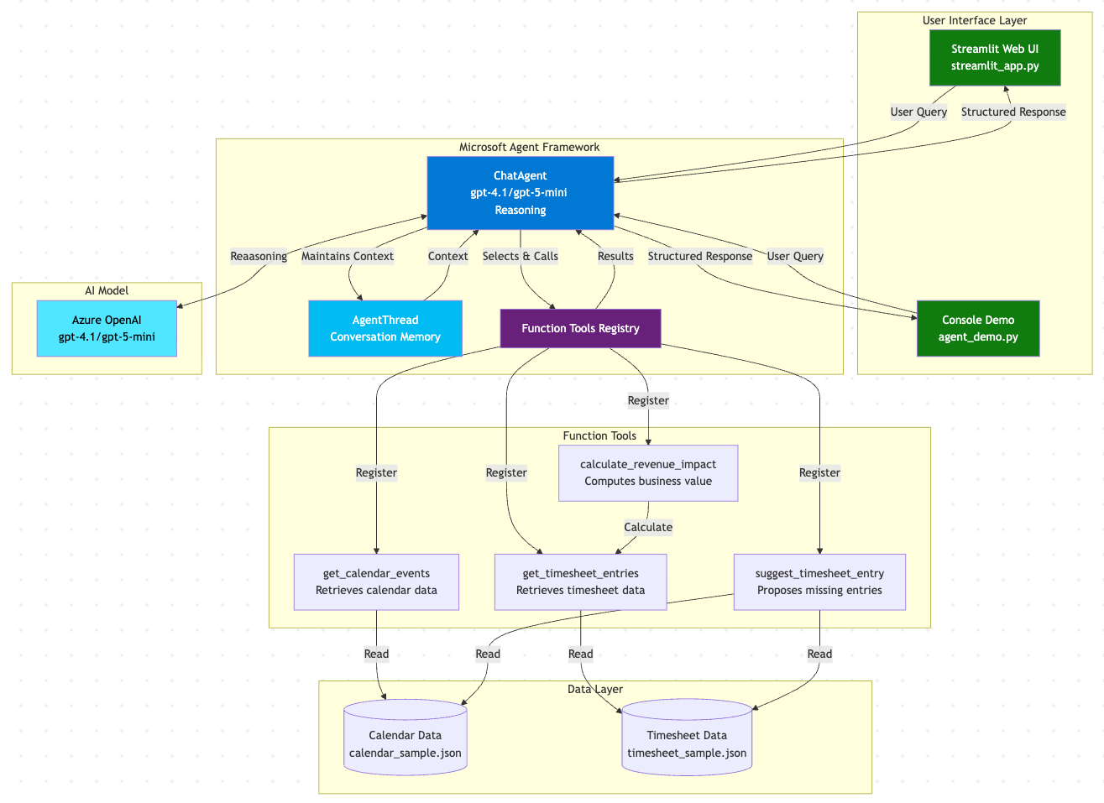
Architecture Diagram

Slide 3
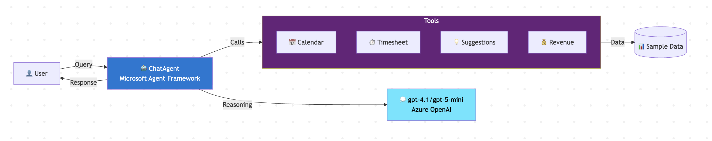
Flow Diagram

Slide 4
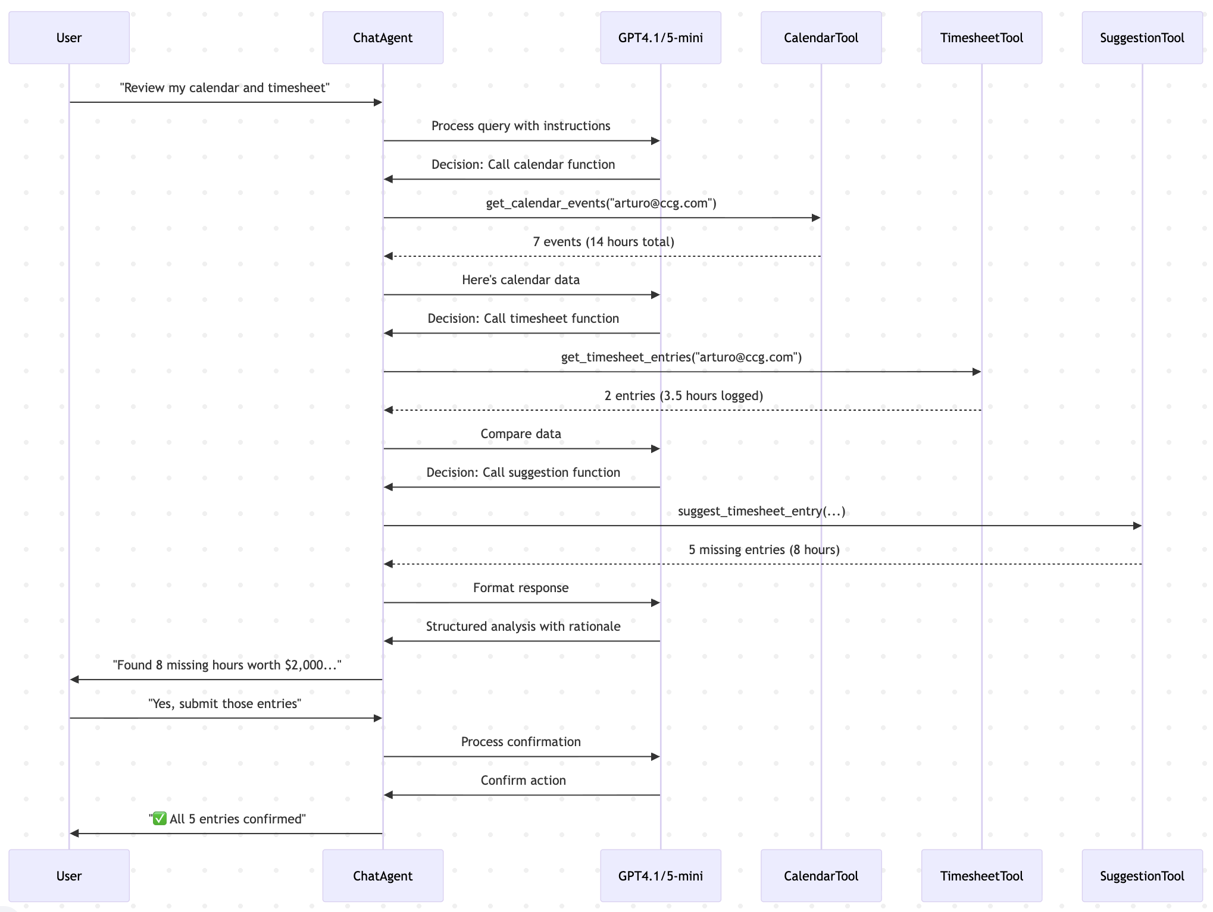
Sequence Diagram

Slide 5
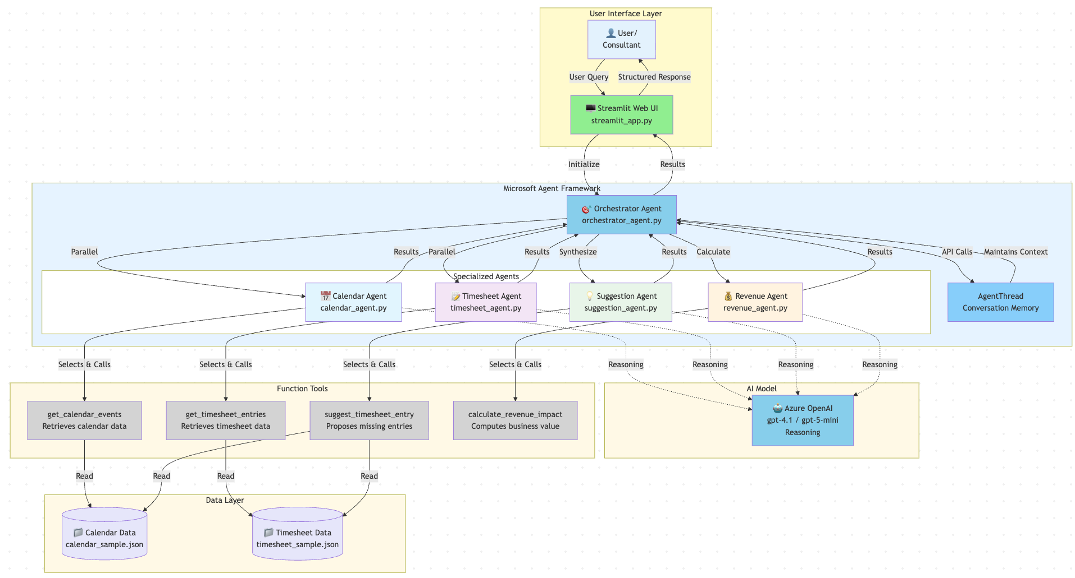
Architecture Diagram

Slide 6
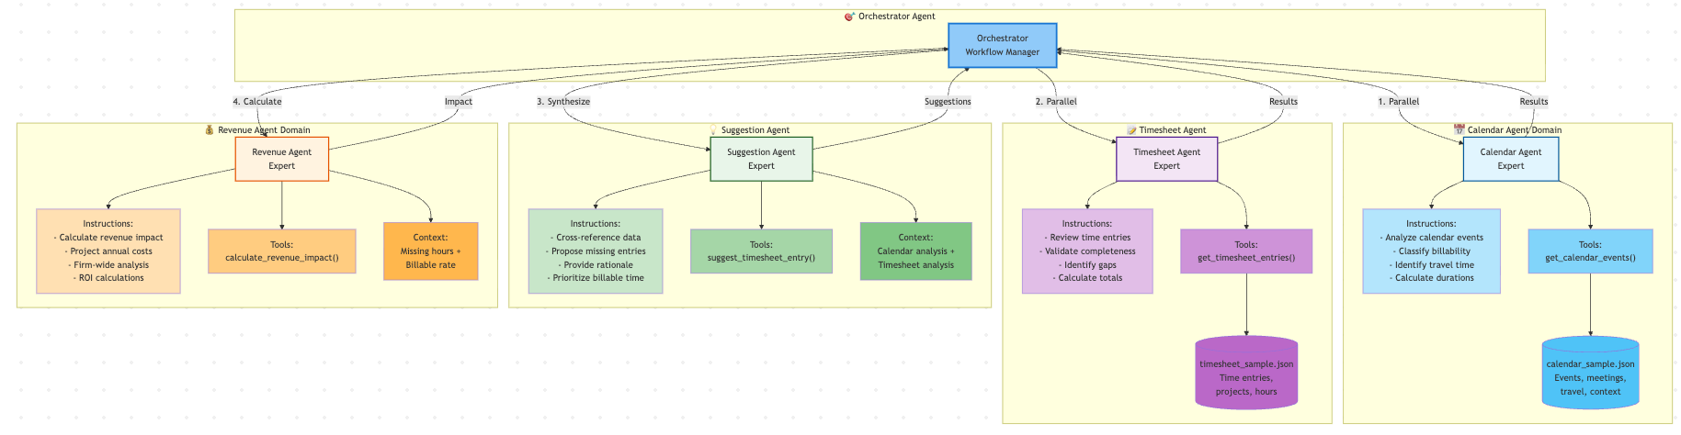
Workflow Manager Diagram

Slide 7
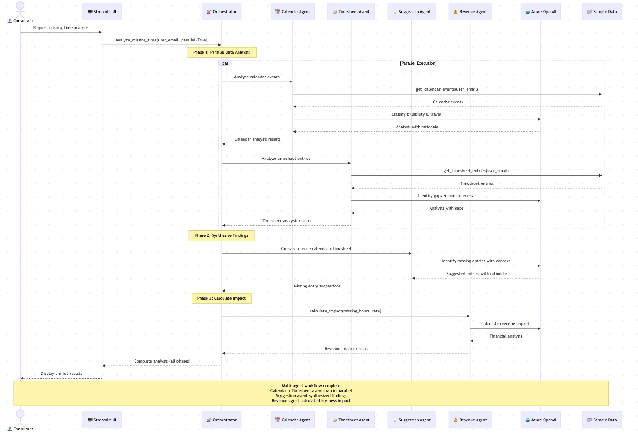
Sequence Diagram

Slide 8
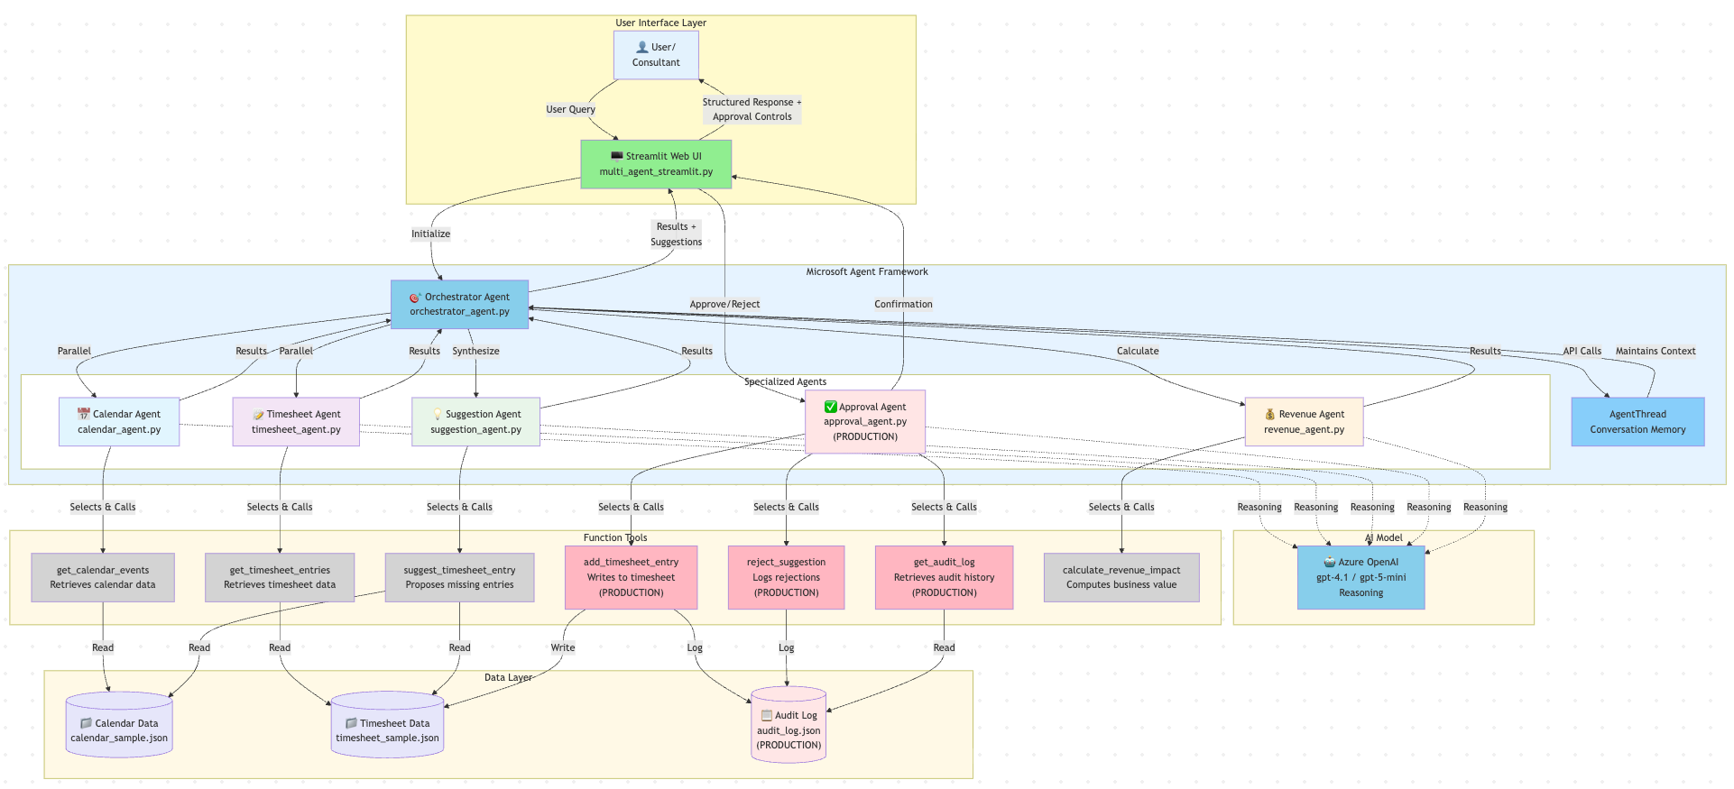
Architecture Diagram

Slide 9
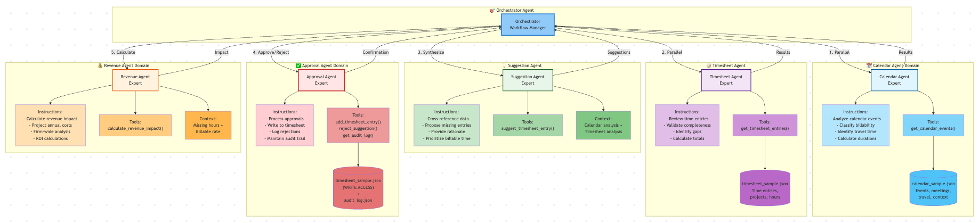
Agent Specialization Diagram

Slide 10
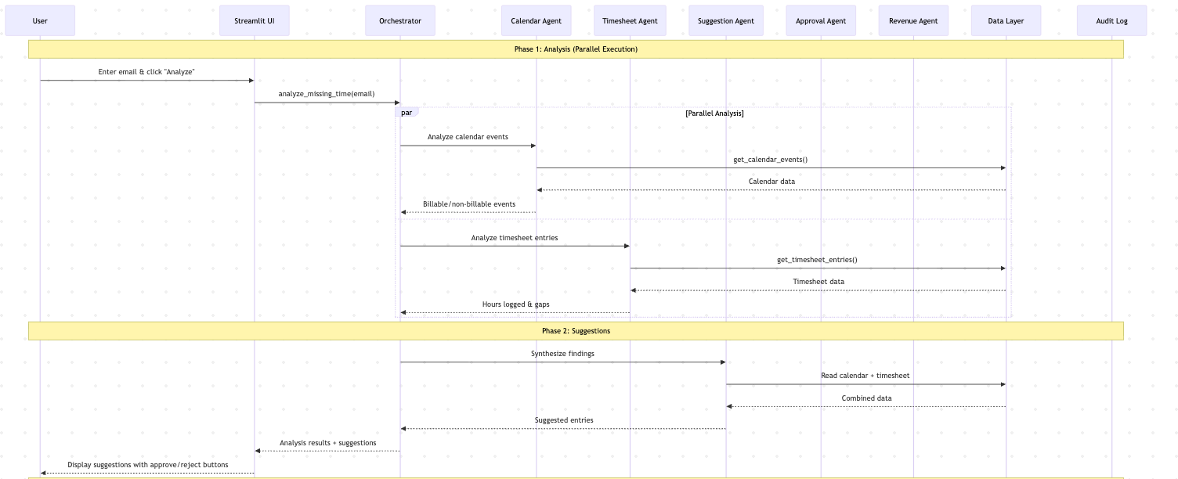
Sequence Flow Diagram (1)

Slide 11
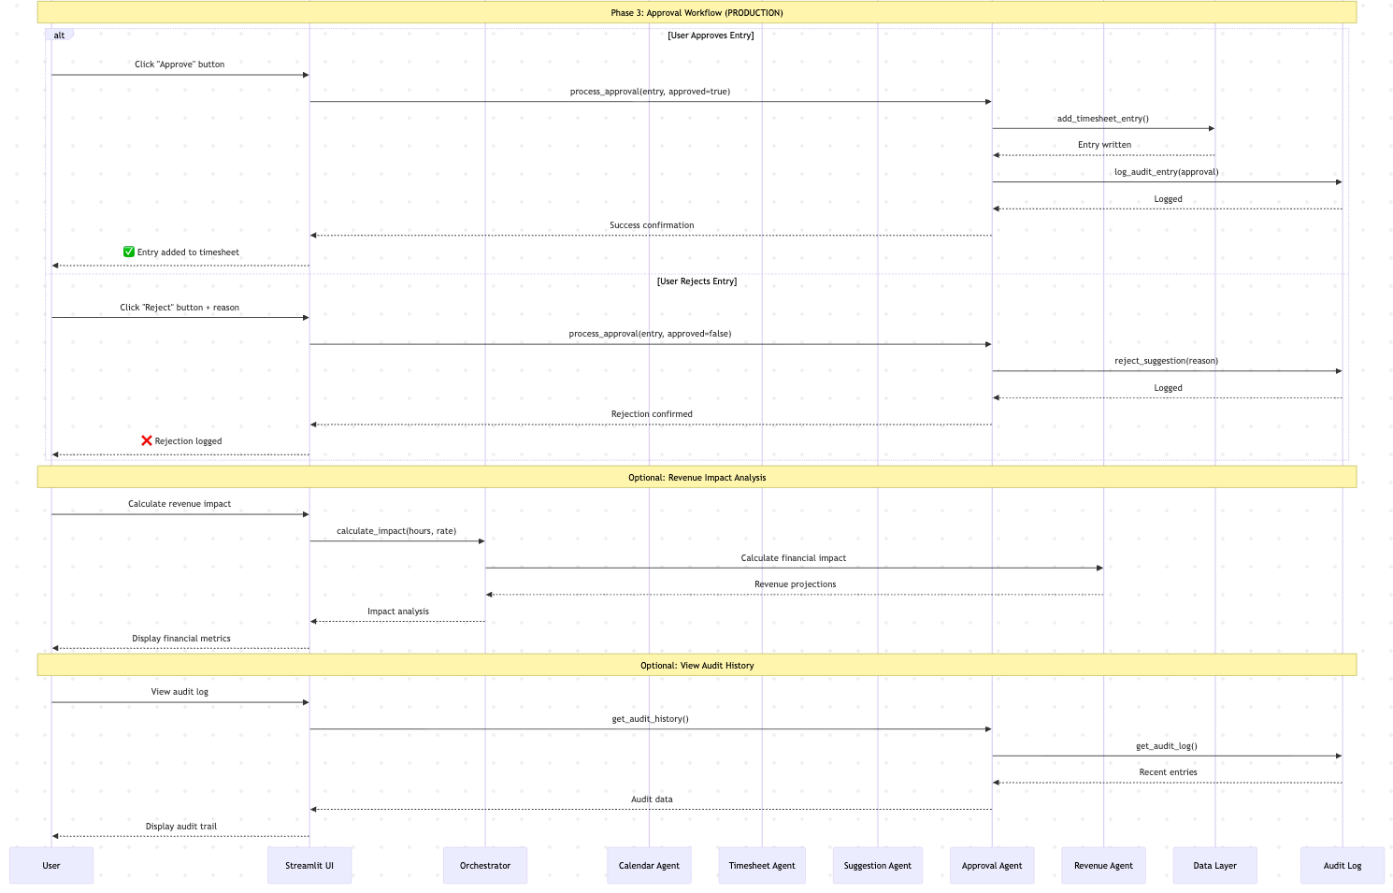
Sequence Flow Diagram (2)

