Slide 1
Interplay of social and actuarial issues for social security in the Caribbean
UNITED STATES
WEST INDIES
ATLANTIC OCEAN
Nassau
THE BAHAMAS
Havana
TURKS AND CAICOS
ISLANDS (U.K.)
CUBA
VIRGIN ISLANDS
(U.S.)
Cockburn Town
Charlotte Amalie
BRITISH VIRGIN
ISLANDS (U.K.)
CAYMAN ISLANDS
(U.K.)
HAITI
DOMINICAN
REPUBLIC
PUERTO RICO
(U.S.)
Road Town
San Juan
ANGUILLA (U.K.)
George Town
The Valley
Population dynamics, aging trajectories, fertility shifts
SAINT-MARTIN/
SINT-MAARTEN
Port-au-Prince
Santo Domingo
SAINT KITTS
AND NEVIS
JAMAICA
Kingston
ANTIGUA
AND BARBUDA
GREATER ANTILLES
Basseterre
St. John's
LESSER
ANTILLES
MONTSERRAT
(U.K.)
Basse-Terre
GUADELOUPE
Roseau
DOMINICA
Gabriel Martínez 2026
CARIBBEAN SEA
ARUBA
(NETH.)
CURAÇAO
(NETH.)
BONAIRE
(NETH.)
Plymouth
Fort-de-France
MARTINIQUE
Oranjestad
Willemstad
Kralendijk
Castries
SAINT LUCIA
SAINT VINCENT AND
THE GRENADINES
Kingstown
BARBADOS
GRENADA
Bridgetown
St. George's
Port of Spain
TRINIDAD
AND TOBAGO
PANAMA
COLOMBIA
VENEZUELA

Slide 2
Linguistic & Cultural Sub-Regions
SOCIOLINGUISTICS
Linguistic Zone | Primary Countries | Population Share | Dominant Languages
Spanish Caribbean | Cuba, Dominican Rep, Puerto Rico | 57.5% | Spanish
French / Creole | Haiti, Guadeloupe, Martinique | 28.0% | French, Haitian Creole
Anglo Caribbean | Jamaica, Trinidad, Barbados, Bahamas | 13.5% | English, English Creoles
Dutch Caribbean | Aruba, Curaçao, Sint Maarten | 1.0% | Dutch, Papiamento

Slide 3




Key Demographic Shifts in Caribbean
Sub-Replacement Fertility
Accelerated Aging
TFR dropped below 2.1 in major islands including Cuba, Puerto Rico, and Jamaica.
Elderly population ratio rising rapidly in Cuba and Puerto Rico due to low births.
Persistent brain drain to North America balancing local unemployment pressure.
Sub-Replacement Fertility
Accelerated Aging
Non-Marital Family Structure
TFR dropped to 1.4–1.6 across most OECS islands, well below the 2.1 replacement benchmark.
Median age rising rapidly past 36 years in Barbados, St. Kitts, and Saint Lucia.
Visiting unions and common-law partnerships dominate, with low formal crude marriage rates.

Slide 4
Total Fertility Rate (TFR) Comparison
FERTILITY TRENDS
Country | 1990 TFR | 2010 TFR | 2026 TFR | Status vs Replacement (2.1)
Barbados | 1.8 | 1.5 | 1.3 | Critically Low
Saint Lucia | 3.1 | 1.8 | 1.4 | Below Replacement
Antigua & Barbuda | 2.2 | 1.7 | 1.4 | Below Replacement
St. Kitts & Nevis | 2.8 | 1.7 | 1.5 | Below Replacement
Grenada | 3.4 | 2.0 | 1.5 | Below Replacement
Dominica | 3.0 | 1.9 | 1.6 | Below Replacement
St. Vincent & Grenadines | 3.2 | 2.1 | 1.7 | Moderate Low
Belize | 4.5 | 2.6 | 2.0 | Near Replacement

Slide 5
Total Fertility Rate (TFR) Comparison
FERTILITY ANALYSIS
Replacement level fertility is 2.1 births per woman. Most Caribbean nations sit below this line.
Country | TFR (1990) | TFR (2010) | TFR (2024/2025) | Status vs Replacement (2.1)
Haiti | 5.2 | 3.5 | 2.7 | Above Replacement
Dominican Republic | 3.6 | 2.6 | 2.2 | Near Replacement
Jamaica | 3.1 | 2.2 | 1.8 | Below Replacement
Trinidad & Tobago | 2.5 | 1.8 | 1.6 | Below Replacement
Cuba | 1.8 | 1.5 | 1.4 | Critically Low
Puerto Rico | 2.2 | 1.6 | 0.9 | Ultra Low

Slide 6
Larger Caribbean Populations by Country
DATA OVERVIEW
Country / Territory | Population (2024/2025) | Share of Region | Annual Growth Rate | Urbanization Rate
Haiti | 11.72 Million | 26.3% | +1.12% | 59.8%
Dominican Republic | 11.33 Million | 25.5% | +0.92% | 83.2%
Cuba | 11.02 Million | 24.8% | -0.35% | 77.4%
Puerto Rico (US) | 3.22 Million | 7.2% | -0.48% | 93.6%
Jamaica | 2.83 Million | 6.4% | +0.15% | 56.7%
Trinidad & Tobago | 1.53 Million | 3.4% | +0.28% | 53.2%

Slide 7
Median Age (2026 Estimates)
AGING PROFILES
Eastern Caribbean islands show advanced demographic aging compared to Central American Belize.

Slide 8

Marriage Rates & Union Formations
FAMILY STRUCTURE DYNAMICS
Low Marriage Rates
Prevalent Union Types
Crude marriage rates across the Eastern Caribbean range between 2.5 to 4.2 per 1,000 residents.
Formal marriage is increasingly delayed until mature adulthood or bypassed in favor of informal unions.
Visiting Unions: Partners maintain separate residences while bearing children.
Common-Law Unions: Co-habiting non-marital partnerships.
Matrifocal Units: High proportion of female-headed households.

Slide 9
Marriage & Family Structure
DATA MATRIX
Country | Crude Marriage Rate | Out-of-Wedlock Births (%) | Avg Household Size | Dominant Union Structure
Saint Lucia | 3.2 / 1,000 | 82% | 2.9 persons | Visiting / Single Mother
St. Kitts & Nevis | 3.5 / 1,000 | 78% | 3.0 persons | Visiting / Extended
Grenada | 2.9 / 1,000 | 81% | 3.2 persons | Matrifocal / Common-Law
Antigua & Barbuda | 4.1 / 1,000 | 74% | 3.1 persons | Single Parent / Extended
Dominica | 3.0 / 1,000 | 79% | 3.1 persons | Common-Law / Visiting
Belize | 4.8 / 1,000 | 62% | 3.8 persons | Nuclear / Common-Law
Out-of marriage: USA: 40%, Chile: 78%, México: 73%, Colombia: 87%, Japan 2.4%. Many in common law unions.
Still, many births out of marriage and out of unión: Chile: 25%, Colombia: 21%

Slide 10



Elderly Dependency & Healthcare Strain
SOCIO-ECONOMIC IMPACT
Countries with highest elderly dependence: Puerto Rico, Martinique & Guadeloupe, Curaca & Aruba, Barbados, Cuba
Countris with lowest elderly dependence: Honduras, Haiti, Guatemala, Belize, Bolivia
Pension Solvency Pressure
Fewer working-age contributors funding national insurance schemes.
NCD Care Burden
65+ POPULATION SHARE (2030 PROJ.)
High prevalence of hypertension and diabetes requiring long-term care.
18.5%
Sandwich Generation
Average across Barbados, St. Kitts, Antigua, and Saint Lucia.
Single mothers balancing elderly parent care and child support.

Slide 11
Old-Age Dependency Ratio Pressure
ECONOMIC IMPACT
Dependents per 100 working-age adults (15-64). Rising sharply in older islands.

Slide 12
Drivers of Declining Marriage & Lower Fertility
CAUSAL ANALYSIS
1
Female Autonomy
2
Out-Migration
Higher tertiary enrollment among women leading to delayed childbearing.
Youth brain drain disrupts local partner pools and union stability.
3
Cost of Living
4
Cultural Norms
Housing expenses lead couples to postpone formal marriage.
Historical acceptance of visiting unions as valid child-rearing units.

Slide 13



Migration Dynamics & Remittance Patterns
MOBILITY & DIASPORA
Labor Outflow
Brain Drain
Remittance Inflow
Intra-Regional
High emigration rates toward US, Canada, and Europe.
Over 60% of tertiary-educated citizens move abroad.
Remittances account for over 20% of GDP in Haiti and Jamaica.
Haitian movement into Dominican Republic and Bahamas.

Slide 14

Cuba: Demographic Crisis & Aging Population
COUNTRY PROFILE
POPULATION
11.02 M
Annual shrinking rate of -0.35%
FERTILITY
OVER 65 YRS
1.4 TFR
21.6%

Slide 15
Puerto Rico: Rapid Population Decline
TERRITORIAL PROFILE
-14.2%
Population drop since 2010 due to economic exodus to US mainland and ultra-low births (0.9 TFR).

Slide 16





Jamaica: Stagnation & Youth Outflow
ISLAND PROFILE
Informal economy
Non-contributory pensions
Large infromal economy, low coverage, large number of elderly with no pension
Relatively recent programs to support elderly with no pension
Zero Growth
Skilled Labor Deficit
Urban Shift
Population stable at 2.83M due to high outward migration balancing natural increase.
Teachers and healthcare workers actively recruited by US and UK institutions.
56.7% urbanized with heavy focus in Kingston Metropolitan Area.

Slide 17




Trinidad & Tobago: Demographics
SOUTHERN CARIBBEAN PROFILE
Fast aging (39 year median age)
Large immigration rom Venezuela in recent years.
Fertility rate: 1.6 children
Significant fiscal support
The labor forcé is contracting
Significant informal economy
High levels of out-migration by college-educated
Most retirees receive the mínimum NIS pension

Slide 18
Eastern Caribbean States (OECS Demographics)
SMALL ISLAND STATES
Barbados
Saint Lucia
Grenada
Antigua & Barbuda
282k pop.
180k pop.
125k pop.
100k pop.
Advanced aging, high life expectancy (77.8 yrs).
Moderate growth, tourism-driven urban drift.
High diaspora population in North America.
Immigration destination for regional workers.

Slide 19




Policy Interventions for Small States
POLICY FRAMEWORK
Childcare Support
Subsidize early childhood centers to support working single mothers.
Pension Adjustments
Gradually align retirement ages with expanding life expectancy.
Legal Equality
Protect property and inheritance rights in common-law partnerships.
Youth Retention
Create remote tech jobs to curtail young adult brain drain.

Slide 20

Epidemiological Transition Indicators
PUBLIC HEALTH
NCD Burden
Diabetes Prevalence
Infant Mortality Gap
Non-communicable diseases (diabetes, cardiovascular) cause over 75% of deaths in Anglo Caribbean.
Caribbean has among the world's highest rates (~12-15% adult prevalence).
Rangers from 5.1/1000 in Cuba to 48.0/1000 in Haiti.

Slide 21
Demographic Policy Action Framework
STRATEGIC INTERVENTIONS
1
2
3
4
Pension Reform
Diaspora Engagement
Healthcare Scaling
Youth Retention
Adjust retirement age to offset labor shortages.
Leverage remote work & talent repatriation.
Expand geriatric care infrastructure.
Boost tech education & local job creation.

Slide 22

Summary: The Demographic Horizon
KEY TAKEAWAYS
1. Persistent Low Fertility
OECS states have firmly entered low fertility regimes, accelerating population decline risks.
2. Non-Traditional Family Norms
Formal marriage is a secondary family structure; visiting and common-law unions prevail.
3. Aging Care Deficit
Small island budgets require structural healthcare and pension adaptation before 2035.

Slide 23
Challenges, social and financial
Economic and actuarial views

Slide 24
It is not possible to predict the evolution of key variables in the long term
Jeremy Greenwood, Nezih Guner and Guillaume Vandenbroucke. Family Economics Writ Large. FEDERAL RESERVE BANK OF ST. LOUIS Working Paper Series
Working Paper 2016-026B https://doi.org/10.20955/wp.2016.026. January 2017
Slope = -0.33
Slope = 10.88
Figure 4. Economic Development and Female Labor-Force Participation for a Panel of Countries, 1890-2005
Figure 6. Gender Gap and Household Technologies versus Female Labor-Force Participation for a Cross Section of Countries
With development, there is more work by women, but there is a great dispersion over time and between countries.
Automation has historically favored women's work (cheaper household appliances). This is not easy to predict, and we are currently living in an era of high automation due to digitalization and AI.

Slide 25
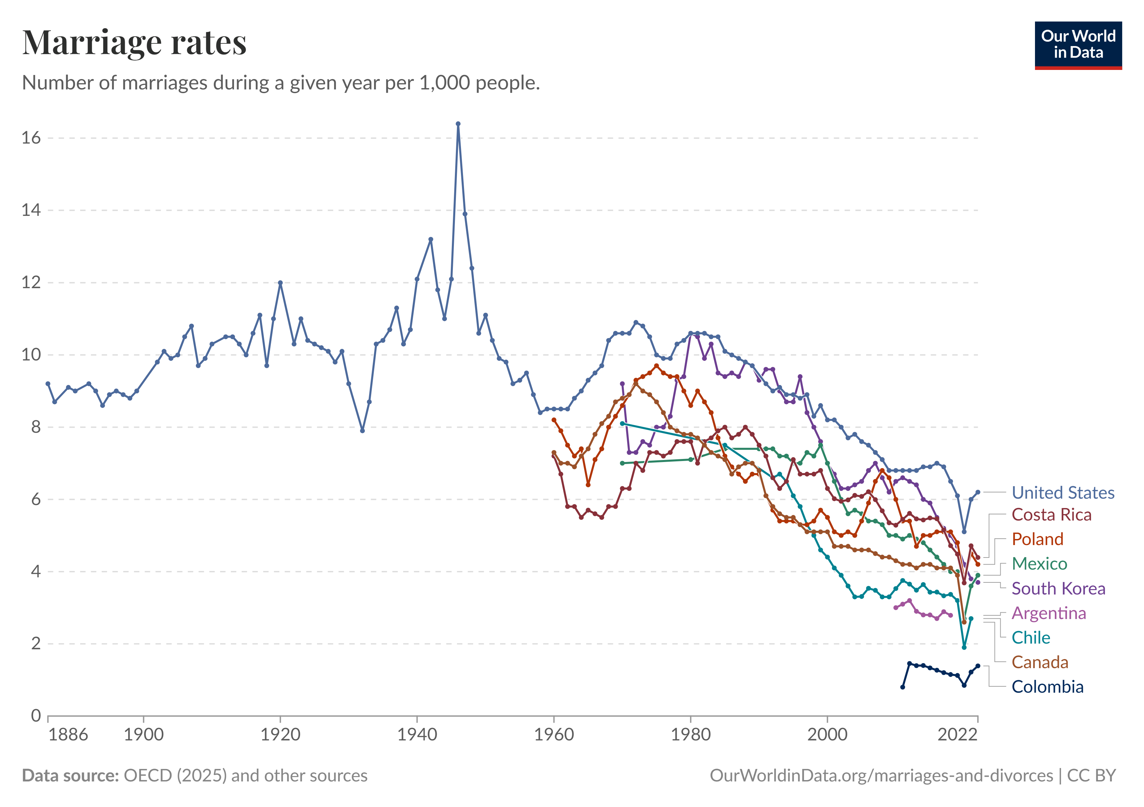
Another example of a variable that is very difficult to predict: marriage
A relatively recent example of the difficulty of predicting behavior, one of great relevance: the fall in marriage rates and the growth of births out of wedlock.
Initially, it seemed that it was just an elevation of the age of marriage.
Now, it seems that there is a significant increase in women who never get married, and those who have children in free unions.
OECD (2025), OECD (2024), US Census Bureau (1949), Centers for Disease Control and Prevention (2020) – with minor processing by Our World in Data

Slide 26



The great family events of the last decades
Huge growth in women's labor force participation rates.
Great decrease in marriage and increase in divorce.
Increase in positive pairing in marriages (the most educated marry in increasing proportions with the most educated).
Growing up children in poverty with a parent (usually a single mother)
Explosion and fall in fertility

Slide 27
Countries found non-contributory pensions as the only way to face the huge political pressure from aging populations with a large share of uninsured
A. Prestaciones de vejez^{b}
B. Prestaciones de discapacidad
Gráfico II.2
América Latina y el Caribe (24 países): valor mensual de las pensiones no contributivas, 2021 o último año con información disponibleª
(En dólares)

Slide 28
Generalized historical problems
Historically, pension systems faced challenges due to
difficulties in financing the payment of benefits,
for not adequately dealing with deep episodes of unemployment,
for paying pensions so low that they generated dissatisfaction among the population,
for operating disordered concepts of invalidity,
for paying such high pensions to some that they discouraged work and generated dissatisfaction from those who did not receive those benefits,
for not recognizing structural changes in families (divorce trends, for example),
for the use of resources for purposes of the state other than paying benefits,
for systematically failing to adapt to population aging,
for not responding adequately to changes in the financial environment, such as inflation or variations in interest rates,
for not having adequate schemes for workers in high-turnover occupations or non-subordinate working conditions.

Slide 29

Hypothesis
The motivation for reforms does not come from innovations in systems design, but from the fact that social dynamics exceed the capacity of the original design to cope with social changes.

Slide 30

It is not possible to predict how women's fertility rates and work, longevity and the need for long-term care, financial costs, tax legislation, women's labor force participation, and other factors that affect the sustainability of systems will evolve.
Social security in the countries of the Americas was founded on a certain expectation that labor markets would evolve to the predominance of salaried labor and that families would be predominantly nuclear. The reality by the 1970s was already one of a significant informal economy and changes in family organization, with high levels of divorce, out-of-wedlock births, and a significant fraction of work in non-salaried formats, largely informal
Shall we rely on actuarial or economic approaches to study the challenges and propose policy?

Slide 31
Actuarial methods | Economic methods
Goal: measurement of financial flows, actuarial liabilities and risks, including future evolution under scenarios | Goal: to identify causality of events and prediction
High internal consistency of models for complete systems | Causal Approach: Using "Reduced Forms" to Capture Relationships Prediction approach: short-term models
Consistent demographic and financial models | There is generally no pretension of modeling systems integrally
Ability to measure accurately, under assumptions. High reliability when there is control capability (e.g. in a private insurance plan) | In causal approaches, the main thing is to identify the validity of the assumptions. In prediction approaches, the important thing is the error of the prediction, regardless of the assumptions.
Actuaries usually work for governments, insurers, other financial institutions, social security agencies, and consulting firms, where they financially manage their health, casualty, life, and property-related insurance policies | Economists usually work for the public and financial sectors, consulting, and increasingly for all types of companies that use data for management, sales, and other processes. Most are not specialists in econometrics and tend to specialize in sectors (e.g., banking, agriculture, ecology, industry, antitrust, labor, health, etc.).

Slide 32
Interplay of social and actuarial issues for social security in the Caribbean
CONCLUSION & DISCUSSION
Balancing social protection, labor retention, and family welfare policies across the Caribbean.
Questions & Discussion

