Slide 3
The Future of 2D Animation in Unity

Slide 4
Arturo Núñez Product Evangelist, Unity Technologies @ArturoNereu

Slide 5
Objectives
At the end of the presentation, you will be able to:
Select the best animation technique for your game based on artistic and technical constraints.
Animate a 2D humanoid character in Unity using Anima2D.
Understand where Unity 2D animation tools are heading to.
Notes:
Here, we will mention the main objectives of attending the talk.
Note for translators: Maybe this is the key slide, since we need to make sure that attendees can leave the room with the knowledge we propose here.

Slide 6
AGENDA
Unity 2D Animation in the Past.
Frame by Frame Animation VS. Skeletal Animation
Anima2D Demo
Native Animation tools sneak peek
Q & A

Slide 7
Animation
The Illusion of Life
Notes:
This slide is to define what the purpose of animation in games is. Which is simulate that the characters and other elements in the game are alive.
The animation is known also as the illusion of life, which basically transforms unanimated drawings or models into living characters. No matter which animation technique we end up using, the goal is to always have a consistent animation that makes the player he is inside the video game.
If for any reason, the animation fails (breaks, is not good enough, drops frames, etc) the player will feel disconnected from the game and will start thinking about it as a piece of software. We want to avoid that.

Slide 8
Frame by Frame Animation

Slide 9
Skeletal Based Animation

Slide 10
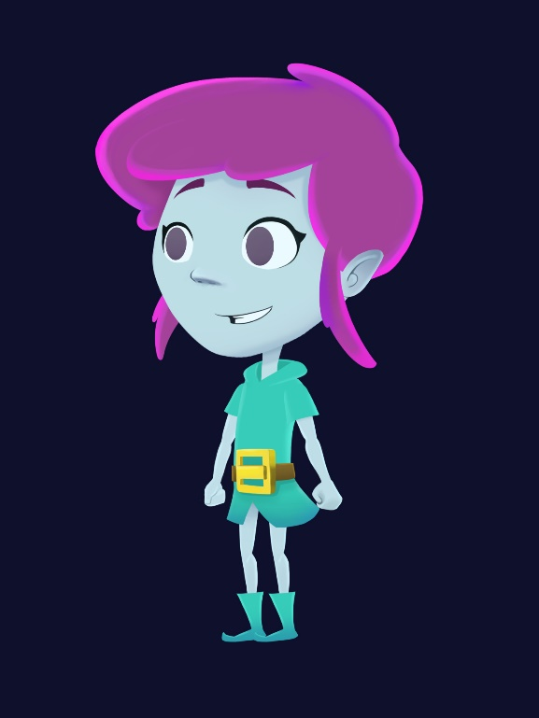
Anima2D Demo
Notes:
In this part, I will show a demo using Unity (the software) to Rig, Animate and Move a character using the Anima2D Animation Tool.
I’m still working on the Assets but, key important things to know are: Bones, Vertices, Attachments, Timeline, Dopesheet, IK, animation curve and interpolation.

Slide 11
Sneak Peek of the native animation tools
Notes:
Here, I will show videos that demonstrates the progress of the native Animation tool for 2D in Unity. I’m waiting for the material but the examples here will be similar to what I showed in the demo, the difference is that they will now be integrated in the software and not via an external plugin as it is now.

Slide 12
References
Slides and demo Project:
https://github.com/ArturoNereu/Unity2DAnimation
Anima2D Package:
https://www.assetstore.unity3d.com/#!/content/79840

Slide 13
Q & A
Notes:
Q&A
Note for Translator: How do I say Q&A in Japanese?

Slide 14
ありがとう
Notes:
Thank you! ありがとう

