Slide 3
The Future of 2D Animation in Unity
Notes:
Good evening, today we will talk about the future of 2D Animation in Unity. As you may heard, we acquired and made free the Asset Store package: Anima2D. The ultimate goal solve the problem of animating 2D characters and objects in Unity in an efficient way.
Description for translators:
This presentation will focus on the 2D animation workflow we have right now in Unity, using the plugin called: “Anima2D”, we will also cover the differences between “Frame by Frame” animation and “Skeletal Animation”, the goal of this part is to know what are the pros and cons of each one.
I will also demo the setup for a 2D character using the Anima2D plugin, which will consist on opening Unity and setting up objects to create a “rig”, and “animations”.

Slide 4
Arturo Núñez Product Evangelist, Unity Technologies @ArturoNereu
Notes:
My name is Arturo Núñez, I work as a product evangelist for the Latin American region and before joining Unity I was working at game studios mostly in 2D games. So I know the struggles of having to use a 3D engine to make 2D games.

Slide 5
Objectives
At the end of the presentation, you will be able to:
Select the best animation technique for your game based on artistic and technical constraints.
Animate a 2D humanoid character in Unity using Anima2D.
Understand where Unity 2D animation tools are heading to.
Notes:
Here, we will mention the main objectives of attending the talk.
Note for translators: Maybe this is the key slide, since we need to make sure that attendees can leave the room with the knowledge we propose here.

Slide 6
AGENDA
Unity 2D Animation in the Past.
Frame by Frame Animation VS. Skeletal Animation
Anima2D Demo
Native Animation tools sneak peek
Q & A

Slide 7
Animation
The Illusion of Life
Notes:
This slide is to define what the purpose of animation in games is. Which is simulate that the characters and other elements in the game are alive.
The animation is known also as the illusion of life, which basically transforms unanimated drawings or models into living characters. No matter which animation technique we end up using, the goal is to always have a consistent animation that makes the player he is inside the video game.
If for any reason, the animation fails (breaks, is not good enough, drops frames, etc) the player will feel disconnected from the game and will start thinking about it as a piece of software. We want to avoid that.

Slide 8
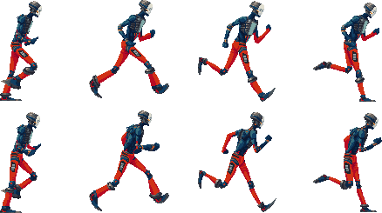
Frame by Frame Animation
Notes:
We will start covering the technique called “Frame by Frame” animation, which has been around in the films and cartoons industry for quite some time. In this technique, we are basically flipping through the pages of a notebook. Where each page contains a part or frame of the animation with a small change with respect to the previous one.
In games, what we usually have, is a large texture called a Sprite Sheet, and what we do is to draw a frame of the texture during a period of time, then after x time passes, we switch to the other one and this gives the illusion of movement.

Slide 9
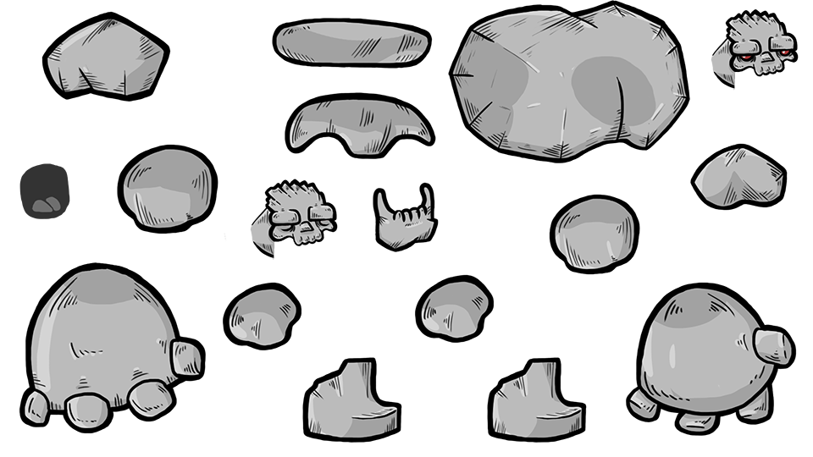
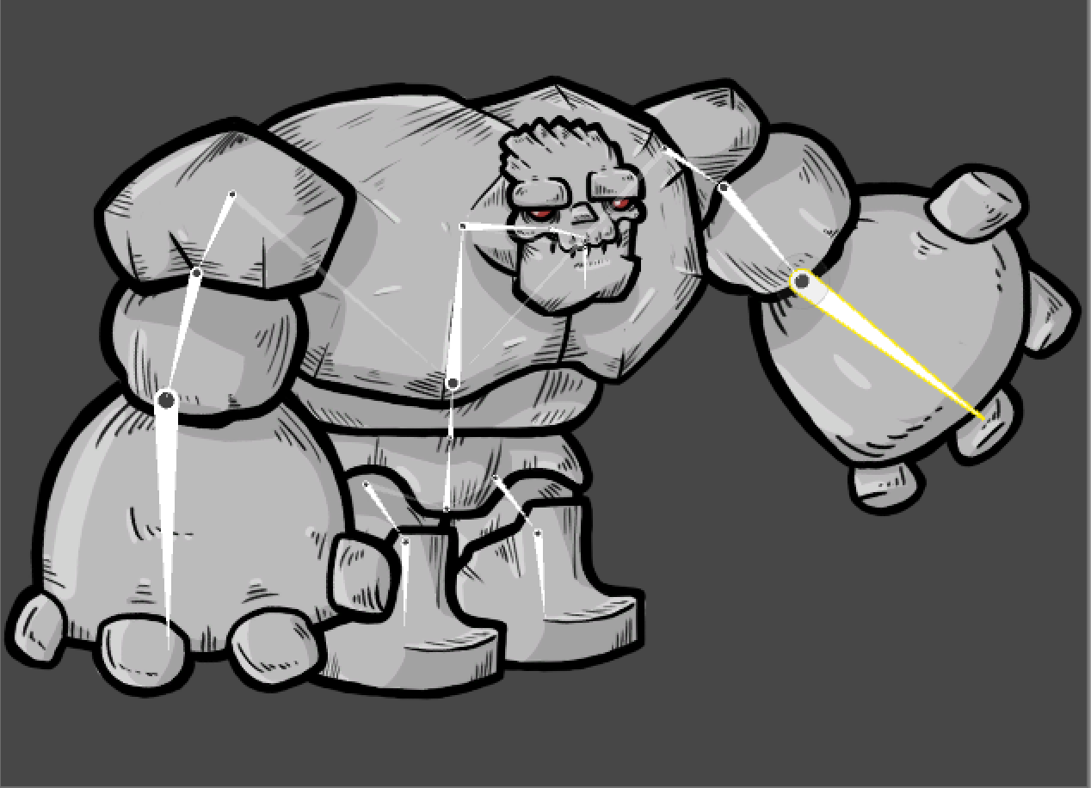
Skeletal Based Animation
Notes:
This is the other technique, called the skeletal based animation. It is called like this because we will create a skeleton for our characters, and the skeleton will be animated (with keyframes), thus, the images that are attached to those bones, will move when the bone moves accordingly.
As a quick note, this technique allows us to have a high number of animations without increasing the build size, which is important. However, the animation takes place on the CPU we need to consider this.
We will discuss more about this in a couple of minutes.

Slide 10
Artistic Comparison

Slide 11
Build Size
Notes:
Notes for the translators:
In this slide, we will discuss how one technique over the other affects the build size(the size in MB of the game). Basically, if we

Slide 12
CPU Overhead

Slide 13
Gameplay

Slide 14
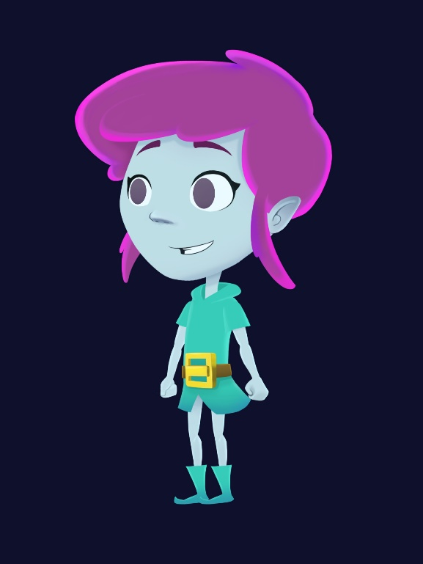
Anima2D Demo
Notes:
In this part, I will show a demo using Unity (the software) to Rig, Animate and Move a character using the Anima2D Animation Tool.
I’m still working on the Assets but, key important things to know are: Bones, Vertices, Attachments, Timeline, Dopesheet, IK, animation curve and interpolation.

Slide 15
Sneak Peek of the native animation tools
Notes:
Here, I will show videos that demonstrates the progress of the native Animation tool for 2D in Unity. I’m waiting for the material but the examples here will be similar to what I showed in the demo, the difference is that they will now be integrated in the software and not via an external plugin as it is now.

Slide 16
References
Slides and demo Project:
https://github.com/ArturoNereu/Unity2DAnimation
Anima2D Package:
https://www.assetstore.unity3d.com/#!/content/79840

Slide 17
Q & A
Notes:
Q&A
Note for Translator: How do I say Q&A in Japanese?

Slide 18
ありがとう
Notes:
Thank you! ありがとう

