Slide 1
Lineage Model
Semantic Recognition of Clusters
Okt 2026

Slide 2
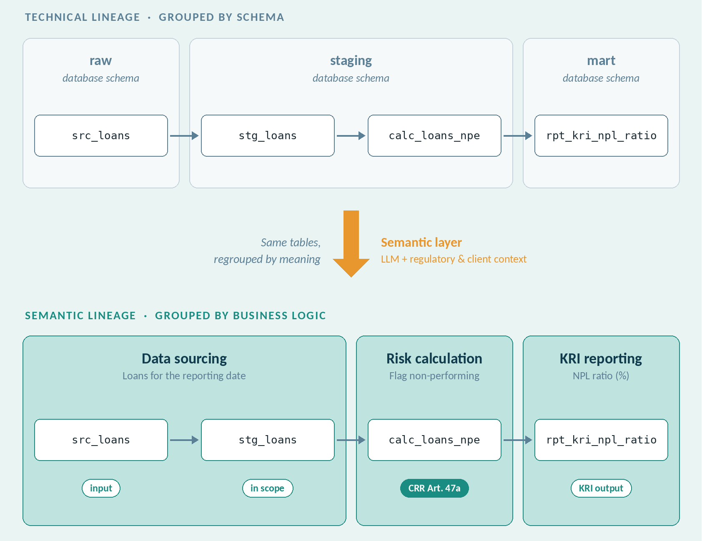
Goal
Research Question
Can we cluster data lineage (transformation steps) based on business logic, so that the entire lineage becomes understandable from the process perspective.
TEST SCENARIOS
1
Regulatory + Rich client metadata
Client wiki files describe tables and column documentation
2
Regulatory + Limited client metadata
Sparse client documentation; standards carry more context
3
Only Regulatory
Regulatory official documents/templates

Slide 3
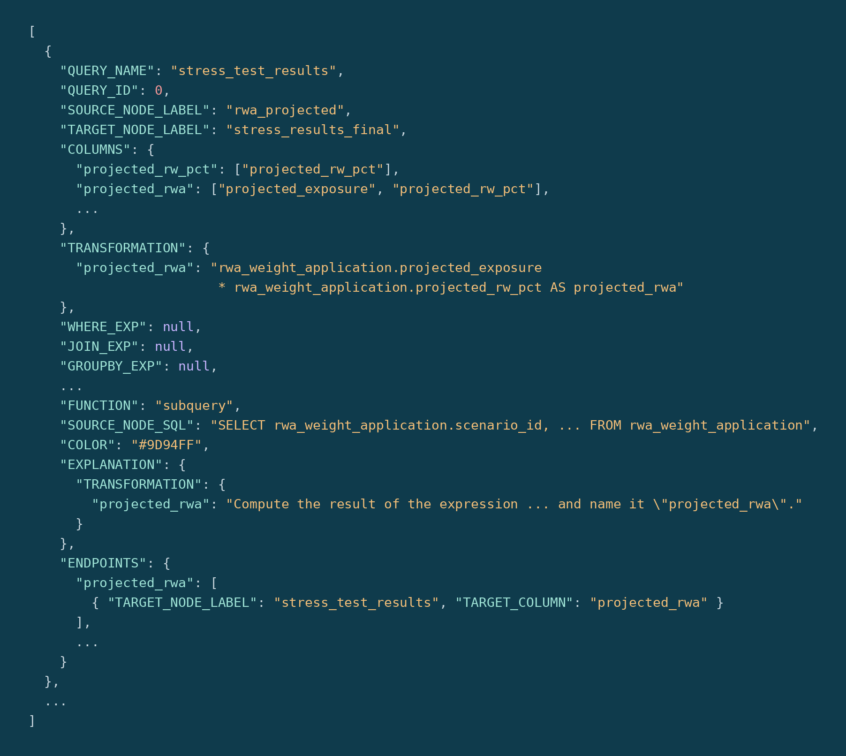
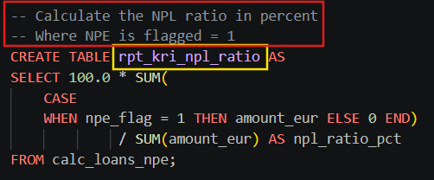
Creating required input
Combining three different inputs
1
Raw SQL files
2
Output JSON
3
Regulatory standards & client metadata
Generate one KRI we know how to judge: Use Python script to generate SQL from Suade FIRE + Manual enrichments in comments for semantic data.
Use raw txt, extract information from schemas, table names, comments
Lineage output JSON taken in by the pipeline
Extract information flow
Reference point for what the enriched output should look like
Regulatory documents (BIRD, FIRE, DPM)
Client documents, e.g. wiki files, table and column descriptions

Slide 4
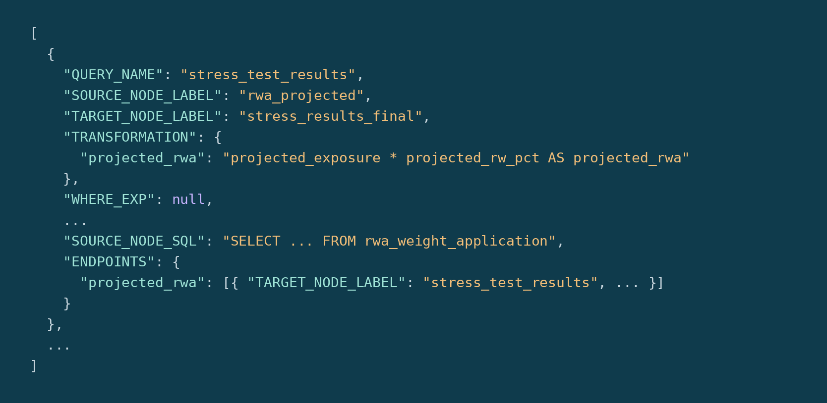
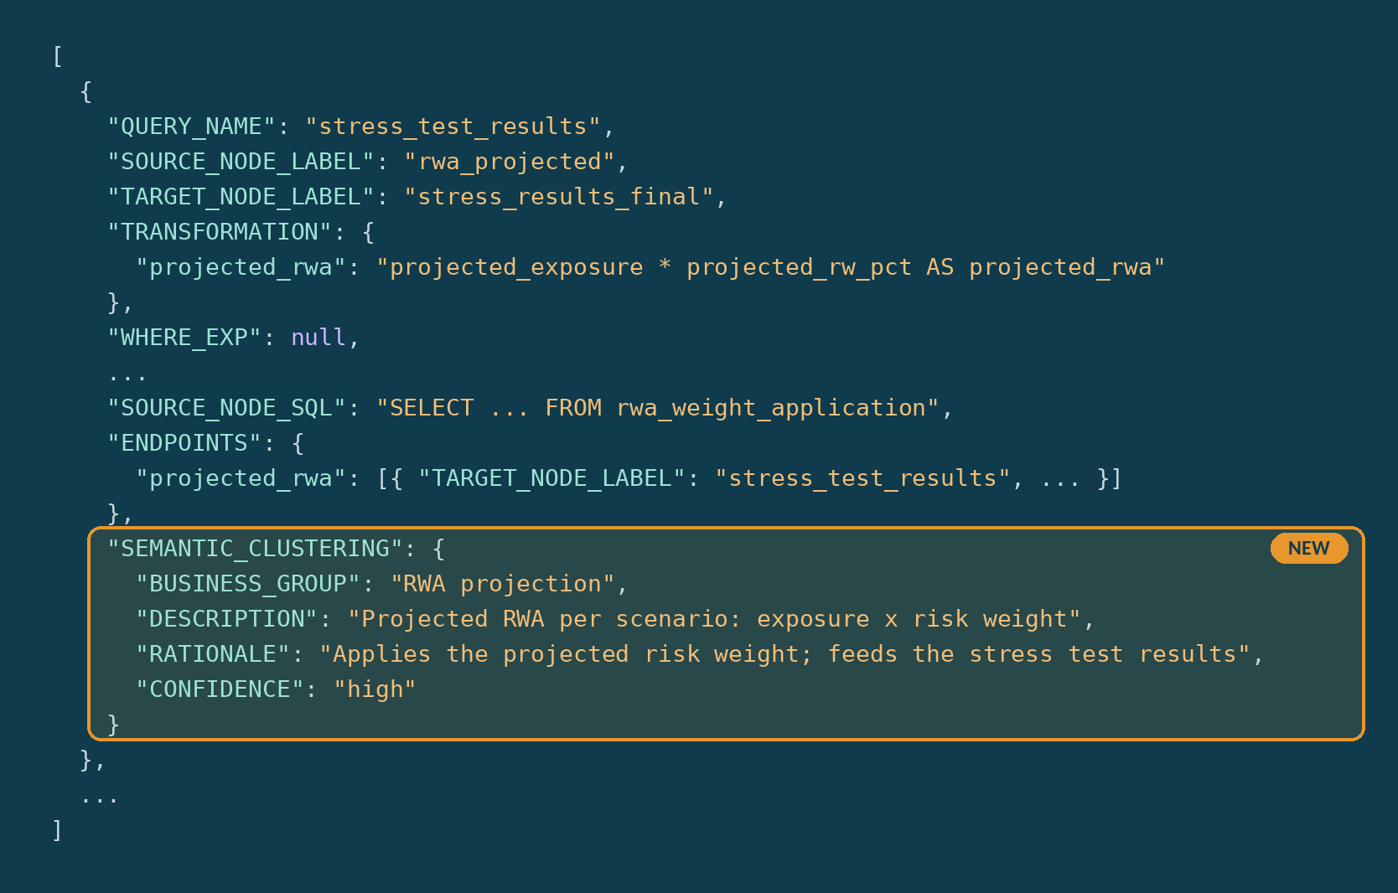
Draft approach and expected output
IN Raw SQL · lineage JSON · BIRD / FIRE / DPM · client docs
OUT UI lineage JSON: additional object into the lineage metadata, later on front end cluster base
1
Define taxonomy
2
Build control set
3
Label transformations
4
Consolidate & output
LLM + human sign-off
Human
LLM
Mostly deterministic
Business groups with definitions, sourced from regulatory and client metadata
Hand-label the demo KRI's transformations: the answer key
One call per step: group, description, rationale, confidence
Propagate labels to edges and attributes, validate, emit the enriched JSON

