Slide 1
Dinakar E J
Final Project

Slide 2
PROJECT TITLE
Cartoonify Me

Slide 3
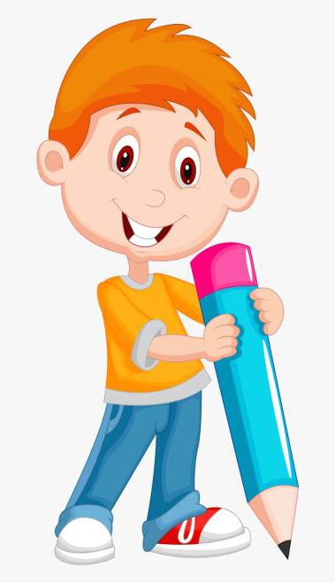

AGENDA
PROBLEM STATEMENT
PROJECT OVERVIEW
WHO ARE THE END USERS?
YOUR SOLUTION AND ITS VALUE PROPOSITION
THE WOW IN YOUR SOLUTION
MODELLING
RESULT
3/21/2024 Annual Review

Slide 4

PROBLEM STATEMENT
TOPIC: CartoonifyMe
To Develop an application named 'CartoonifyMe' that enables users to transform their images into cartoon-style representations. This application should provide a user-friendly interface for uploading images and applying various image processing techniques such as grayscale conversion, edge detection, and bilateral filtering to achieve the cartoon effect. Users should be able to save the cartoonified images with ease. 'CartoonifyMe' aims to offer an intuitive solution for creating captivating cartoon-style images effortlessly.

Slide 5
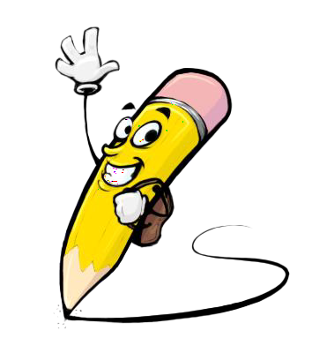
PROJECT OVERVIEW
1. Purpose: The project aims to create a user-friendly application that allows users to transform their images into cartoon-style representations.
2. Functionality: Users can upload their images through a simple interface. The application then applies various image processing techniques, including grayscale conversion, edge detection, and bilateral filtering, to achieve the cartoon effect.
3. Outcome: The result is an easy-to-use tool that empowers users to effortlessly create captivating cartoon-style images from their photographs, enhancing their creativity and visual expression.

Slide 6

WHO ARE THE END USERS?
1. Casual Photographers: Individuals who enjoy taking photos as a hobby or for personal use can use the application to add a fun and creative touch to their images, transforming them into whimsical cartoons.
2. Social Media Users: People who frequently share photos on social media platforms can utilize the application to generate eye-catching cartoon versions of their images, making their posts stand out and potentially increasing engagement.
3. Graphic Designers: Professionals or amateurs involved in graphic design can benefit from the application's ability to quickly generate cartoon-style images, saving time and effort in manual editing processes.
4. Art Enthusiasts: Those interested in digital art or cartooning can explore the application as a tool for experimentation and creative expression, using it to produce unique and stylized artwork from their photographs.

Slide 7

YOUR SOLUTION AND ITS VALUE PROPOSITION
Our solution, "CartoonifyMe," provides a straightforward yet powerful platform for transforming ordinary images into captivating cartoon-style representations. By seamlessly integrating image processing techniques like grayscale conversion, edge detection, and bilateral filtering, users can effortlessly create unique and visually appealing cartoon images. "CartoonifyMe" offers a user-friendly experience, enabling casual photographers, social media users, graphic designers, and art enthusiasts to unlock their creativity and enhance their visual content effortlessly, making their photos stand out with a fun and artistic flair.

Slide 8
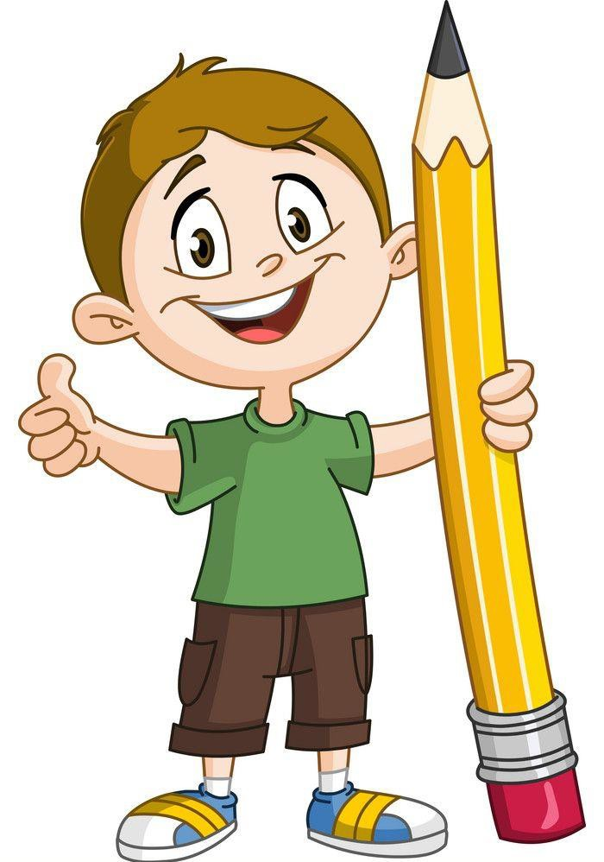
THE WOW IN YOUR SOLUTION
The wow factor of "CartoonifyMe" lies in its simplicity and effectiveness. With just a few clicks, users can transform their ordinary photos into stunning cartoon-style images. By leveraging advanced image processing techniques under the hood, such as grayscale conversion and edge detection, the program seamlessly applies artistic effects while maintaining ease of use. Whether you're a casual photographer or a graphic designer, "CartoonifyMe" empowers you to effortlessly create captivating and unique visual content that will leave viewers impressed and delighted.
3/21/2024 Annual Review

Slide 9
MODELLING
The steps involved in developing this project “CartoonifyMe” are described below also we can consider this to SDLC (Software Development LifeCycle).
1. Requirement Gathering
2. Research and Planning
3. Setup Development Environment
4. Code Implementation
5. Testing
6. Refinement
7. Documentation
8. Deployment
9. Feedback and Maintenance

Slide 10
RESULTS
"CartoonifyMe" delivers impressive results by effortlessly transforming ordinary photos into captivating cartoon-style images. Users simply upload their image, and the program applies advanced techniques like grayscale conversion, edge detection, and bilateral filtering to create stunning visual effects. The user-friendly interface ensures easy navigation, making it accessible to a wide range of users, from casual photographers to graphic designers. With "CartoonifyMe," anyone can unlock their creativity and produce unique, eye-catching visual content that stands out with a fun and artistic flair.

