Slide 1
CI/CD devops project
"Mediabox" plugin for WDTV Live Media player
Created by Artem Sereda
Summer Kharkov 2021

Slide 2
Target: Create media plugin for old WDTV Live player (arm linux). Backend based on Golang. Frontend running inside hardware player (php).
Main problems: Old linux core media player not full supported https connections, new ssl codecs, core sertificates etc. So need make backend proxy: convert https requests to media data sites into http requests.
Relevance: Many peoples around the world still use this media player with good picture on tv. But product maintainer not support this device anymore. So need the solution.

Slide 3
Project: Deploy OpenStack cloud (own hardware resources used) with two instances for test and stage builds. Backend on Golang using github repo, webhooks for Jenkins build jobs. Instances deployed by Terraform. Initial configuration by Ansible. Successful builds delivery to external work servers. Mediaplayer plugin (php) request info from external servers 8090 port and render page with media on TV (frontend).
Instruments:
1. Openstack (microstack) 1. WDTV Live Media player
2. Terraform 2. Desktop (6Gb AMD Phenom X4 945)
3. Ansible 3. Home Server (Atom D425)
4. Jenkins 4. Home Server (Intel E6500)
5. Ubuntu (desktop, servers)
6. VSCode
7. Golang, php

Slide 4
Sheme

Slide 5
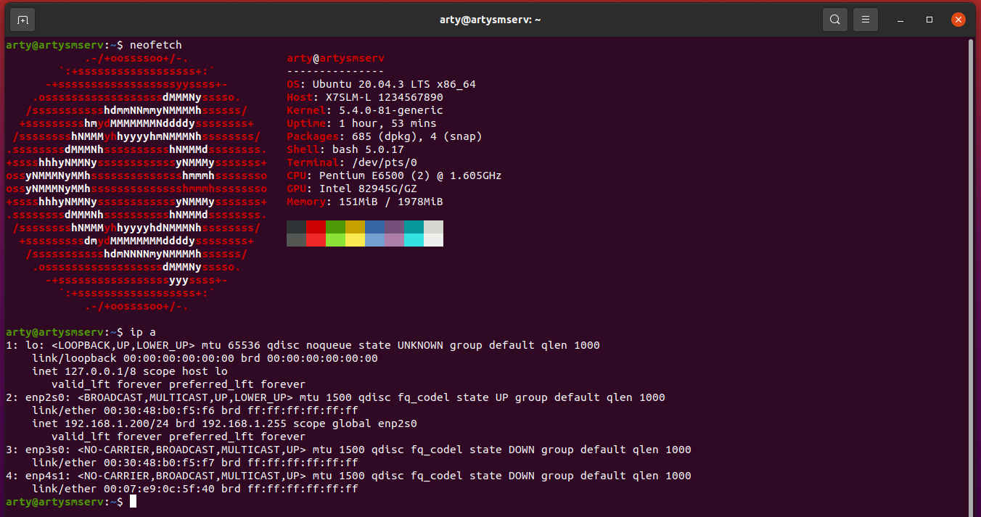
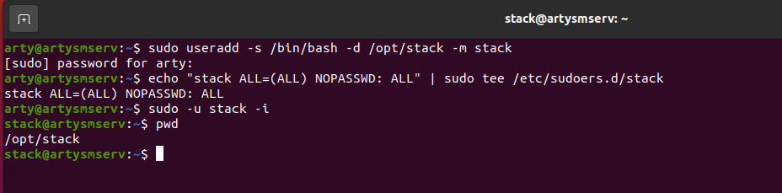
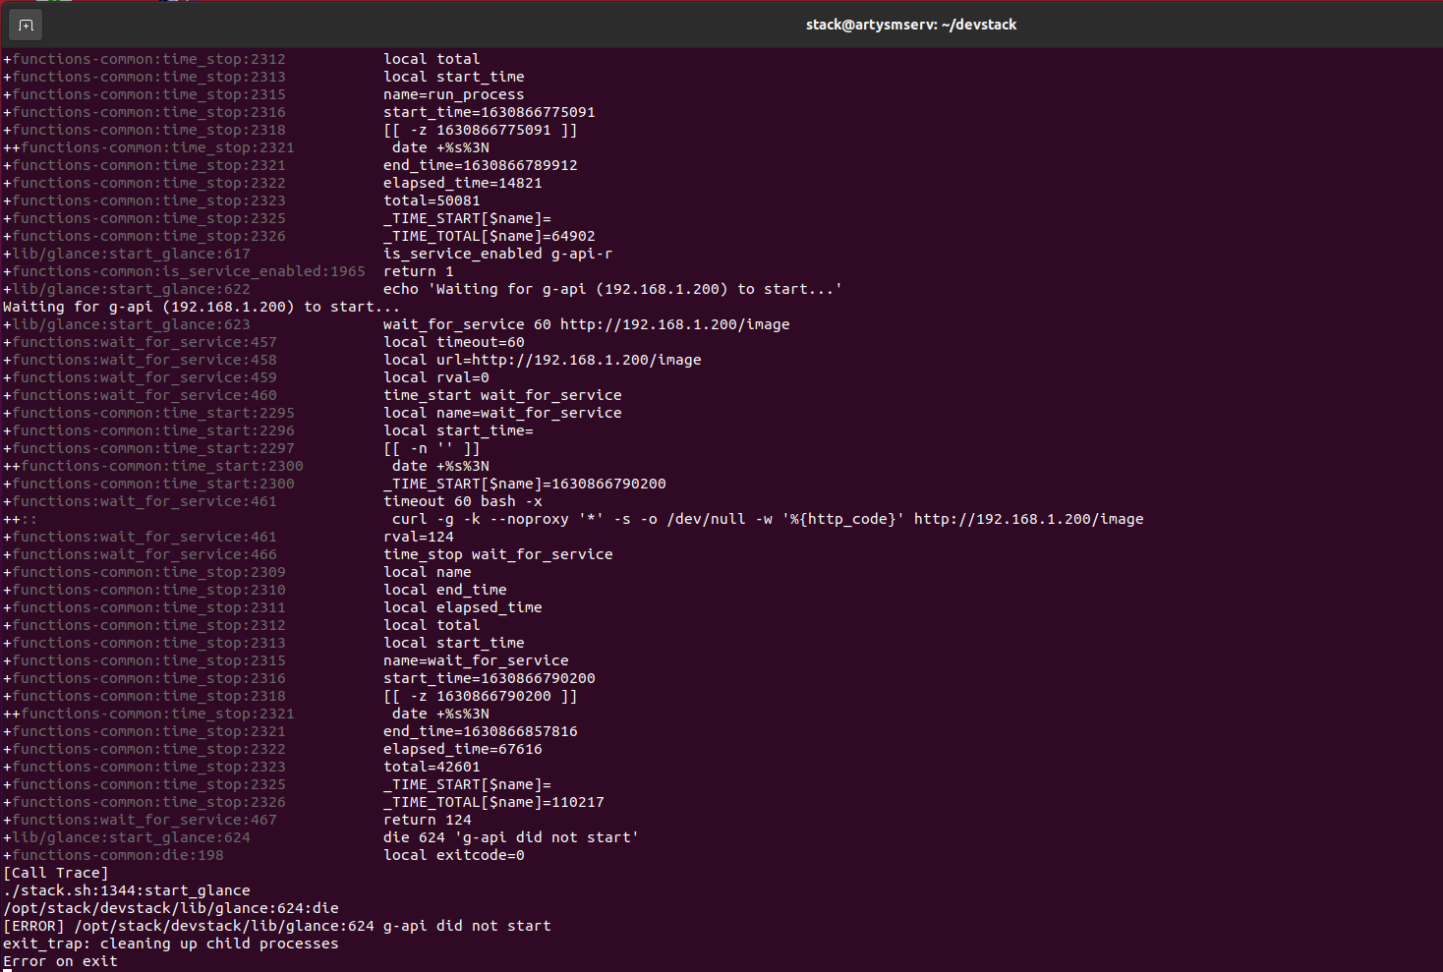
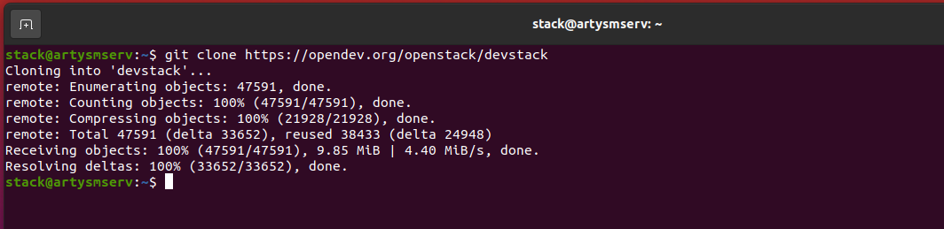
Workflow
OpenStack
Try to build DevStack variant on supermicro server 2gb. Result – fault. Not enough resources.

Slide 6
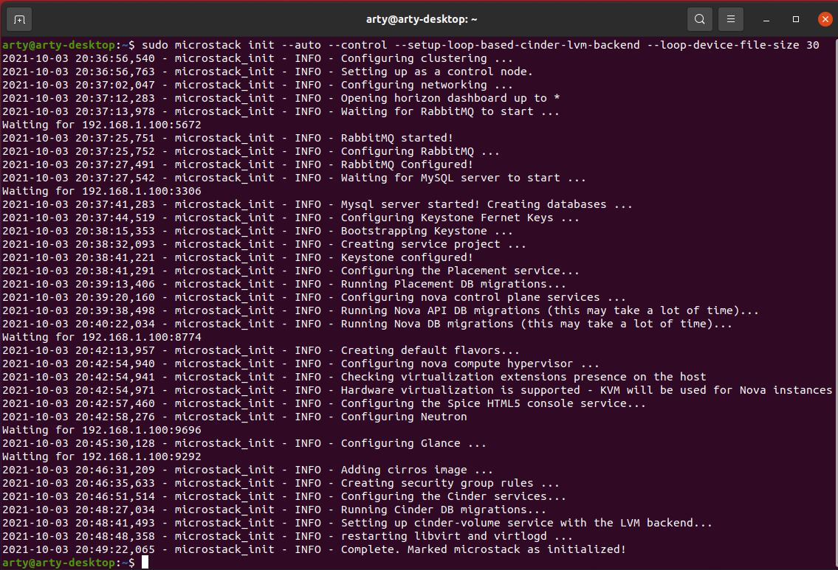
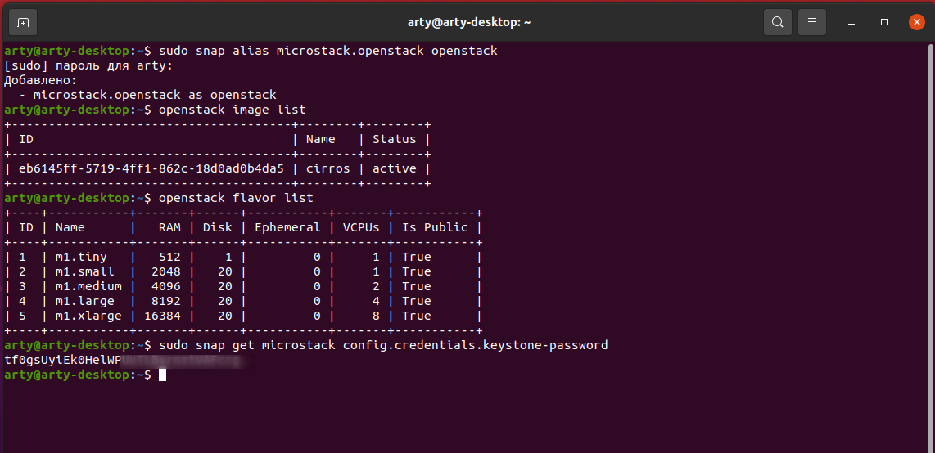
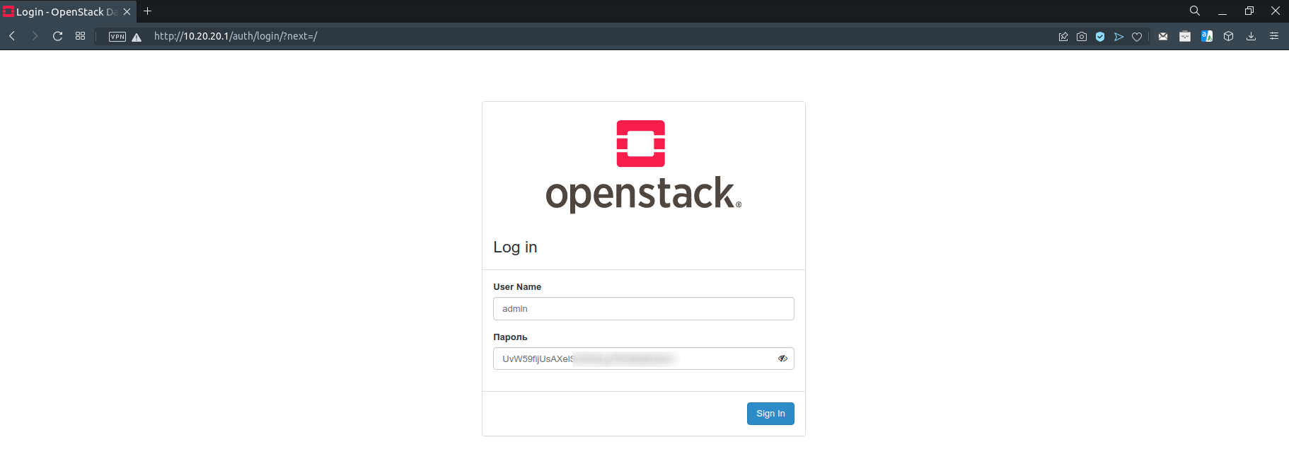
Workflow
OpenStack
Finally use microstack from snap on desktop with 6Gb + 9Gb swap

Slide 7
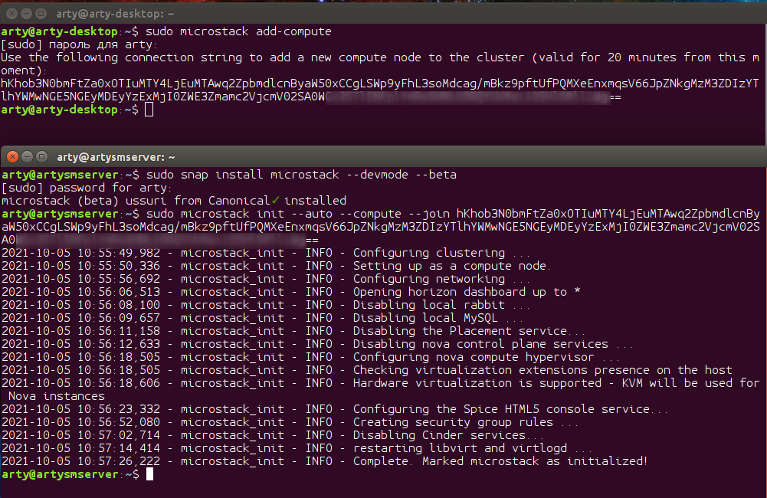
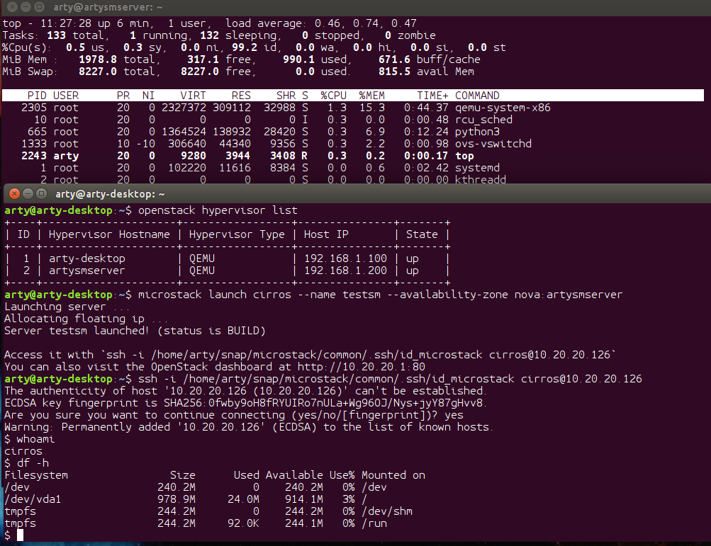
Workflow
OpenStack
Add microserver into OS cloud as compute node.

Slide 8
coming…...

