Slide 1
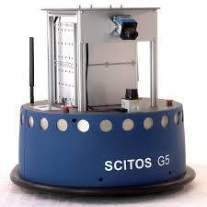
Mini Project 2 :
Sensor readings from a wall-following robot
By Anton

Slide 2
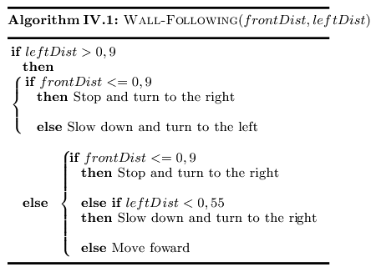
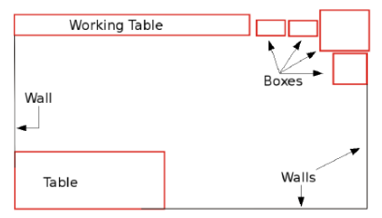
Story
A months ago, I programmed SCITOS, a robot, to follow the wall without any collision

Slide 3

Story
Unfortunately, last week, my computer crashed, and I'd lost the program...

Slide 4

Story
The program is still in my SCITOS but it's impossible to extract the program

Slide 5
Story
The only things SCITOS can do is to execute the program and collect all the data of his sensors and the action he did.

Slide 6

Story
Mission :
Recreate the program from the data SCITOS with
Machine learning model

Slide 7
Agenda
Story
Exploratory Data Analysis
Modelling
Feature Engineering
Verify and Evaluate the Training Model
Tuning
Choice of the best model with the test set
Conclusion

Slide 8
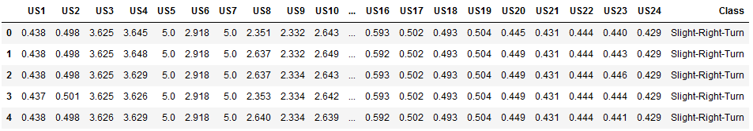
Exploratory Data Analysis
Raw sensors Data
Action
5456 instances
No missing values
24 first columns : raw data from the 24 ultrasound sensors.
These values are between 0 and 5.
Could represent the voltage of the signal from the sensor (range 20cm to 300cm)
Last columns : Action the robot will do

Slide 9
Exploratory Data Analysis
WALL
US1
US24
US2
US23
US3
US22
US4
US21
US5
US20
US6
US19
US7
US18
US8
US17
US9
US16
US10
US15
US11
US14
US13
US12

Slide 10
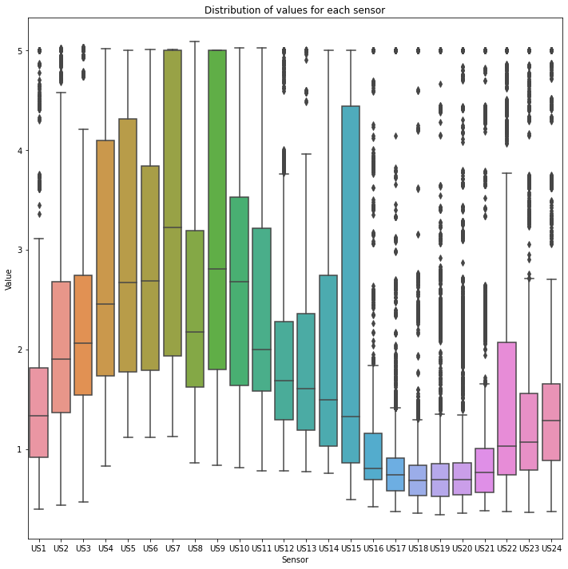
Exploratory Data Analysis
Right side of SCITOS
Left side of SCITOS

Slide 11
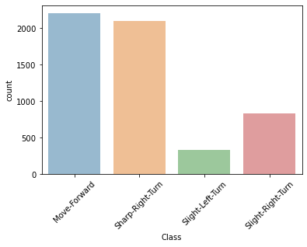
Exploratory Data Analysis
4 classes :
Move Forward
Slight Left Turn
Slight Right Turn
Sharp-Right-Turn

Slide 12
Modelling
Target : Predict what the robot should do
Features : Raw sensors data
Supervised Classification (multi-class)
6 Estimators :
LogisticRegression
Support Vector Machine (Classification)
Naive Bayes
K Nearest Neighbor
Random Forest (Classification)

Slide 13
Modelling
Splitting and standardized
Training set (75%)
Test set (25%)
Fit and transform
Transform
StandardScaler()
X_train_scaled
y_train_scaled
X_test_scaled
y_test_scaled

Slide 14
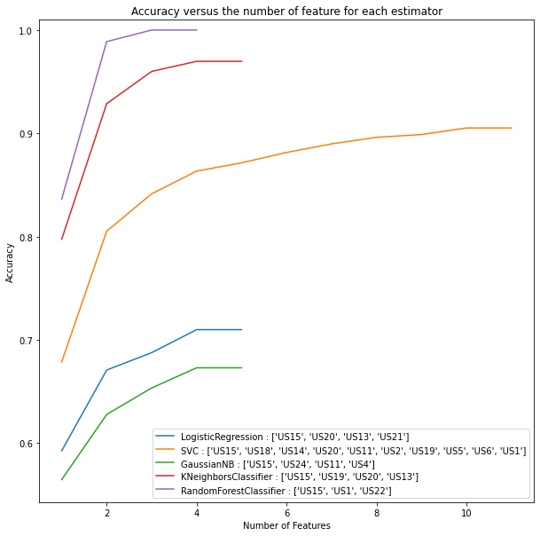
Modelling
Feature Engineering
List the most important features for each estimator
Give me an overview of the accuracy of the training model (no cross validation for this part)

Slide 15
Modelling
Verify and Evaluate the Training Model
Cross validation = 5
Estimator | All features | Forward selected features | Number of features selected
LogisticRegression | 0.70 | 0.71 | 4
SVC | 0.88 | 0.88 | 10
GaussianNB | 0.53 | 0.67 | 4
KNeighborsClassifier | 0.85 | 0.95 | 4
RandomForestClassifier | 0.99 | 0.91 | 3

Slide 16
Modelling
Tuning for training set
Estimator | All features | Tuned with All features
SVC | 0.88 | 0.91
KNeighborsClassifier | 0.85 | 0.95
RandomForestClassifier | 0.99 | 0.99

Slide 17

Modelling
Choice of the best model with the test set
RandomForestClassifier
0. 99
KNeighborsClassifier0. 91
Support Vector Machine
0. 9

Slide 18
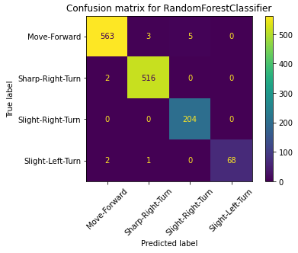

Conclusion
RandomForestClassifier is the best model to predict with a accuracy of 99%
Even the data set was unbalance, the model do good job to predict to turn slight left (no need to oversample)
The mission is a success
Possible improvement :
Deeper feature engineering for RandomForestClassifier
Tuning with selected features

Slide 19


Slide 20
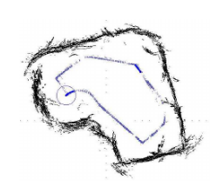

Slide 21
US24
US1
US2
US23
US3
US22
US4
US21
US5
US20
US6
US19
US7
US18
US8
US17
US9
US16
US10
US15
US11
US14
US13
US12

Slide 22
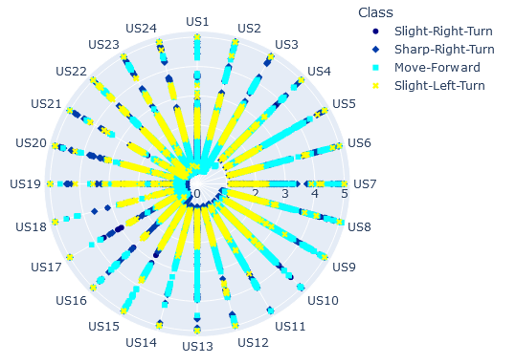
Exploratory Data Analysis

