Slide 1
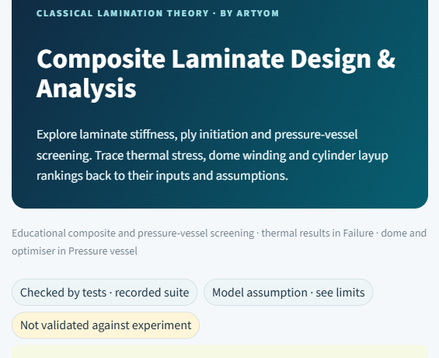
PROJECT PRESENTATION · 8 OCTOBER 2026
A composite laminate calculator built with AI: ply data in, stresses and failure loads out, checked against a textbook
AI-written engineering code is not correct by default, so every stage of this program has a test or a reference.
Ply data → failure load
one calculation chain in the browser, so a laminate can be followed stage by stage instead of trusted as a black box
175 tests, 2 audits
the AI-written code was independently reviewed and tested: tests, audits and a second AI model found and fixed real errors
126 textbook values
one published laminate example compared with the app value by value, each against its source-based tolerance
Live application composite-laminate-tool.streamlit.app (start page screenshot)
Artem Khan · GitHub repository · Live application · 8 Oct 2026
1 / 14
Notes:
Purpose: show the app and that its numbers are checked. The point is not that AI wrote code, but that every stage has a test or a reference. My own contribution is on slide 8.

Slide 2
CONTENTS
The program first, then how the AI-generated code was reviewed and tested, then one check against a textbook
Each section answers one question about whether the numbers can be used.
01
The app
what goes in, what the model does, what comes out
02
Calculation chain
how a stacking sequence becomes laminate stiffness
03
Failure and pressure vessel
when a ply fails, and what a cylinder wall can carry
04
Further studies
thermal stress, dome winding and a layup search
05
Built with AI
who wrote what, and how the code was checked
06
Validation against Kaw
does the app reproduce a published example?
07
Status
what the numbers can and cannot be used for
Central question: What does the app calculate, and how far can its numbers be trusted?
Order: app → calculation → failure and vessel → further studies → AI build → validation → status
Artem Khan · GitHub repository · Live application · 8 Oct 2026
2 / 14
Notes:
Order: the program, how it was built and checked, then one textbook comparison. The central question is on this slide.

Slide 3
01 · THE APP · WORKFLOW
Input → model → output → comparison: one app takes ply data to failure loads, and a textbook example is the reference
Each step has its own place in the app, so a wrong number can be traced to the step that produced it.
1 Input
→
2 Model
→
3 Output
→
4 Comparison
Ply stiffness, strengths, thickness, stacking angles and loads or pressure, entered once in the sidebar.
Rotate ply stiffness, sum the plies into A, B, D, solve strain and curvature, recover ply stress, apply the failure criteria.
Stiffness matrices, stress at every ply face, load factor to first failure, cylinder pressures and a PDF report.
A textbook laminate whose intermediate results are printed, compared value by value; 175 tests on the code.
so every tab works on the same data
one tab per stage, so errors can be located
each result states its assumption
so the model is tested against known numbers
Q → Q-bar(θ) → A, B, D → ε₀, κ → ε(z) = ε₀ + z·κ → σ = Q-bar(θ)·ε(z) → failure index
Defaults give a working example at once: T300/5208 carbon/epoxy, [0/45/−45/90]s, 8 plies, 1.000 mm.
Kaw, worked example §4.3 · live application
Artem Khan · GitHub repository · Live application · 8 Oct 2026
3 / 14
Notes:
Walk the four boxes left to right. Input is entered once; each model stage has its own tab, so an error can be located. The comparison starts at slide 9. Likely question: does it cover failure? Only stiffness, strain and stress are compared with the textbook; the book prints no strengths.

Slide 4
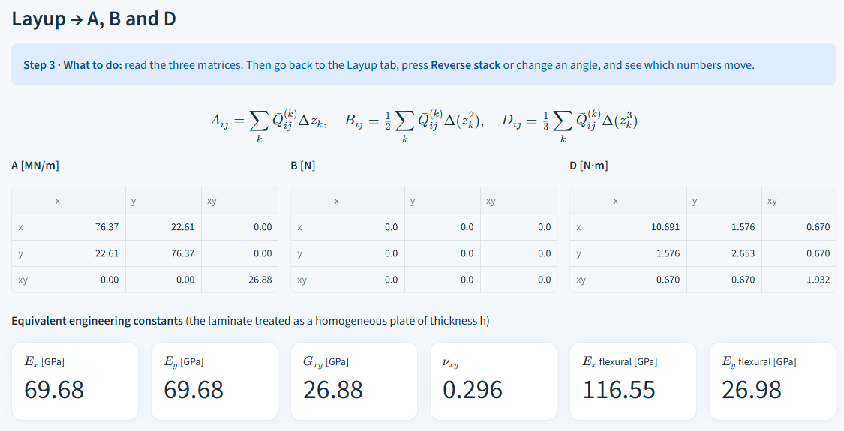
02 · CALCULATION CHAIN · ABD TAB
The ABD matrix turns a stack into laminate stiffness: A11 = A22 = 76.37 MN/m, B = 0, D11 about four times D22
It predicts behaviour: a symmetric stack does not bend when stretched; outer 0° plies stiffen bending along x.
Screenshot of the app, tab 3 · ABD, default laminate [0/45/−45/90]s
What the numbers tell
—
B = 0: stretching does not bend a symmetric stack.
—
A11 = A22: the same stretch stiffness along x and y.
—
D11 10.69 against D22 2.65 N·m: bending along x is stiffer.
Conventions, fixed once so all tabs agree: SI units inside, engineering shear γ = 2ε, angles counter-clockwise, plies listed from the −h/2 face.
Live application, tab 3 · ABD, default input
Artem Khan · GitHub repository · Live application · 8 Oct 2026
4 / 14
Notes:
ABD turns the stack into stiffness. B = 0 because the stack is symmetric; D11 is about four times D22 because the 0 degree plies are outermost. Conventions are fixed once: SI, engineering shear, angles counter-clockwise.

Slide 5
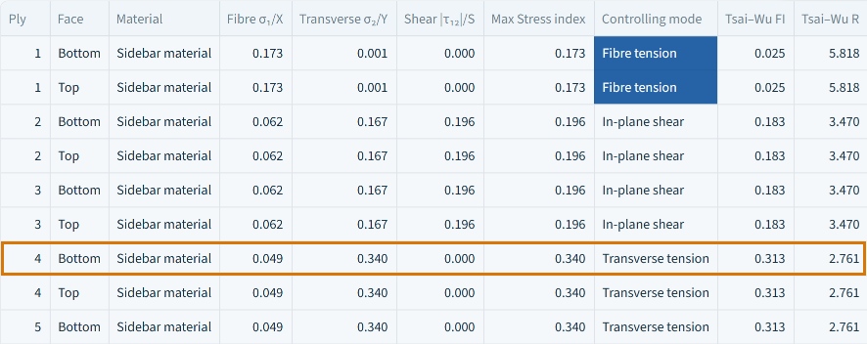
03 · FAILURE AND PRESSURE VESSEL · FAILURE TAB
Three failure criteria check every ply face; Max Stress and Hashin name the failing mode, Tsai–Wu gives one combined index
Running all three shows whether the answer depends on the criterion chosen.
Screenshot of the app, tab 5 · Failure: criteria per ply face (highlighted: ply 4, bottom)
Max Stress
each stress against its own strength; names the controlling mode
Tsai–Wu
all stress components in one quadratic index and a load factor; no separate failure mode, and F12 is assumed
Hashin
separate fibre and matrix modes; names the active one
Tsai–Wu R = 2.761 at plies 4 and 5, which tie in a symmetric stack; the app names the first, ply 4 bottom. There Max Stress is 0.340 (transverse tension, load factor 1/0.340 = 2.94), so Tsai–Wu is the stricter of the two.
Default laminate under Nx = 100 kN/m: initiation at 2.76 times the load (Tsai–Wu, ply 4, bottom face).
Live application, tab 5 · Failure · strengths are cited teaching data
Artem Khan · GitHub repository · Live application · 8 Oct 2026
5 / 14
Notes:
Three criteria run on every ply face. Tsai-Wu gives one index and a load factor and no failure mode; Max Stress and Hashin name the mode. The demonstration laminate initiates at 2.76 times the load (Tsai-Wu, ply 4, bottom face). Strengths are cited teaching data.

Slide 6
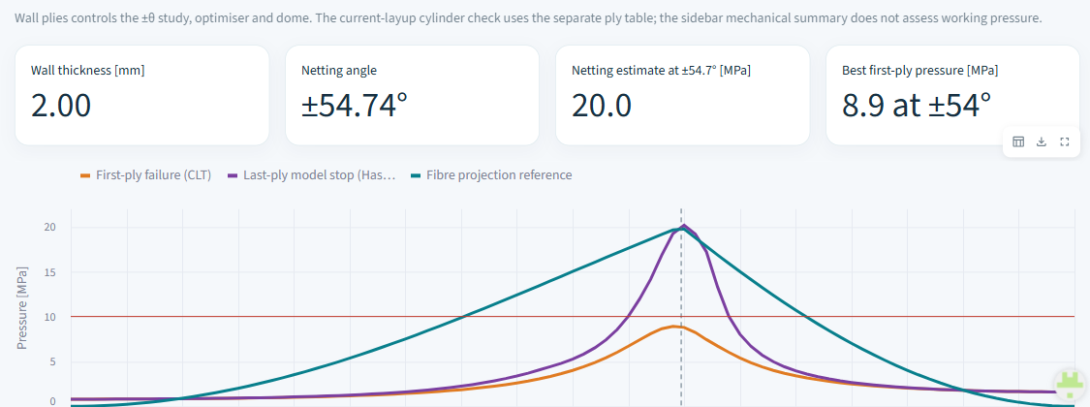
03 · FAILURE AND PRESSURE VESSEL · PRESSURE VESSEL TAB
A cylinder under pressure gets three different model results, 2.96, 6.03 and 7.50 MPa, and none is a burst pressure
The tab turns pressure into wall loads, so one laminate model can be asked three different questions.
Screenshot of the app, tab Pressure vessel: angle study, 16-ply wall
Default 8-ply wall, MPa
First ply: load at which the first ply fails (elastic model). Model stop: load where a run with plies failing one by one halts under a stated rule; it moves from 5.96 to 7.13 MPa when the assumed damage factors go from 0.01 to 0.5. Netting: fibres only.
Wall loads: Nx = pR/2 along the axis, Ny = pR around the hoop. Netting (fibres only) balances them at tan²θ = 2, which gives θ = 54.74°; the chart compares the three models at every angle.
These are results of three different models, not lower and upper bounds of a real burst pressure.
Live application, tab Pressure vessel · default [0/45/−45/90]s wall, 1 mm, R = 100 mm
Artem Khan · GitHub repository · Live application · 8 Oct 2026
6 / 14
Notes:
A cylinder wall under pressure: Nx = pR/2, Ny = pR, netting angle 54.74 degrees. The three bars are three models, not bounds of a burst pressure. The model stop moves from 5.96 to 7.13 MPa with the assumed damage factors, so it is a screening value.

Slide 7
04 · FURTHER STUDIES
Thermal stress, dome winding and a layup search reuse the laminate model to answer questions the plain wall cannot
Each study adds one effect, with its limit stated, so the extra numbers are not mistaken for predictions.
Thermal stress
Dome winding
Layup search
21.27 MPa
15 of 41
128 of 203,490
Cooling by 100 °C leaves transverse stress in the plies before any load; it lowers the first-ply load factor of the default laminate from 2.76 to about 1.285.
The winding angle changes along a dome, so the wall is checked station by station: 15 stations are membrane-valid, the weakest about 4.32 MPa.
The ply count per angle is searched instead of guessed: top first-ply about 8.86 MPa; model stop 20.10 MPa against 20.00 MPa fibre-only.
No temperature-dependent properties, no cure chemistry.
Uses a separate 16-ply helical wall.
A sampled search, not a global optimum.
Each study has its own tests and an AI review; none has an experimental check.
Demonstration values of the default inputs, live application
Artem Khan · GitHub repository · Live application · 8 Oct 2026
7 / 14
Notes:
Each study adds one effect: thermal residual stress, dome stations, a sampled layup search. Each has its limit stated. None has an experimental check.

Slide 8
05 · BUILT WITH AI
The AI wrote the code; I designed the workflow, checked Kaw by hand and ran the review process that corrected the code
AI code is not trusted by default, so the checks I set decide what stays.
A My contribution
B What the review found
—
I designed the workflow: order of operations and sections, so a reader can follow material → laminate response → failure.
22 comments
6 found no error; two audits fixed 10 findings, e.g. netting 5.63 → 4.50 MPa
—
I checked Kaw's example by hand and in the app, and built side-by-side book pages and screenshots. My question about ply load added part (e).
—
I ran the AI review: Claude wrote, ChatGPT reviewed, Claude and myself verified each finding by derivation or test. My rules: sourced data, no fitting, full tests.
—
I planned the sequence, prompts and checks, and stopped work that went the wrong way.
Each comment was checked by derivation or by running the code; the reviewer's literature remarks were not checked.
Review records of Claude and ChatGPT for dome, Hashin and progressive failure
Artem Khan · GitHub repository · Live application · 8 Oct 2026
8 / 14
Notes:
My contribution: the workflow design, the Kaw check by hand and in the app, and the review process (Claude wrote, ChatGPT reviewed, Claude verified each finding by derivation or test). Example of what the review found: netting 5.63 against the exact 4.50 MPa. Be ready to show the hand work for Kaw.

Slide 9
06 · VALIDATION AGAINST KAW · REFERENCE CASE
Kaw's example follows the app's own workflow: input, model, output, comparison, with printed numbers to check at each step
Every intermediate result is printed in the book, so each stage can be checked, not only the final answer.
1 Input
→
2 Model
→
3 Output
→
4 Comparison
Glass/epoxy E1 38.6, E2 8.27, G12 4.14 GPa, ν12 0.26; 5 mm plies; stack [30/−45/−60]; Nx 1500 N/m, My 1500 N.
Q → Q-bar per ply → A, B, D → mid-plane strain and curvature → ply stress.
A11 273.46 MN/m, εx 162.36 µε, ply 2 σ1 −20.43 MPa, ply forces 12 920, −20 596 and 9 176 N/m.
126 printed values of the book: Q, Q-bar, A, B, D, strain, stress, ply force.
typed in unchanged, nothing fitted
unsymmetric stack: B ≠ 0, stretching and bending couple
read from the app tabs
each against its source-based tolerance
2.5 … 7.5
ply 3 · −60°
Book z points down, the app's up, so points are paired by numeric z. Kaw p. 7 labels the third local strain γ12/2 but prints the engineering value, 1.919·10⁻³ for ply 2; the app's engineering γ12 matches it. Ply z in mm.
−2.5 … 2.5
ply 2 · −45°
−7.5 … −2.5
ply 1 · 30°
The book prints no strengths: this case checks stiffness, strain and stress, not any failure load.
Kaw, worked example §4.3, pp. 1–10
Artem Khan · GitHub repository · Live application · 8 Oct 2026
9 / 14
Notes:
Kaw's example follows the same four steps as the app. Inputs are typed unchanged. B is not zero because the stack is unsymmetric. The book prints no strengths, so this checks stiffness, strain and stress only.

Slide 10
06 · VALIDATION AGAINST KAW · NUMBERS
All 126 printed values agree with the app inside their own tolerances; the largest relative gap is 0.04 %
A printed value is known only to about half of its last digit, so each is tested against its source-based allowance.
Quantity | Book | App | Gap | Allowed ±
A11, stretch stiffness (MN/m) | 273.5 | 273.46 | 0.044 | 0.05
B11, coupling (kN) | −384.7 | −384.70 | 0.0034 | 0.05
D11, bend stiffness (kN·m) | 5.266 | 5.2660 | 0.000025 | 0.0005
εx, mid-plane strain (µε) | 162.4 | 162.36 | 0.040 | 0.05
Largest relative gap: ply 1 τ12 (MPa) | −12.49 | −12.485 | 0.0049 | 0.005
116
non-zero printed values, each within half a unit of its last printed digit
7
printed zeros, compared by absolute error
3
Five of the 126 values. Gap = |app − book| from the full app values, in the unit of the row; Allowed = half of the book's last printed digit (ply forces: ±2.5 N/m, see below). The last row, the largest relative gap, uses 99 % of its allowance.
ply forces (12 920, −20 595, 9 175 N/m), within the propagated tolerance ±2.5 N/m; they sum to the applied 1500 N/m, so equilibrium holds
Kaw §4.3, pp. 2–10 · all 126 values re-computed separately
Artem Khan · GitHub repository · Live application · 8 Oct 2026
10 / 14
Notes:
126 printed values: 116 non-zero values against half of their last printed digit, 7 zeros by absolute error, 3 ply forces against +-2.5 N/m because the book rounds midpoint stresses before multiplying. Gaps are computed from the full app values (B11: 0.0033568 kN). The largest gap uses 99 percent of its allowance. The percentage gap only shows size, it is not the pass criterion.

Slide 11

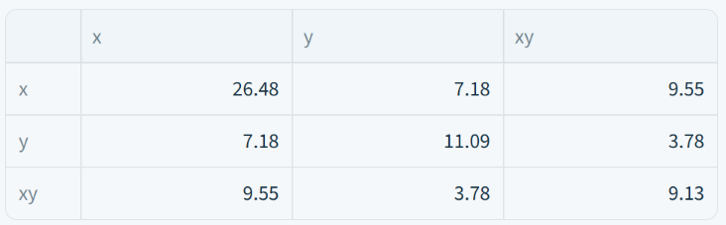
06 · VALIDATION AGAINST KAW · STIFFNESS OF ONE PLY
The Q-bar screen shows the same 3×3 matrix as the book at 30°, and at −45° and −60°
Q-bar is one ply's stiffness rotated to the laminate axes, in GPa; the app shows 2 decimal places.
Ply angle 30°: Kaw, printed
Ply angle 30°: app, screenshot
−45°
9 of 9 entries equal at 2 decimal places
−60°
9 of 9 equal; Q11 and Q22 swap places against 30°, as the rotation requires
All 27 Q-bar entries agree to the printed digits; the largest relative gap at full precision is 0.0123 %.
Kaw, worked example §4.3, pp. 2–3 · app screen "Inspect one ply angle"
Artem Khan · GitHub repository · Live application · 8 Oct 2026
11 / 14
Notes:
Angle 30 degrees is shown large; -45 and -60 degrees match the same way. For these three angles the rotation gives the printed matrix; it is one example, not a proof for every angle.

Slide 12
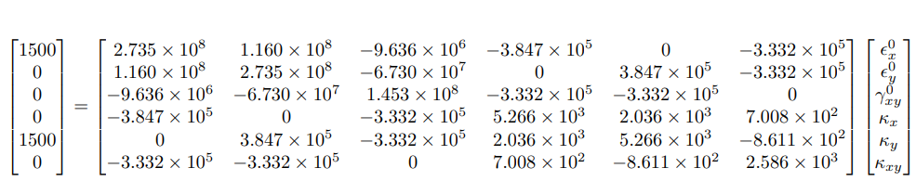
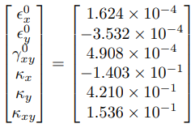
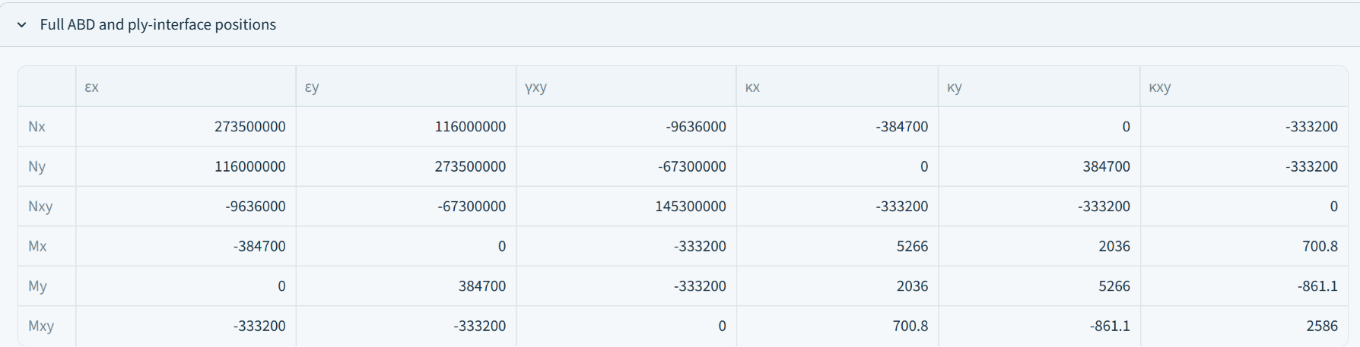
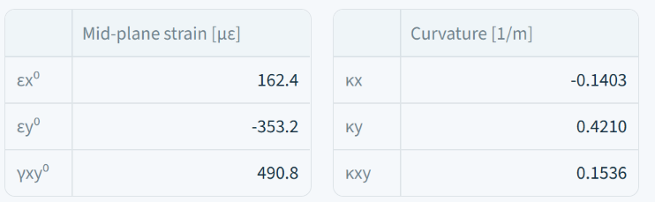
06 · VALIDATION AGAINST KAW · LAMINATE STIFFNESS AND MID-PLANE RESPONSE
The 6×6 ABD matrix and the mid-plane response match the book; the strain and stress tables that follow start from these values
ABD links loads N, M to mid-plane strain and curvature; the app screen shows the book's four digits.
A, B, D matrix: stretch, coupling and bend stiffness
Mid-plane strain and curvature
Kaw, printed
Kaw, printed
App, screenshot
App, screenshot
Book: 1.624, −3.532, 4.908 (10⁻⁴) and −0.1403, 0.4210, 0.1536 per m. App: 162.4, −353.2, 490.8 microstrain and the same curvatures.
Kaw §4.3, pp. 4–5 · app panel "Full ABD and ply-interface positions"
Artem Khan · GitHub repository · Live application · 8 Oct 2026
12 / 14
Notes:
ABD and mid-plane response match the book for this example; the strain and stress tables on the next slide are computed from them.

Slide 13
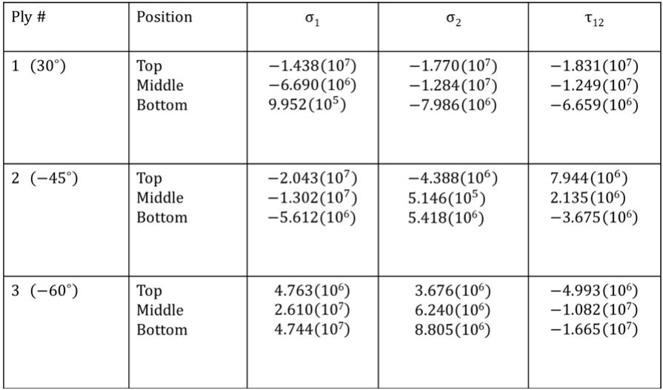
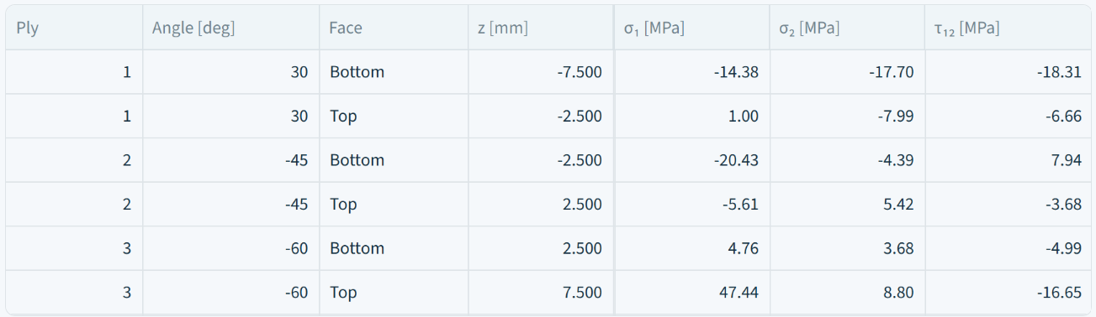
06 · VALIDATION AGAINST KAW · STRESS THROUGH THE THICKNESS
Ply-face stresses match the book's table on p. 9, which is what failure criteria are applied to
Stress along the fibres σ1, across them σ2 and shear τ12 at each ply face, in MPa; the book prints pascals.
Kaw, printed, p. 9 (top, middle and bottom of each ply)
App, screenshot (the two faces of each ply; strain columns left out)
The strain table (p. 8) matches the same way: ply 1 at z = −7.5 mm is −2.532(10⁻⁴), −2.043(10⁻³), −4.423(10⁻³) in the book and −253, −2043, −4423 microstrain in the app. The middle rows, which the app screen leaves out, are compared in the verification report; the largest relative gap, 0.0396 %, is τ12 of ply 1 at z = −5 mm.
Book "Top" is the app's "Bottom" (book z points down, app z up): at z = −7.5 mm σ1 is −1.438·10⁷ Pa in the book and −14.38 MPa in the app.
Kaw §4.3: strain table p. 8, stress table p. 9 · app strain and stress table
Artem Khan · GitHub repository · Live application · 8 Oct 2026
13 / 14
Notes:
Stress table is on p. 9, strain table on p. 8. Book 'Top' is the app's 'Bottom' because z points the other way.

Slide 14
07 · STATUS
The app is checked where a reference exists and labelled where none does, so it is a screening tool, not a predictor
Stiffness and stress are verified against a textbook; failure and pressure numbers are model results.
Checked, and what that gives
Assumed, and what that limits
—
Stiffness, strain, stress and ply forces match Kaw's example for this stack and load; one example supports the chain, it does not cover every case.
—
Strengths and damage factors are model inputs: the model stop moves from 5.96 to 7.13 MPa with them, so it is a screening value.
—
175 tests, two audits and a second AI review found and fixed errors, so the code is not simply believed.
—
The textbook prints no strengths, so no failure load is checked against it.
—
Key numbers are frozen in tests/snapshot_v3.json, so later edits cannot change them unnoticed.
—
No experimental comparison yet: a function for vessel burst tests exists in validation/, but its four potential data sources are unverified.
Use it to screen and to teach laminate behaviour; do not quote its failure or pressure numbers as predictions.
Live app: composite-laminate-tool.streamlit.app · repository on GitHub
Artem Khan · GitHub repository · Live application · 8 Oct 2026
14 / 14
Notes:
The app is checked where a reference exists and labelled where none does. Do not quote failure or pressure numbers as predictions. A comparison function for vessel burst tests exists, but its data sources are not verified yet.

