Slide 1


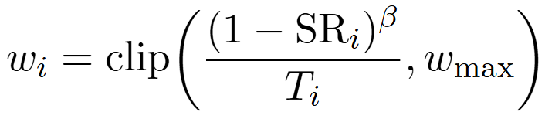



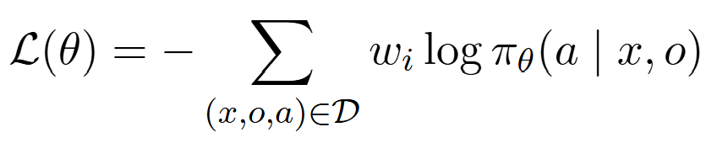






Search and Collect (frozen $π_{0}$)
2. Curate and Weight
A. sample & cluster actions
B. branch
C. repeat
D. score
Keep successful trajectories
Re-rollout tasks with <15 success
Weight each task:
$$w_{i}=\text{clip}\left(\frac{{\left(1−{SR}_{i}\right)}^{β}}{T_{i}},w_{max}\right)$$
$$a_{1}$$
Majority Action:
$$a_{1}$$
Branching
Score: 1
$$a_{2}$$
Majority Action:
Same Prompt
$$a_{2}$$
Branching
3. Supervised Fine-Tune
Score: 0
One epoch of Supervision
weighted token-level cross-entropy loss:
$$a_{3}$$
Minority Actions:
Sample various actions
Branch majority actions
Repeat branching process for every step
$$a_{4}$$
Pruning

Slide 2



Policy Update
Rollout
Finish All Steps?
Yes
Model Training
Evaluate
No
Full 300 tasks, Pass@8:
OSWorld
OSWorld-Noisy
Data Collection
$$a_{1}$$
Weight
Same Prompt
$$a_{1}$$
Model Evaluation
Branching
$$a_{2}$$
Supervised Fine-Tune
$$a_{2}$$

Slide 3
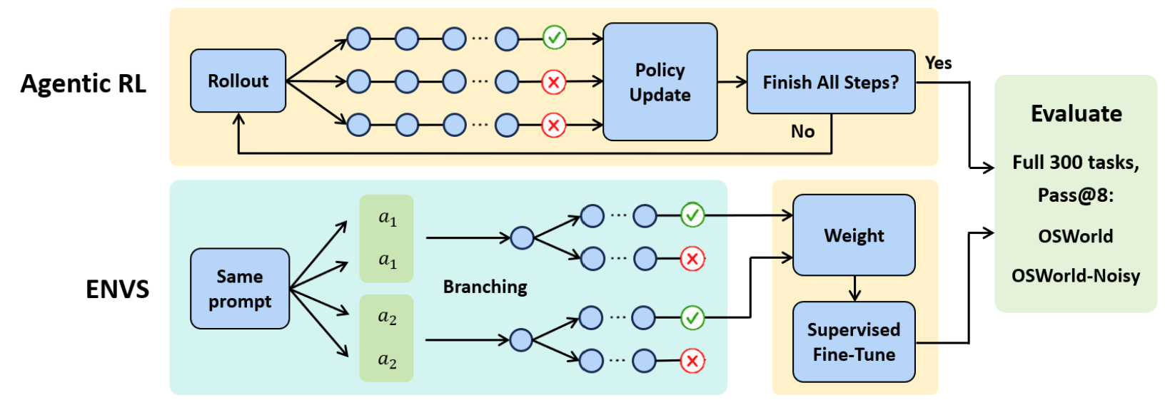
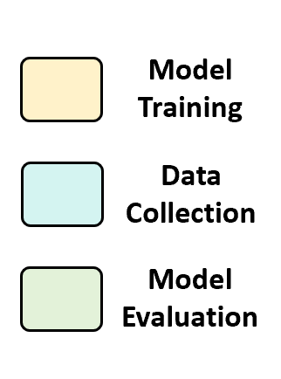
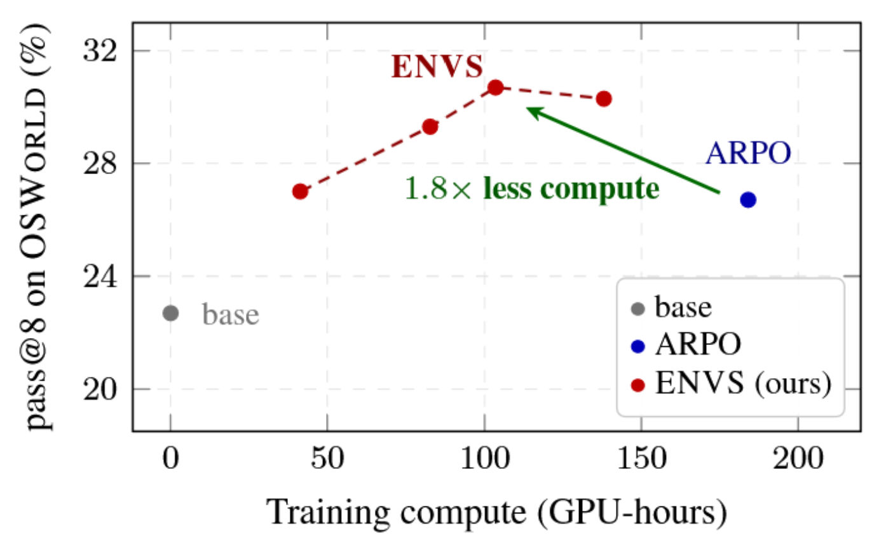
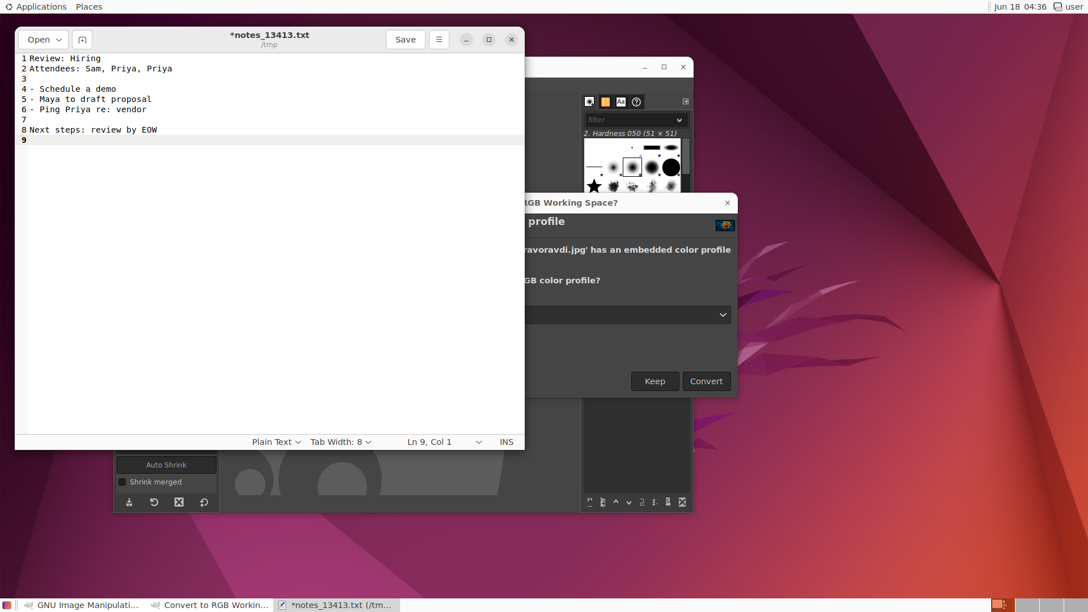
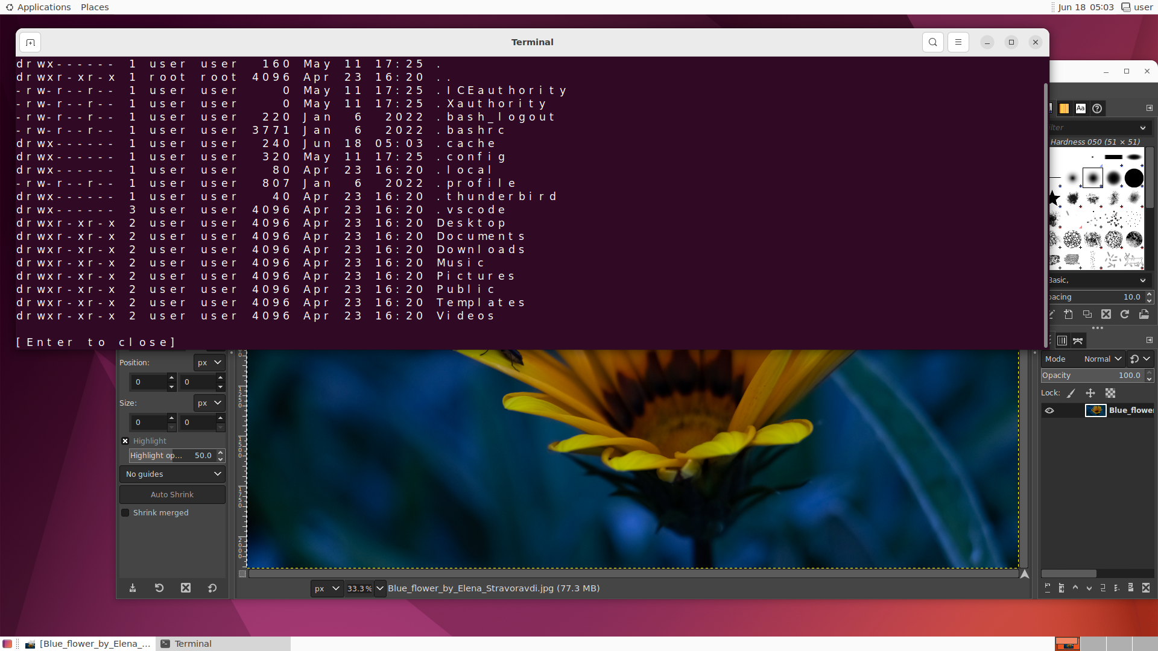
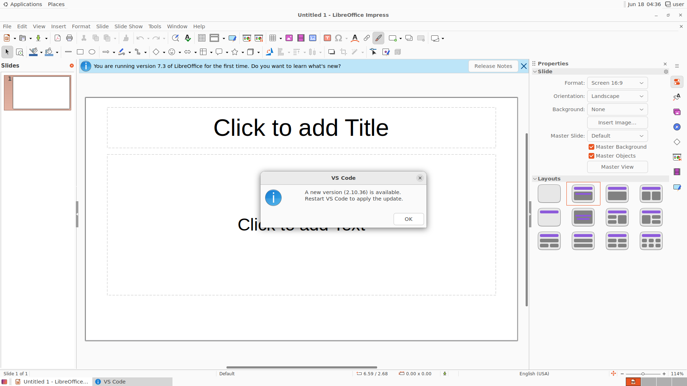
(a) ENVS vs. RL: Decoupling data collection from model training
(b) Compute accuracy frontier
(c) OSWorld-Noisy
Injecting noise:
Simulating human interruption;
Evaluating model robustness.
Notification
System Warning
Concurrent App
etc.

Slide 4
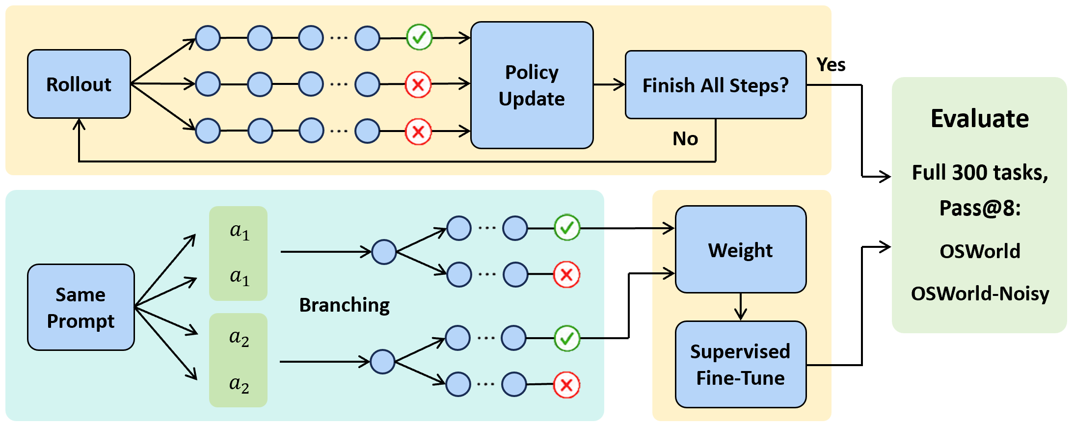

(a) ENVS vs. RL: Decoupling data collection from model training
Agentic RL
ENVS (Ours)
(b) Compute accuracy frontier
(c) OSWorld-Noisy Contribution
Injecting noise, simulating human interruption, eval robustness
Noise type: pop-ups, resizing, concurrent app, etc.

