Slide 1


A 2-days National Level Hackathon on
AI in Education
JEE Saathi AI
Team Name: Curi_Mind
Team Leader: Arunima Paunikar
Team Member: Gauri Belokar
Nagpur

Slide 2
Area Overview
Area Overview: JEE Preparation - Competitive Exam Preparation (Engineering Entrance – JEE)
Objective: Help students crack JEE Main and Advanced to get into top engineering colleges like IITs, NITs, IIITs.
Challenges Students Face:
Vast and complex syllabus (Physics, Chemistry, Mathematics)
Difficulty identifying weak topics
Managing time effectively
Lack of personalized guidance and instant doubt resolution
Expensive coaching classes
Opportunities for AI:
Personalized study plans based on strengths and weaknesses
Smart topic tracking with heatmaps and progress bars
Instant problem-solving via text, voice, or photo upload
Adaptive mock tests and resources, practice problems required as per syllabus

Slide 3
Area Overview
Potential Benefits of AI
Step-by-step problem solving with multiple methods and explanations
Dynamic, personalized study plans and reminders synced with calendars
Data-driven insights to identify weak areas and optimize revision
24×7 access to study resources and support from anywhere
Stress management tools, such as breaks, motivational nudges, and light wellness exercises
This positions AI as a personal mentor, problem solver, and mental wellness coach, making exam preparation more effective, accessible, and student-friendly.

Slide 4
Area Overview
Motivation Behind Selection of Area
High Cost of Coaching: Many students cannot afford expensive coaching classes.
Lack of Quality Resources: Limited access to reliable study materials.
No Personalized Mentorship: Students need guidance tailored to their strengths and weaknesses.
Difficulty Managing Doubts: Questions often remain unresolved without instant help.
Vast Syllabus: Uncertainty about how to cover all topics effectively.
Confusion on Practice: Students don’t know which problems to practice for JEE Main and Advanced, or which are important.
Limited Free Mock Tests: Few accessible options for evaluating performance and improving strategy.
Need for AI Solution: A system like JEE Saathi AI can provide personalized study plans, adaptive practice, doubt resolution, and structured guidance.

Slide 5
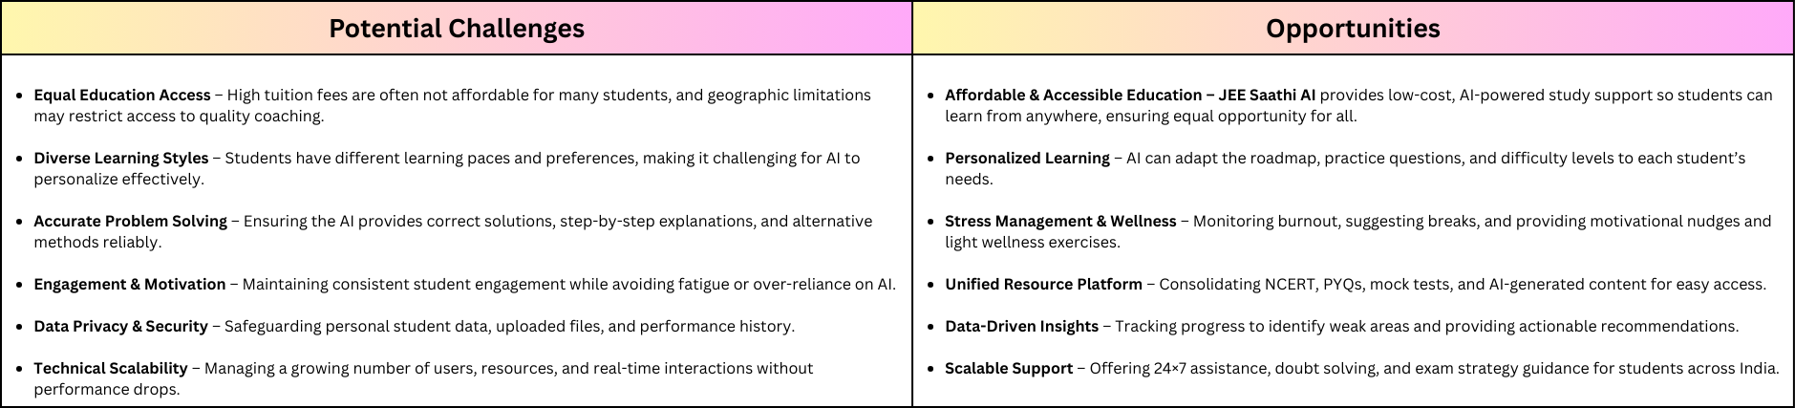
Potential Challenges and Opportunities
Link: https://www.canva.com/design/DAGxszOVLsQ/8FRKWuOqG7RatTAMTgNVqw/edit?utm_content=DAGxszOVLsQ&utm_campaign=designshare&utm_medium=link2&utm_source=sharebutton

Slide 6
Preliminary Solution Concept
JEE students often struggle with scattered study materials, difficulty spotting weak areas, and stress during preparation. JEE Saathi AI is designed as an all-in-one platform that makes studying easier, personalizes learning, and supports student wellness.
Simplifying Study: The AI gathers NCERT books, previous year questions, and mock tests in one place. It automatically creates weekly or monthly study plans and can sync them with the student’s calendar.
Answering Questions: Students can upload problems as a photo, text, or voice, and the AI gives step-by-step solutions, alternative methods, and easy-to-understand explanations.
Supporting Progress: The AI adjusts the student’s roadmap based on performance, updates daily or weekly goals, and keeps track of progress with reminders.
Beyond Academics: The AI watches for study fatigue, suggests breaks, sends motivational nudges, and helps manage stress with light quizzes or meditation tips.
Overall, JEE Saathi AI acts as a personal mentor, problem solver, and wellness coach, helping students stay consistent, focused, and confident while preparing for JEE.

Slide 7
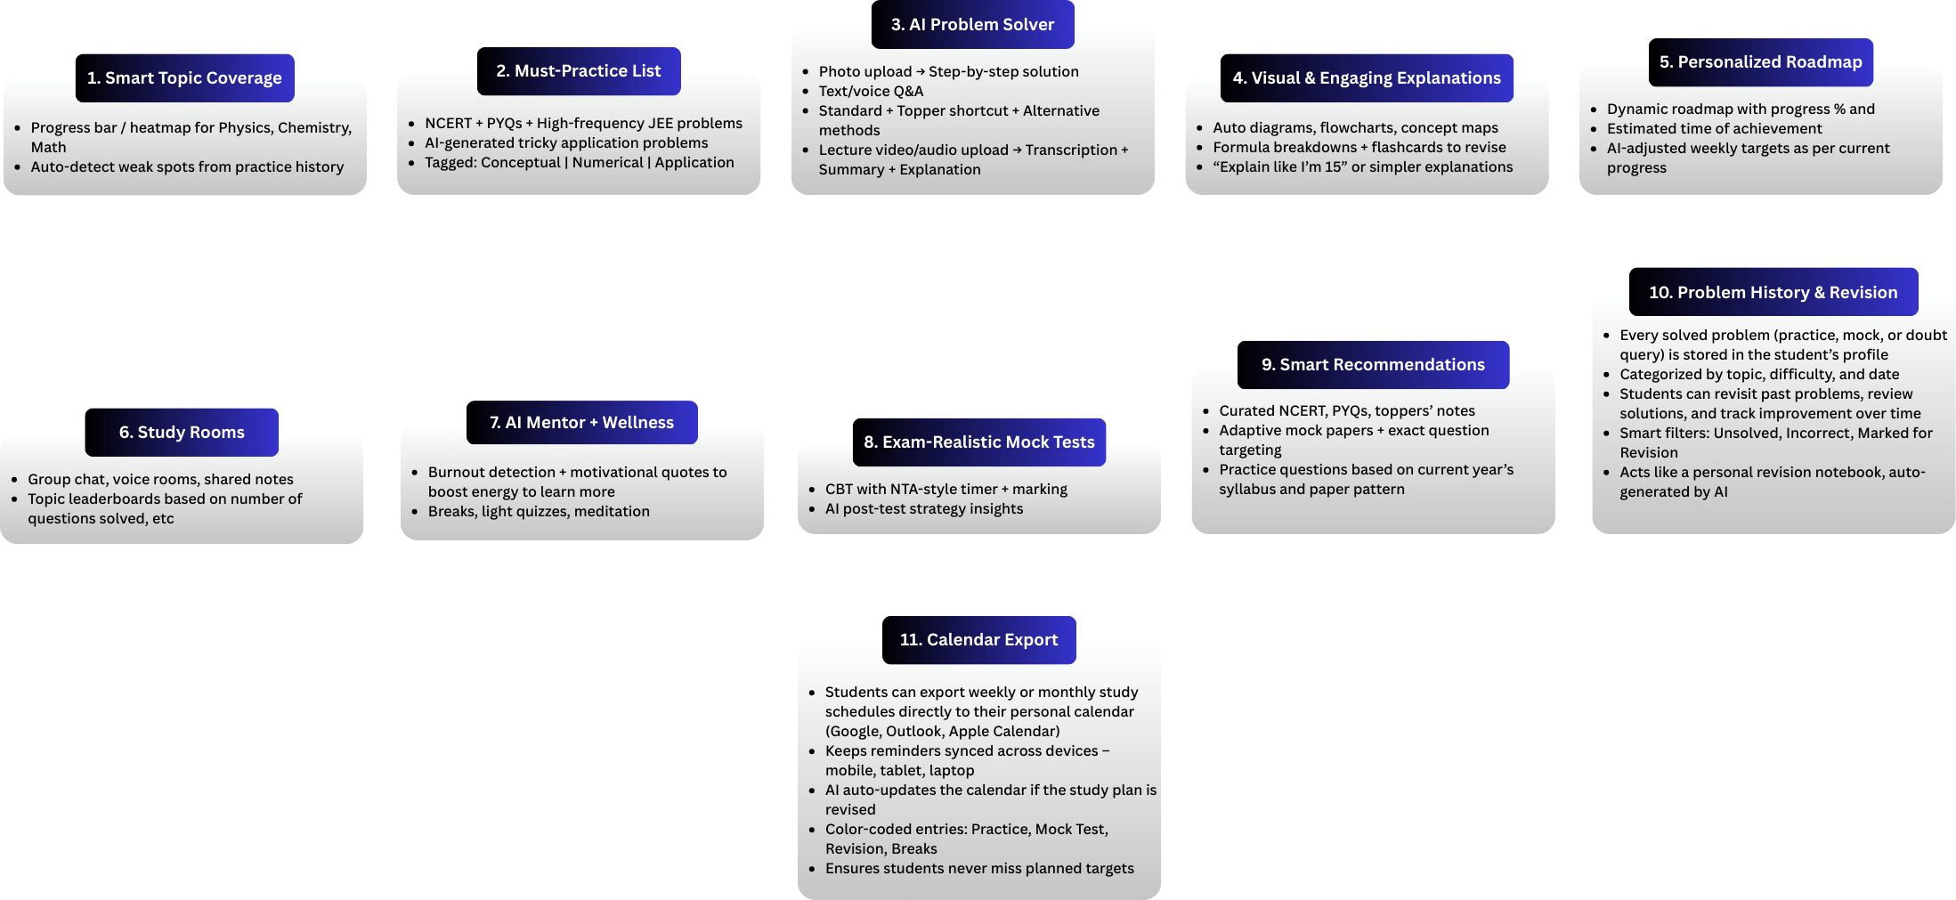
Key Features and Functionalities
Link: https://www.canva.com/design/DAGxc652Gbo/ZsZiCEWTlRvkub0jjLhLlA/edit?utm_content=DAGxc652Gbo&utm_campaign=designshare&utm_medium=link2&utm_source=sharebutton

Slide 8
Target Users and Expected Use Cases
Target Users
JEE Aspirants: Students preparing for JEE Main and Advanced (Class 11 & 12).
Self-Study Students: Those who cannot afford coaching or want supplemental guidance.
Coaching Students: Students enrolled in coaching who need extra practice, doubt resolution, and performance tracking.

Slide 9
Target Users and Expected Use Cases
Expected Use Cases
Personalized Study Plans: AI generates customized learning schedules based on strengths, weaknesses, and target exam date.
Topic & Concept Tracking: Students can track mastery of Physics, Chemistry, and Math topics via progress bars or heatmaps.
Problem Solving: Upload or input questions (text/photo) to get step-by-step solutions, alternative methods, and shortcuts.
Doubt Resolution: Students can ask questions via text or voice and get instant explanations.
Practice Recommendations: AI suggests important problems for JEE Main/Advanced based on topic performance.
Mock Tests & Analytics: Adaptive tests with performance analysis, highlighting weak areas and time management insights.
Revision Assistance: Summaries, formulas, and key points from notes, PDFs, or lectures for quick revision.

Slide 10
Data Requirements and Privacy Considerations
Data Requirements
User Profile Data
Name, Class (11/12),
Exam attempt (Main/Advanced),
Study goals
Academic Data
Topic-wise performance, test scores, accuracy, time taken per question
Practice Data
Questions attempted, correctness, difficulty level, weak/strong topics
Behavioral Data
Study patterns, daily activity, login frequency, time spent per subject
Resource Data
Uploaded doubts (text, image, voice)
Accessed notes, lectures, and summaries
Content Data (External Sources)
NCERT textbooks (free, official, legal)
Latest JEE syllabus (NTA official website)
Previous year JEE papers (freely available)
Reference books (H.C. Verma, Irodov, O.P. Tandon, Cengage, etc.) → used only for extracting patterns, summaries, and AI-generated practice (not redistribution)
Formulas, short notes, quick revision sheets (condensed, AI-curated)

Slide 11
Data Requirements and Privacy Considerations
Privacy Considerations
Collect Less Data: Only take what is needed for learning.
Secure Data:
While sending → protect with HTTPS (HyperText Transfer Protocol Secure) / SSL (Secure Sockets Layer)
While storing → protect with AES (Advanced Encryption Standard) encryption
No Personal Info in Training: Remove names/IDs before using data for AI.
User Rights: Students can view, update, or delete their data anytime.
Safe Login: OTP (One-Time Password) / Email / Google login for security.
Content Use:
NCERT (National Council of Educational Research and Training), syllabus, past papers → free and legal to use
Reference books → only summaries or AI-generated problems, no PDF sharing
Follow Laws:
Follow India’s DPDP Act 2023 (Digital Personal Data Protection Act 2023)
Follow GDPR (General Data Protection Regulation)-like rules for consent and transparency

Slide 12
AI Technologies and Methods
NLP (Natural Language Processing): Text/voice doubt solving
CV (Computer Vision): Scan handwritten/printed questions
Recommendation System: Personalized questions & study plan
Adaptive Learning: Adjusts roadmap as per student progress
Predictive Analytics: Performance forecast & readiness check
Knowledge Graphs: Link concepts across subjects
Generative AI (Gemini API, etc): Step-by-step solutions, summaries
Speech AI: Voice queries & text-to-speech answers
AI Test Analysis: Mock test insights & weak area detection

Slide 13
Implementation Approach
Phase 1 (Sept 1–7): Core AI Setup
Build MERN app skeleton (React + Node/Express + MongoDB)
Add WebSocket for real-time chat
Connect Gemini API for Q&A + AI doubt solver
Phase 2 (Sept 8–14): AI Enhancement
Add image-based doubt solving (OCR → Gemini)
Practice problem recommendations
Collect resources (NCERT, syllabus, past papers)
Phase 3 (Sept 15–21): User Features
Chat Rooms for peer learning
Progress tracking dashboard
Secure login (Google/OTP)
Phase 4 (Sept 22–26): Final Features & Testing
Add Leaderboards
Refine AI responses & recommendations
Beta test with students, fix bugs, improve UI/UX
Final Deployment (Sept 27)
Frontend → Vercel
Backend → Render
Security → HTTPS/SSL + AES encryption
Deliver live demo & pitch

Slide 14
Evaluation Metrics
Anticipated Impact
Improved Learning Efficiency: Students get instant doubt resolution (saves time compared to waiting for teachers).
Cost Savings: Affordable AI support reduces dependence on expensive coaching/doubt classes.
Personalized Preparation: Adaptive problem recommendations improve weak areas faster.
Higher Student Satisfaction: 24×7 mentor, stress reduction, and peer learning via chat rooms.
Scalability: One AI system can support thousands of students simultaneously.

Slide 15
Evaluation Metrics
Success Metrics (with Expected Targets)
AI Response Time: Avg. < 2 seconds for text queries.
Answer Accuracy: % of correct/acceptable solutions (target: >85%).
User Engagement: ≥ 60% DAU/MAU (Daily/Monthly Active Users) ratio, avg. session length 15–20 mins, ~10+ doubts asked/day/student
Learning Progress: 20–30% improvement in mock test scores within 4-5 weeks
Retention Rate: ≥ 70% students active for >4 weeks
Satisfaction Score: Student feedback rating (target: 4.5+/5).
System Uptime: Availability >99% for smooth experience.

