Slide 1
Chart.js
http://www.chartjs.org/
Gonzalo Ruiz Cagigas
F. Damián Ortega Molina

Slide 2
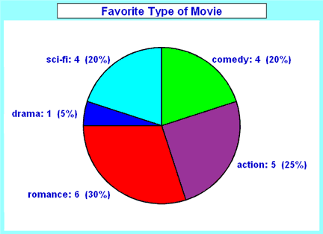
Diagrama de Sectores (Pie Chart)

Slide 3
HTML
<!doctype html>
<html>
<head>
<title>Pie Chart</title>
<script src="js/Chart.bundle.js"></script>
</head>
<body>
<div id="canvas-holder" style="width:40%">
<canvas id="chart-area" />
</div>

Slide 4
HTML
<script>
var config = {
type: 'pie',
data: {
datasets: [{
data: [20,25,30,5,20 ],
backgroundColor: ['green', 'purple','red','blue','rgb(35,117,201)'],
label: 'Favorite Type of Movie'
}],
labels: ["comedy", "action", "romance", "drama", "sci-fi"]
},

Slide 5
HTML
options: {
responsive: true,
legend: {display: true, position: 'bottom',},
title: {display: true, fontSize: 30, text: 'Favorite Type of Movie'},
animation: {animateScale: true, animateRotate: true}
}
};

Slide 6
HTML
window.onload = function() {
var ctx = document.getElementById("chart-area").getContext("2d");
window.myPie = new Chart(ctx, config);
};
</script>
</body>
</html>

Slide 7
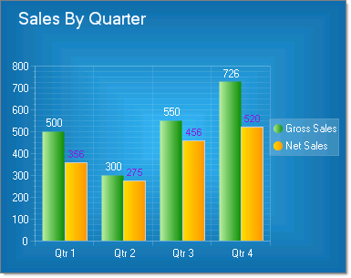
Gráfico de Barras

Slide 8
HTML
<!doctype html>
<html>
<head>
<title>Bar Chart</title>
<script src="js/Chart.bundle.js"></script>
<style>
canvas {
-moz-user-select: none; -webkit-user-select: none;
-ms-user-select: none;
}
</style>
</head>

Slide 9
HTML
<body>
<div id="container" style="width: 75%;">
<canvas id="canvas"></canvas>
</div>

Slide 10
HTML
<script>
var barChartData = {
labels: ["Qtr1", "Qtr2", "Qtr3", "Qtr4"],
datasets: [{
label: 'Gross Sales',
backgroundColor: 'rgba(0,255,0,0.5)', borderColor: 'green', borderWidth: 2,
data: [500,300,550,726]
}, {
label: 'Net Sales',
backgroundColor: 'rgba(255,255,0,0.5)', borderColor: 'yellow', borderWidth: 2,
data: [356,275,456,520]
}]
};

Slide 11
HTML
window.onload = function() {
var ctx = document.getElementById("canvas").getContext("2d");
Chart.scaleService.updateScaleDefaults('linear', {ticks: {min: 0}});
window.myBar = new Chart(ctx, {
type: 'bar', data: barChartData,
options: {
responsive: true,
legend: {position: 'right',},
title: { display: true,
text: 'Sales By Quarter',
fontSize: 30 },
}
});};
</script>
</body>
</html>

Slide 12
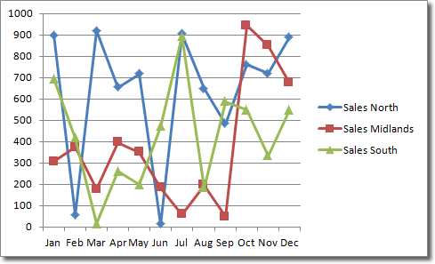
Gráfico de líneas
Mes | Norte | Centro | Sur
Enero | 900 | 310 | 690
Febrero | 50 | 390 | 400
Marzo | 910 | 200 | 0
Abril | 650 | 400 | 250
Mayo | 710 | 350 | 200
Junio | 0 | 200 | 460
Julio | 900 | 70 | 900
Agosto | 650 | 200 | 200
Septiembre | 490 | 40 | 580
Octubre | 850 | 950 | 550
Noviembre | 720 | 850 | 330
Diciembre | 900 | 690 | 550

Slide 13
HTML
<!DOCTYPE html>
<html>
<head>
<title>Line Chart</title>
<script src="js/Chart.bundle.js"></script>
<style>
canvas{
-moz-user-select: none; -webkit-user-select: none; -ms-user-select: none;
}
</style>
</head>

Slide 14
HTML
<body>
<div style="width:75%;"> <canvas id="canvas"></canvas> </div>
<script>
var config = {
type: 'line',
data: {
labels: ["January", "February", "March", "April", "May", "June", "July", "August",
"September", "October", "November", "December"],

Slide 15
HTML
datasets: [{
label: "Sales North", fill: false,
backgroundColor: 'blue', borderColor: 'blue',
data: [900,50,910,650,710,0,900,650,490,850,720,900]},
{ label: "Sales Midlands", fill: false,
backgroundColor: 'red', borderColor: 'red',
data: [310,390,200,400,350,200,70,200,40,950,850,690]},
{ label: "Sales South", fill: false,
backgroundColor: 'green', borderColor: 'green',
data: [690,400,0,250,200,460,900,200,580,550,330,550]
}]
},

Slide 16
HTML
options: {
responsive: true,
title:{display:true, text:'Ventas por zonas', fontSize: 30},
tooltips: {mode: 'index', intersect: false},
hover: {mode: 'nearest', intersect: true},
elements: {line: {tension: 0}},
scales: {
xAxes: [{ display: true, scaleLabel: {display: true, labelString: 'Mes'} }],
yAxes: [{ display: true, scaleLabel: {display: true, labelString: 'Valor'} }]
}
}
};

Slide 17
HTML
window.onload = function() {
var ctx = document.getElementById("canvas").getContext("2d");
window.myLine = new Chart(ctx, config);
};
</script>
</body>
</html>

