Slide 1

MAKERERE
UNIVERSITY
COLLEGE OF COMPUTING AND INFORMATION SCIENCES
GROUP Y PRESENTATION DATA SCIENCE PROJECT
ARUBE JOSHUA 21/U/1102
LUBEMBE COLIN WAFULA 21/U/05828/PS
LUYIMBAZI TIMOTHY 21/U/18300/PS
KATO TREVOR THOMAS 21/U/13085/PS
NANSUMBA MARY VANESSA 21/U/10131/PS

Slide 2
INTRODUCTION
This deals with analysis of a dataset containing statistics related to the Malaria disease, public health, water, sanitation, and demographic indicators for all countries in Africa from the year 2007 to 2017. The dataset helps to provide insights into the state of health and living conditions across these nations.
The dataset has 594 rows and 27 columns containing numerical values, objects and geographical values. It contains 0 duplicates and quite a number of null values. The dataset comprises of information from different countries, each represented by specific columns

Slide 3
SOME DATASET FEATURES
This is an overview of some of the available columns in our dataset that were a major part in our analysis
Incidence of Malaria (per 1,000 population at risk)
Malaria Cases Reported
Use of Insecticide-Treated Bed Nets (% of under-5 population)
Rural Population (% of Total Population)
Urban Population (% of Total Population)
Country Name
Year

Slide 4
KEY OBJECTIVES
To analyze the trends in the number of Malaria cases in African countries from the year 2007 to 2017.
To analyze the changes in the Incidence of Malaria in African countries from the year 2007 to 2017.
To study and compare the impact of the columns of the dataset towards the number of Malaria cases reported.
To determine which country had the highest average of reported cases of Malaria from the year 2007 to 2017.
To determine the year with the highest number of reported Malaria cases in Africa.
To determine the region with the highest number of Malaria cases reported.
To analyze the changes in the Rural and Urban population rates in African countries over the years 2007 to 2017
To compare the water and sanitation services between the Urban and Rural population in African countries.
To determine the year with the highest number of children receiving antimalarial drugs.
To analyze the relationship between the number of reported Malaria cases and the percentage of the Rural and Urban population in African countries.

Slide 5
PROCESSES INVOLVED
Data Exploration
This involved analyzing the dataset to identify the features and familiarize with them such that we can do data cleaning and preparation.
Data Cleaning
We used descriptive data in particular the mean to fill in for null values with low percentage and used 0 for values with high percentage
Data Visualization
Under Data visualization, we analyze and view the components of the dataset in order to generate meaningful conclusions from the various visualizations of the data
Model Building
Basing on the dataset, we make a predictive model by selecting the best algorithm to do informed predictions , through training the model and evaluation of its accuracy

Slide 6
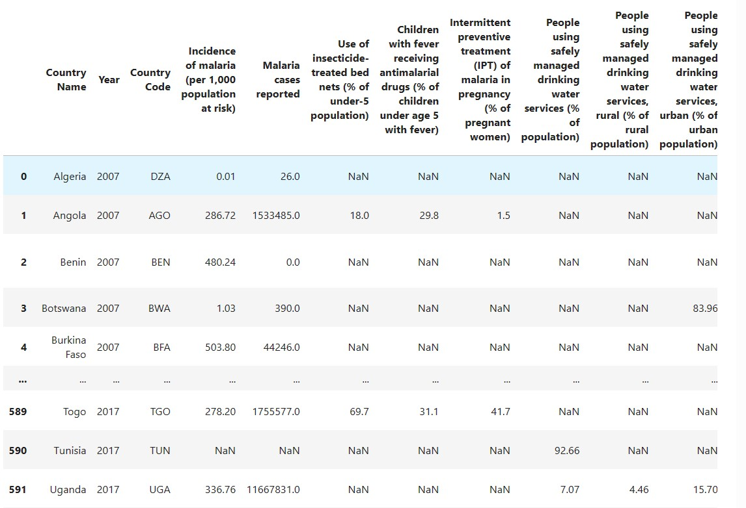
Dataset before cleaning

Slide 7
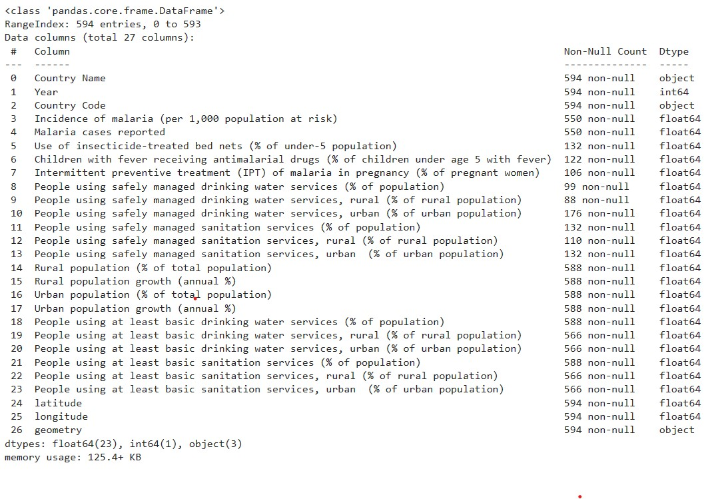
Data Exploration – Data types

Slide 8
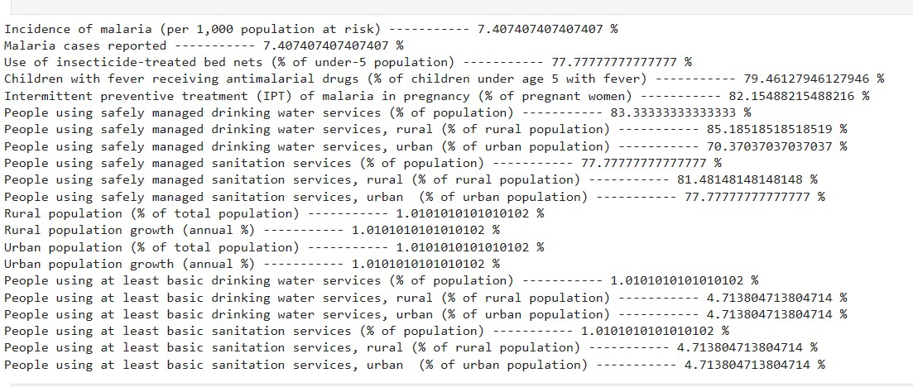
Percentage of Null values of each column

Slide 9
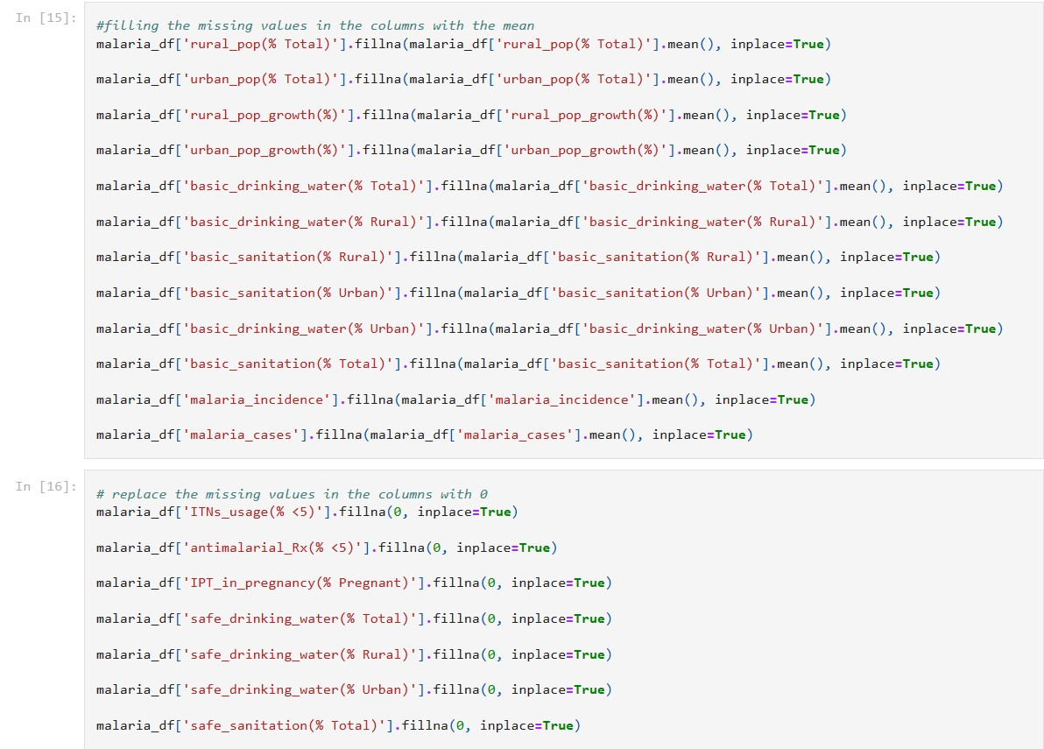
Cleaning process

Slide 10
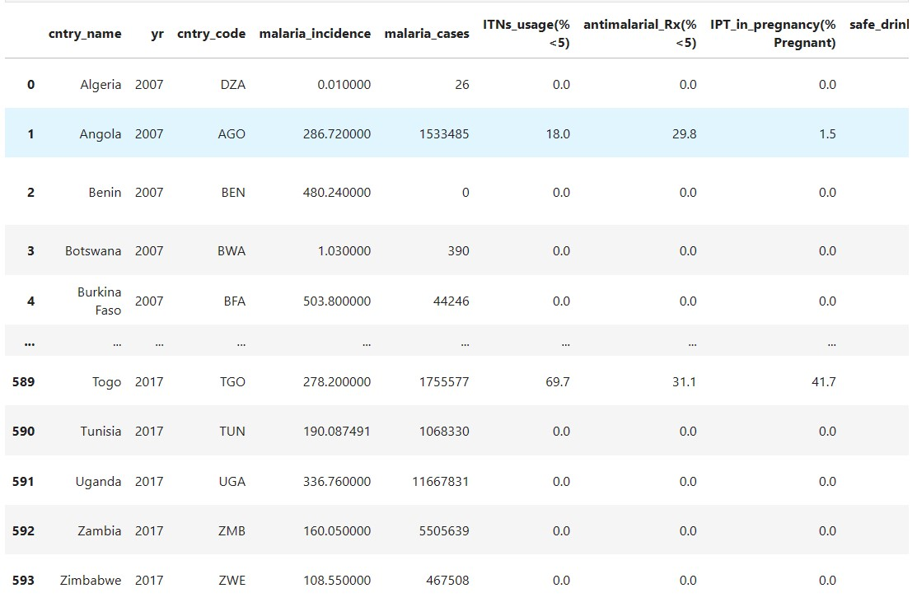
Dataset after cleaning

Slide 11
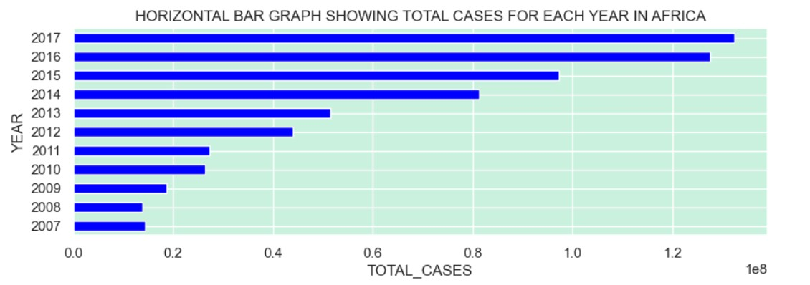
Total malaria cases

Slide 12
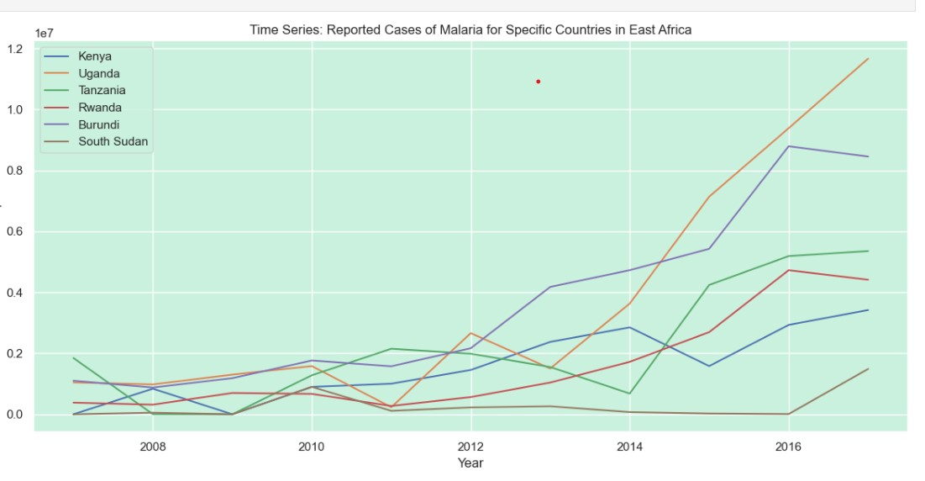
General Malaria Trend In East African countries

Slide 13
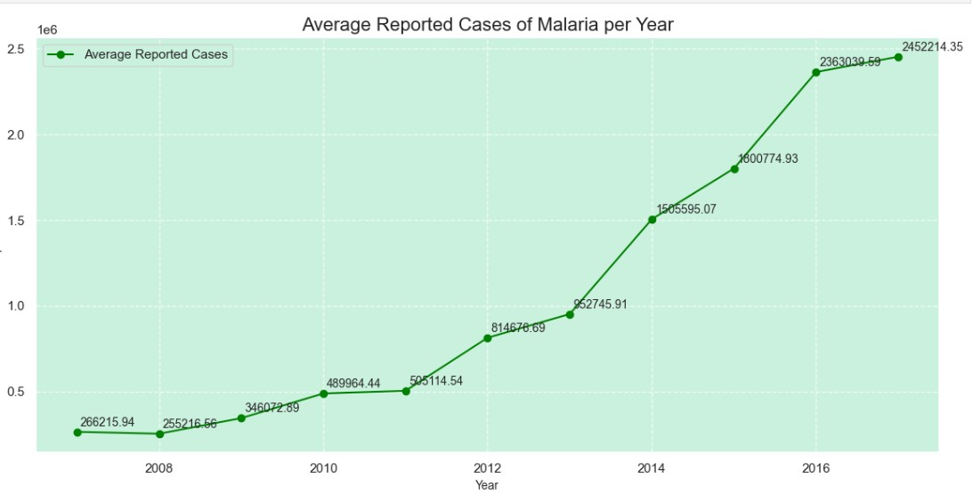

Slide 14
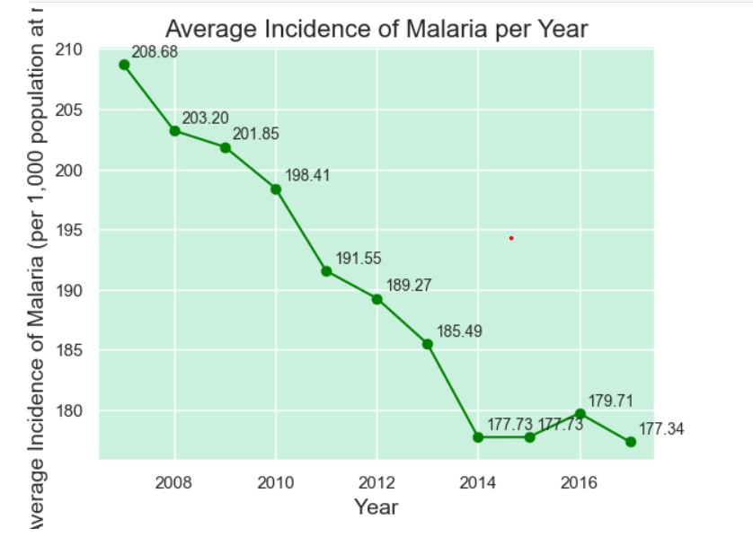

Slide 15
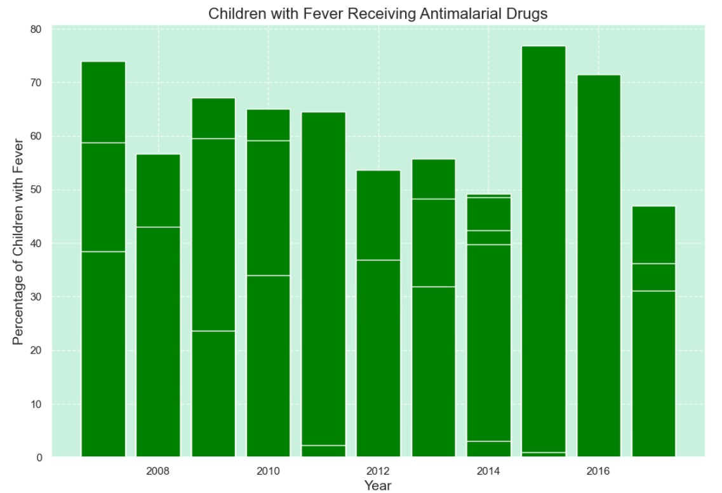

Slide 16
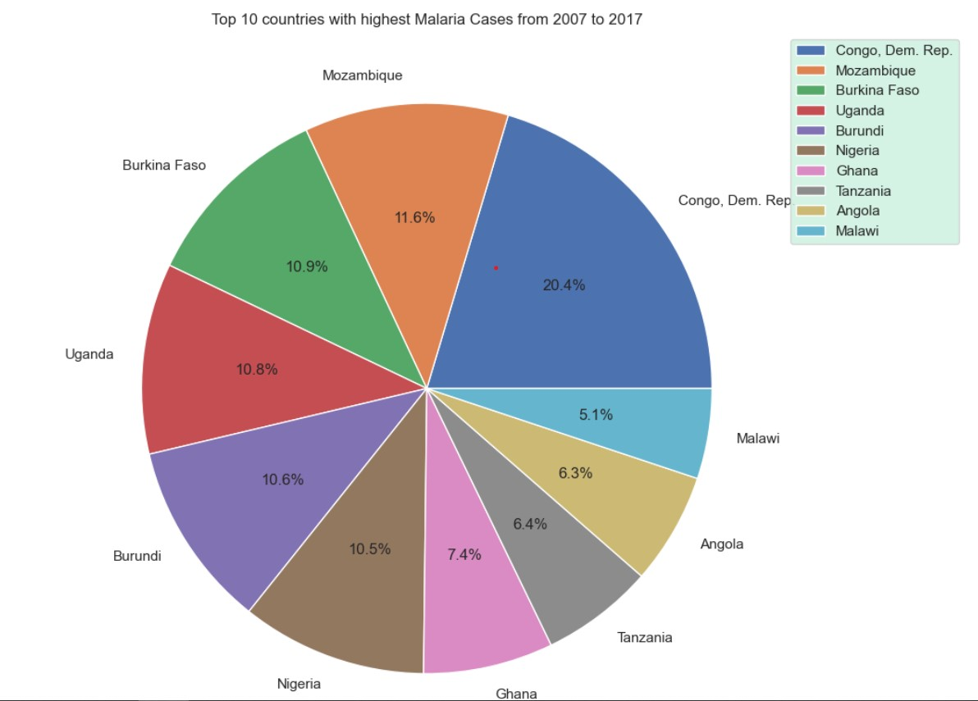

Slide 17
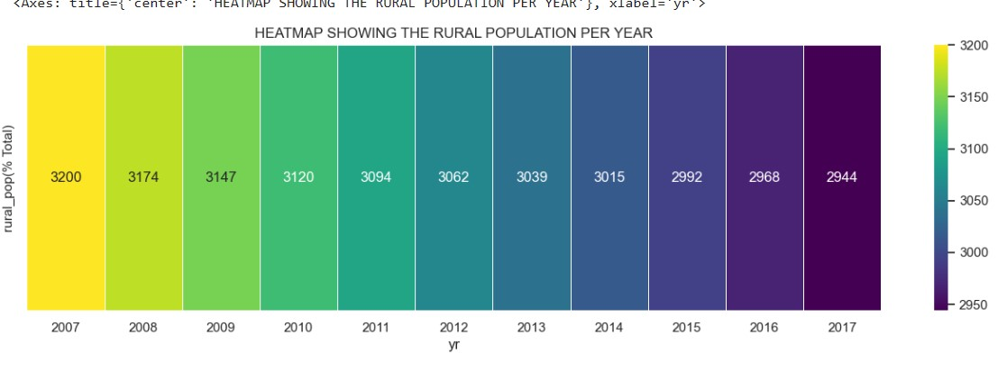
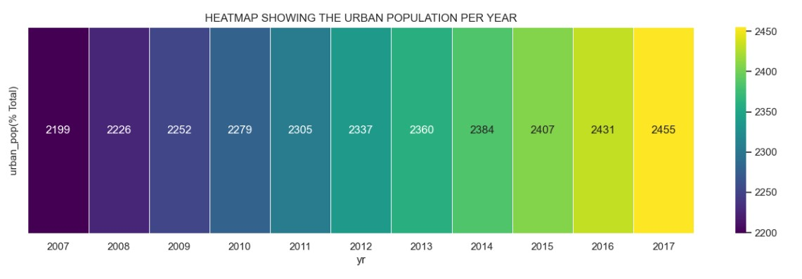

Slide 18
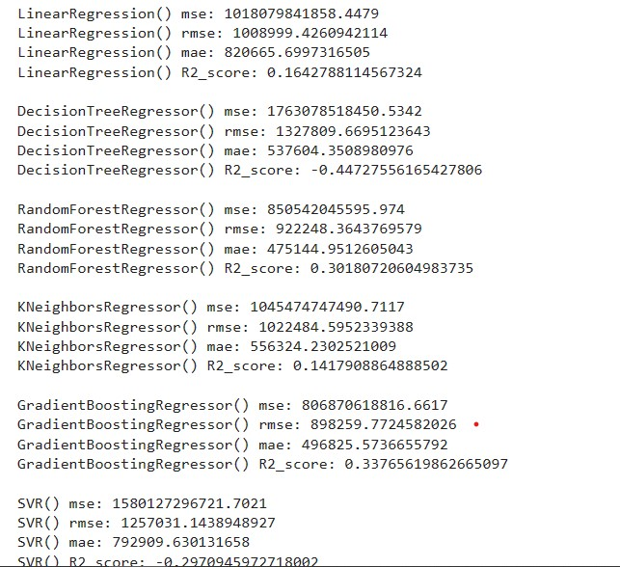

Slide 19
CONCLUSIONS
We see that the number of malaria cases reported has a general increase from the year 2007 to 2017.
There was a general decrease in the average of the incidences of malaria per year.
We established that there was a low correlation for most of the columns.
The Democratic Republic of Congo was found to dominate in the average malaria cases reported from the year 2007 to 2017 with Mozambique coming in second.
2017 was registered with the highest number of malaria cases.
There was a population decrease in rural areas while there was a population rise in urban areas as time passed from 2007 to 2017
The percentage of population growth is decreasing over time from 2007 to 2008
Overall, we see that even if measures have been put in place to reduce malaria which facilitated reduction in the risk of malaria, the overall malaria cases have increased through out the years from 2007 to 20017

