Slide 1
Modified FFN Architecture with tiled input (Algorithm, Trace of Algorithm and Datapath Block Diagram

Slide 2
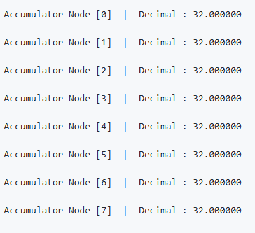
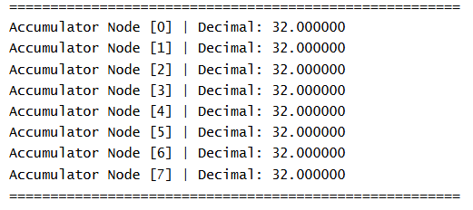
Comparison Between Pipelined FFN Verilog Design and FFN C Code for different input combinations
Case 1 : All the input elements = 1, all the elements of up projection matrix = 0.5 and all the elements of the down projection matrix = 0.25
Output from the C code
Output from the Verilog code

Slide 3
Comparison Between Pipelined FFN Verilog Design and FFN C Code for different input combinations
When different input combinations were applied, the output from the Verilog code contained unwanted zeros. The reason was transposed down projection matrix scheme used in stage 4 caused synchronization error in accumulator.
Also, for greater feature size, the code was not synthesizable in Vivado. Thus a modified design approach is used for FFN.

Slide 4
Algorithm
1xd input is tiled into t = (d/m) tiles, each tile of dimension 1xm, dx4d up projection matrix and 4dxd down projection matrix is divided into T = (4d²/m²) tiles, each tile of dimension mxm
for 0 ≤ input_tile_index < t fetch the input row vector from previous stage
accumulator = 0
for 0 ≤ up_proj_tile_idx < T fetch the up projection matrix tile from external memory
up_proj_out = input * up_proj_tile
up_proj_tile_idx += 1
relu_out = max (0, up_proj_out)
for 0 ≤ down_proj_tile_idx < T fetch the down projection matrix tile from external memory
down_proj_out = relu_out * up_proj_tile
accumulator += down_proj_out
down_proj_tile_idx += 1

Slide 5
First Cycle
Trace of Algorithm
1x1 up projection tile
up_proj_out
1x1 down projection tile
x0
x1
a0
a1
a2
a3
a4
a5
a6
a7
c0
c1
x0a0
ReLU
x0a1
d1
b0
b1
b2
b3
b4
b5
b6
b7
d0
1x1 input vector tile
e0
e1
f0
f1
accumulator
down_proj_out
g0
g1
x0a0c0
h0
h1
x0a0c0
0
i0
i1
j0
j1

Slide 6
Second Cycle
1x1 up projection tile
up_proj_out
1x1 down projection tile
x0
x1
a0
a1
a2
a3
a4
a5
a6
a7
c0
c1
x0a0
ReLU
x0a1
d1
b0
b1
b2
b3
b4
b5
b6
b7
d0
1x1 input vector tile
e0
e1
f0
f1
accumulator
down_proj_out
g0
g1
x0a0c1
h0
h1
x0a0c0
x0a0c1
i0
i1
j0
j1

Slide 7
Third Cycle
1x1 up projection tile
1x1 down projection tile
up_proj_out
x0
x1
a0
a1
a2
a3
a4
a5
a6
a7
c0
c1
x0a1
ReLU
x0a1
d1
b0
b1
b2
b3
b4
b5
b6
b7
d0
1x1 input vector tile
e0
e1
f0
f1
accumulator
down_proj_out
g0
g1
x0a1d0
h0
h1
x0a0c0+x0a01d0
x0a0c1
i0
i1
j0
j1

Slide 8
Fourth Cycle
1x1 up projection tile
up_proj_out
1x1 down projection tile
x0
x1
a0
a1
a2
a3
a4
a5
a6
a7
c0
c1
x0a1
ReLU
x0a1
d1
b0
b1
b2
b3
b4
b5
b6
b7
d0
1x1 input vector tile
e0
e1
f0
f1
accumulator
down_proj_out
g0
g1
x0a0c0+x0a0d0
x0a1d1
h0
h1
x0a0c1+ x0a1d1
i0
i1
j0
j1

Slide 9
Block Diagram of Pipelined FFN Datapath
mxm up projection PE
mxm down projection PE
ReLU
up_proj_out
relu_out
row_input_latch
down_proj_out
1xm input vector tile
1xd accumulator
up_proj_reg
down_proj_reg
up_proj_data
down_proj_data
input fetching and address generation stage
Up projection stage
ReLU stage
Down projection stage
Write Back stage

Slide 10
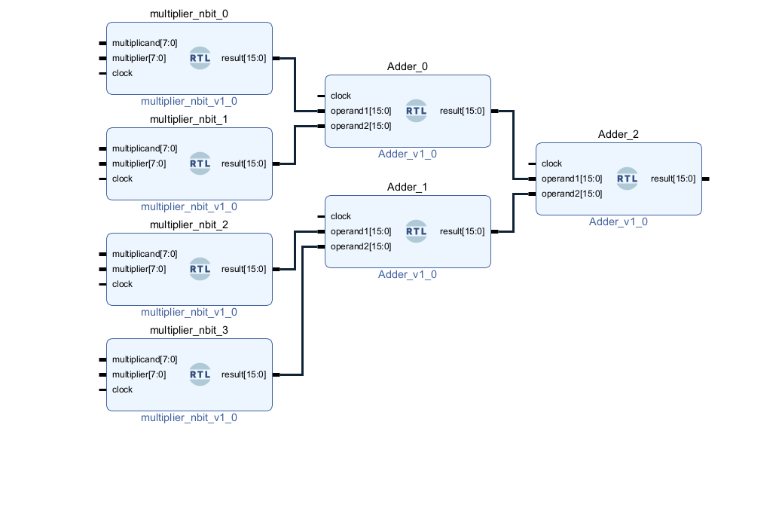
Up and Down Projection PE and Column- wise adder tree
^{X}
⁺
^{X}
⁺
^{X}
⁺
^{X}
Theoretical Schematic
Schematic From Vivado

Slide 11
Accumulator
down_proj_tile_idx
Decoder
down_proj_out
+
+
+
+

Slide 12
Thank You

