Slide 1
MODIFIED PIPELINED FFN DESIGN
Different modules, their interconnections in top module, testbench and results
JULY 16, 2026

Slide 2
TABLE OF CONTENTS
01
Introduction
05
Second submodule : axi read master
02
RTL Schematic
06
Third submodule : wide-word bram
03
Synthesized design
07
Stage 1 : Fetch and address generation
04
First submodule : Adder Tree
08
Fetch and address generation FSM

Slide 3
TABLE OF CONTENTS
09
Stage 2 & 4 : up and down projection
13
Timing diagram
10
Stage 3 : relu
14
Resource utilization
11
Stage 5 : accumulation
12
Testbench output

Slide 4
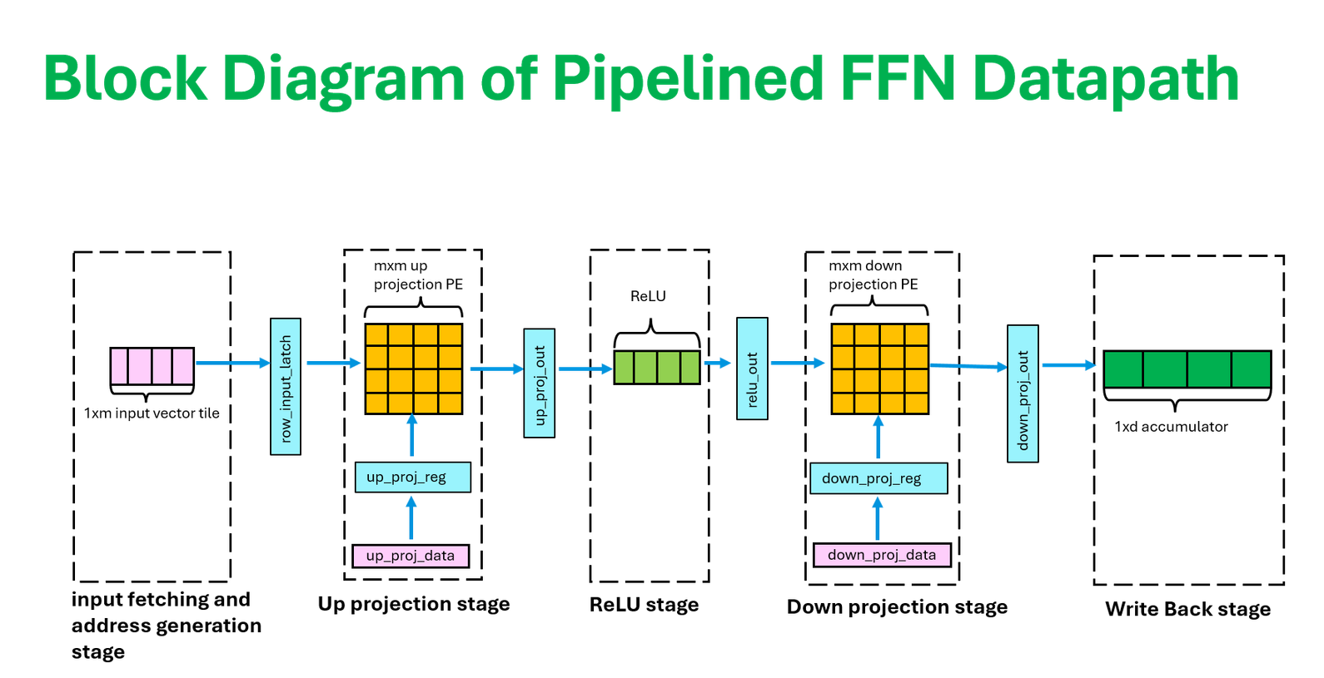
INTRODUCTION
Truely Pipelined Feed Forward Network
Features :
5 pipelined stages
Tile-based computation
AXI4 external memory access

Slide 5
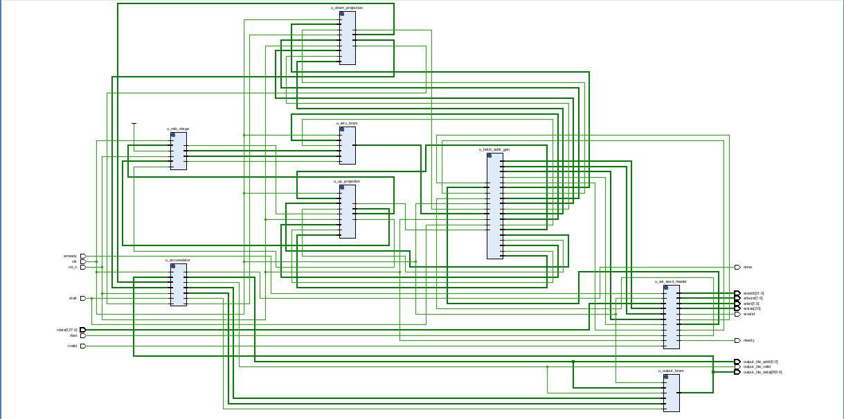
RTL SCHEMATIC
DOWN PROJECTION
FETCH AND ADDRESS GENERATION
RELU BRAM
RELU
UP PROJECTION
ACCUMULATOR
FETCH AND ADDRESS GENERATION
OUTPUT BRAM

Slide 6
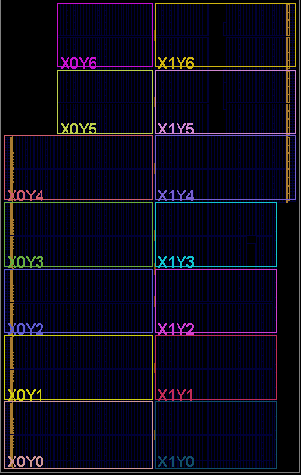
SYNTHESIZED DESIGN

Slide 7
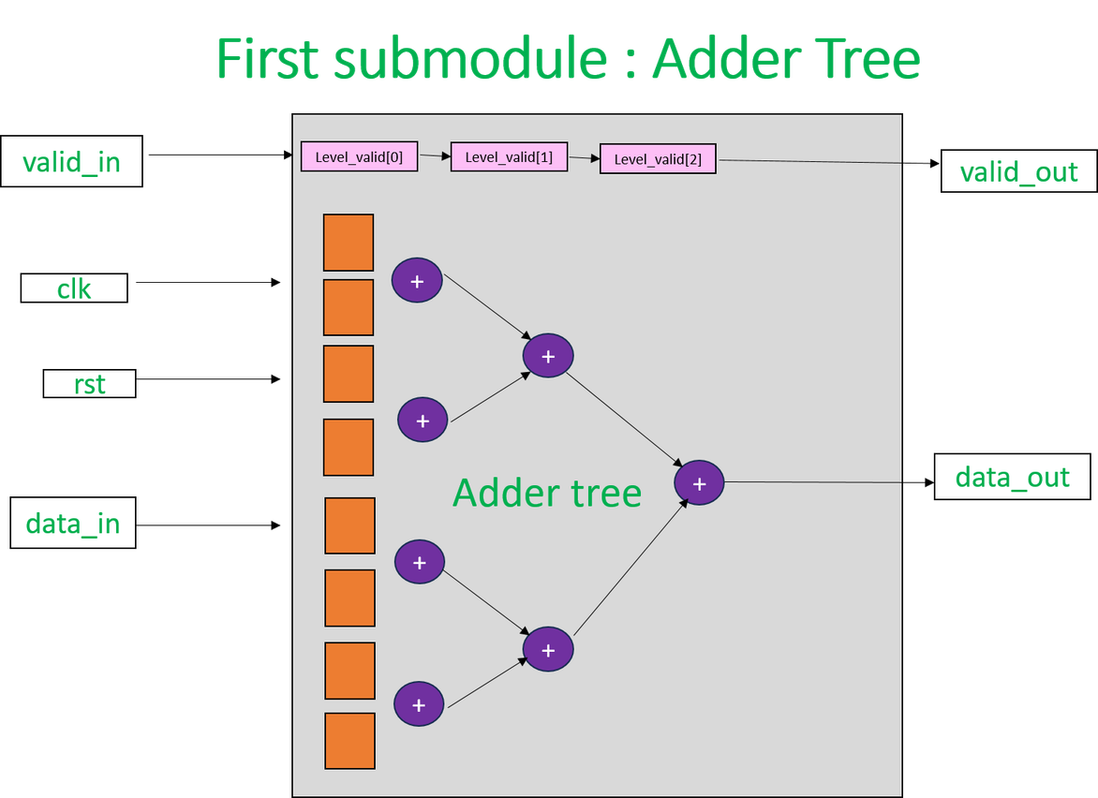
FIRST SUBMODULE : ADDER TREE

Slide 8
FIRST SUBMODULE : ADDER TREE
Internal wires for each tree level
PIPE parameter
Level 0 has m values of input data width bits
Level 1 has m/2 values of input data width+1 bits
………………….
Level L has 1 value of input data width+L bits, where L = log2(m)
Has a parameter PIPE to toggle between pipelined and combinational implementation.
PIPE = 1 : flip flops between the stages, increases latency, shortens combinational logic path, higher clock frequency.
PIPE = 0 : result in a single clock cycle, 0 clock cycle latency, long critical path, slower clock frequency.
Intermediate results stored in flat array per level

Slide 9
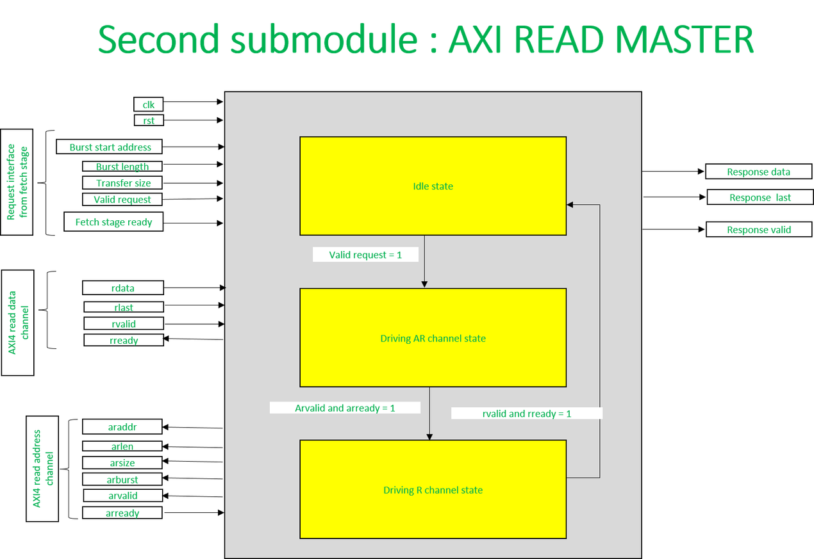
SECOND SUBMODULE : AXI READ MASTER

Slide 10
SECOND SUBMODULE : AXI READ MASTER
Operation Overview
Design Overview
•Accepts a read request
•Issues AXI4 AR channel transactions
•Collects R channel data
•Result through output interface
•Handles one burst at a time
  3 interfaces
1. Internal request interface
2. AXI read address channel
3. AXI read data channel
  FSM contains 3 states
1. Idle state
Master waits to work
Both AXI channels inactive
2. Address read state
Holds address
Holds control signals
3. Data read state
Data words flow through FSM to
response interface

Slide 11
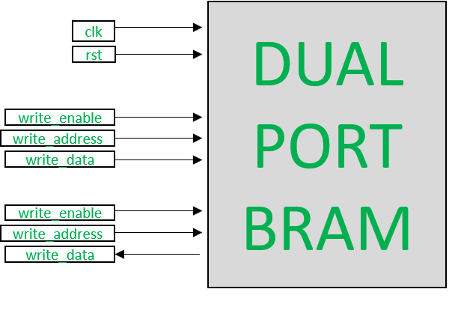
THIRD SUBMODULE : WIDE-WORD BRAM

Slide 12
THIRD SUBMODULE : WIDE-WORD BRAM
Operation Overview
Design Overview
•Stores one tile per address.
•Allows reading/writing 1xm tile in 1 cycle
  Write enable=1
Data written in specified address
  Read enable=1
Data read from specified address
  Synthesis directive
* ram_style = "block" * used for
in- built bram utilization

Slide 13
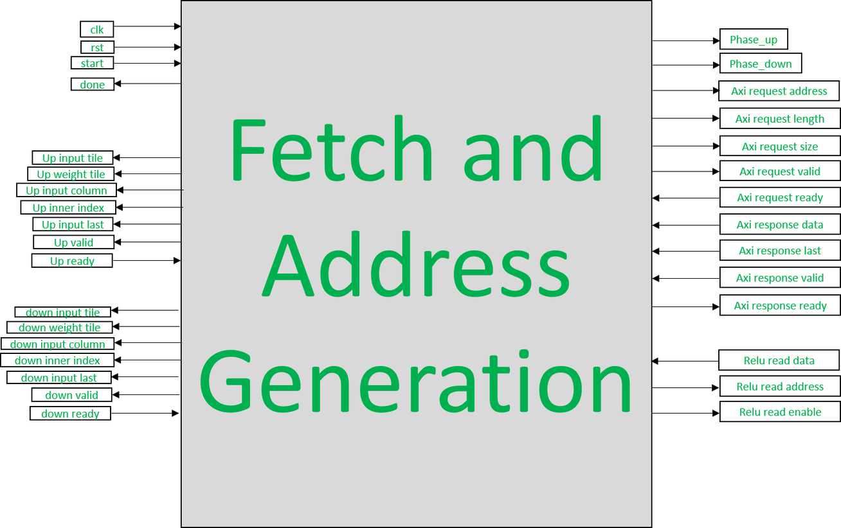
STAGE 1 : FETCH AND ADDRESS GENERATION

Slide 14
FETCH AND ADDRESS GENERATION FSM
Idle
Request input tile
Request input tile wait
Preset signals for first input request
  Axi request valid is set to 1
  If axi request ready=1 then axi request valid is reset
  If axi response is valid then axi response data is stored in input tile buffer till axi response last is set.
Send up pair to up projection
  if up ready=1, send input tile and up projection tile from internal buffer to respective registers
  Advance counters and pre-set next request
Request up weight tile wait
Request up weight tile
  If axi response valid is set then axi response data is stored weight tile buffer till axi response last
  Axi request valid is set to 1
  If axi request is ready then reset axi request valid
Read ReLU tile
from local BRAM
Down relay
Wait relu
Request up weight tile
  wait 1 cycle for bram read to be complete.
  relu output is present in
relu tile buffer
  Axi request valid is set to 1
  If axi request is ready then reset axi request valid
Send down pair to up projection
Done
  if down ready=1, send input tile and up projection tile from internal buffer to respective registers
  Advance counters and pre-set next request
Request down weight tile wait
  Set done=1
  Move to Idle state
  If axi response valid is set then axi response data is stored weight tile buffer till axi response last

Slide 15
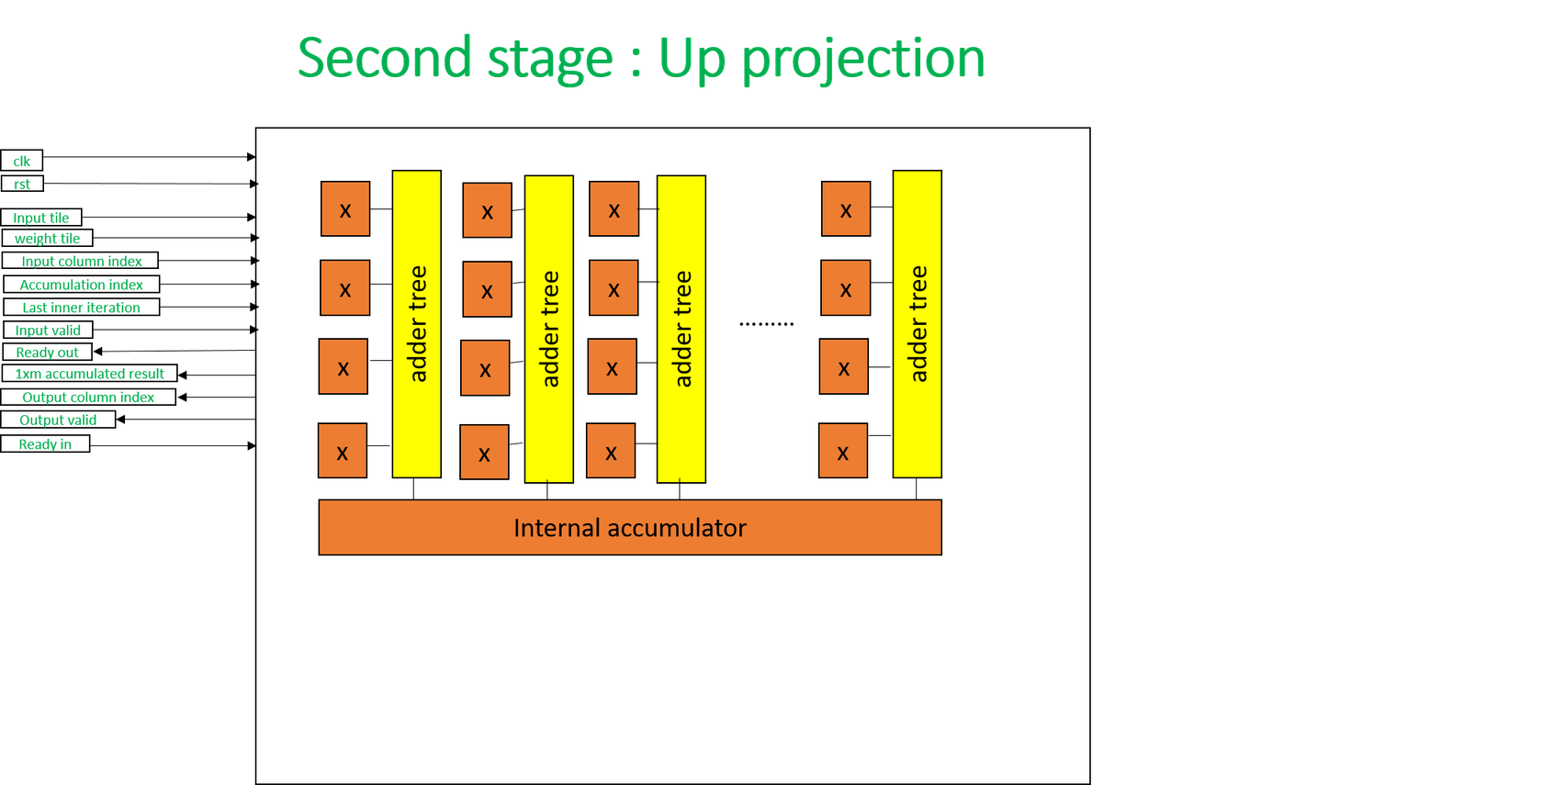
STAGE 2 & 4 : UP AND DOWN PROJECTION

Slide 16
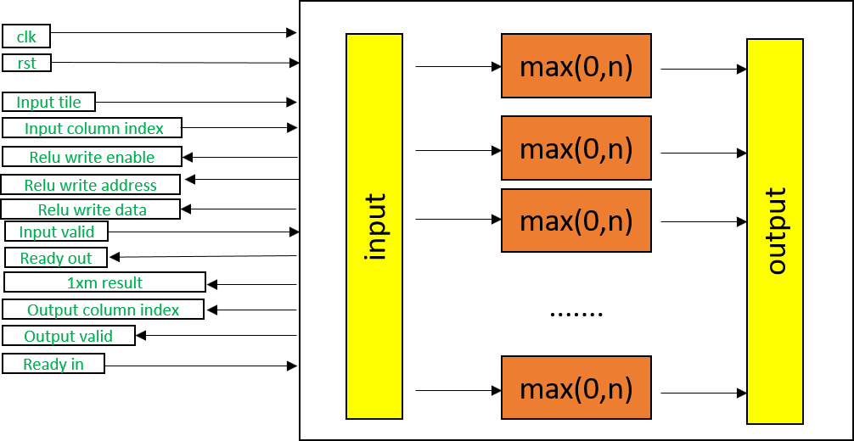
STAGE 3 : RELU

Slide 17
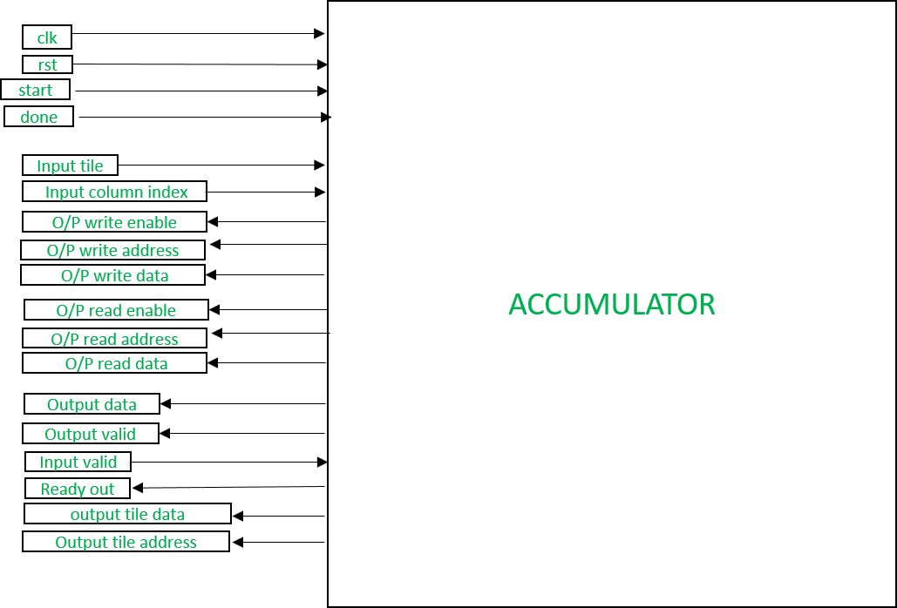
STAGE 5 : ACCUMULATION
if input is valid and accumulator is ready
Write path: accept result tile from down projection
Start

Slide 18
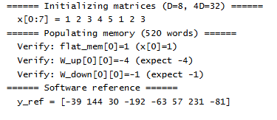
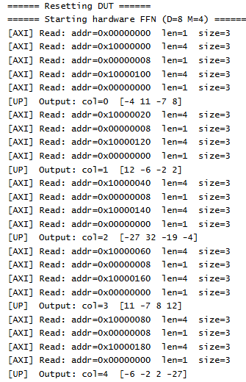
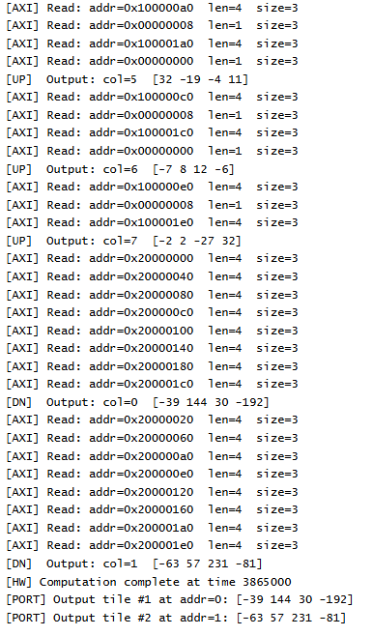
TESTBENCH OUTPUT
INPUT AND OUTPUT FROM GOLDEN MODEL
INPUT AND OUTPUT FROM DIFFERENT ITERATIONS

Slide 19
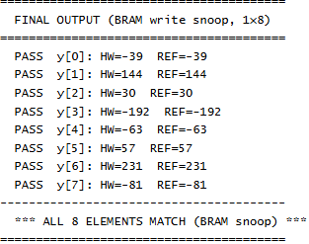
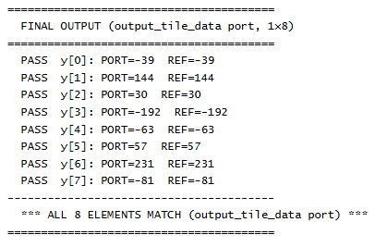
TESTBENCH OUTPUT
OUTPUT COMPARISON BETWEEN HARDWARE AND GOLDEN MODEL

Slide 20
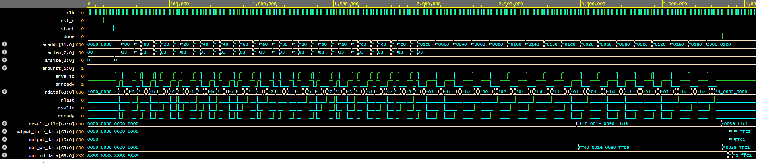
TIMING DIAGRAM
RESULT

Slide 21
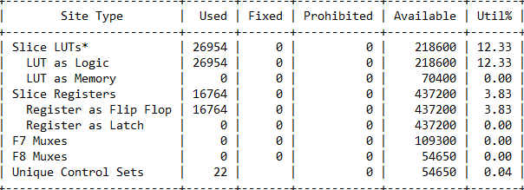
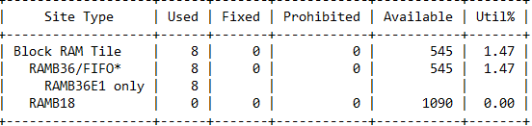


RESOURCE UTILIZATION

Slide 22
THANK YOU

