Slide 1
MODIFIED PIPELINED FFN DESIGN
Fully parallel design, FPGA board efficient implementation, block diagrams and results
July 21, 2026

Slide 2
OVERVIEW
  Introduction
  Global Architecture Overview
  Fully pipelined FFN implementation
  Resource - efficient FFN implementation
  Resource Utilization analysis
  Latency analysis
  Throughput analysis

Slide 3
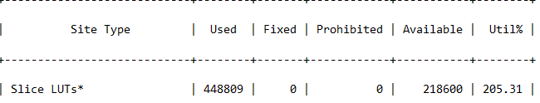
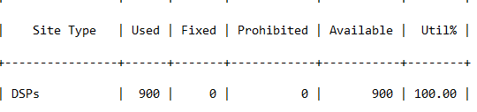
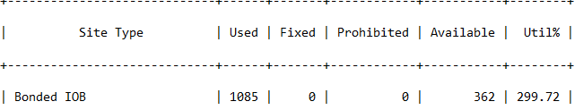
INTRODUCTION
Background
Earlier, fully pipelined 5 stage feed forward network was implemented, but due to massive resource utilization, a resource - optimized feed forward network has been implemented for Zync - 7000 FPGA board.
Objectives
  Reduce the usage of DSP slices.
  Reduce the usage of LUT slices.
  Reduce the usage of IOB.
  Create seperate implementations considering :
1. High resource utilization, low latency
2. Low resource utilization, high latency

Slide 4
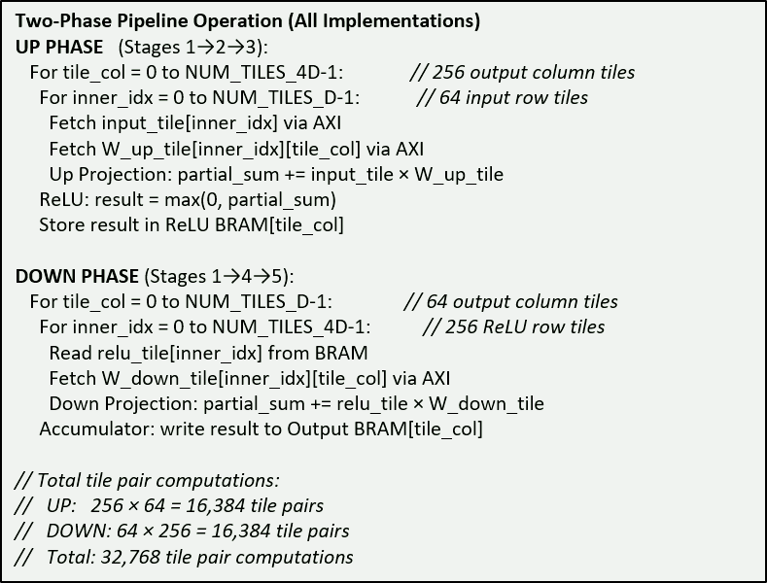
GLOBAL ARCHITECTURE OVERVIEW
Both implementations share the same five-stage pipeline structure. The mathematical operation is y = ReLU(x · W_up) · W_down, where x is 1×D, W_up is D×4D, and W_down is 4D×D. Data is processed in tiles of size M, and the pipeline operates in two phases: UP (compute x·W_up + ReLU) and DOWN (compute ReLU_out·W_down + accumulate).

Slide 5
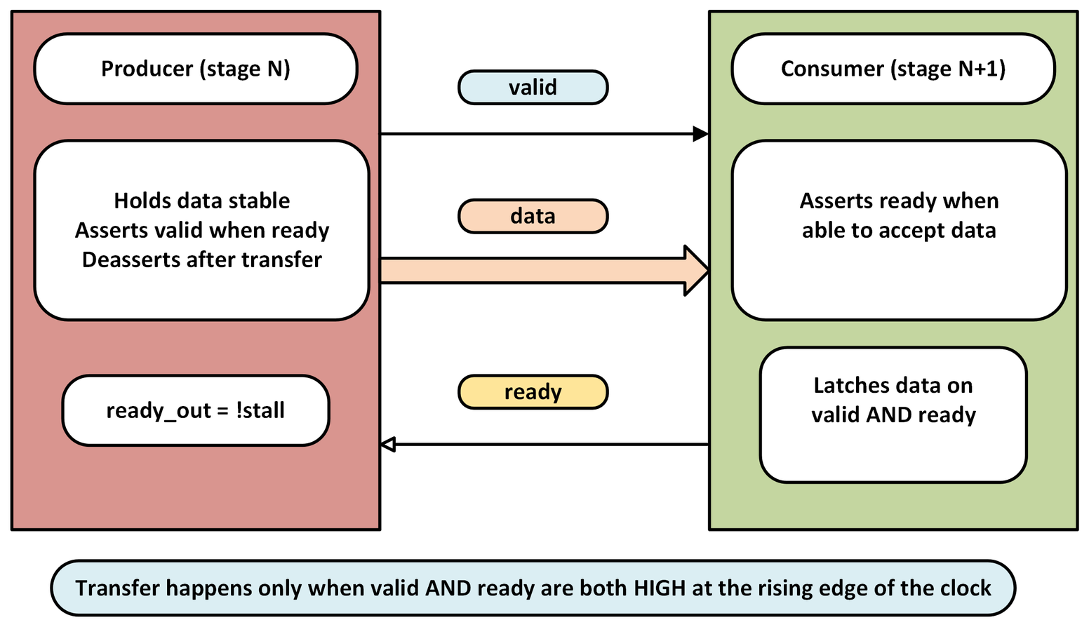
VALID READY HANDSHAKE DATA TRANSFER

Slide 6
FULLY PIPELINED FFN IMPLEMENTATION
Algorithm
Up phase
  For tile_col = 0 to 63: (64 output column tiles)
  For inner_idx = 0 to 255: (256 ReLU row tiles)
  Fetch: relu_tile[inner_idx] from BRAM + W_down_tile[inner_idx][tile_col] from AXI
  Compute: down_proj(relu_tile, W_down_tile) → partial sum
  Accumulator: write result to output BRAM at tile_col
Down phase
  For tile_col = 0 to 255: (256 output column tiles)
  For inner_idx = 0 to 63: (64 input row tiles)
  Fetch: input_tile[inner_idx] + W_up_tile[inner_idx][tile_col]
  Compute: up_proj(input_tile, W_up_tile) → partial sum
  ReLU: max(0, result) → store in ReLU BRAM at tile_col

Slide 7
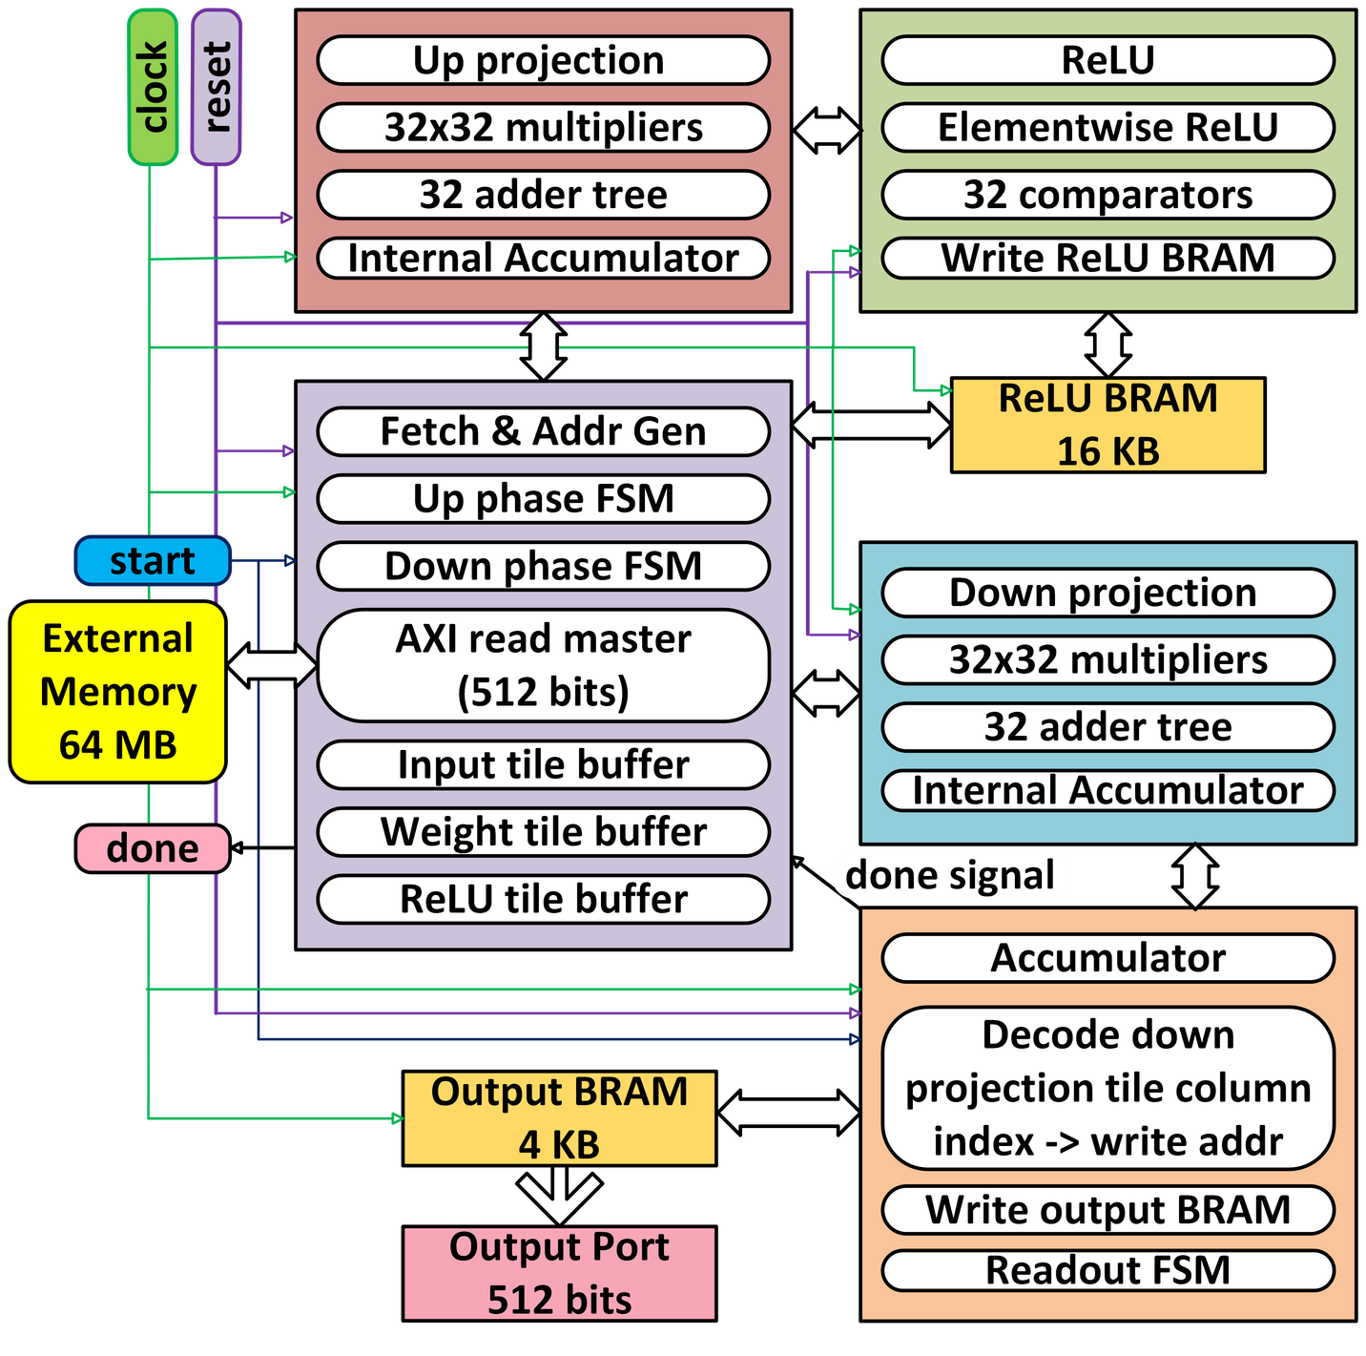
FULLY PIPELINED FFN IMPLEMENTATION
FULLY PIPELINED FFN ARCHITECTURE

Slide 8
RESOURCE-EFFICIENT FFN IMPLEMENTATION
Design Philosophy
Sub-cycles | Columns processed
0 | 0-7
1 | 8-15
2 | 16-23
3 | 24-31
  This implementation uses aggressive time-multiplexing, 64-bit AXI bus, and a 64-bit output serializer to reduce the resource utilization
  Each projection stage uses 8 parallel multiplier column instances instead of 32. This requires ceil(32/8) = 4 cycles per inner iteration.
  64-bit AXI bus reduces IOB from 1085 to 189 pins. Weight tiles that required 32 beats on 512-bit now require 256 beats on 64-bit.
  Instead of 512-bit parallel output lines, output is streamed as 8 beats of 64 bits each. The internal readout FSM of the accumulator is disabled and replaced by a dedicated serializer FSM.

Slide 9
RESOURCE-EFFICIENT FFN IMPLEMENTATION
Algorithm
Up phase
Down phase
  For tile_col = 0 to 255:
  For inner_idx = 0 to 63:
  Fetch: input_tile[inner_idx] + W_up_tile[inner_idx][tile_col]
  Cycle 0: up_proj(input_tile, W_up_tile[cols 0-7])
  Cycle 1: up_proj(input_tile, W_up_tile[cols 8-15])
  Cycle 2: up_proj(input_tile, W_up_tile[cols 16-23])
  Cycle 3: up_proj(input_tile, W_up_tile[cols 24-31])
  Accumulate into all 32 accumulator entries
  ReLU: max(0, result) → store in ReLU BRAM
  For tile_col = 0 to 63:
  For inner_idx = 0 to 255:
  Fetch: relu_tile[inner_idx] + W_down_tile[inner_idx][tile_col]
  Cycle 0: down_proj(relu_tile, W_down_tile[cols 0-7])
  Cycle 1: down_proj(relu_tile, W_down_tile[cols 8-15])
  Cycle 2: down_proj(relu_tile, W_down_tile[cols 16-23])
  Cycle 3: down_proj(relu_tile, W_down_tile[cols 24-31])
  Accumulate into all 32 accumulator entries
  Write result to output BRAM

Slide 10
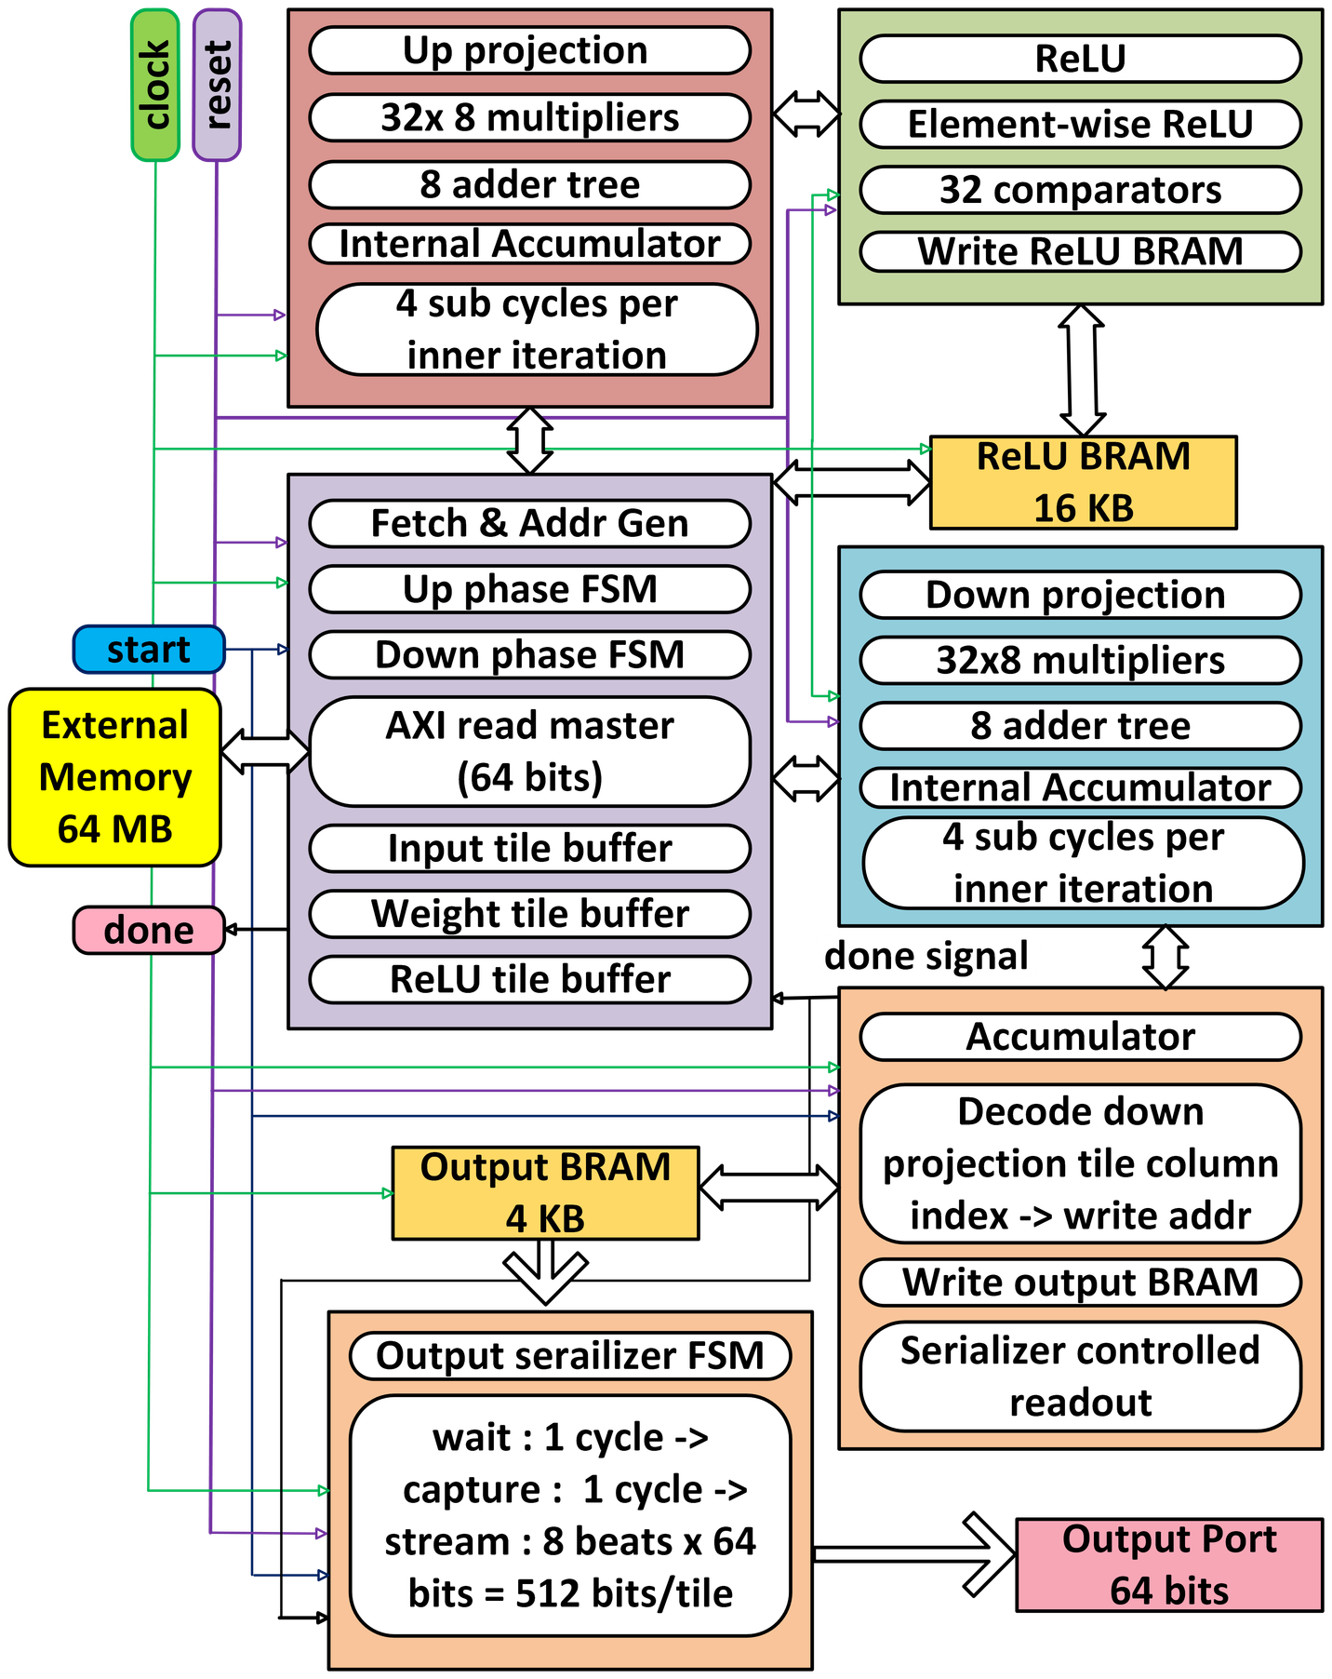
RESOURCE-EFFICIENT FFN IMPLEMENTATION
RESOURCE-EFFICIENT FFN ARCHITECTURE

Slide 11
GLOBAL & IMPLEMENTATION-SPECIFIC PARAMETERS
Timing
  Assumed clock period, T_clk = 200 MHz
  AXI address latency, T_ar = 2 cycles
  BRAM read latency, T_bram = 2 cycles
  FSM transition overhead per tile pair, T_fsm = 3 cycles
Parameters
Derived tile count
  D = 2048
  M = 32
  DATA_W = 16
  AXI_ADDR_W = 32
  Tiles along D = D/M = 64
  Tiles along 4D = 4D/M = 256
  Number of tiles for up phase, N_up = 256 x 64 = 16384
  Number of tiles for down phase , N_down = 64 x 256 = 16384
  Total number of tiles, N_total = 16384 x 2 = 32768
Adder tree pipeline depth, TD = ceil (log2(M)) = 5

Slide 12
GLOBAL & IMPLEMENTATION-SPECIFIC PARAMETERS
Derived operation count
  Total multiply-accumulate operations = MACS = 2 × D × 4D = 8D² = 33,554,432
  Element-wise ReLU operations = ReLU_ops = 4D = 8192
  Output saturation clampings = Satur_ops= 2 × M × (NT4D + NTD) = 20,480
  Number of parallel columns per projection stage = NC
  Sub-cycles per iteration, NS = ⌈M/NC⌉
  AXI data width = AW
  Elements per AXI beat = EPB = (AW/DATA_W)
  Beats per output tile = BPT = (M/EPB)
  Beats for 1xM input tile = B_in = ⌈M × DATA_W / AW⌉
  Beats for MXM weight tile = B_wt = ⌈M² × DATA_W / AW⌉
Implementation specific parameters

Slide 13
Parameters | FULLY PARALLEL | RESOURCE-EFFICIENT
Number of parallel columns, NC | 32 | 8
Number of Subcycles per inner iteration | 1 | 4
AXI data width, AW | 512 | 64
Elements / AXI beat, EPB | 32 | 4
Beats / input tile, B_in | 1 | 8
Beats / weight tile, B_wt | 32 | 256
Beats / output tile, BPT | ---- | 8
DSP | 2048 | 512
GLOBAL & IMPLEMENTATION-SPECIFIC PARAMETERS
Implementation specific parameters

Slide 14
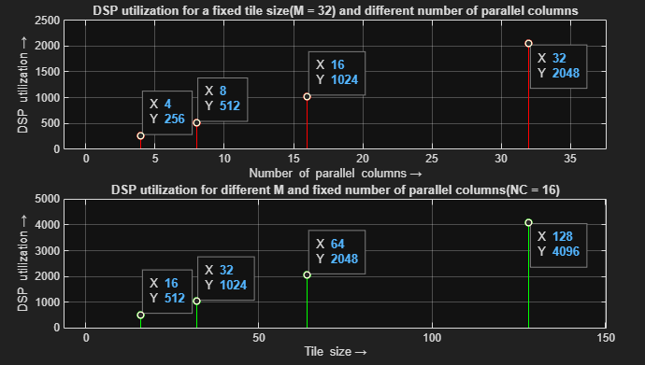
RESOURCE UTILIZATION
NC : Number of parallel columns in each projection stage
M : Tile size
Calculated
DSP METRIC | EXPRESSION | FULLY-PIPELINED | RESOURCE-EFFICIENT
DSP per stage | NC × M | 1024 | 256
DSP total | 2 × NC × M | 2048 | 512
From Synthesis report
DSP METRIC | FULLY-PIPELINED | RESOURCE-EFFICIENT
DSP usage | 900 ** | 512
DSP total | 2048 | 512
** Rest of the DSPs are mapped to LUT slices.

Slide 15
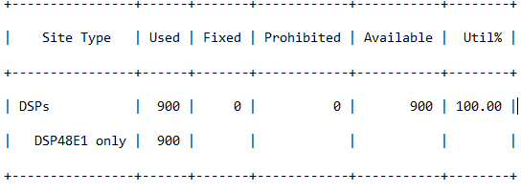
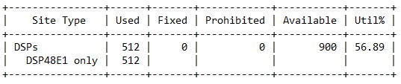
RESOURCE UTILIZATION
From synthesis reports
Fully parallel version
Resource efficient version

Slide 16
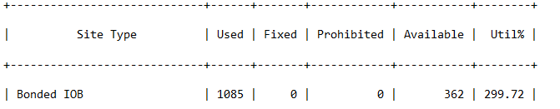



RESOURCE UTILIZATION
Calculated
IOB COMPONENT | EXPRESSION | FULLY-PIPELINED | RESOURCE-EFFICIENT
Input signals | clk + rst+ start + arready + rdata + rlast + rvalid | 518 | 70
Output signals | done + araddr + arlen + arsize + arburst + arvalid + rready + output_tile_data + output_tile_addr + output_tile_valid | 625 | 154
Total | Input signals + Output signals | 1143 | 224
From Synthesis report

Slide 17
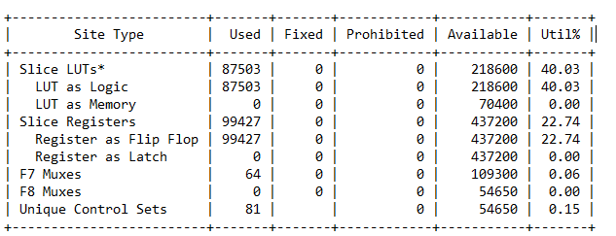
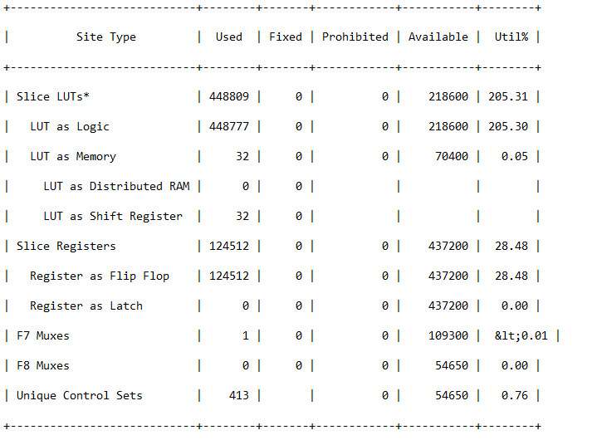
RESOURCE UTILIZATION
From synthesis reports
Slice logic
Resource efficient version
Fully parallel version

Slide 18
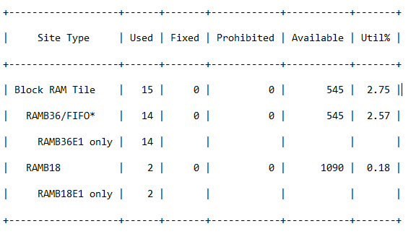
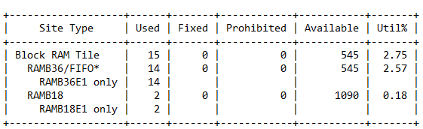
RESOURCE UTILIZATION
From synthesis reports
Memory
Resource efficient version
Fully parallel version

Slide 19
T_fetch_up : Time taken in Up phase per tile pair
T_fetch_down : Time taken in Down phase per tile pair
LATENCY
T_proj : Time-multiplexed projection: NS sub-cycles, each with FEED→PIPE→ACC
T_up, T_down : Phase latencies

Slide 20
Latency Analysis
Metric | Expression | FULLY PARALLEL | RESOURCE-EFFICIENT
T_fetch_up | T_ar + B_in + T_ar + B_wt + T_fsm = 2 + ⌈M×DW/AW⌉ + 2 + ⌈M²×DW/AW⌉ + 3 | 40 | 271
T_fetch_down | T_bram + T_ar + B_wt + T_fsm = 2 + 2 + ⌈M²×DW/AW⌉ + 3 | 39 | 263
T_proj (not last) | T_idle + NS × (T_feed + T_pipe + T_acc) = 1 + NS × (1 + TD + 1) = 1 + NS × (TD + 2) = 1 + 7·NS | 8 | 29
T_proj (last) | 1 + NS × (TD + 2) + T_out = 2 + 7·NS | 9 | 30
T_tile_up | max(T_fetch_up, T_proj) | 40 | 271
T_tile_down | max(T_fetch_down, T_proj) | 39 | 263
T_readout | NTD × (T_issue + T_relay + T_capture) = NTD × 3 = 3 × NTD or NTD × (T_wait + T_capture + BPT) = NTD × (1 + 1 + BPT) = NTD × (2 + BPT) | 192 | 640
T_up | N_up × T_tile_up + NT4D | 655,616 | 4,440,640
T_down | N_down × T_tile_down + NTD | 639,040 | 4,305,216
T_total | T_up + T_down + T_readout | 1,294,848 | 8,746,496

Slide 21
LATENCY
Component | FULLY-PIPELINED | RESOURCE-EFFICIENT | % | %
AXI data transfer | 1,064,960 | 8,519,680 | 82.2% | 97.4%
AXI address phase ovehead | 98,304 | 98,304 | 7.6% | 1.1%
FSM + BRAM relay overhead | 114,688 | 114,688 | 8.9% | 1.3%
Readout | 16,896 | 13,824 | 1.3% | 0.2%

Slide 22
CALCULATED THROUGHPUT
Parameter | EXPRESSION | FULLY-PIPELINED | RESOURCE-EFFICIENT
MAC throughput | MACs/T_total | 25.9 | 3.83
DSP efficiency | MACs / (T_total × DSP_count) x 100 % | 1.26% | 0.75%
BW efficiency | (Bytes_total / T_total)/(AW / 8 ) x 100 % | 82.2% | 97.4%

Slide 23
THANK YOU!
For your attention

