Slide 1
Attention Is All You Need

Slide 2
Introduction
Earlier, the dominant sequence transduction model were based on Recurrent Neural Networks(RNN).
But sequential computation prevents parallel processing.
Long range dependencies are difficult to learn.
Thus, the authors proposed replacing recurrence entirely with attention mechanisms.
The key idea was : Instead of processing tokens one by one, each token can directly attend to all other tokens in the sequence.

Slide 3
Example
“The animal didn’t cross the street because it was tired.”
Attention allows the word “it” to look at all the previous words at the same time and determines the mist relevant context.

Slide 4
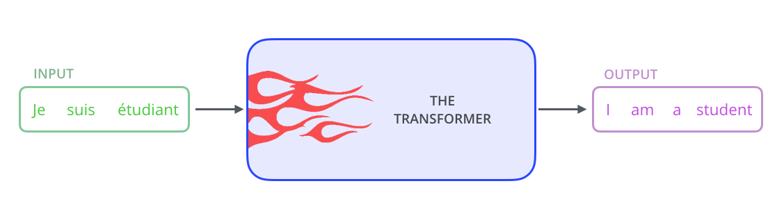
A High-Level Look
In machine translation application, it would take a sentence in one language and output its translation in another.

Slide 5

Inside the transformer model, the are two components : Encoder and Decoder

Slide 6
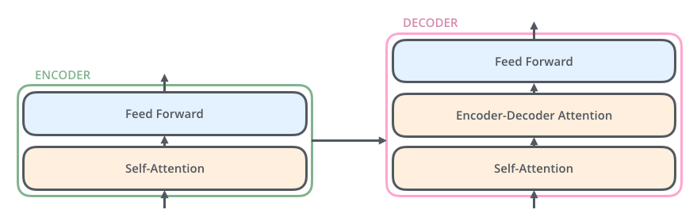
The encoding and decoding component is a stack of 6 encoders.
1. The encoder’s inputs first flow through a self-attention layer – a layer that helps the encoder look at other words in the input sentence as it encodes a specific word.
2. The outputs of the self-attention layer are fed to a feed-forward neural network.
3. The decoder has both those layers, but between them is an attention layer that helps the decoder focus on relevant parts of the input sentence

Slide 7

Input Embeddings
Words are converted to vectors.
Each word is embedded into a vector of size 512. Those vectors are represented with these simple boxes.
The embedding only happens in the bottom-most encoder.
To give the model a sense of the order of the words, we add positional encoding vectors

Slide 8
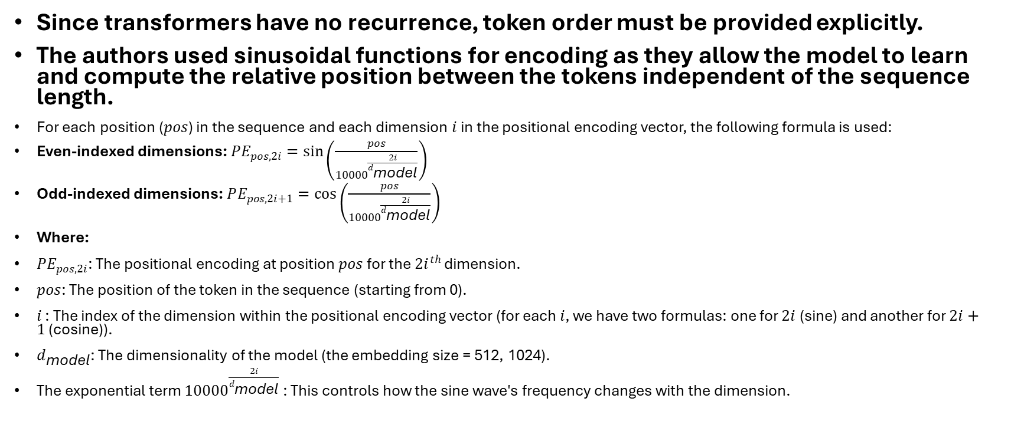
Positional Encoding
Since transformers have no recurrence, token order must be provided explicitly.
The authors used sinusoidal functions for encoding as they allow the model to learn and compute the relative position between the tokens independent of the sequence length.
For each position ($pos$) in the sequence and each dimension $i$ in the positional encoding vector, the following formula is used:
Even-indexed dimensions: $PE_{pos,2i}=\sin\left(\frac{pos}{10000^{\frac{2i}{d_{\text{model}}}}}\right)$
Odd-indexed dimensions: $PE_{pos,2i+1}=\cos\left(\frac{pos}{10000^{\frac{2i}{d_{\text{model}}}}}\right)$
Where:
$PE_{pos,2i}$: The positional encoding at position $pos$ for the $2i^{th}$ dimension.
$pos$: The position of the token in the sequence (starting from 0).
$i$ : The index of the dimension within the positional encoding vector (for each $i$, we have two formulas: one for $2i$ (sine) and another for $2i+1$ (cosine)).
$d_{\text{model}}$: The dimensionality of the model (the embedding size = 512, 1024).
The exponential term $10000^{\frac{2i}{d_{\text{model}}}}$ : This controls how the sine wave's frequency changes with the dimension.

Slide 9
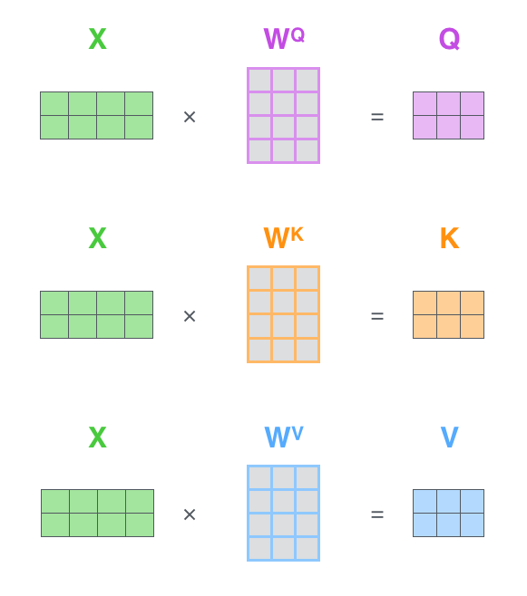
Self attention
Calculate Q,K,V vector for every token. The dimensions of these vectors are 64.
WQ, WK, WV are weight
Matrices we trained.

Slide 10
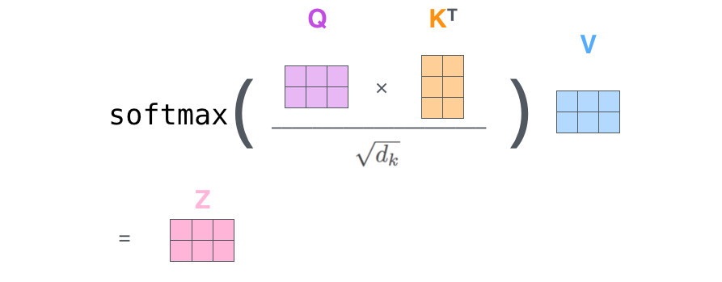
Scaled Dot Product Attention
Why scaling ?
Without scaling large dot products can cause extremely small gradients after softmax.
d_k = dimension of key vector

Slide 11
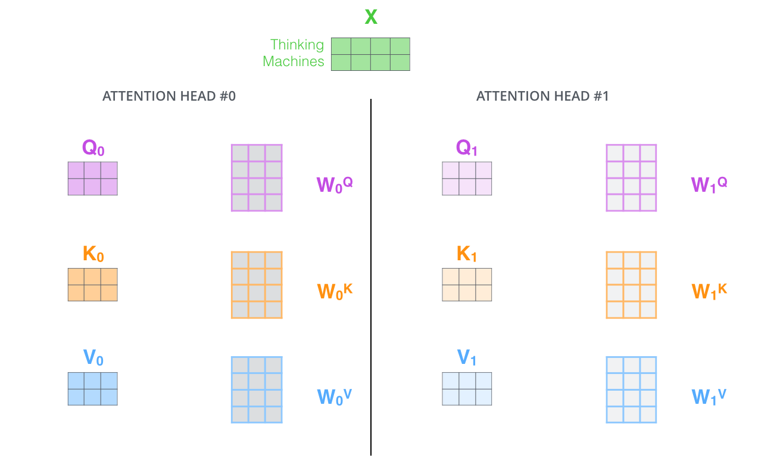
Multi-Head Attention
Instead of one attention operation, the transformer uses multiple heads.
In the paper, the number of heads = 8
Each head learns different relationships like grammar, subject-verb agreement,
Long range dependencies.

Slide 12
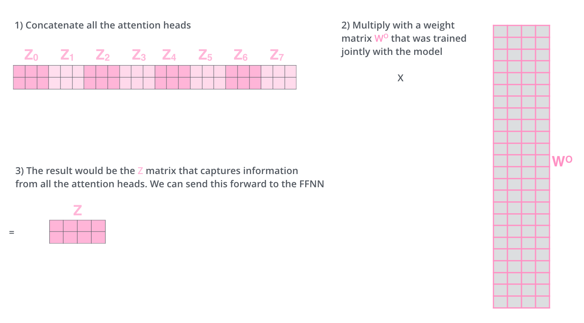
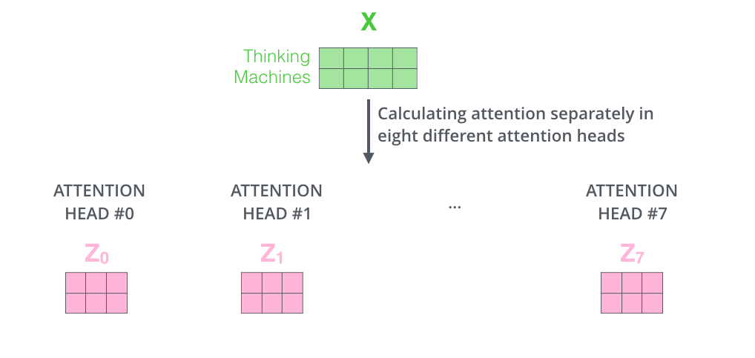
Multi-Head Attention
Advantages : 1. Parallel learning
2. Better context understanding

Slide 13
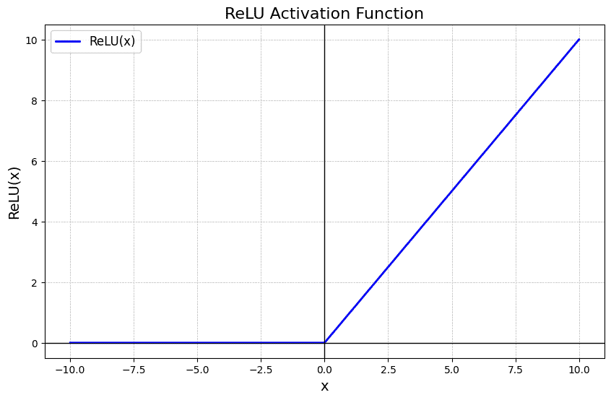
Feed forward network
Encoder output vector for the specific token
ReLU
Linear
Linear
Vector containing neurons
Zi
Iup
Wdown Z+Bdown
Idown
Wup Z+Bup
Down projection
Up projection
ReLU (Rectified Linear Unit) is defined as the maximum of 0 and the input x:
f(x) = max(0, x)
Where Wup and Wdown are weight matrices with dimensions 2048 x 512 and 512 x 2048, Bup and Bdown are the bias vectors. Iup and Idown are intermediate vectors.

Slide 14




Residual connections and Layer Normalization
Residual connection : y = x + F(x)
Layer Normalization : 1. Calculate Mean:
2. Calculate Variance:
3. Normalize:
4. Scale and Shift:
The γ and β parameters are learnable weights that allow the model to retain expressive power.

Slide 15
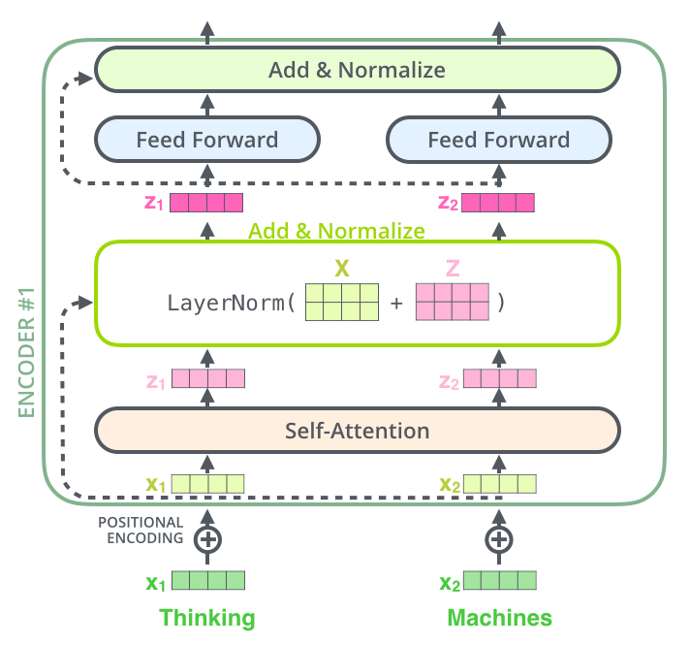
Complete Encoder Structure

Slide 16
Decoder Layer
The decoder layer has three components :
1. Masked Self Attention : The output embedding is shifted by one position. Thus, when the model attempts to predict the word at position t , it only has access to position 1 to t – 1. Combined with causal masking, which blocks attention mechanism from looking ahead, shifting ensures that the model learns real language patterns rather than just copying data.

Slide 17
Decoder Layer
2. Encoder – Decoder Attention : The encoder start by processing the input sequence.
The output of the top encoder is then transformed into a set of attention vectors K and V.
These are to be used by each decoder in its “encoder-decoder attention” layer which helps the decoder focus on appropriate places in the input sequence.
The following steps repeat the process until a special symbol is reached indicating the transformer decoder has completed its output.
The output of each step is fed to the bottom decoder in the next time step, and the decoders bubble up their decoding results just like the encoders did. And just like we did with the encoder inputs, we embed and add positional encoding to those decoder inputs to indicate the position of each word.

Slide 18
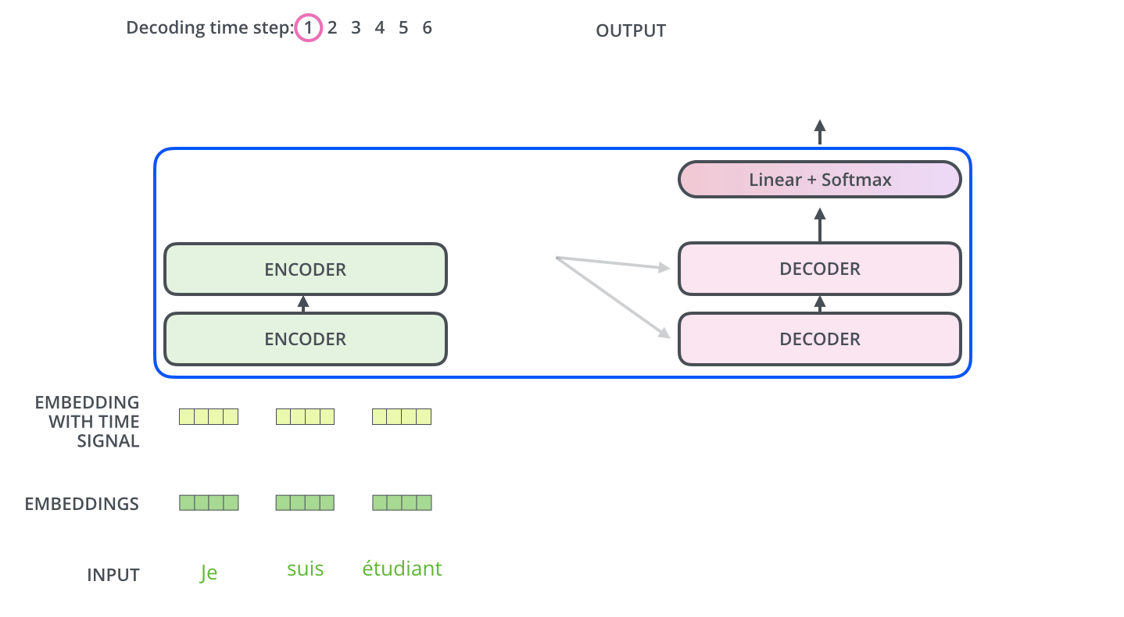
Decoder Layer
The “Encoder-Decoder Attention” layer works just like multiheaded self-attention, except it creates its Queries matrix from the layer below it and takes the Keys and Values matrix from the output of the encoder stack.

Slide 19

Decoder Layer

Slide 20
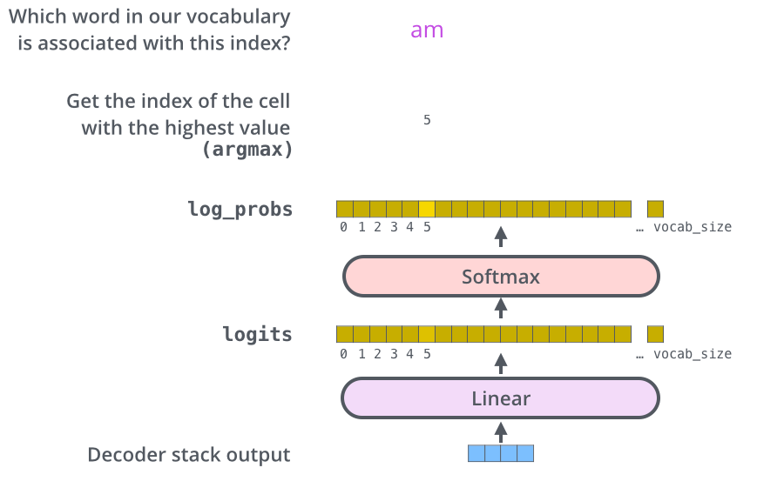
The Final Linear and Softmax Layer
The decoder stack outputs a vector of floats, which is turned into a word by final Linear layer followed by a Softmax Layer.
The Linear layer is a simple fully connected neural network that projects the decoder output vector into logits vector.
Let’s assume that our model knows 10,000 unique English words (our model’s “output vocabulary”) that it’s learned from its training dataset. This would make the logits vector 10,000 cells wide – each cell corresponding to the score of a unique word. That is how we interpret the output of the model followed by the Linear layer.
The softmax layer then turns those scores into probabilities (all positive, all add up to 1.0). The cell with the highest probability is chosen, and the word associated with it is produced as the output for this time step.

Slide 21
Training Details
Dataset : Machine translation ( English to German, English to French)
Parameters : Layers = 6, Heads = 8, Embedding dimension = 512
Dimension of up projection and down projection weight matrix = 2048, Drop out = 0.1, Batch size = 25,000 tokens.
Optimizer : Adam
Warmup steps : 4000

Slide 22
Experimental Results
English to German : BLEU score : 28.4
English to French : BLEU score : 41.8
The Transformer outperformed previous recurrent and convolutional architectures while requiring less training time.
BLEU : Bilingual Evaluation Understudy is an automated algorithm used to evaluate the quality of text translated by machines by comparing it to professional human translation.

Slide 23
Advantages of Transformers :
1. All tokens are processed simultaneously.
2. Long range dependencies.
Disadvantages of Transformers :
1. Quadratic complexity.
High memory consumption.
2. Requires positional encoding.

Slide 24
References
1. Attention Is All You Need by Ashish Vaswani, Noam Shazeer, Niki Parmar, Jakob Uszkoreit, Llion James, Aidan N. Gomez, Lukasz Kaiser, Illia Polosukhin
2. The Illustrated Transformer by Jay Alammar

Slide 25
THANK YOU

