Slide 1
FLASHATTENTION: Fast and Memory-Efficient Exact Attention with IO-Awareness

Slide 2
Introduction
The time and memory complexity of self-attention are quadratic in sequence length.
Solution : FLASHATTENTION : computes exact attention with far fewer memory accesses.
Goal : 1. Compute Softmax operation without accessing whole i/p.
Solution : Tiling : Incrementally performing softmax in several passes by splitting the i/p into different blocks.
2. Not storing intermediate attention matrix for backward pass.
Solution : Store Softmax normalization factor to recompute softmax in backward pass.

Slide 3
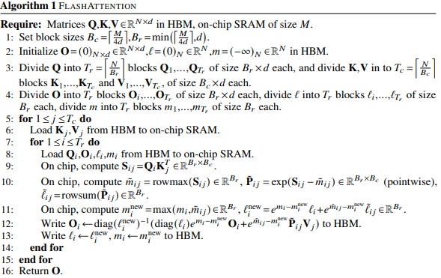
Algorithm

Slide 4
Advantages of FLASHATTENTION
Divide matrices into tiles
Main Idea
Computation on each tile separately
Error introduced
Additional computation to compensate error
1. More FLOP count.
2. Far fewer memory accesses than self attention.
3. Faster in wall-clock time.

Slide 5
FARE : A Fine-grained Pipelined Reconfigurable FlashAttention Kernel

Slide 6
Introduction
FlashAttention lacks reconfigurability.
Due to hardware limitations, different stages of attention mechanism cannot be executed in parallel for different inputs by pipelining.
FARE allows us to do that.

Slide 7
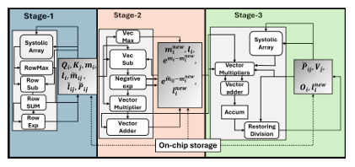
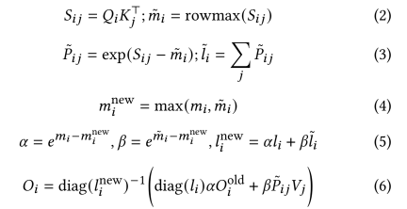
Overview of FARE for FlashAttention Execution and related Equations

Slide 8
STAGE 1 OVERVIEW
K matrix of dimension N X d is divided into Tc blocks each with dimension Bc X d
Bc
d
Transpose
Kj^T
Q Matrix of dimension N X d is divided into Tr number of blocks, each with dimension Br X d
Sij
Dim : Br X Bc
Dim : Br X Bc
Dim : Br X1
Dim : Br X Bc
Systolic Array
RowMax
RowSub
RowExp
RowSum
d
Bc
Bc
Bc
Br
Br
Br
Br
Br
Qi
Br
Dim : Br X 1
Output of STAGE 1

Slide 9
Proposed Additional Block in STAGE 1
A Prefetch Engine is a dedicated hardware control block designed to completely decouple off – chip memory latency from execution. It ensures that the systolic array in stage 1 is strictly compute – bound, not memory-bound.
The Prefetch Engine runs parallel to the main accelerator control path as an autonomous microcontroller)

Slide 10
Basic Block Diagram of Predictive Prefetch Engine
Prefetch Engine
axi_araddr
clk
axi_arlen
rst
axi_arvalid
AXI Master Burst Memory Interface (Handshake Signals)
axi_arready
axi_rdata
Start
axi_rvalid
Q base Address
axi_rlast
Host Control Interface
axi_rready
K base Address
bram_wr_en_Q
Engine Busy
bram_wr_addr_Q
bram_wr_data_Q
BRAM Buffer Interface
Compute_tile_done
bram_wr_en_K
Compute Handshake Line
bram_wr_addr_K
Prefetch_tile_ready
bram_wr_data_K
Current_bank

Slide 11
NO
FSM Design for the Prefetch Engine
YES
AXI BURST Q STATE
IDLE STATE
ADDRESS CALC STATE
Start==1?
NO
YES
NO
axi_rlast ==1&& axi_rvalid==1 ?
J_pf==T_c && i_pf==0 ?
YES
SWAP BANKS
pf_K_required==1 ?
NO
NO
YES
YES
Compute_tile_done==1?
WAIT STATE
AXI BURST K STATE
YES
NO
axi_rlast ==1&& axi_rvalid==1 ?

Slide 12
Look Ahead Address Generator Logic
Initialize i_pf = 0, j_pf = 0, pf_K_required = 1
Calculate Byte Offsets :
Offset_Q = B_R* D_MODEL
Offset_K = B_C* D_MODEL
Compute Physical Target addresses :
next_addr_Q = addr_Q_base + (i_pf * Offset _Q)
next_addr_K = addr_K_base + (j_pf * Offset _K)
Advance Prefetch counters for the following tile
i_pf = i_pf + 1
if i_pf == T_R:
i_pf = 0
j_pf = j_pf + 1
pf_K_required = 1
else: pf_K_required = 0

Slide 13
Different Input and Output Signals for Prefetch Engine
A single cycle clock pulse sent by central processor to command engine to start execution
Start
A multi bit bus holding the absolute physical address where Q matrix starts in HBM. It provides the starting point for Look Ahead Address Generation Unit.
Q base Address
Host Control Interface
K base Address
A multi bit bus holding the absolute physical address where K matrix starts in HBM. It provides the starting point for fetching K tiles.
Engine Busy
Allows the central processor to initiate, configure, monitor prefetch engine
A multi bit bus holding the absolute physical address where Q matrix starts in HBM. It provides the starting point for Look Ahead Address Generation Unit.

Slide 14
Driven by Stage 1 Compute Controller back to Prefetch Engine. It is a release signal, informing the engine that systolic array has finished executing the operations on the current tiles. The exact clock edge when compute_tile_done goes high, Prefetch Engine transitions from Wait State to Swap Banks State.
Compute Handshake Line
Compute_tile_done
Prefetch_tile_ready
Driven by Prefetch Engine to Stage 1 Compute Controller. It is a guarantee signal assuring that the next required tiles are completely fetched from the HBM.
Current_bank
Synchronizes Prefetch Engine with Stage 1 Systolic Array. Prevents Data Race, Overwriting, Execution Stalls
Pointer flag for the dual bank memory allocation. It decides which physical half of the on-chip BRAM addresses(0-2047/2048-4095) belongs to the Prefetch Engine and which half belongs to the Compute Engine. When current_bank=0, Prefetch Engine writes incoming AXI data to Bank 0 and Compute Engine reads from Bank 1. During Swap Banks State, this bit flips, and ownership inverts

Slide 15
Output Address Bus. It points the external memory controller to the memory offset of the required Q or K block.
8 bit signal tells the memory controller to send 8 bit data after getting address request from the Output Address Bus.
axi_araddr
axi_arlen
Address handshake pair. axi_arvalid means the requested address is stable and real, while axi_arready means that the memory controller is free and accepted the request.
AXI Master Burst Memory Interface (Handshake Signals)
axi_arvalid
axi_arready
axi_rdata
Input Data Bus. Carries actual matrix from the HBM to on chip DRAM.
axi_rvalid
Data handshake pair. axi_rvalid means that a valid data is sitting on the axi_rdata bus, while axi_rready means that the Prefetch Engine is free and accepted the data.
axi_rready
axi_rlast
Manages the block data transfers between Prefetch Engine and HBM
1 bit marker flag that informs the prefetch engine that the current item on the data bus is the absolute final piece of the requested tile. The exact cycle when axi_rlast and axi_rvalid are both true, the FSM terminates burst state, resets the element tracking counters an checks if thenext matrix tile is needed to be fetched.

Slide 16
1 bit control signals that tell BRAM exactly when to write data. bram_wr_en_Q is driven high only when the FSM is in AXI BURST Q State and axi_rvalid=1. The same applies to bram_wr_en_K.
Output Address Buses. Multi bit bus specifies the row index inside the BRAM where the incoming data must be written.
For Q : if current_bank=0, then bram_wr_addr_Q = element_count, if current_bank=1, then bram_wr_addr_Q = element_count + 2048
For K : Instead of linear index, it drives transposition calculation:
address = k_col_count * B_C + k_row_count.
bram_wr_en_Q
bram_wr_en_K
BRAM Buffer Interface
bram_wr_addr_Q
bram_wr_addr_K
bram_wr_data_Q
bram_wr_data_K
Pass the raw matrix element values received from the off-chip HBM to BRAM. These buses are directly registered to axi_rdata bus.
Directly connected to the on-chip dual port DRAM. Prefetch engine only owns the write port of it.

Slide 17
AXI BURST Q STATE
If axi_arvalid ==1&& axi_arready==1
axi_arvalid<-0
If axi_rlast ==1&& axi_rvalid ==1&& pf_K_required==1
axi_araddr<-addr_K_base + (j_pf*offset_k)
axi_ arlen<-(B_C*D_MODEL)-1
axi_arvalid<-1
Value of Different Control Signals at Different States
AXI BURST K STATE
If axi_arvalid==1 && axi_arready==1
axi_arvalid<-0
ADDRESS CALC STATE
engine_busy <-1
prefetch_tile_ready<-0
axi_araddr <-addr_Q_base + (i_pf*offset_q)
axi_arlen<-(B_R*D_MODEL)-1
axi_arvalid<-1
i_pf<-i_pf +1
If i_pf +1==T_R
i_pf<-0
j_pf<-j_pf +1
pf_K_required<-1
Else pf_K_required<-0
IDLE STATE
i_pf<-0, j_pf<-0
engine_busy <-0
prefetch_tile_ready<-0
pf_K_required<-1
current_bank<-0
WAIT STATE
prefetch_tile_ready<-1
SWAP BANKS STATE
prefetch_tile_ready<-0
current_bank<-~current_bank

Slide 18
Memory Streaming and Matrix Transpose Logic
Default write strobes down
bram_wr_en_Q <-0, bram_wr_en_K <-0;
If (current_state==AXI BURST STATE && axi_rvalid==1)
bram_wr_en_Q <-1, bram_wr_data_Q<-axi_rdata
bram_wr_addr_Q <= (current_bank == 1'b0) ? element_count : (element_count + 2048);
if (axi_rlast==1) then element_count<-0
else element_count<-element_count+1

Slide 19
If (current_state==AXI BURST STATE K && axi_rvalid==1) then
bram_wr_en_K<-1, bram_wr_data_K<-axi_data;
bram_wr_addr_K<-(current_bank==0)?(K_col_count*B_C*K_row_count):(K_col_count*B_C+K_row_count + 2048)
If (K_col_count==D_MODEL-1) then k_col_count<-0
{
If (K_row_count==B_C-1) then K_row_count<-0
Else K_row_count <- K_row_count +1
}
Else K_col_count <- K_col_count +1

Slide 20
Advantages of Prefetch Engine
1. Overlaps off-chip memory access with systolic array execution. The next data tile is already loaded before the current computation loop ends.
2. Eliminates execution stalls in systolic array processing elements.
3. Executes K matrix transposition on-the-fly inside BRAM routing wires.
4. Fetches stationary K tiles only when the inner loop overflows.

Slide 21
Thank You

