Slide 1
Faster Matrix Multiplication and Element-Wise Add and Normalization Technique

Slide 2



Matrix multiplication of : $\left(1×d\right)×(d×4d)$
$$\left[ \begin{matrix}1 & 2\end{matrix}\right]×\left[\begin{matrix}1 & 3 \\ 2 & 4\end{matrix} …\right]$$
d
4d
1. Conventional Matrix Multiplication
4
1 3
4
2 3
4
3
4
2 1 2 1
2 1 2
2 1
2
1x1
2x2
1x3
2x4
Cycle 1
Cycle 2
Cycle 3
Cycle 4
…..
$$4d^{2}$$
3. Tensor Core
1
3
1
X
1
X
d
+
+
…..
$$4d$$
2
2
X
X
2
4

Slide 3
1 X d
Latency, throughput and resource utilization during matrix multiplication of 1 x d row vector for a token with projection matrix of dimension d x nd, where n = 4
FlashAttention
1 X dh X h
1 X d
Method | Latency | d | value | Throughput | d | value | Resource Utilization | d | value
1. Conventional Matrix Multiplication | 4d² | 1024 | 4,194,304 | 1/4d² | 1024 | 2.38 e-7 | 1 | 1024 | 1
 |  | 2048 | 16,777,216 |  | 2048 | 5.96e-8 |  | 2048 | 1
2. Systolic Array | 5d-1 | 1024 | 5,119 | 1 | 1024 | 1 | 4d | 1024 | 4,096
 |  | 2048 | 10,239 |  | 2048 | 1 |  | 2048 | 8,192
3. Tensor Core | (1+log₂ (d)) | 1024 | 11 | 4d | 1024 | 4,096 | 8d²-4d | 1024 | 8,384,512
 |  | 2048 | 12 |  | 2048 | 8,192 |  | 2048 | 33,546,240
Add and Normalize
1 X d
Feed Forward Network
1 X d
Add and Normalize
1 X d

Slide 4
Latency, throughput and resource utilization for different combinations of n and d
Method | n | d | Latency | value | Throughput | value | Resource Utilization | value
1. Conventional Matrix Multiplication | ² | ⁵¹² | nd² | 524288 | 1/nd² | 1.9e-6 | 1 | 1
 | ⁶ |  |  | 1572864 |  | 6.3e-7 |  | 1
 | ⁸ |  |  | 2097152 |  | 4.8e-7 |  | 1
 | ² | ¹⁰²⁴ |  | 2097152 |  | 4.8e-7 |  | 1
 | ⁶ |  |  | 6291456 |  | 1.6e-7 |  | 1
 | ⁸ |  |  | 8388608 |  | 1.2e-7 |  | 1
2. Systolic Array | 2 | 512 | (n+1)d-1 | 1535 | 1 | 1 | nd | 1024
 | 6 |  |  | 3583 |  | 1 |  | 3072
 | 8 |  |  | 4607 |  | 1 |  | 4096
 | 2 | 1024 |  | 3071 |  | 1 |  | 2048
 | 6 |  |  | 7167 |  | 1 |  | 6144
 | 8 |  |  | 9215 |  | 1 |  | 8192
3. Tensor Core | ₂ | ₅₁₂ | (1+log₂ (d)) | 10 | nd | 1024 | 2nd²-nd | 1047552
 | ₆ |  |  | 10 |  | 3072 |  | 3142656
 | ₈ |  |  | 10 |  | 4096 |  | 4190208
 | ₂ | ₁₀₂₄ |  | 11 |  | 2048 |  | 4192256
 | ₆ |  |  | 11 |  | 6144 |  | 12576768
 | ₈ |  |  | 11 |  | 8192 |  | 16769024

Slide 5
Key Takeaways from the Table
Tensor core method produces the highest throughput among the three methods discussed for matrix multiplication in Feed Forward Network.
It also uses the highest amount of resources among the three.
To minimize the resource utilization without affecting the throughput, we can use tiling along with tensor core.

Slide 6
Requirement
To perform matrix multiplication in the FFN tile wise in pipelined manner, we first require Add & Norm Layer to perform operations on each element of the 1 X d output vector for each token from flashattention layer parallelly.
Elementwise addition is not an issue.
But with conventional normalization technique, the entire 1X d row vector is required at the time of execution, so we need a better technique.

Slide 7
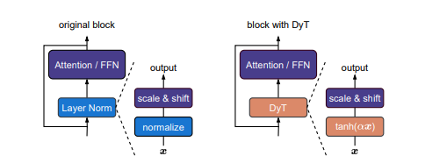
Proposed Alternate Normalization Techniques
1. Dynamic Tanh function (DyT):
Layer Normalization layers map inputs to outputs using a tanh- like S shaped curve in the deep layers, which scales regular input accelerations an squashes extreme outlier values. So we can use a simple, element-wise alternative that can emulate Layer Normalization without calculating mean or variance.
DyT(x) = γ*tanh(αx) + β , where α is a learnable scalar parameter. γ and β are learnable, per-channel vector parameters.

Slide 8
Proposed Alternate Normalization Techniques
2. Fixed Factor Scaling : During training, the model tracks a moving average of means and variances across the dataset, saving them to mean_running and var_running for each d_model.
S = gamma ./ sqrt(var_running + epsilon); //Static Scaling Factor S represents the total multiplying factor for each d_model.
beta_prime = beta - (gamma .* mean_running) ./ sqrt(var_running + epsilon); // Shifting vector takes the original trained bias and subtracts the historical offset caused by running mean.
y = x .* S + beta_prime;

Slide 9
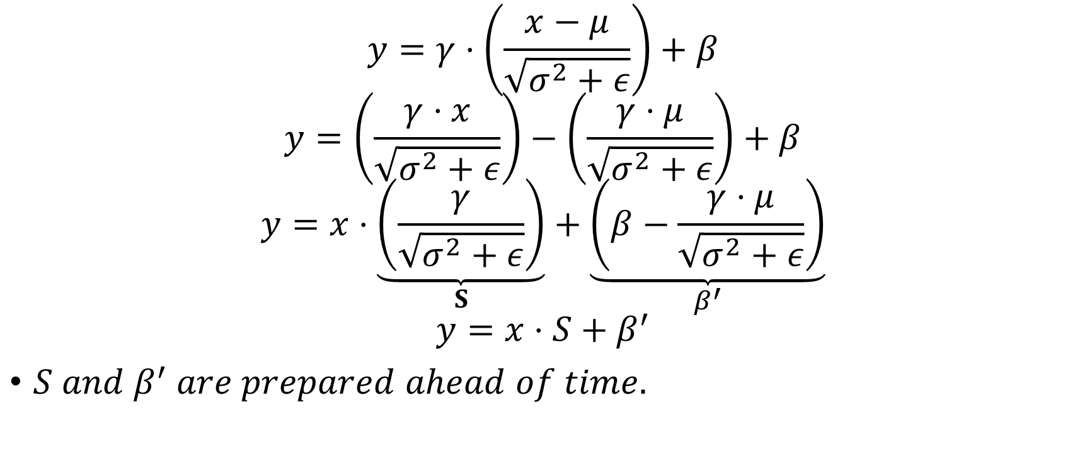
Mathematical Proof
$$y=γ⋅\left(\frac{x−μ}{\sqrt{σ^{2}+ε}}\right)+β$$
$$y=\left(\frac{γ⋅x}{\sqrt{σ^{2}+ε}}\right)−\left(\frac{γ⋅μ}{\sqrt{σ^{2}+ε}}\right)+β$$
$$y=x⋅\underset{S}{\underbrace{\left(\frac{γ}{\sqrt{σ^{2}+ε}}\right)}}+\underset{β^{′}}{\underbrace{\left(β−\frac{γ⋅μ}{\sqrt{σ^{2}+ε}}\right)}}$$
$$y=x⋅S+β^{′}$$
$S and β^{′} are prepared ahead of time.$
=>
=>
=>

Slide 10
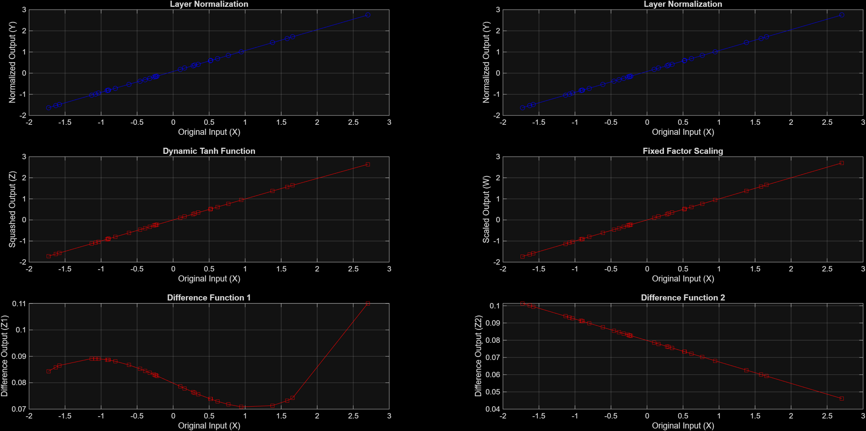
Experiments
Input and Output plots for Layer Normalization, Dynamic Tanh Function and their difference for d_model = 32
Input and Output plots for Layer Normalization, Fixed Factor Scaling and their difference for d_model = 32

Slide 11
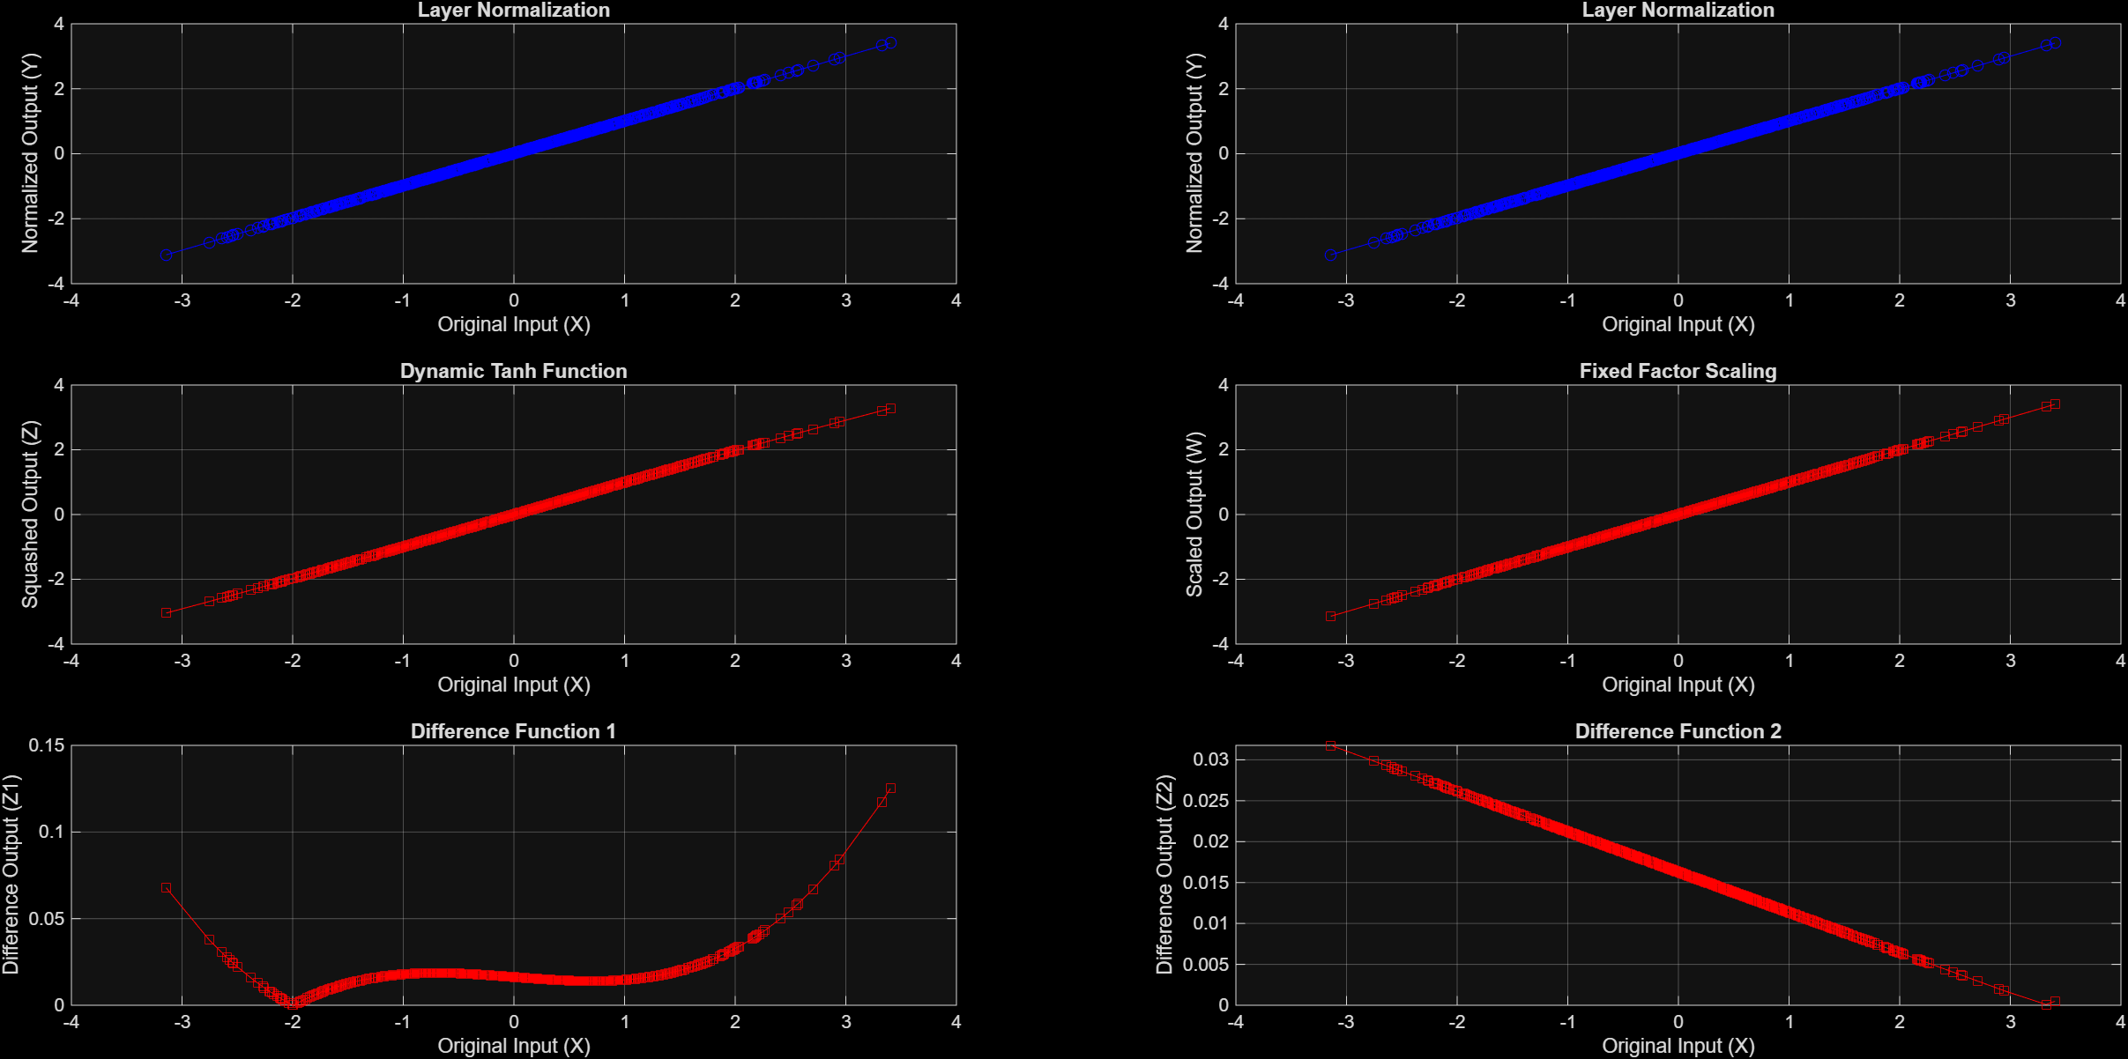
Experiments
Input and Output plots for Layer Normalization, Dynamic Tanh Function and their difference for d_model = 1024
Input and Output plots for Layer Normalization, Fixed Factor Scaling and their difference for d_model = 1024

Slide 12
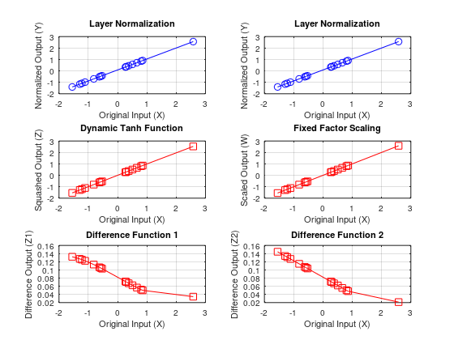
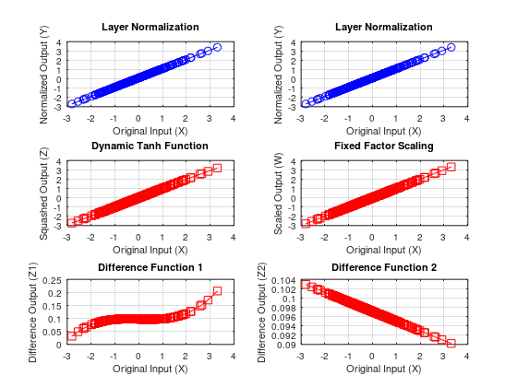
Experiments
Different Input vector is used.
d = 16
d = 256

Slide 13
THANK YOU

