Slide 1
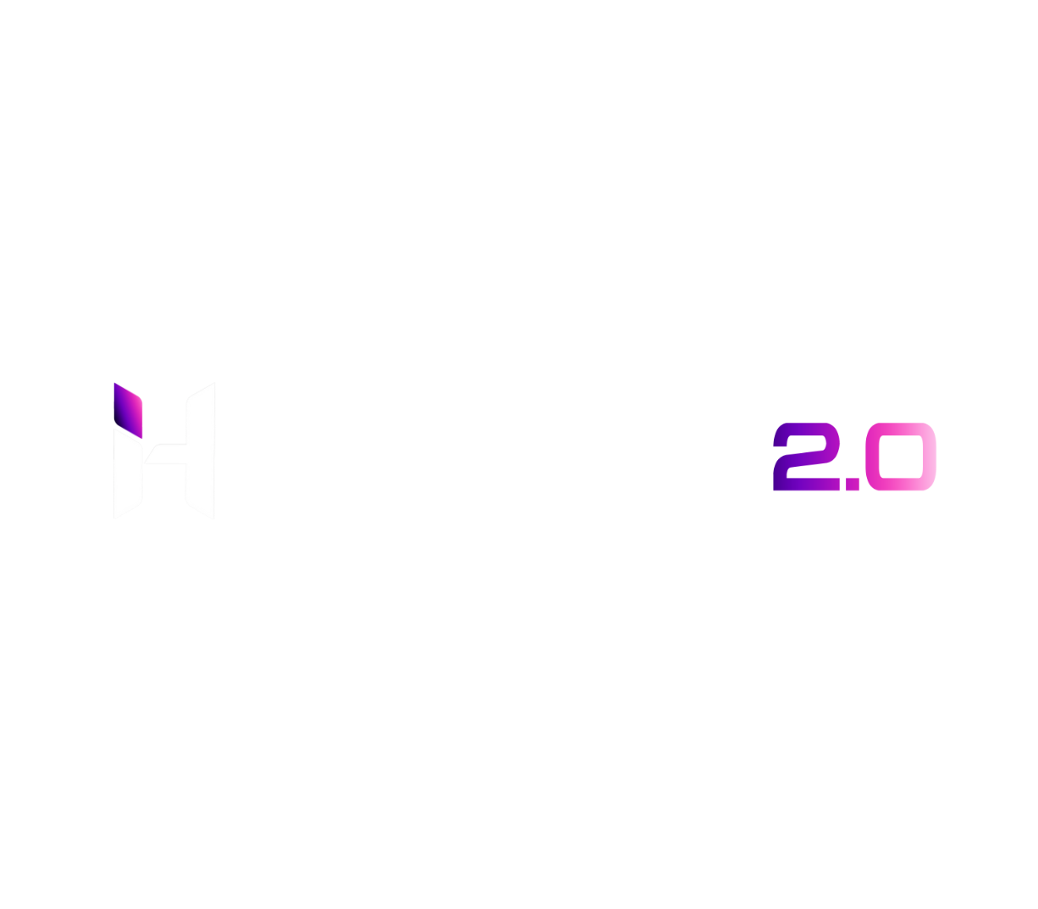



Team Name and Members Detail
Hack n' Innovate
Team Name : Wabra
Team Member 1 : Aruj Bansal
Team Member 2 : Kartikey Tandon
Team Member 3 : Annanay Aggarwal
Theme :
[Open Innovation]

Slide 2
Problem Statement (100-200 words)
Our project is groundbreaking, as we discovered there are no existing players in this field. We solve many problems for both businesses and individuals, with powerful analysis that reduces manual labor and provides sentimental insight. Our technology allows companies to track progress and analyze communication patterns effortlessly. For individuals, we offer a deeper understanding of emotions behind their chat partner's words. Our project has the potential to revolutionize communication and business processes, with no competitors in the field. Join us on this journey to change the way we interact with each other.

Slide 3
Proposed Solution and Use Case
Wabra Chat Analyzer unlocks hidden insights in your conversations. Our advanced technology provides true sentiment and analytical data for both businesses and individuals. Make data-driven decisions and gain a deeper understanding of communication patterns. Our solution identifies areas for improvement and celebrates successes. For individuals, gain insights into personal relationships. At Wabra, we believe every conversation holds potential for growth. Join us on this journey to revolutionize communication and discover the limitless potential of chat analysis. Use Case: Can be used by businesses for reducing manual labor of analyzing chats. Used in finding out the non-working employees. Used by individuals for finding feelings of their chat partner.

Slide 4
Details about your approach / Flow of development / Tech-stack
Tech-stack: Machine Learning, Artificial Intelligence, Sentimental Analysis, Data Visualisation, Web Scraping, Streamlit, Python
Features: Total Messages Sent, Media and Link Shared, Most Busy Users, Most Common Word Cloud, Most Common Words, Emoji Analysis, Daily Timeline, Monthly Timeline, Activity Map, Most Busy Month, Most Busy Day, Weekly Activity Map + Heatmap, Sentimental Analysis
Approach: We used Natural Language Processing (NLP) for creating the ‘Wabra Chat Analyzer’.

Slide 5
USP and Scalability of Solution
Introducing our solution with a unique set of USPs that set us apart from the competition. Our first mover advantage gives us a head start in developing cutting-edge technology in the field of chat analysis. Our advanced analytical analysis enables businesses to make data-driven decisions by gaining a deeper understanding of their team's communication patterns. Also, our advanced sentimental analysis provides a whole new level of understanding to personal relationships by deciphering the true emotions behind conversations. Together, these USPs make our solution truly groundbreaking, and we are excited to continue pushing the boundaries of what is possible in chat analysis.

Slide 6
Additional Information
Achievements: Won in hackathons and competitions like VIT RASVERSE, IEEE BVICAM, HACKNITR, Shark Tank LNMIT, Blockverse, Sanrachna, etc.
Video and demo:
https://www.youtube.com/watch?v=5MU_ECucils
https://github.com/Aruj77/Chat-Analyzer

